Slide 1
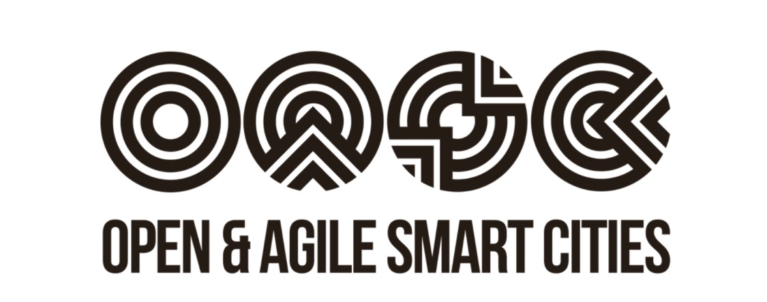
Creating the global smart city data and services marketplace

Slide 2
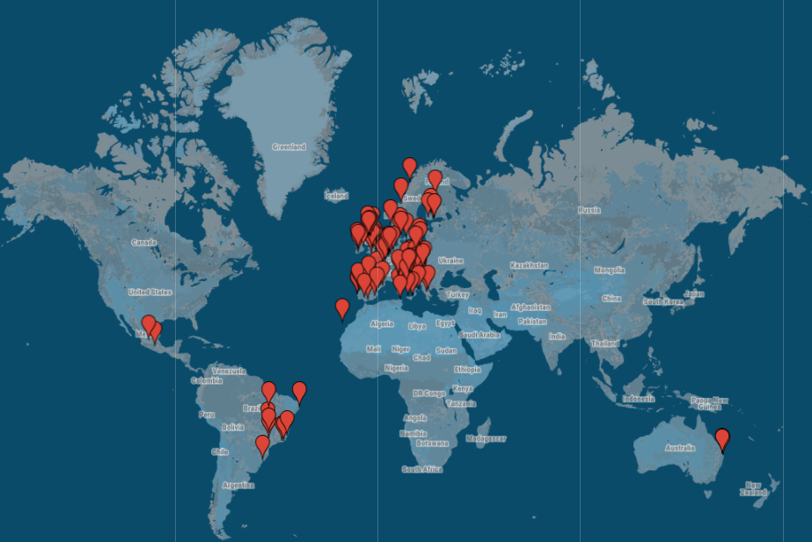
Basics
Global smart city network
Founded in 2015 in Brussels with a first wave of 31 cities from 7 countries
Currently 104 cities from Australia, Austria, Belgium, Bosnia, Brazil, Croatia, Denmark, Finland, France, Greece, Hungary, Ireland, Italy, Mexico, Netherlands, Norway, Poland, Portugal, Scotland, Slovenia, and Spain.
Focused on light-weight implementation of open data services using common standards, technologies, and architectures

Slide 3
Approach
OASC supports the digital transition of cities and communities into platforms, enabling development of demand-driven innovative technologies and services.
Cities need interoperability and standards to boost competitiveness by avoiding vendor lock-in, comparability to benchmark performance, and easy sharing of best practices.
No single solution has emerged to substitute the many 100s of legacy IT systems that exist in any city. OASC is a light-weight, non-exclusive, yet effective and exponentially scalable way to provide interoperability.
OASC supports solutions that can be implemented with respect for local practices and job creation.

Slide 4
Focus
Implementation Driven
  Country-level and international city to city collaboration around concrete use cases
  Tied together via strategic programme projects
Common Information Models
  Standardisation of context data among cities
  Co-leadership of ETSI standardisation group
  Vice-chairmanship of SG20 FG-DPM
Reference Open Data Architecture
  Tools and models for real-time open data publication
  Transactional data roadmap via BDVA

Slide 5
Implementation

Slide 6
Use case: City of Things
Antwerp, Belgium
Operated jointly by imec and City of Antwerp
Funded EUR 40 million over 5 years
Largest IoT living lab in Europe
IoT communication infra over 80 km2
More than 100 gateways
More than 50.000 users
Streaming real-time mobility and pollution data to service providers (e.g. to Here maps jointly with Porto and Santander)
Supporting services for city service innovation

Slide 7
Use case: Synchronicity
Creating Digital City Services market through 8 reference zones for deployment and testing
34 partners, 11 countries, 4 continents
Funded EUR 20M over 3.5 years
Base layer for a Smart City data economy in EU and beyond

Slide 8
Use case: SELECT for Cities
Antwerp, Copenhagen, Helsinki
PCP project building overarching IoT platform allowing heterogeneous setups to accommodate single solutions
Funded EUR 5M over 5 years
1st Open Call currently open

Slide 9
OASC priorities 2017
6th Wave
Reference architecture
City support services
ITU Partnership
  SG20 FG-DPM
  KPIs 4SSC
Data valorisation roadmap
  Leading large initiative for 2018
  Looking for global partner locations
  Focus on transactional systems for city data

Slide 10
Questions?
Dr. Davor Meersman
GM OASC

