Slide 1
Importance of international standards in promoting interoperability within
Smart City ecosystem
Jesus Cañadas

Slide 2








Smart Cities
Internal Systems (Municipality)
Context
Waste
Services
Public
Lighting
Parking
(public and
private)
Exists or will exists systems
Social
Networks
Independent
Proprietary
Not standards
Not share resources and data
Sensors
Sensors
Sensors
External systems
Mobil
…
Utilities
Transport companies
Smart Building
The independent systems can provide services,
but a Smart City is more than a sensorized city
Hotels
Airports

Slide 3


Smart Cities
Generating useful information
Process
Common acquisition based on standards (if it is possible)
Data models standards
Storage and analyzed by Knowledge Layer
Useful Information
External
Sources
KNOWLEDGE LAYER
DATABASES
BIG DATA
ANALITICS SYSTEMS
The data are converted in useful information and predictable.
COLLECTION LAYER
MULTIPROTOCOL CONNECTOR
ITU-T Y.2060
“Overview of the Internet of things”
Benefits
Show the state of the city
Anticipate to the problems
Offer services according to higher maturity levels
Standardized
Social
Networks
Parkings
Sensors
(internal and external)
Building
Sensors
Waste
Sensors
Traffics Lights
Sensors

Slide 4


Smart Cities
Creating new business models and services
External applications
Improved
Waste
Services
Improved
Parking
Services
Interoperability layer allow access and receive information from external systems or private platform
Transport companies
Hotels
New business
models
If external systems are connected, we have:
  more data
  better analysis
  more useful information
  better services will be provide to the citizens
If the industry can access to allowed data, it will access to a more useful information, so it will be able to create new business models
New services and applications
Standardized
INTEROPERABILITY LAYER
OPEN DATA
APIs
KNOWLEDGE LAYER
Developers
DATABASES
BIG DATA
ANALISYS
COLLECTION LAYER
MULTIPROTOCOL CONNECTOR

Slide 5
RECOMMENDATION DETERMINED UIT-T Y.4454
“Platform interoperability for smart cities”

Slide 6
External plataforms Smart port / airport / station / other city
City Platform
Smart Port Platform
MOBILITY
ENVIRONMENT
TOURISM
RECYCLING
WATER
…...
RECYCLING
WATER
…...
SUPPORT LAYER
SERVICE LAYER
INTERFACE
SERVICE LAYER
AUDIT
Northbound
SMART SERVICES INTERFACE
MONITORING
INTEROPERABILITY LAYER
INTERFACE
INTEROPERABILITY LAYER
SECURITY
APIs
DEVELOPMENT KIT
OPEN DATA PORTAL
LOGGING
SCHEDULE
INTEROPERABILITY INTERFACE
SUPPORT LAYER
SECURITY
MANAGEMENT
KNOWLEDGE LAYER
KNOWLEDGE LAYER
REST API
SECURITY
SERVICE HISTORY
INTERFACE
WEB UI
REAL TIME
BACH
ANALYTICS
CEP ENGINE
ETL
GIS ENGINE
GIS REP.
DATABASES
RULES
M LEARNING
BI ENGINE
…...
…...
…...
REAL TIME REP.
SEMÁNTICA CIUDAD
CONFIG. REP.
DATA/METADATA COLLECTION INTERFACE
CONNECTORS
COLLECTION LAYER
INTERFACE
CONNECTORS
SECURITY
NOTIFICATIONS
SEMANTIC ABSTRACTION PROTOCOL
PLUG-INS
ADAPTERS
Southbound
MULTIPROTOCOL CONNECTOR
MQTT, WS, REST...

Slide 7
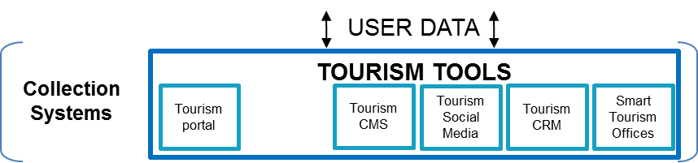
Smart Cities:
Horizontal Platforms with uses cases: Y.4454 -> Y.SSCP
Open and Standard Interfaces
SUPPORT LAYER
SERVICE LAYER
INTEROPERABILITY LAYER
CITY 1
WASTE
COLLECTION
WATER
…...
Benefits
SERVICE LAYER
KNOWLEDGE LAYER
Sharing resources and data
Interoperability between applications
Scalability
Analytics capabilities
Anticipate to the problems
Provide better services to citizens
Generate new business models
INTEROPERABILITY
LAYER
COLLECTION LAYER
SECURITY
REST API
WEB UI
SUPPORT LAYER
SERVICE LAYER
DATABASES
INTEROPERABILITY LAYER
CITY 2
KNOWLEDGE LAYER
Example
ITU-T Y.STD
“Reference Model for Smart Tourist Destinations: platform interoperability and functionalities”
COLLECTION LAYER

Slide 8
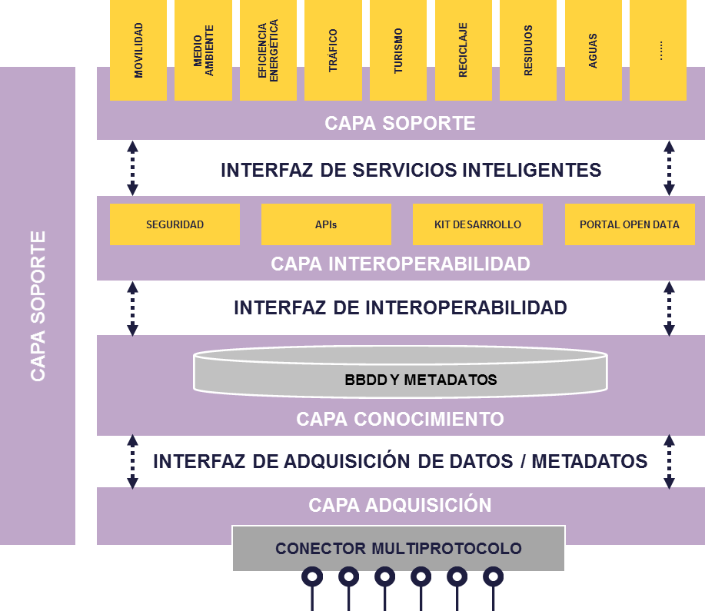
RECOMMENDATION DETERMINED UIT-T Y.4454
Virtual Laboratory
The applications can access to all cities by the same way
NGSI 9/10
Virtual Laboratory
MQTT, WS, REST, CoAP, Sigfox,...
MQTT, WS, REST, CoAP, Sigfox,...
MQTT, WS, REST, CoAP, Sigfox,...
SEMANTIC FILTER DATAMODEL
Parkings
Touristic
data
Others
Parkings
Touristic
data
Others
Parkings
Others

Slide 9


Smart Cities
External Objects
Smart Territory
If the city is connected with the internal and external elements, it will transform Smart Cities into a Smart Territory
In a Smart Territory, the internal and external objects send and receive information from the city
A Smart Territory will coordinate the work of all components and it will optimize the work of them
Private
Enterprise
Close city
Rural areas
Standardized
Standardized
ITU-T Y.SRC
“Requirements for deployment of smart services in rural communities”
Standardized
Internal
Objects
Buildings
Ports
Stations

Slide 10
Thank you

