Slide 1
6th ITU Green Standards Week
5-9 September 2016, Montevideo, Uruguay
How a well Governed and Managed ICT can Help to Adopt a New Urban Agenda
Graciela Braga
CGEIT, CPA, Advisor
gracielainesbraga@gmail.com

Slide 2
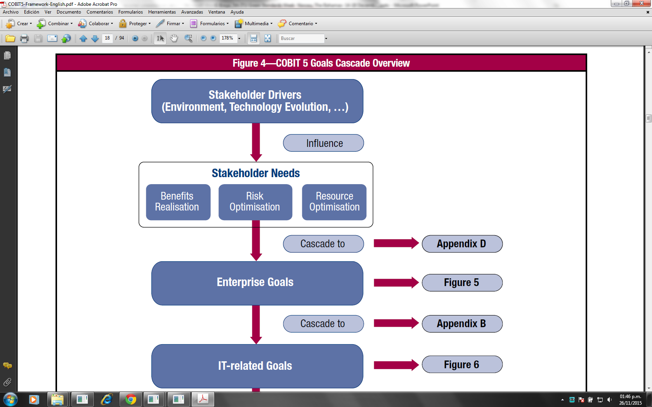
HABITAT III DRAFT NEW URBAN AGENDA July 2016
Principles and commitments
PRINCIPLES | BY
Leave no one behind | No poverty Equal rights and opportunities Safety/No discrimination and violence Public participation Equal access to physical and social infrastructure and basic services
Sustainable and inclusive urban economies | Leveraging the agglomeration benefits of well-planned urbanization, high productivity, competitiveness and innovation Employment and decent work for all Equal access to economic and productive resources and opportunities No land speculation / Secure land tenure.
Environmental sustainability | Clean energy, resource and land use efficiency in urban development, as well as protecting ecosystems and biodiversity, including adopting healthy lifestyles in harmony with nature Sustainable consumption and production patterns Urban resilience Reducing disaster risks Mitigating and adapting to climate change.
BY ICT

Slide 3
HABITAT III DRAFT NEW URBAN AGENDA July 2016
Technology’s Role
14. While the specific circumstances of cities, towns, and villages vary, we affirm that the New Urban Agenda is universal in scope, participatory and people-centered, protects the planet, and has a long-term vision, setting out priorities and actions at the global, regional, national, sub-national, and local levels that governments and other relevant stakeholders in every country can adopt based on their needs.
15. We will work to implement this New Urban Agenda within our own countries and at the regional and global levels, taking into account different national realities, capacities, and levels of development, and respecting national legislations and practices, as well as policies and priorities.
91. We will implement integrated planning that aims to balance short-term needs with long-term desired outcomes of a competitive economy, high quality of life, and sustainable environment. (…) while making efforts to leverage innovations in technology and to produce a better living environment.
150. We will promote the development of national information and communications technology policies and e-government strategies as well as citizen-centric digital governance tools, tapping into technological innovations, including capacity development programs, in order to make information and communications technologies accessible to the public,(…), to enable them to develop and exercise civic responsibility, broadening participation and fostering responsible governance, as well as increasing efficiency.

Slide 4
ICT’s Potential to help addressing Principles and Role – ISACA’s COBIT5
PRINCIPLES | Governance and Management Questions on IT (source: COBIT5, figure 7)
Leave no one behind Sustainable and inclusive urban economies Environmental sustainability | How critical is IT to sustaining the city? What critical city processes are dependent on IT, and what are the requirements of city processes? / How dependent is city on external providers? What do I do if IT is not available? Did city address all IT-related risk? How does city get value from the use of IT? How can city best exploit new technology for new strategic opportunities? Are end users satisfied with the quality of the IT service? Are sufficient IT resources and infrastructure available to meet required city strategic objectives? How does city manage performance of IT? / How does city use IT resources in the most effective and efficient manner? Does IT support the city in complying with regulations and service levels? Are the total IT effort and investments transparent?

Slide 5
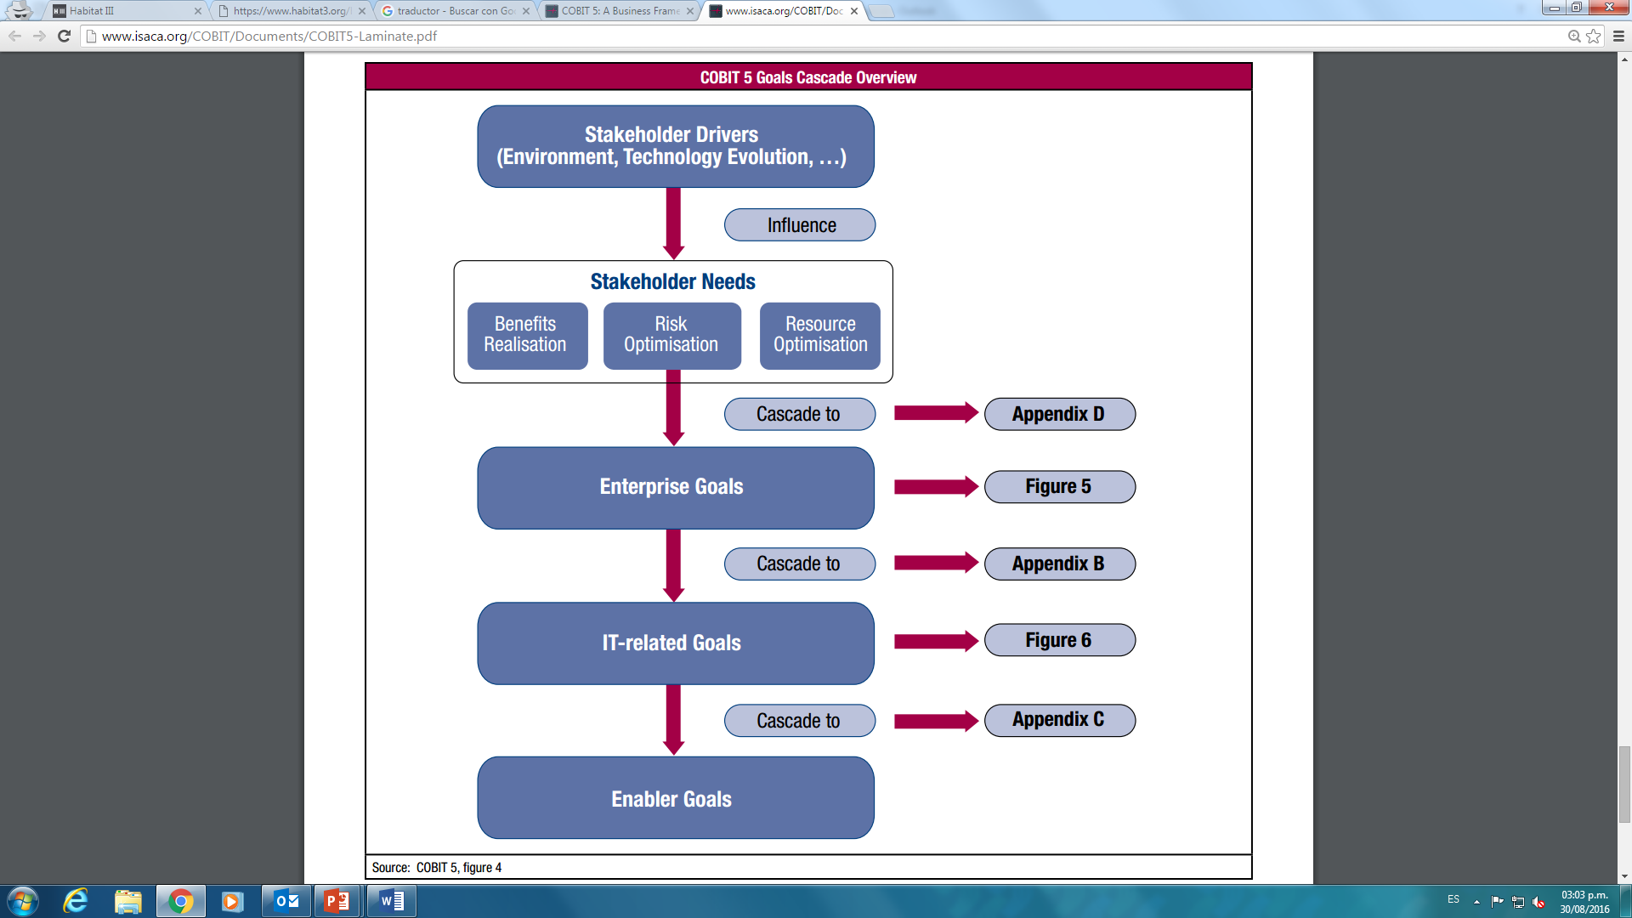
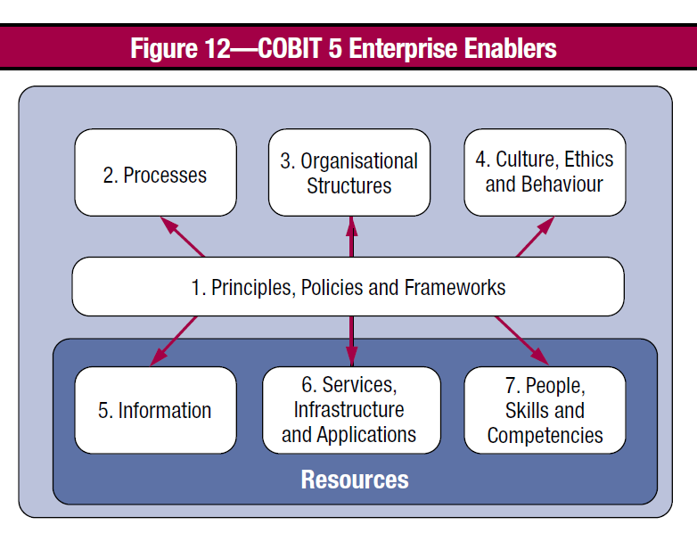
ISACA’s COBIT5
 | Sour http://www.isaca.org/COBIT/Pages/Product-Family.aspx

Slide 6
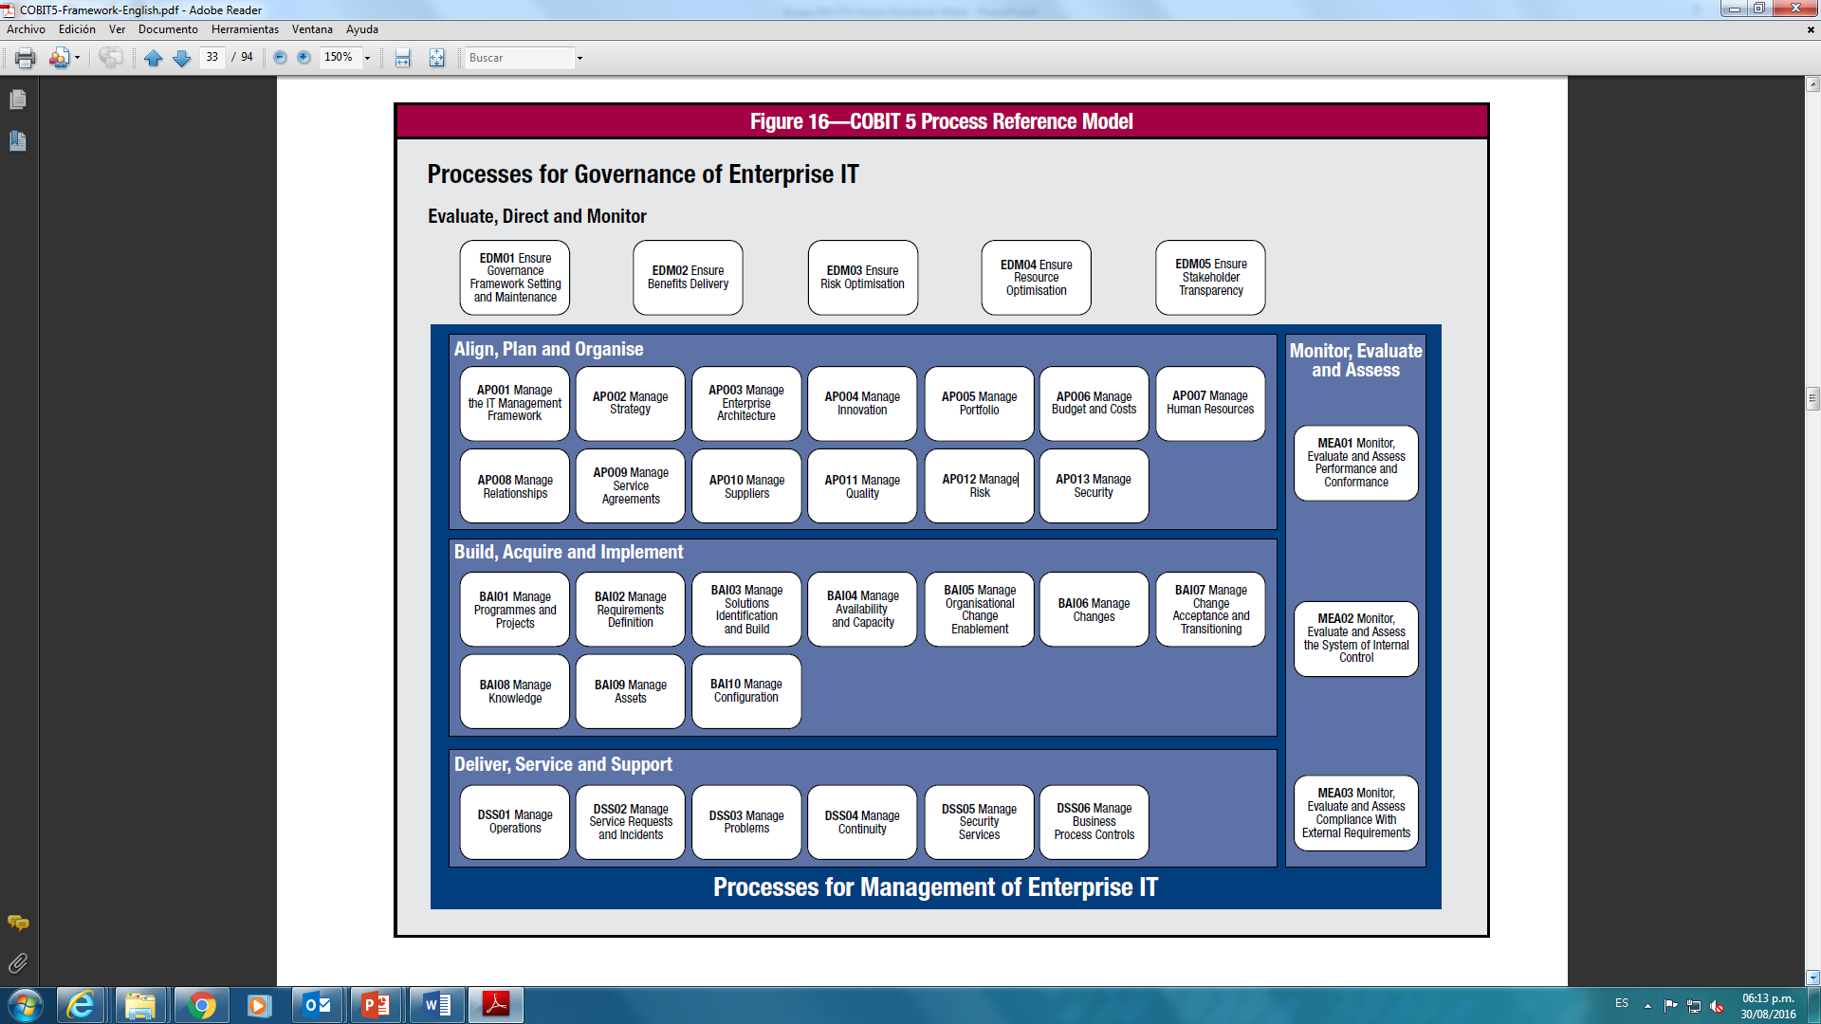
COBIT 5 Process Reference Model and baseline selected processes
Leave no one behind
Sustainable and inclusive urban economies
Environmental sustainability
Source: COBIT 5 Framework Figure 16 and Implementation Figure 47

Slide 7
Conclusion
New Urban Agenda, Climate change adaptation and Sustainability are
stakeholders’ needs and nation/city/business requirements
but more than anything
are a human responsibility
A well governed and managed ICT can ensures stakeholders identification, needs evaluation, city and ICT alignment, and ICT process with capacity of delivering outcomes even if the conditions are not the best.

