Slide 1
5th ITU Green Standards Week Nassau, The Bahamas 14-18 December 2015
“Everybody wants to go to heaven, but nobody wants to die”
Mr. Gervon Abraham,
Manager- External Relations and Government Affairs, TSTT/Vice Chair – CANTO CSR Committee.
Email: gabraha@tstt.co.tt

Slide 2
Let’s not Waste our E-Waste: Turning E-Waste into an Advantage.
Heaven…The Joys of new ict gadgets
The increase in mobile subscriptions observed in 2014 is reflected in an increase in the mobile penetration rate. The mobile penetration rate in the mobile voice market stood at 149.1 as at December 2014, representing a 1.9 percent increase over 2013. This implies that there were approximately 149 mobile subscriptions per 100 inhabitants in Trinidad and Tobago as at the end of 2014.
https://tatt.org.tt/
Notes:
Source of Image

Slide 3
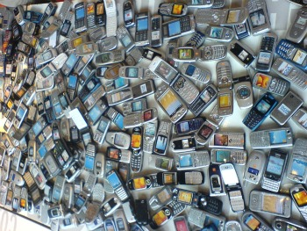
Let’s not Waste our E-Waste: Turning E-Waste into an Advantage.
Death – End of Life cellular devices and other e waste
Notes:
Source of Image

Slide 4
Let’s not Waste our E-Waste: Turning E-Waste into an Advantage.
End-of-Life (or EoL) Mobile Handset (or Phone) – A mobile handset that is no longer suitable for use, or may not be up to the required specification, and is destined for disassembly and recovery of spare parts, material recovery and recycling or for final disposal.
According to the StEP Initiative, 'E-waste' is a term used to cover almost all types of electrical and electronic equipment (EEE) that has or could enter the waste stream. Although e-waste is a general term, it can be considered to cover TVs, computers, mobile phones, white goods (e.g. fridges, washing machines, dryers etc.), home entertainment and stereo systems, toys, toasters and even kettles.
Notes:
EOL…..StEP sources…Solving the E-Waste Problem (StEP) Initiative: http://www.step-initiative.org

Slide 5
Let’s not Waste our E-Waste: Turning E-Waste into an Advantage.
Partnership the wider appeal.
WHO is CANTO. Caribbean Focus. Global Perspective.
VISION: To become the leading authority in shaping information, communication and technology in the Caribbean Region and the Americas.
MISSION: Influence the innovation and development of ICT solutions for the benefit of members by developing, navigating and leveraging relationships with all stakeholders.
Advocate for policies, legislation and rules which advance the creation of an environment which facilitates the deployment of services and technologies around the region.
We have an annual conference and this is an open invitation to attend or if you are so inclined join our CSR Committee. We have a Caribbean perspective.
Notes:
http://www.canto.org/

Slide 6
Let’s not Waste our E-Waste: Turning E-Waste into an Advantage.
Partnership the wider appeal.
Our major partner to date has been the secretariat for The Basel Convention on the Control of Transboundary Movements of Hazardous Wastes and their Disposal.
The Basel Convention on the Control of Transboundary Movements of Hazardous Wastes and their Disposal has as its overarching purpose the protection of "human health and the environment against the adverse effects of hazardous and other wastes".
To date there are 181 Parties to the treaty and in the Caribbean region these include: Antigua & Barbuda, Bahamas, Barbados, Belize, Cuba, Dominica, Dominican Republic, Guyana, Jamaica, St. Kitts & Nevis, St. Lucia, St. Vincent & the Grenadines, Suriname and Trinidad & Tobago.
Notes:
http://bcrc-caribbean.blogspot.com/p/about.html

Slide 7
Let’s not Waste our E-Waste: Turning E-Waste into an Advantage.
What we have done.
The CANTO Corporate Social Responsibility (CSR) Committee was convened in response to the increasing desire by stakeholders in the dynamic and ever evolving ICT market to achieve a balance between business and social responsible interests. In doing so, the Committee was established to achieve several objectives, which included the following:
To identify and address CSR issues related to telecoms/ICT and trends globally and within the region;
To research, identify and promote CSR best practices among the CANTO membership; and
To highlight existing and identify prospective CSR projects in region
CANTO CSR Committee has prepared two papers two far.
*Best Practices for the Environmentally Sound Management of Mobile Handsets and Equipment
*Best Practices for the Establishment of Take-back Systems for Mobile Handsets
http://canto.org/document-centre/committee-documents/
Notes:
http://canto.org/document-centre/committee-documents/

Slide 8
Let’s not Waste our E-Waste: Turning E-Waste into an Advantage.
Many ways forward. Opportunities for EWASTE A double Edged sword
Employment….Entrepreneurship..(Telecom providers, Governments (Policy development) and Regulatory Bodies, Collection, Sorting, refurbishment, material recovery, recycling and Repatriating)
Protection of Human health and the Environment.
Global Partnerships – the end to End conversation.
Manufacturers, telecom operators and mobile phone distributors should consider the possibility of sharing, as part of Extended Producer Responsibility (EPR) systems, the physical and/or financial obligations entailed by the collection and management of used mobile phones. This is particularly necessary and should be implemented as soon as possible in countries where the legislation and infrastructure for the collection of used mobile phones is lacking.
CANTO and its CSR Committee, alongside the Basel Convention Regional Centre for the Caribbean, stand ready and willing to assist and collaborate with regional stakeholders to develop sustainable solutions for the ICT sector.

Slide 9
Let’s not Waste our E-Waste: Turning E-Waste into an Advantage.
The Green PC Project. A real CASE
http://www.newsday.co.tt/businessday/0,151964.html

Slide 10
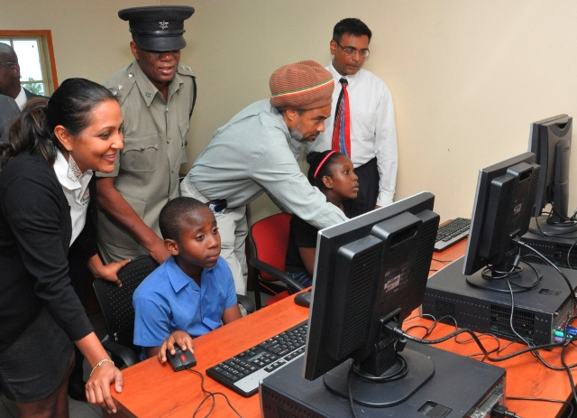
Let’s not Waste our E-Waste: Turning E-Waste into an Advantage.

