Slide 1
Promoting sustainable ewaste management systems in developing countries
5th ITU Green Standards Week
Nassau, The Bahamas 14-18 December 2015
Smail AL HILALI
Industrial Development Specialist
UNIDO
s.alhilali@unido.org

Slide 2
Content
Overview on E-waste management challenges
Key elements of a sustainable e-waste management system
UNIDOs e-waste management approach
UNIDO portfolio in developing countries

Slide 3
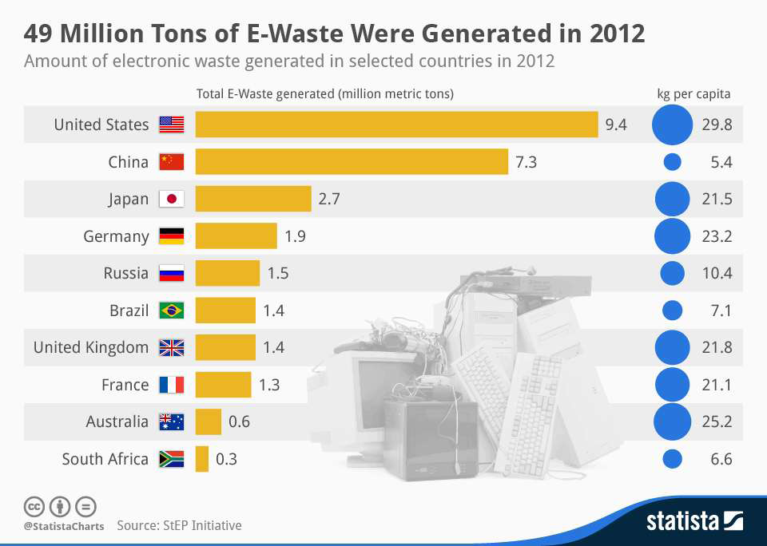
Global e-waste developments
Shorter lifespan of electrical and electronic equipment (EEE) due to changes in technology and consumer behaviour
E-waste production expected to increase 45% between 1995 and 2020

Slide 4
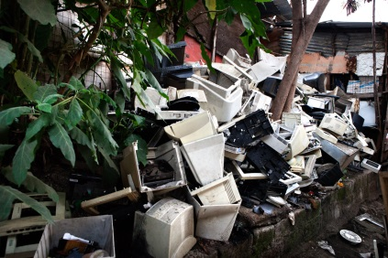
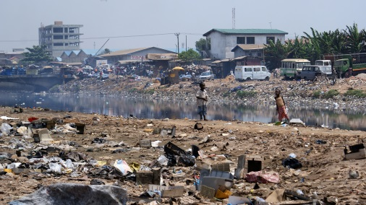
Background about e-waste
In 2030 developing countries will discard 400 - 700 million obsolete PCs/year compared to 200 million - 300 million in developed countries
Urban mining: 40-800 times more gold in 1t of Printed Wiring Boards (PWB) than in 1t of ore
But it also yields hazardous substances: POPs, Ba, Cd, Pb, Hg, Cr, Pd, etc.
Products of main concern: CRTs, flat screens, batteries, CFCs/fridges, Hg/lamps

Slide 5
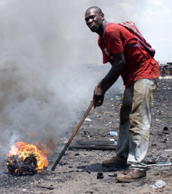
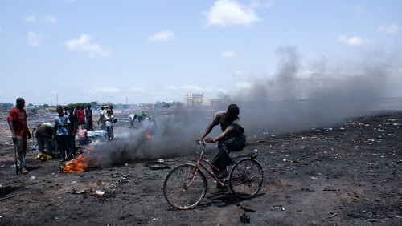
E-Waste Management Challenges (1)
Poor / illegal “recycling” of e-waste and “cherry-picking” of valuable fraction -> incentives needed
Recycling options for critical fractions
  Only 5 smelters globally treat PWB according to international standards
  Treatment of CRT glass, Hg-Lamps,
  contaminated plastics,…
Trans-boundary movement of
hazardous waste
  Basel Convention
  Bamako Convention (African countries)
Sources: Khaliq et al. (2014); Global E-waste Management Market (2011-2016)

Slide 6
E-waste management challenges (2)
Lack of “standardized” definitions
Divergent views on WEEE: Is it “municipal”, “special”, “hazardous”, or POPs waste? Or none of them?
Wide variety of perspectives: resource recovery, public health, environment, worker’s health and safety, eco-design, financing, awareness raising, standards, regulations, enforcement, etc.
Large numbers and varied affiliations of stakeholders (Governments, private entrepreneurs, informal sector, NGOs, IGOs, CSOs, research organizations…)

Slide 7
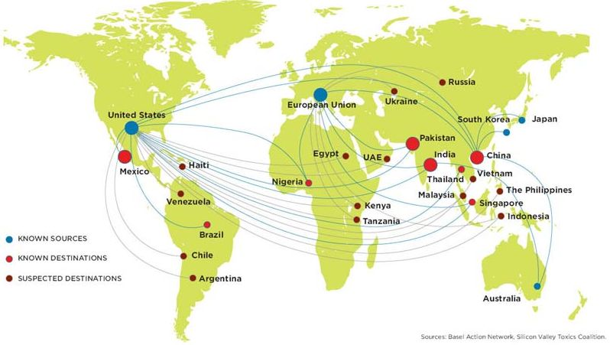
E-waste management challenges (3)
Current regulatory loopholes that allow exports of “used” EEE & WEEE from developed to developing countries
Cost of reverse logistics (process of returning EEE/WEEE from the owner to capture value or for proper disposal)
Sources: Khaliq et al. (2014); Global E-waste Management Market (2011-2016)

Slide 8
How to establish a sustainable E-Waste Management system?

Slide 9
General UNIDO E-Waste concept
UNIDO helps build and consolidate local capacities to promote sustainable e-waste recycling industries, through the whole life cycle of electric and electronic devices, to recover efficiently valuable resources, while generating quality jobs and caring about the environment and health.
Distribution&
Consumption
Collection
Pre-Processing
End-Processing
Disposal
Supporting green industries that safeguard the environment and create quality jobs
Promoting partnerships for knowledge exchange and technology transfer
Helping countries develop their e-waste management systems and strategies based on the whole recycling chains and life-cycle
Enhancing North-South, South-South and triangular cooperation and knowledge sharing

Slide 10
Key pillars of sustainable e-waste management
§
$

•

Policy& Legislation
Business& Financing
Technology & Skills
Monitoring & Control
Marketing &Awareness
EXAMPLES
Planning
Dismantling
Facility
General information on E-waste
PILOT PHASE
General
assessment
Exploring partnerships
Direct action
Supporting
Existing SME´s
TA for
operators
IMPLEMENTATION
Import ban on ODS fridges
Midterm solutions
Strict purchasing
policies
Establish
dismantling/
recycling facility
Develop
Independent
Auditing body
Supporting
competition
Awareness
campaign
Longterm solutions
Sustainable self-finace scheme
Certification of
facility
(int. standards)
Legislation on E-Waste
Sustainable
Auditing system

Slide 11
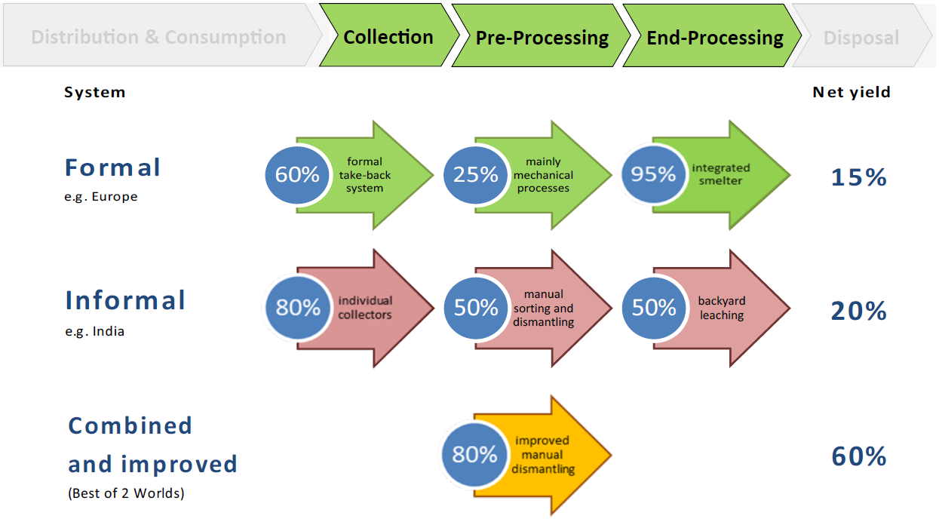
Best of 2 Worlds approach

Slide 12
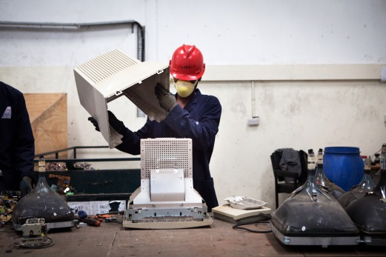
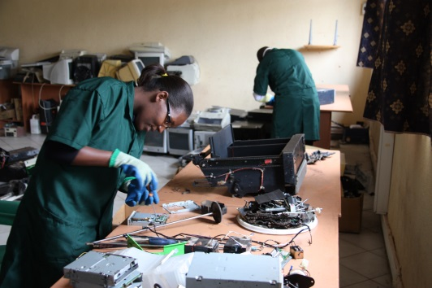
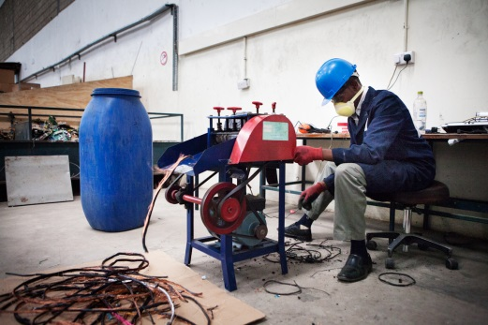
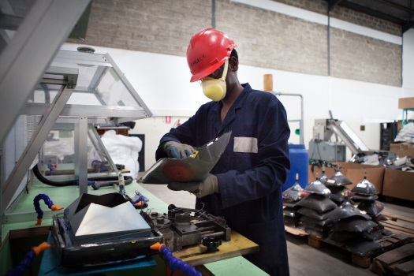
Key elements of UNIDOs approach
Detailed inventory of existing volumes and ongoing initiatives
Design of collection and processing schemes
Set-up / up-scale of national e-waste treatment options, including the establishment of sustainable business models
Connection to downstream markets on national, regional and international level in accordance with international conventions, e.g. Basel Convention
Policy and legislation development or enhancement, including collection strategies and financing mechanisms
Capacity building, training and awareness-raising
Notes:
UNIDO promotes the establishment of sustainable recycling industries in developing countries to build local capacity and to ensure sustainable treatment of e-waste along the whole recycling chain.

Slide 13

Process of E-Waste Flows
INPUT
TREATMENT
OUTPUT
Manual
Dismantling
Further
Treatment
Downstream
Options
Collection
Receiving
Individuals
(via Collection Points)
B2B
(Companies/
Organizations)
Informal Sector
(Scavengers,...)
SCREENS (TV, CRTs, LCDs..)
Hot Wire –Seperation (Lead glass screen)
STORAGE
Weighing
Sorting
Pre-Processing
Storing
Transport
TRANSPORT:
LAMPS
Decon-tamination
Hg-Lamps
Local
White Goods
(Fridges,...)
Degasification (CFCs)
Regional/
Cross-
national
Small WEEE
Cable-
Stripper
Refurbishment
Plastic Shredder
Batteries
Inter-
national/ Oversea
Legend:
WEEE
Pb, Acids,...
Fractions (non-hazardous)
FACILITY
Hazardous fractions/ waste

Slide 14
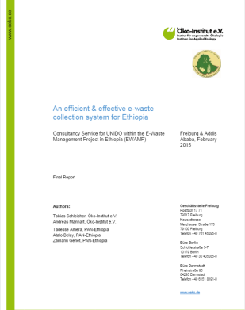
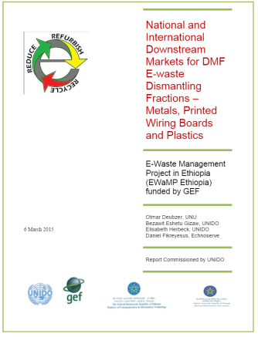
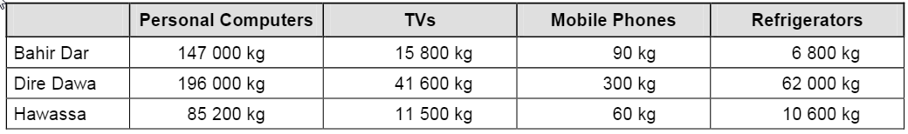
Inventory
Example: Ethiopia
General
Initial inventories to get an overview of:
Existing policies and ongoing initiatives
Financing mechanisms and stakeholder networks
Collection, treatment and downmarket schemes
Units in stock, current and future e-waste flows- e.g. volumes:
Notes:
What is the e-waste situation in the country/region/city?

Slide 15
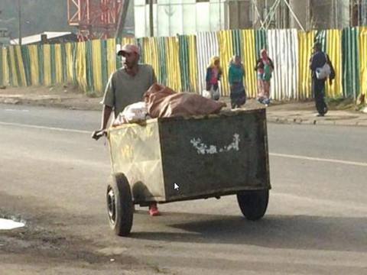
Collection
INPUT
How to reduce stock and ensure future input?
Permanent drop-off facility
Special drop-off events
Door-to-door pick-up
Stakeholder responsibility:
  Government
  Retailer
  Original Equipment Manufacturers (OEM)
  Commercial entity: electronic recyclers or generic waste collectors
Notes:
How to ensure future input and reduce stock?

Slide 16
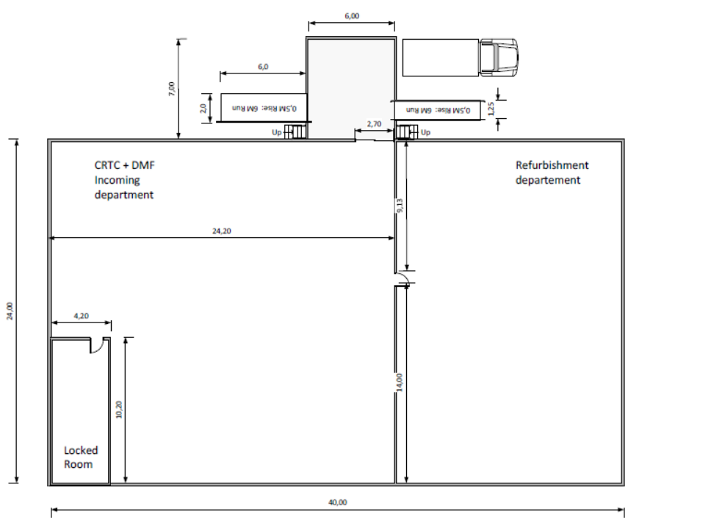
Dismantling Facilities
TREATMENT
Review of existing and planning of new DMFs
Optimize work prozesses and product/waste
flows
Provide technical assistance/ staff training
Reduce waste and ensure security and health standards
Take into account input (collected material) and output streams (valuable materials, hazardous waste,...) for facility design

Slide 17
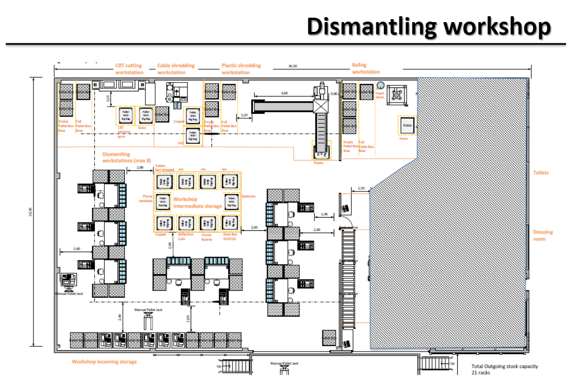
Example: Ethiopia
Project Site: Akaki/Addis Ababa
CRT Cutting
Cable Shredding
Plastic Shredding
IntermediateStorage
Dismantling workstation

Slide 18
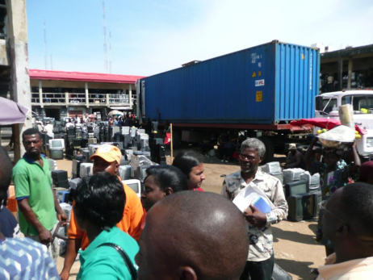
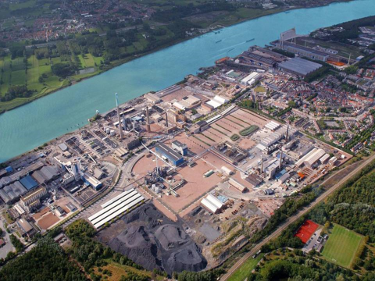
Downstream Markets
OUTPUT
Identify environmentally and socially sound potential local,
regional and international buyers
  Non-hazardous outputs: national/ regional markets
  Hazardous outputs: international smelters
Analyze the purchasing conditions and business models of
potential buyers and their branches
Take into account:
- Quality and contamination of material outputs
- International conventions on hazardous waste transport
- Administrative and legal restrictions
- Local and World market prices

Slide 19
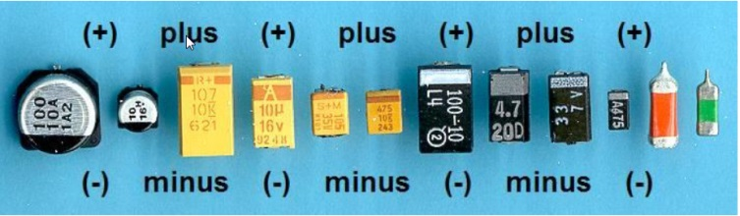
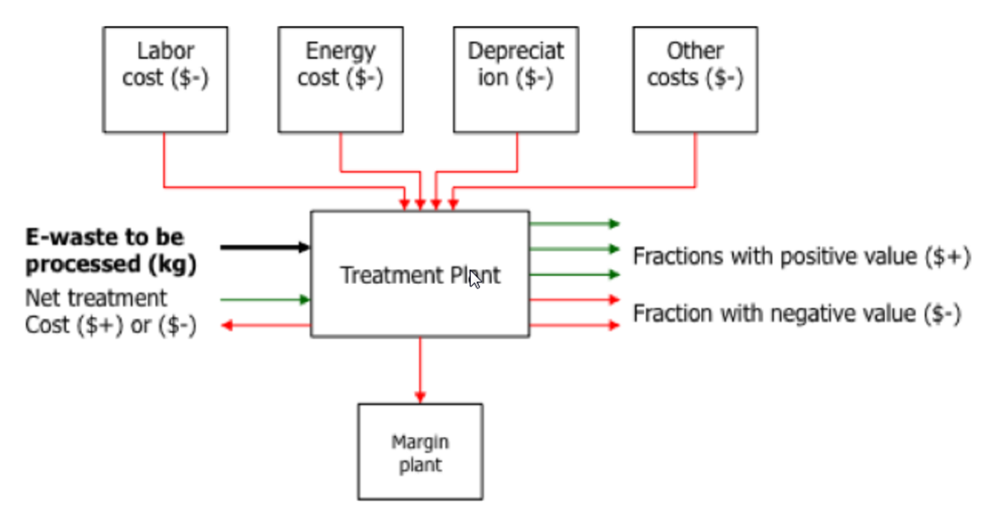
Business & Finance
General
Ensure proper treatment of all fractions
( i.e. Valuable / non-valuable and Hazardous / non-hazardous)
Establish adequate financing schemes
(e.g Expanded Producer Responsibility- EPR)
Incentivize DMFs
Develop sustainable business models

Slide 20
Revenues/ Costs of Manual WEEE Dismantling (USD/year)

Slide 21












Policy & Legislation
General
Helping countries develop their e-waste management policies and strategies based on the whole recycling chains and life-cycle
Establishing monitoring/auditing/ policy enforcement processes
Cooperation with international stakeholders and e-waste networks:

Slide 22
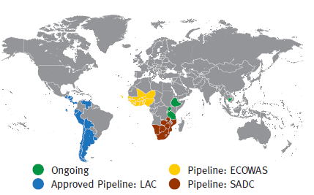
UNIDO E-Waste management portfolio
Ongoing:
Uganda: Establishment of a manual dismantling facility for WEEE
Tanzania: Component on E-waste management (One UN Programme)
Ethiopia: E-waste Management Project
Cambodia: Creating job opportunities & effective e-waste management
Pipeline:
Regional e-waste project for Latin America
Regional e-waste project for ECOWAS
Regional e-waste project for SADC

Slide 23

Thank you for your attention!
Smail AL HILALI
UNIDO
s.alhilali@unido.org

