Slide 1
Green Standards Week
Forum on “Turning the E-waste Challenge into an Opportunity”
Managing Sustainable ICT
Cristina Bueti
Adiviser International Telecommunication Union
15 December 2015

Slide 2
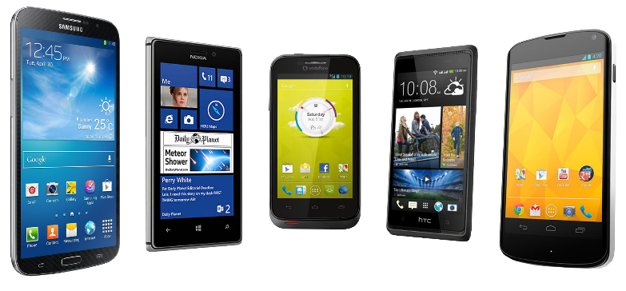
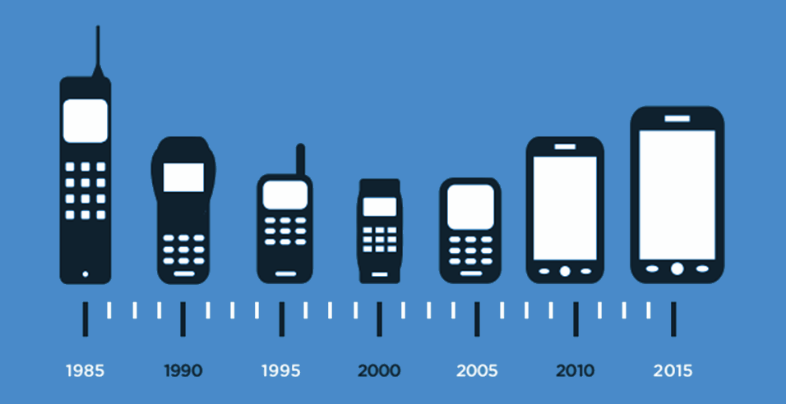
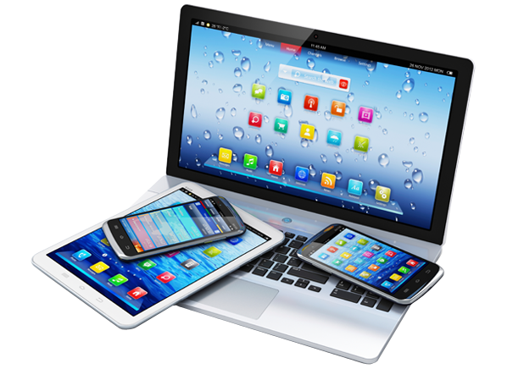
From Bricks to Brain
The evolution of modern technologies

Slide 3
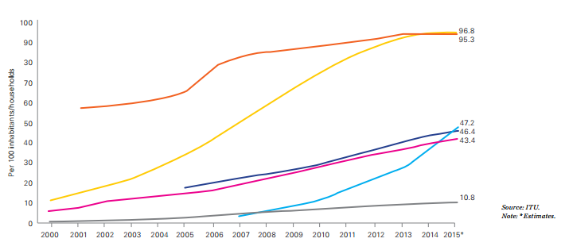
15 Years of ICT Growth: What Has Been Achieved?
Mobile-cellular telephone subscriptions
Individuals using the Internet
Population covered by 2G mobile-cellular network
Mobile broadband subscriptions
Fixed-broadband subscriptions
Households with Internet

Slide 4
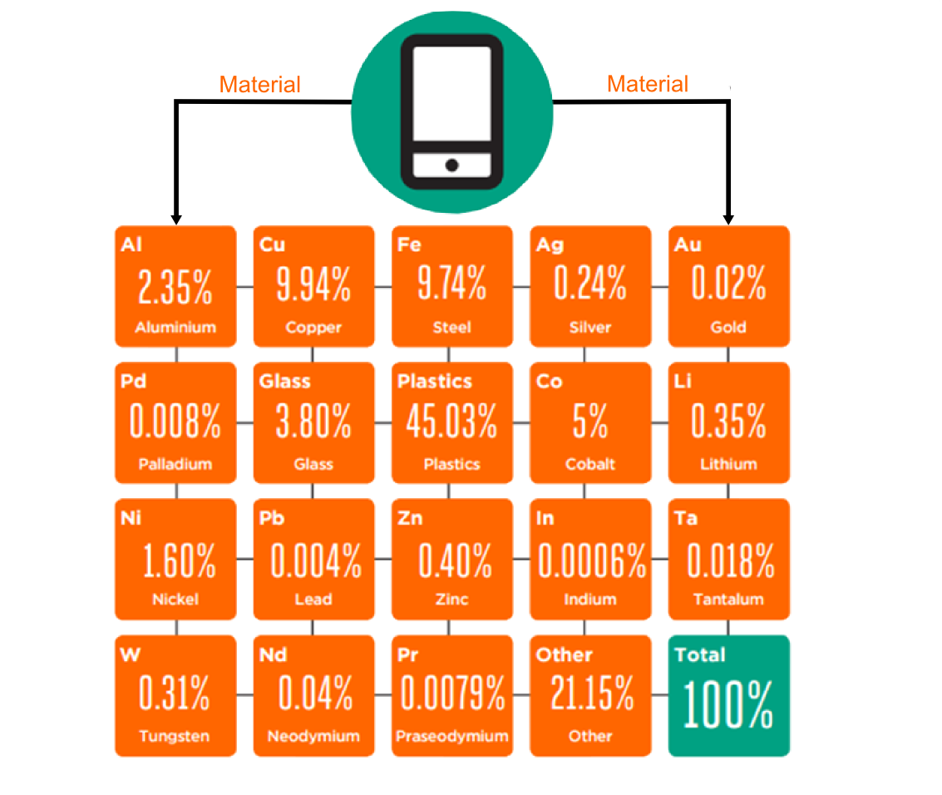
An ecological awakening: the finite nature of the world
Bill of materials of a mobile phone including strategic and rare metals
Notes:
Source: GSMA 2015
A bill of materials or product structure (sometimes bill of material, BOM or associated list) is a list of the raw materials, sub-assemblies, intermediate assemblies, sub-components, parts and the quantities of each needed to manufacture an end product. Electronic equipment and displays contain a significant amount of strategic and/or rare materials. A BOM may be used for communication between manufacturing partners, or confined to a single manufacturing plant. A bill of materials is often tied to a production order whose issuance may generate reservations for components in the bill of materials that are in stock andrequisitions for components that are not in stock.

Slide 5
“THERE IS NO PLAN B, BECAUSE THERE IS NO PLANET B”

Slide 6
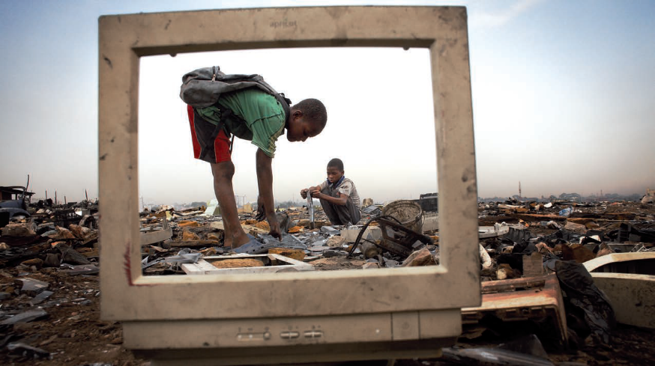
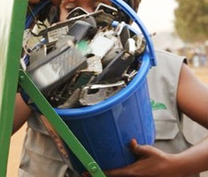
Estimated Amount of E-waste
€ 48 Billion
2014 42 Million tonnes of e-waste

Slide 7
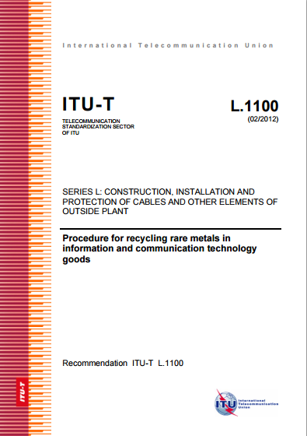
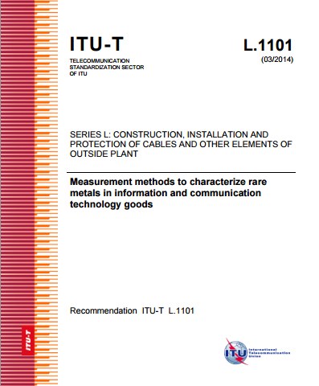
ITU-T Recommendations

Slide 8
Thank you!
ITU-T/SG5 “Environment & Climate Change” itu.int/go/tsg5
ITU-T and Climate Change itu.int/go/ITU-T/climate

