Slide 1
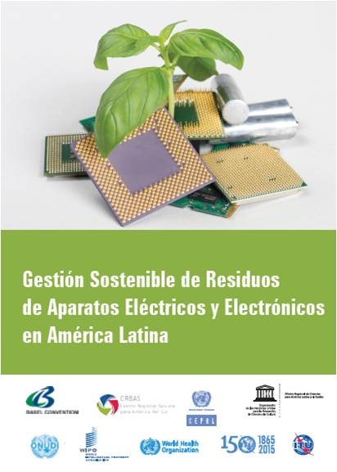
5th ITU Green Standards Week
Nassau, The Bahamas 14-18 December 2015
Sustainable Management of Waste Electrical and Electronic Equipment (WEEE)
in Latin America
Daniela Torres, Eng. MSc
ITU FG SSC WG4 Coordinator
ITU Consultant

Slide 2
Content
Introduction to the Report
Country Assessment Results
Main Findings of the Report
The Way Forward

Slide 3
1. Introduction to the Report
The Context
ICTs growth
Year 2013 ⁽¹⁾
Initiatives
WEEE growth Year 2014 ⁽²⁾
Mobile Penetration: 115%
The Americas: 11.7 mt
UN initiatives
Broadband penetration: 9% fixed (9%) & mobile (24%)
Private sector initiatives
Global platforms
Government initiatives
LATAM: 3,8 mt
S. America: 2,7 mt
Mexico, CA & Caribbean: 1,1 mt
Source: (1) ITU Statistics & (2) Baldé, et al. United Nations University
3

Slide 4
“Sustainable Management of Waste Electrical and Electronic in Latin America”
1. Introduction to the Report
To identify challenges for sustainable management
To outline a joint roadmap for future implementation
To provide an overview of WEEE management in Latin America
WEEE
MANAGEMENT IN LATIN AMERICA
The first UN Report of its kind

Slide 5
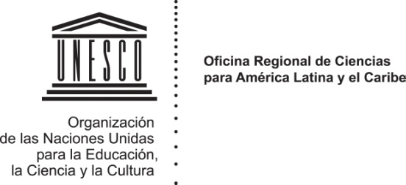






1. Introduction to the Report
Authors and Contributors

Slide 6
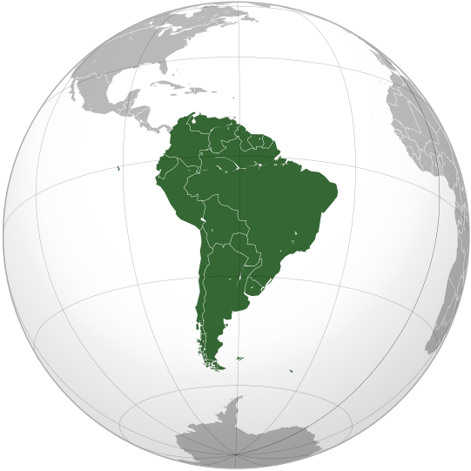
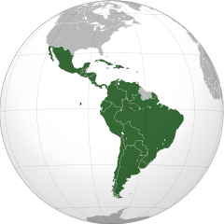
2. Country Assessment
Scope of the Analysis
Argentina, Bolivia, Brazil, Chile, Colombia, Ecuador, Paraguay, Peru, Uruguay and Venezuela.

Slide 7
2. Country Assessment
Parties to the Basel Convention
Parties to the Convention ⁽¹⁾ | Signature, Succession to Signature (d) | Ratification, Acceptance (A), Approval (AA), Accession (a) | Entry into force
Argentina | 28/06/1989 | 27/06/1991 | 05/05/1992
Bolivia (Plurinational State of) | 22/03/1989 | 15/11/1996 | 13/02/1997
Brazil |  | 01/10/1992 (a) | 30/12/1992
Chile | 31/01/1990 | 11/08/1992 | 09/11/1992
Colombia | 22/03/1989 | 31/12/1996 | 31/03/1997
Ecuador | 22/03/1989 | 23/02/1993 | 24/05/1993
Paraguay |  | 28/09/1995 (a) | 27/12/1995
Peru |  | 23/11/1993 (a) | 21/02/1994
Uruguay | 22/03/1989 | 20/12/1991 | 05/05/1992
Venezuela (Bolivarian Republic of) | 22/03/1989 | 03/03/1998 | 01/06/1998
(1) Parties to the Basel Convention on the Control of Transboundary Movements of Hazardous Wastes and their Disposal. http://www.basel.int/Countries/StatusofRatifications/PartiesSignatories/tabid/4499/Default.aspx

Slide 8

2. Country Assessment
2.1 ARGENTINA
Specific Regulation
Dispersed and heterogeneous regulations.
A healthy environment is under the guardianship of the Constitution, in agreement with the Basel Convention.
Policy N.24.051 on Hazardous waste also provides the legal framework for e-waste.
Public
Policy
Policies are scarce and disorganized
“Renovate” incentive Programme: encourage distributors of electrical appliances to recover equipment from households
International Commitment
Part of project Eco-normas of the European Union and Mercosur
Basel Convention and the Mercosur Agreement (South Common Market Agreement)
Part of the UNIDO project for persistent organic pollutant (POP) management from e-waste.
The Basel Convention entered into force in Argentina in 1992.
WEEE
Management
National Institute of Industrial Technology (INTI, Instituto Nacional de Tecnología Industrial), announced programmes for the creation of WEEE processing plants
Country Partnerships for WEEE management and Foundations that offer training
Notes:
La provincia de Buenos Aires, y la ciudad Autónoma de Buenos Aires cuentan con pautas, obligaciones y responsabilidades en la gestión de los RAEE…

Slide 9

2. Country Assessment
2.2 BOLIVIA
Specific Regulation
There is no specific regulation for WEEE management.
A working group has been constituted with public and private sector representatives, with the aim of developing specific technical standards.
Public
Policy
Absence of public policies for WEEE management.
At the government level, the Ministry of Productive Development and Plural Economy together with Ministry of Environment and Water are promoting national policies on e-waste management, including the Extended Producer Responsibility (EPR) principle.
International Commitment
The Basel Convention entered into force in Bolivia in 1997.
Part of the UNIDO project for POP management from e-waste
WEEE
Management
There are no formal recycling initiatives in the country
There are many recycling awareness campaigns
There are associations and private companies that work for e-waste disposal without using appropriate technologies.
Notes:
La provincia de Buenos Aires, y la ciudad Autónoma de Buenos Aires cuentan con pautas, obligaciones y responsabilidades en la gestión de los RAEE…

Slide 10
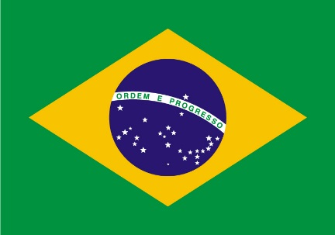
2. Country Assessment
2.3 BRASIL
Specific Regulation
National law called "Waste Law" states that everyone holds the responsibility for its e-waste generation. This applies to commerce and municipal activities as well as consumers.
Federal Law Nº 12.305 on National Policy on Solid Waste, covers proper management of e-waste.
Public
Policy
Implementation regulations include tools for creating national policies and action plans for e-waste and its selective collection.
International Commitment
The principle of Extended Producer Responsibility (EPR) is included in the regulatory frameworks of the country regarding the life cycle of e-waste.
The Basel Convention entered into force in Brazil in 1992.
WEEE
Management
There are companies specialized in WEEE management.
Once recycled, it goes through a reverse logistics process.
Notes:
La provincia de Buenos Aires, y la ciudad Autónoma de Buenos Aires cuentan con pautas, obligaciones y responsabilidades en la gestión de los RAEE…

Slide 11

2. Country Assessment
2.4 CHILE
Specific Regulation
There is no specific regulation for the WEEE management.
E-waste is treated as hazardous waste.
The Bill introducing the Extended Producer Responsibility (EPR) is under debate.
Public
Policy
Regulation on the Register of Emissions and Pollutant Transfer (REPT).
Public access database aimed at disseminating information on emissions, waste, and transfer of pollutants.
International Commitment
Ratification of the Basel Convention, through Decree No. 685 in 1992.
Part of the UNIDO project for POP management from WEEE.
WEEE
Management
Two certified companies and a waste reconditioning programme.
Informal recycling sector, is a challenge for the country.
Notes:
La provincia de Buenos Aires, y la ciudad Autónoma de Buenos Aires cuentan con pautas, obligaciones y responsabilidades en la gestión de los RAEE…

Slide 12

2. Country Assessment
2.5 COLOMBIA
Specific Regulation
Specific policy on integrated waste management of electronic appliances
Law No. 1672, defines the public policy guidelines on integrated management of WEEE.
Public
Policy
Congress has established guidelines for the adoption of a public policy for integrated management of WEEE, under the guidance of the Ministry of Environment.
International Commitment
Colombia has ratified the Basel Convention, under Law 253 in 1996 (which entered into force in 1997).
WEEE
Management
There are collection systems to manage computers, lighting, peripherals and batteries.
There is no sufficiently automated technology for dismantling and recovery of materials.
Notes:
La provincia de Buenos Aires, y la ciudad Autónoma de Buenos Aires cuentan con pautas, obligaciones y responsabilidades en la gestión de los RAEE…

Slide 13

2. Country Assessment
2.6 ECUADOR
Specific Regulation
Ecuador has a National Regulation for Hazardous Waste. E-waste is treated as such
The Ministerial Agreement No. 161 defines the “Regulation for pollution prevention and control of chemical substances, hazardous and special wastes”.
Public
Policy
National Policy on post consumption of electrical equipment and disuse of electronics, applies the principle of Extended Producer Responsibility (ERP).
The Ministry of Environment (as of 2015) is working on the proposal for a technical standard on how to apply the ERP principle to electrical equipment and disuse of electronics.
International Commitment
The Basel Convention entered into force in Ecuador in 1993.
Part of the UNIDO project for POP management from WEEE.
WEEE
Management
There are nine companies that have an environmental licence to carry out activities in the different phases of waste management, storage, transportation and dismantling.
Notes:
La provincia de Buenos Aires, y la ciudad Autónoma de Buenos Aires cuentan con pautas, obligaciones y responsabilidades en la gestión de los RAEE…

Slide 14

2. Country Assessment
2.7 PARAGUAY
Specific Regulation
There is no specific regulation for the WEEE management.
Constitution has several articles to protect the environment.
Law N42/90 prohibits importing, dumping and using products considered hazardous.
Public
Policy
WEEE started to be treated by the involved institutions in the country.
One of the problems is the lack of awareness of the population regarding waste disposal.
International Commitment
The Basel Convention entered into force in Paraguay with Law No. 547 in 1995.
WEEE
Management
There are no organizations dedicated to the management of WEEE.
Notes:
La provincia de Buenos Aires, y la ciudad Autónoma de Buenos Aires cuentan con pautas, obligaciones y responsabilidades en la gestión de los RAEE…

Slide 15

2. Country Assessment
2.8 PERU
Specific Regulation
Specific Regulation for WEEE: “National Regulation for the Use and Management of Waste of Electrical and Electronic Equipment” – Decree No. 001-2012.
Public
Policy
The Ministry of Environment has developed public campaigns for the collection of WEEE.
There are two plans on how to handle e-waste with private companies that are supported by the national government.
International Commitment
The Ministry of environment and the Swiss Cooperation have signed an agreement to develop the project “Sustainable Recycling Industries”.
Part of the UNIDO project for POP management from WEEE.
The Basel Convention entered into force in 1994.
WEEE
Management
There are several companies that manage WEEE in the country.
There is a special project with the private sector called “Corporate Social Responsibility” for the Management of WEEE.
Notes:
La provincia de Buenos Aires, y la ciudad Autónoma de Buenos Aires cuentan con pautas, obligaciones y responsabilidades en la gestión de los RAEE…

Slide 16

2. Country Assessment
2.9 URUGUAY
Specific Regulation
There is no specific regulation for the e-waste management.
There are general regulations to protect the environment.
Public
Policy
Uruguay has a general public framework for waste management including WEEE.
There are some initiatives driven by the National Government, such as the National Agency of Research and Innovation, Ceibal Plan and the Technological Laboratory of Uruguay.
International Commitment
The Basel Convention was ratified in Uruguay in 1991, with Law No. 16.221 and entered into force in 1992.
Uruguay is the home of the Coordinating Center of the Basel Convention and the Regional Center of Stockholm Convention for Latin America and the Caribbean.
Part of the UNIDO project for POP management from WEEE.
WEEE
Management
It does not have appropriate entities for the final disposal of WEEE.
There are private initiatives for waste management including WEEE collection.
Notes:
La provincia de Buenos Aires, y la ciudad Autónoma de Buenos Aires cuentan con pautas, obligaciones y responsabilidades en la gestión de los RAEE…

Slide 17
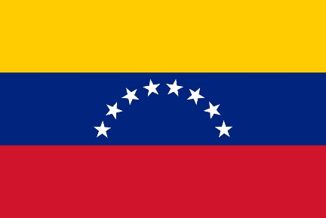
2. Country Assessment
2.10 VENEZUELA
Specific Regulation
There is no specific regulation for the management of WEEE.
Uses the established normative on general waste as a reference.
Public
Policy
There are no environmental policies for this purpose.
It is expected that the national government will set up intergovernmental roundtables that will coordinate actions and elaborate on public policies.
International Commitment
Signed and ratified the Basel Convention with the Approving Law No. 36.396 on 1998.
Part of the UNIDO project for POP management from WEEE.
WEEE
Management
5 national private companies are in charge of the waste management process that deal with collection, storage, treatment and dismantling of WEEE.
There is no available technology for WEEE disposal.
Notes:
La provincia de Buenos Aires, y la ciudad Autónoma de Buenos Aires cuentan con pautas, obligaciones y responsabilidades en la gestión de los RAEE…

Slide 18




3. Summary of Findings in the Report
Country | National Regulation on e-waste | Public Policies | International Commitment | E-waste management technologies*
Argentina
Bolivia
Brasil
Chile
Colombia
Ecuador
Paraguay
Perú
Uruguay
Venezuela
(*) This is based on information available on identified patenting activity in these countries.

Slide 19
3. Findings of the Report
E-waste Management Challenges
Legal & regulatory gaps for
WEEE management
Non-sustainable economic models for WEEE management
Sustainability management across WEEE Lifecycle
(illegal exports & environmental pollution)
Exclusion of the Extended Producer Responsibility (ERP) principle
Lack of knowledge of WEEE management
Limited technological availability & technology transfer
Lack of Global E-waste Management Standards

Slide 20
3. Findings of the Report
E-waste Management Challenges
The region needs to foster the coordination between environment & ICT representatives towards efficiency and sustainable management of WEEE
Countries need to work on WEEE specific regulatory frameworks. Development and compliance mechanisms are needed.
WEEE management requires effective governance. Roles and responsibilities of actors must be well defined.
Informal WEEE management is a challenge in the Region. WEEE management must be safe across its whole lifecycle.
WEEE programs must be designed including sustainability aspects. Opportunities to create green-jobs and promote technological innovation should be considered.
1
2
3
4
5
Notes:
Coordination among environmental & ICT representatives is required for efficiency and sustainability of management of WEEE in the region
Not all countries have WEEE specific regulatory frameworks. They need to develop them and their compliance mechanisms. International standards can be used as references.
WEEE management requires effective governance models, including all stakeholders. Roles & responsibilities have to be well defined.
Informal WEEE management has effects on health & quality of life.
WEEE management must be safe across its whole lifecycle.
WEEE programs in the region do not include economic analysis of the environmental and social risks related to a mismanagement of WEEE. Opportunities to create green-jobs and promote technological innovation should be considered.

Slide 21
4. The Way Forward
10 Key Policy Recommendations
Identify sources & account volumes
Include Life Cycle vision of e-waste
Promote sustainable management alliances
Promote : Recycling Repair, Reuse, Eco-design
Develop synergies & optimize resources
1
3
5
7
9
2
4
6
8
10
Deepen country analysis in all sustainability aspects
Work on preventive policies & learn from experience
Develop infrastructure for mgmt. beyond borders
Raise consumer & stakeholder awareness
Promote innovation & technology transfer
Notes:
Identify sources of WEEE generation and account for management volumes.
Deepen the analysis at the country level, including aspects such as key actors, social framework, cultural boundaries, etc.
Manage e-waste considering the whole life cycle.
Work on preventive policies to avoid e-waste contamination. Learn from international initiatives (ITU-T Study Group 5, PACE and Step).
Establish initiatives for more effective project implementation and to strengthen e-waste sustainable management alliances.

Slide 22
Thank you
Sustainable Management of Waste Electrical and Electronic Equipment (WEEE)
in Latin America
Download the Report at: http://www.itu.int/en/ITU-T/climatechange/Pages/publications.aspx
Contact: greenstandard@itu.int
Daniela Torres, Eng. MSc
ITU FG SSC WG4 Coordinator
ITU Consultant

