Slide 1
E-waste in Latin America: Statistical analysis & Policy recommendations
Federico Magalini
A joint report with:

Slide 2
Technology in modern societies
Massive societal benefits linked to use of modern electronics and ICT/TLC:
Medicine, transportation, education, communication, security,
Internet of Things opportunities
Links between functionalities enabled, as:
Food processing & conservation
Telecommunication & e-learning, office productivity
Medical & diagnosis
…
…and Sustainable Development Goals (SDGs), as:
SDG4 (Ensure inclusive and equitable quality education)
SDG7 (Ensure access to a ordable, reliable, sustainable and modern energy)
SDG12 (Ensure sustainable consumption and production patterns)
...

Slide 3
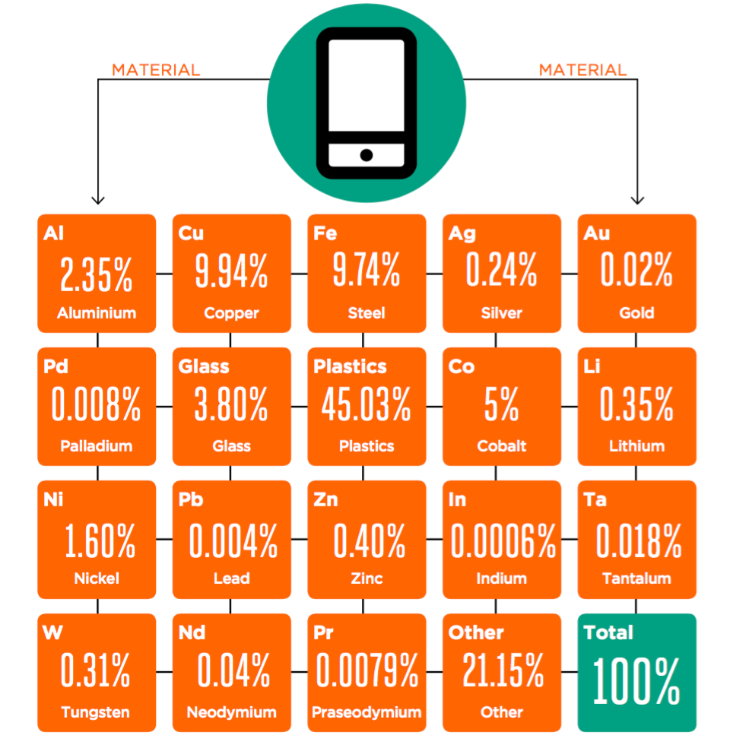
Impact on natural resources of modern electronics: Mobile Phones
Annual sales

Slide 4
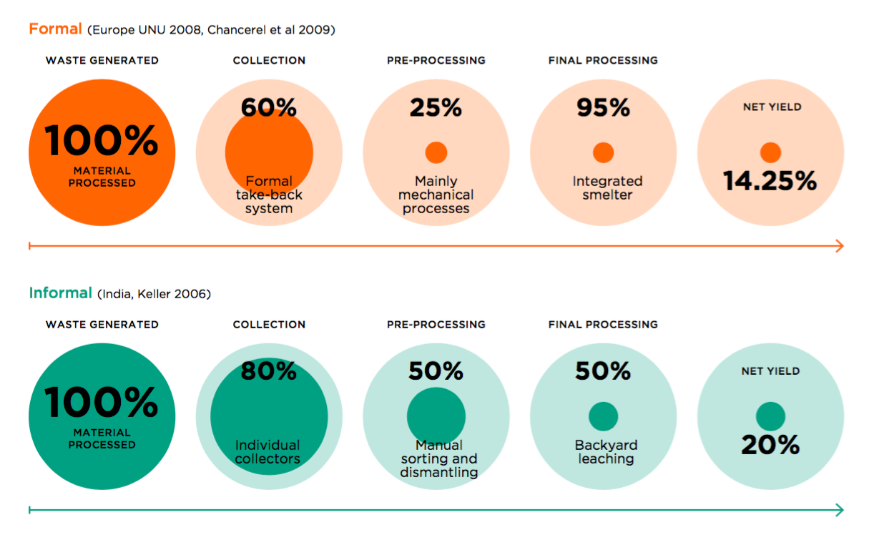
Closing the Loop
We should always look at the OVERALL recyclign chain efficnecny considerign all the steps in the recyclign chain

Slide 5
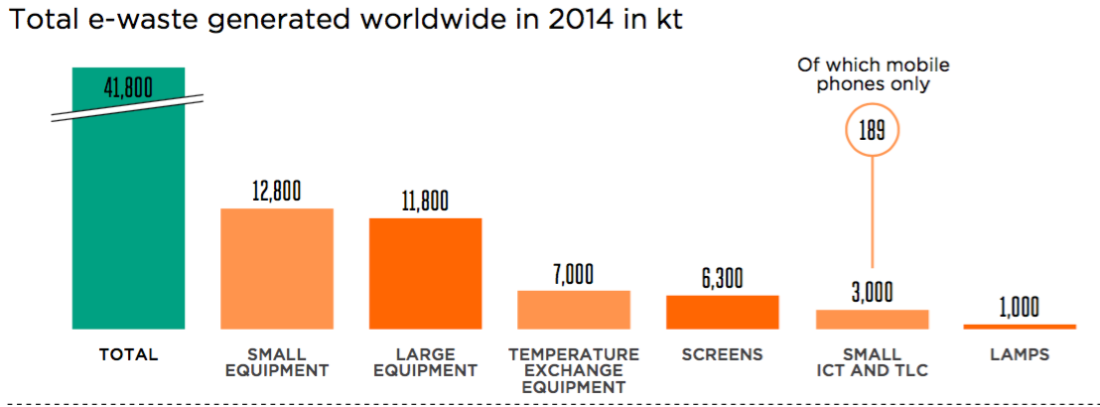
E-waste generated worldwide
Amount of e-waste generated worldwide is growing:
Small equipment and Large equipment play a major role
Mobile Phone only represent a small share in the Small ICT and TLC waste stream
Mobile Phone account for less than 0,5% in weight of total e-waste generated

Slide 6
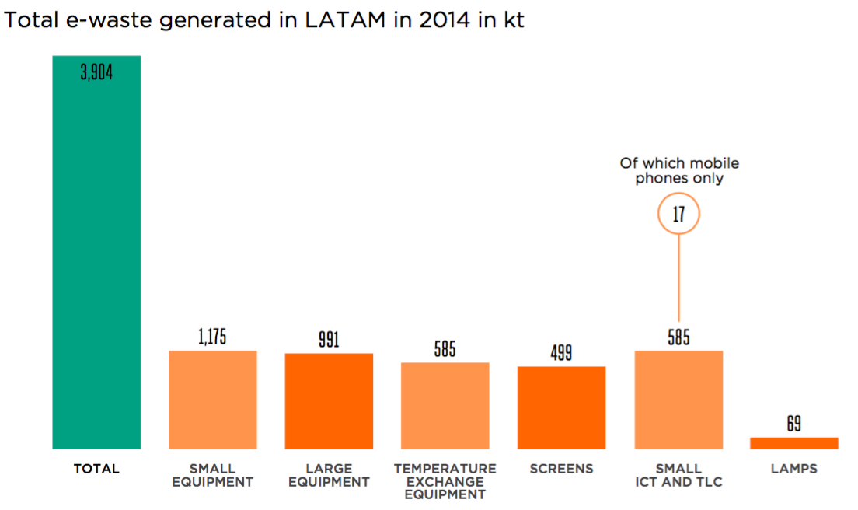
E-waste generated in Latin America (2014, kt)

Slide 7
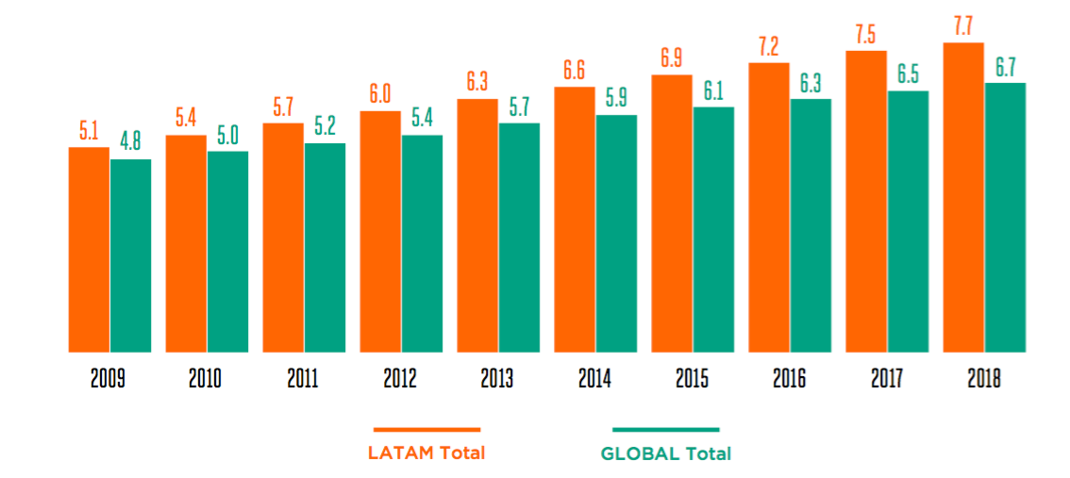
Growth rate for e-waste (worldwide and Latin America, kg/person)
Average in Latin America is slightly higher compared to worldwide average
Annual Growth rate in Latin America (6%) is also higher compared to worldwide average (5%)

Slide 8
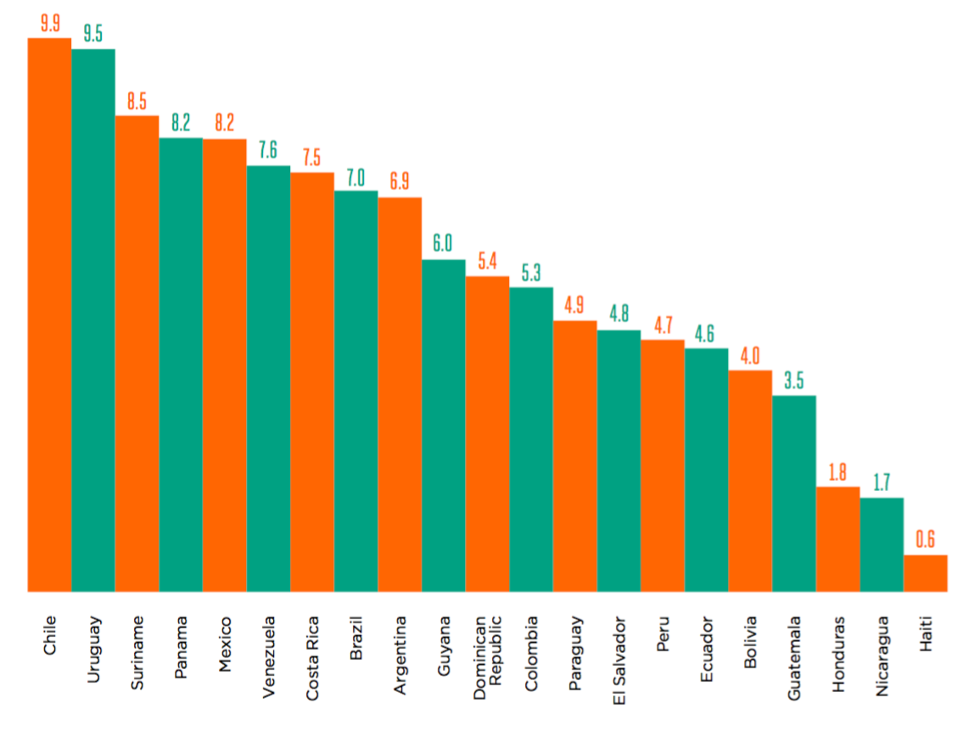
E-waste generated per person, individual countries (2014)
Amount of e-waste generated (kg/person) varies per country
Total amount of e-waste highly influenced by total population.

Slide 9
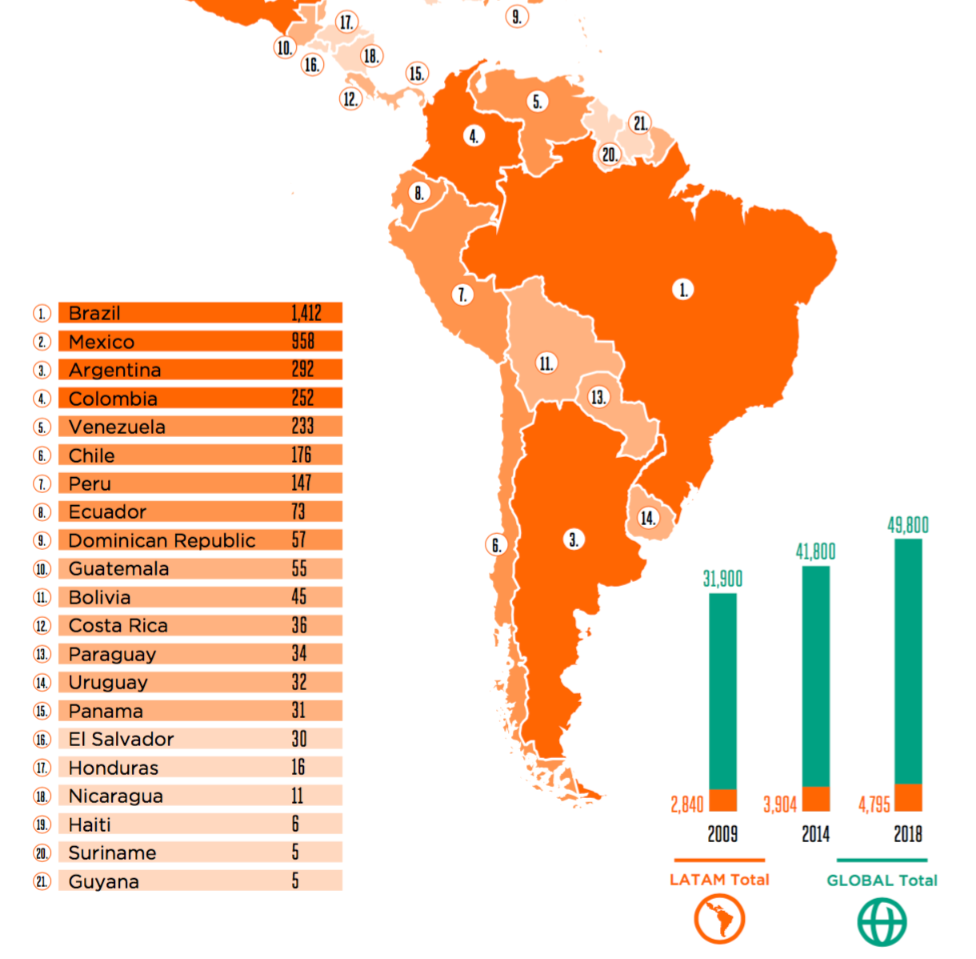
E-waste generated, total per country (2014)
Brazil (1412 kt) & Mexico (958 kt) are by far the countries with more e-waste generated (2014)
Countries in Central America generate less amount (call for a regional approach most probably)

Slide 10
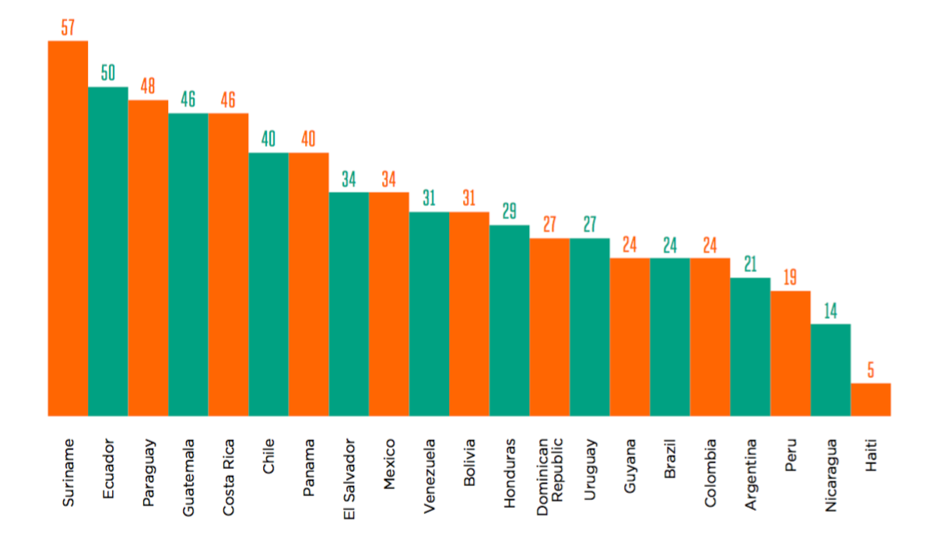
Waste from Mobile Phones (g/person), individual countries (2014)

Slide 11
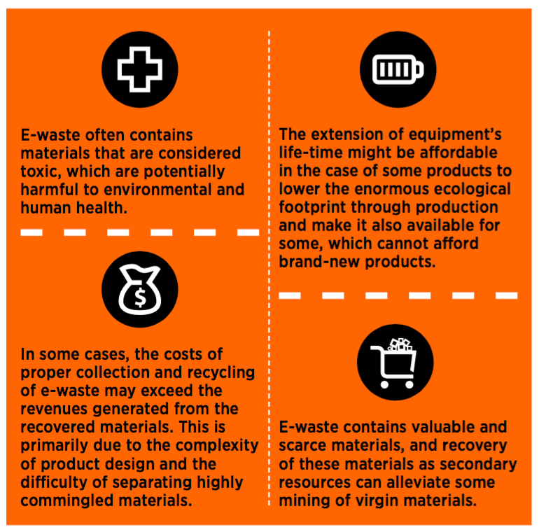
E-waste and take back legislation
National & Regional assessment of collection and recycling infrastructure is needed
Proper financing mechanism is needed
Alternative approaches are possible:
Society bearing costs
Waste holders/consumers
Producers (EPR)

Slide 12
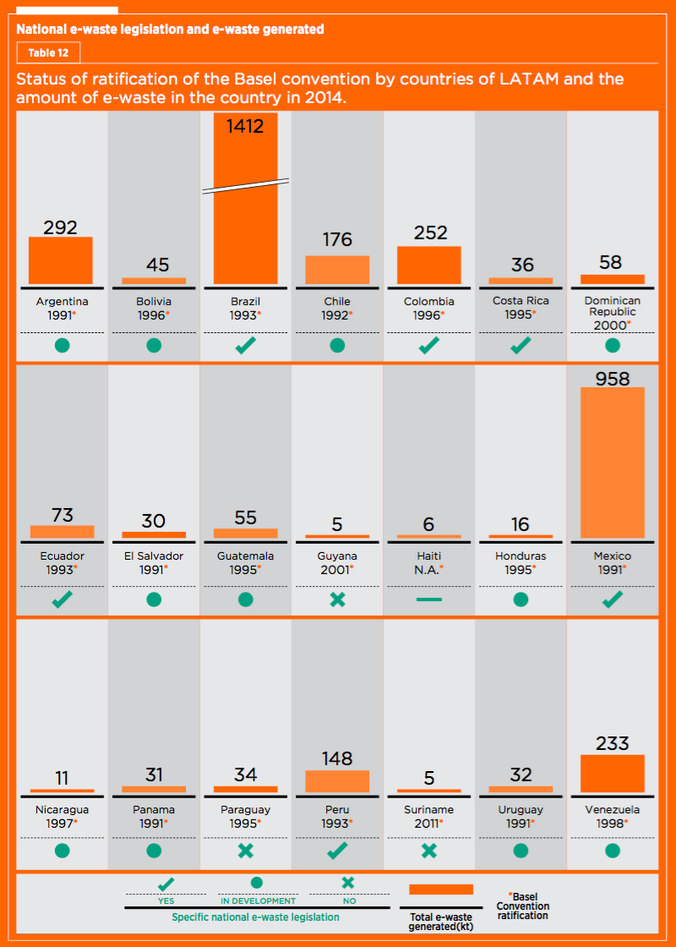
Policy development in Latin America
Majority of Countries transposed Basel Convention
Only few countries have compete e-waste legislation in place
Majority of countries are developing e-waste legislation
Basic e-waste management & recycling infrastructure exist:
Linked to scrap processing
Specific e-waste processing expected to grow
End-processing of critical fractions or environmentally sound disposal need to be further developed

Slide 13
Key priorities in policy development

Slide 14
Thank you
Questions?
Mail to: Magalini@unu.edu

