Slide 1
5th ITU Green Standards Week Nassau, The Bahamas 14-18 December 2015
E-WASTE & INFORMAL RECYCLERS:
Regulatory Mechanisms for Inclusion
Melissa Owen
mowen@ambientelegal.com

Slide 2
E-Waste Standards in Latin America
Enacted in 6 countries in the region
Emerging in several more
Extended Producer Responsibility Model common across the region

Slide 3
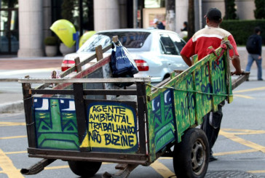
Informal Recyclers

Slide 4
Informal Recyclers & E-Waste
Separation & Collection
Manual / Semi- Manual Dismantling
Hand Off to Formal Sector

Slide 5
Regulatory Inclusion: Brazilian Model
National Waste Law
Waste Regulation
Sectoral Agreements for Reverse Logistics

Slide 6
Lessons for Future Regulations
Include informal sector in development of the laws and regulations
Employ a “Best of 2 Worlds” approach
Promote plans to educate, organize, and formalize the traditional recyclers
Encourage EPR schemes to contract informal sector
Address the problematic waste fractions

