Slide 1
“ Challenges and Benefits of Electronic
Recycling Programs”
Igor Boguslavsky

Slide 2
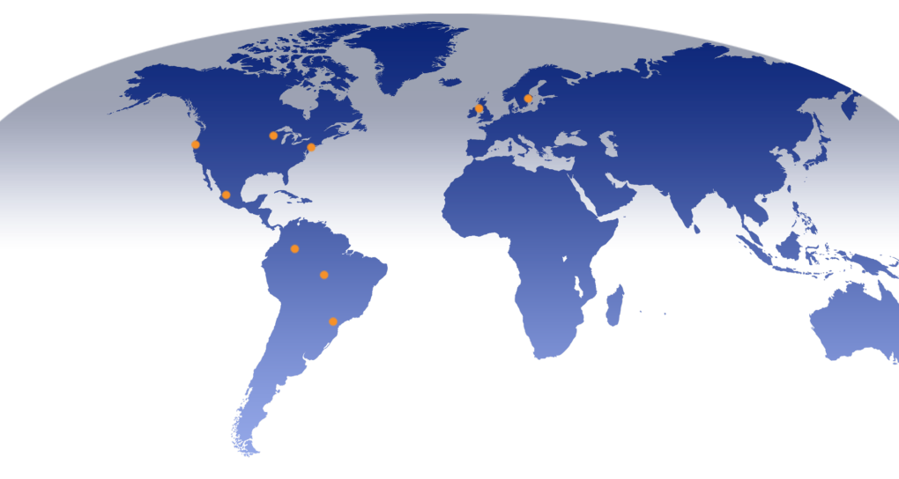
Global Footprint
Elk Grove Village, IL
Northbrook, IL
Chicago, IL
Kristinehamn, Sweden
Moscow, Russia
Kilwinning, Scotland
Hayward, CA
Bridgewater, NJ
Zabreh ,
Czech Republic
Guadalajara, Mexico
Bogota, DC
Colombia
Manaus, Brazil
São Paulo, Brazil

Slide 3
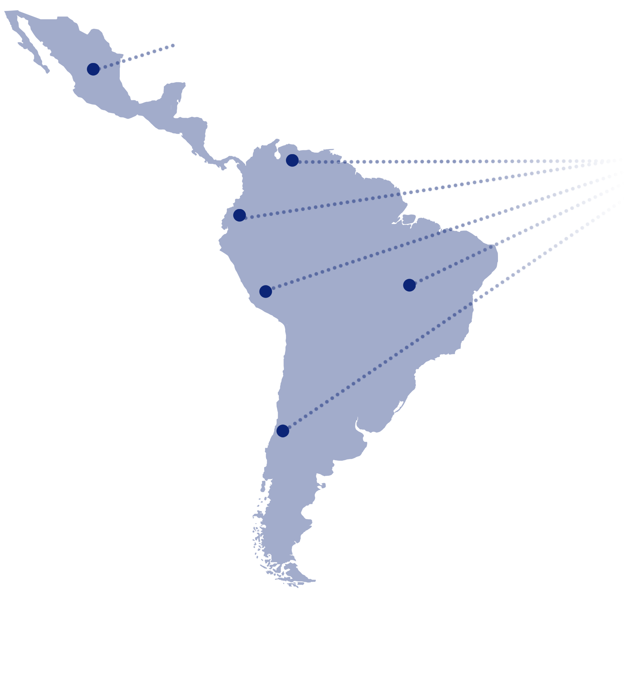
Take back programs in Latin America
Mexico
First started in 2006
Colombia
Ecuador
Peru
Brazil
Working with operators and brands we developed takeback programs which are free to consumers.
Since starting our first program in Mexico in 2006 we collected over 1 million cell phones, over 10 tons of accessories and over 5 tons of batteries
Chile

Slide 4
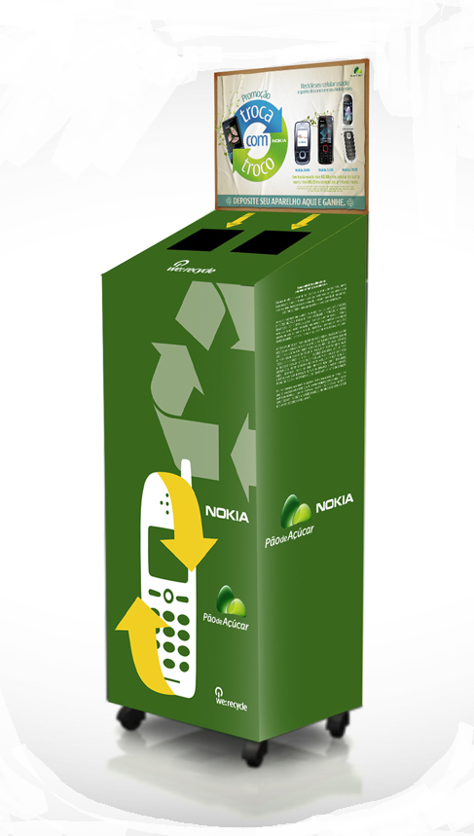
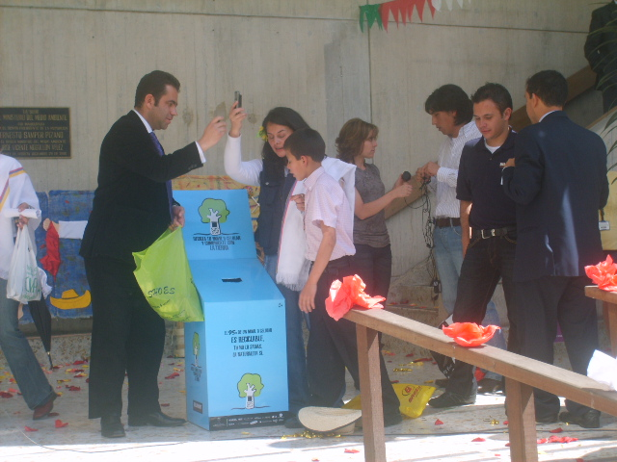
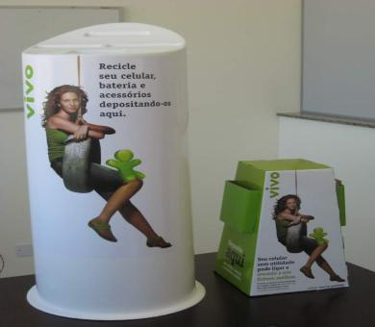
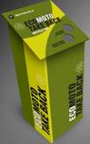
Take back programs in Latin America
Brazil
Colombia
Mexico
Brazil

Slide 5
Challenges – Latin America
Educating consumers that electronic recycling is good for the environment and therefore benefits everyone in society.
Logistics – offering collection points outside of major metropolitan centers is quite challenging and expensive.
Lack of legitimate in-country recycling/refining facilities requires all materials to be exported increasing costs and complexities.
Compliance with import-export regulations especially when the exporter of records is not the original importer of records.
Remaining competitive in spite of high logistics and handling costs

Slide 6
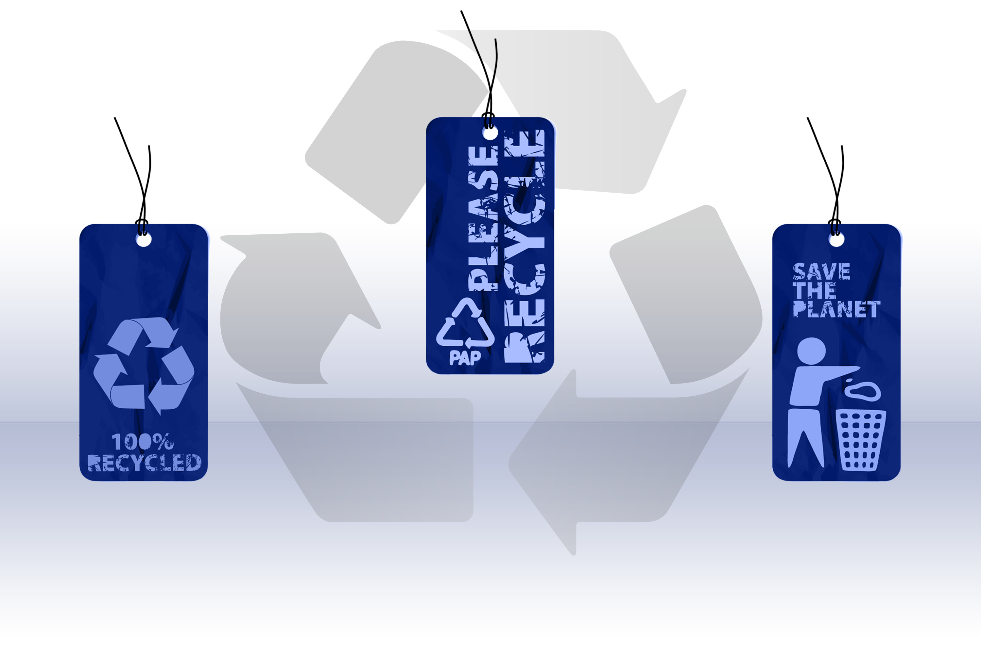
Recycling Benefits
Decrease volume
of materials
being dumped in landfills
Recovered value being used to support environmental programs and charities
Decrease the use of
natural resources

Slide 7
Thank you
Igor Boguslavsky
President and Founder
Belmont Trading Company

