Slide 1
The role of ITU in shaping Smart Sustainable Cities
Ahmed Zeddam

Slide 2
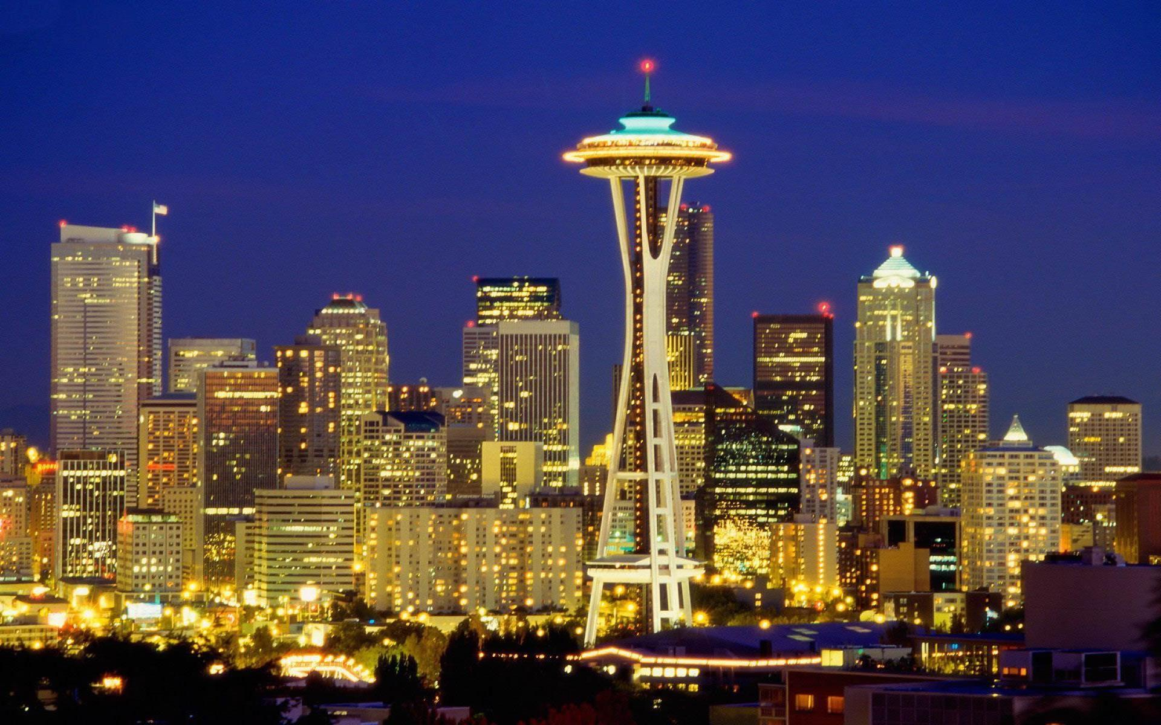
Standards are vital to shape Smart Sustainable Cities
Cities are responsible for more than 70% of global greenhouse gas emissions and they are accountable for 60-80% of global energy consumption.

Slide 3
ITU-T Study Group 5
Environment and Climate change
Working Party 1
Damage prevention and safety
Working Party 3
ICT and climate change
7 Questions
5 Questions
Working Party 2
Electromagnetic fields: emission, immunity and human exposure
6 Questions

Slide 4
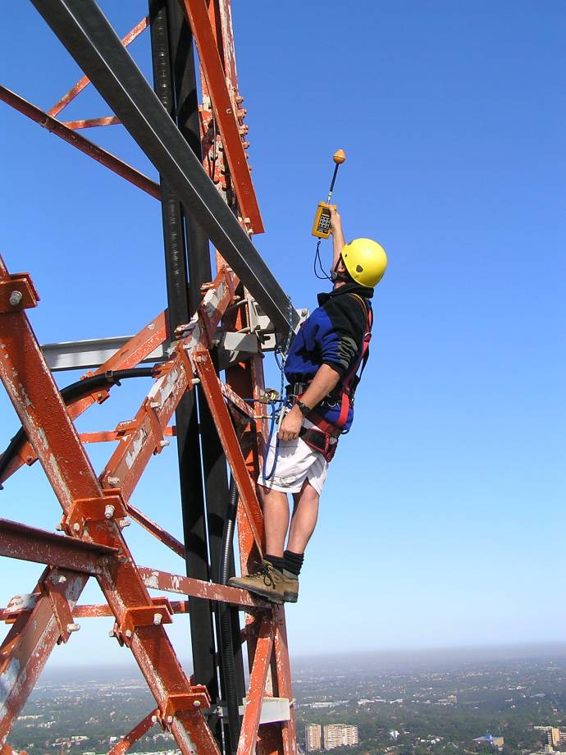
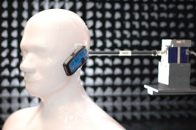
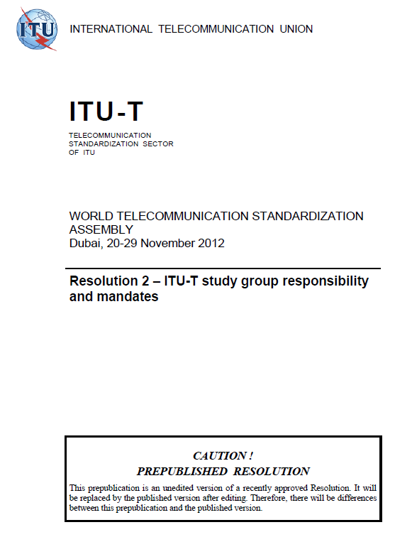
Concerns related to human exposure to EMF
Q7/5 - Human exposure to electromagnetic fields (EMFs) due to radio systems and mobile equipment
Guidelines for the protection of people exposed to
electromagnetic fields (EMF) due to radio systems and
mobile equipment
Recommendations how to show compliance with limits of
human exposure to EMF
Provide for the general public clear and easily available data
concerning electromagnetic field levels
ITU-T Recommendation K.91: guidance on how to assess and monitor human exposure to radio frequency (RF) electromagnetic fields (EMF) in areas with surrounding radio communication installations based on existing exposure and compliance standards
ITU-T Recommendation K.83: guidance on how to make long-term measurements & monitoring of EMF in the selected areas that are under public concern, in order to show that EMFs are under control and under the limits
Notes:
Question 7 - "Human exposure to electromagnetic fields (EMFs) due to radio systems and mobile equipment"

Slide 5
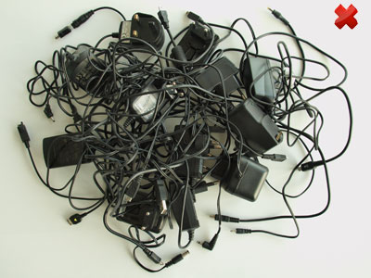
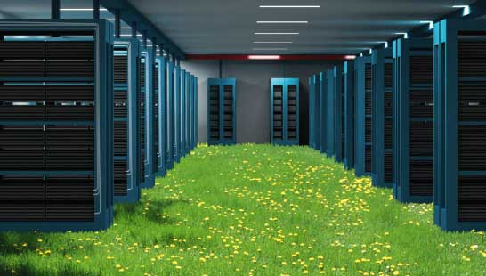
Methodologies on Cities
Tackling E-Waste
Q13/5 - Environmental impact reduction
including e-waste
Green ICT Standards
Green Data Centers
Q17/5 - Energy efficiency for the ICT sector and
harmonization of environmental standards
Q18/5 - Methodologies for the assessment of
environmental impact of ICT

Slide 6
Focus Groups
Smart Water Management
Smart Sustainable Cities
Established by the ITU-T TSAG meeting in Geneva, 4-7 June 2013
Will work in close collaboration with the FG-SSC
1st Meeting: 10 December, Lima, Perú
Established at SG5 meeting in Geneva, 29 January to 7 February 2013
As an open platform for smart-city stakeholders
2nd meeting held on 17 September 2013 in Madrid, Spain
Contributions are needed!
Notes:
The creation of this Focus Group highlights the necessity of a multi-stakeholder approach to the development of ‘smart’ water-management systems; one that incorporates the views of irrigation, agriculture, environment and communications ministries as well as those of the ICT industry and relevant intergovernmental and non-governmental organizations.
FG-SWM is expected, in alia, to contribute to specify the roles to be played by ICTs in smart water management.
The new Focus Group will work in close collaboration with the Focus Group on Smart Sustainable Cities (FG-SSC).
------------------------------------------------------------------------------------------------------------------------------------------------
The FG–SSC will to assess the standardization requirements of cities aiming to boost their social, economic and environmental sustainability through the integration of information and communication technologies (ICTs) in their infrastructures and operations.
The FG–SSC will analyze ICT solutions and projects that promote environmental sustainability in smart cities and will identify best practices which could facilitate the implementation of such solutions in cities. It will develop a standardization roadmap taking into consideration the activities currently undertaken by the various standards developing organizations (SDOs) and forums. This “Focus Group on Smart and Sustainable Cities (FG – SSC)” will leverage the role of the ICT sector to foster the growth of smart and sustainable cities worldwide.
Chairman - Silvia Guzman, Telefónica
Vice-Chairmen - Pablo Bilbao, Federation Argentina de Municipios
- Flavio Cucchietti, Telecom Italia
- Sekhar Kondepudi, National University of Singapore
- Nasser Saleh Al Marzouqi, UAE
- Franz Zichy, USA
- Ziqin Sang, Fiberhome Technologies Group

Slide 7
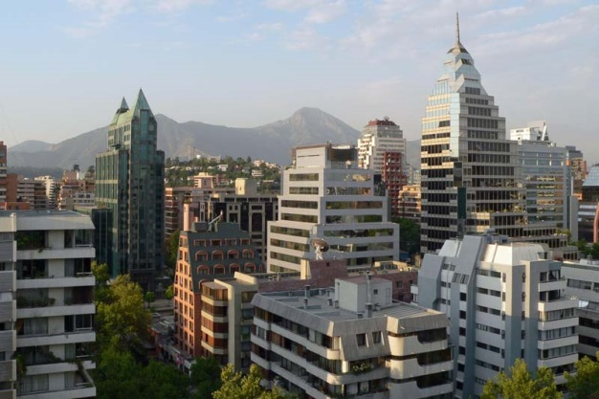
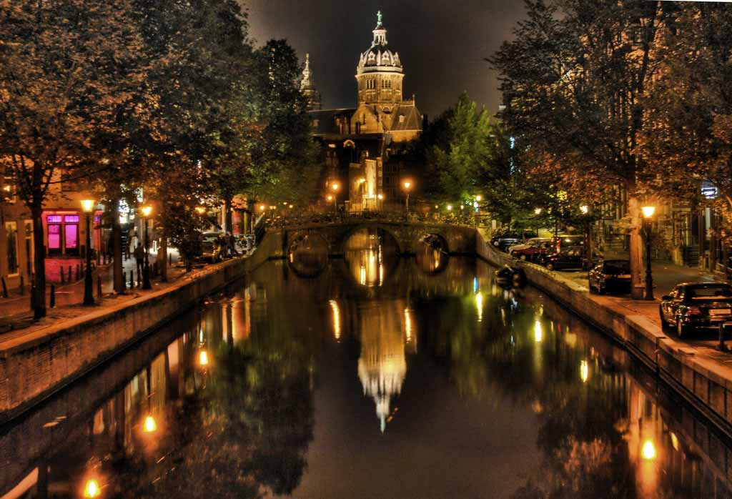
Conclusions
Need for SDOs to collaborate and work together
Need for ITU to work with municipalities, ICT sector, policy makers, international and regional organizations;
Development of joint and comprehensive strategies;
ITU as global platform for the empowerment of smart sustainable cities.

Slide 8
Links & Additional Information
ITU-T and climate change http://www.itu.int/ITU-T/climatechange
ITU Symposia & Events on ICTs and Climate Change http://www.itu.int/ITU-T/worksem/climatechange
Contact: greenstandard@itu.int

Slide 9
Thank you

