Slide 1
ITU-T Study Group 3 activities on International mobile roaming (IMR)
Rapporteur: Ms Eriko Hondo (KDDI, Japan)
TSB Secretariat: Dr Lara Srivastava

Slide 2
Growth of mobile subscribers
Mobile Roaming RG is established
Mobile Termination
Rapporteur Group (RG) is established
(*estimate)
Source: World Telecommunication/ICT Indicators Database, ITU

Slide 3
Growth of mobile broadband
Mobile Data Roaming Regulation begins in Europe
(*estimate)
Source: World Telecommunication/ICT Indicators Database, ITU

Slide 4
First ITU-T SG3 Mobile roaming Rapporteur Group
First rapporteur group established in January 2009
Source: Contribution 17 from Australia which proposes the study of international mobile roaming within Study Group 3
In particular, it was proposed to study best practice approaches for mobile roaming that seek to improve the timeliness and transparency of billing and to reduce the prices for consumers as well as the costs to mobile operators
Rapporteur(s):
Ms. Eriko Hondo (KDDI, Japan)
Ms. Josephine Adou (ATCI, Cote d’Ivoire)
Mr. Omari Al-Rashdan (Jordan Telecom, Jordan)

Slide 5
Initial Timeline for the work of the Rapporteur Group 2009-2012 (January 2009 Terms of Reference)
By September 2009
Action 1: identify recent studies within administrations, regulators and regions
Action 2: identify market developments that have contributed to a reduction in roaming rates for consumers
Action 3: Hold a workshop on this issue
Action 4: Liaise with the GSM Association in relation to this study
By June 2010
Action 5: Present the findings of this study, including any updates
Action 6: decide the next steps for this study based on the findings above

Slide 6
ITU-T SG3 Mobile Roaming Rapporteur Group Discussions and Workshop
Discussion
Active countries submitted contributions/TD continuously
8 countries/organizations, 52 documents
Discussion both at the face-to-face meeting and in the mailing list was also lively
Workshop was effective to learn the practical situation of mobile roaming market
Questionnaire generally showed the trends of mobile roaming rates
Concerns are common, but diverse background of the participants
Country, Position, Policy, Economy, Growth of mobile industry…
(TD: Temporary Document)

Slide 7
Results of the work of the 2009-2012 Roaming Rapporteur Group
In May 2010, the Rapporteur Group’s Terms of Reference were revised, with a view to publishing a Recommendation or Supplement
A Recommendation, ITU-T D.98, was successfully approved during the last Study Period, in January 2012

Slide 8
Approval of ITU-T Recommendation D.98
Determined text at the SG3 meeting held in January 2012
Approved at the next SG3 meeting held in September 2012
Contents:
1 Scope
2 References 3 Definitions 4 Abbreviations and acronyms 5 Principles for lowering international mobile roaming rates
5.1 Empowering consumers
5.2 Market-based solutions
5.3 Regulatory intervention

Slide 9
Key aspects of ITU-T Recommendation D.98
Benefits to Consumers
Education and protection
Appropriate Information
measures to inform customers about IMR service tariff
measures to warn customers when they arrive in another country that the roaming service is possible, but higher than national tariff
Efficient Competition
give choices to consumers
Efficient Regulation
importance to take into account the effect of regulatory decisions
Possible interventions for the benefit of users by encouraging competition

Slide 10
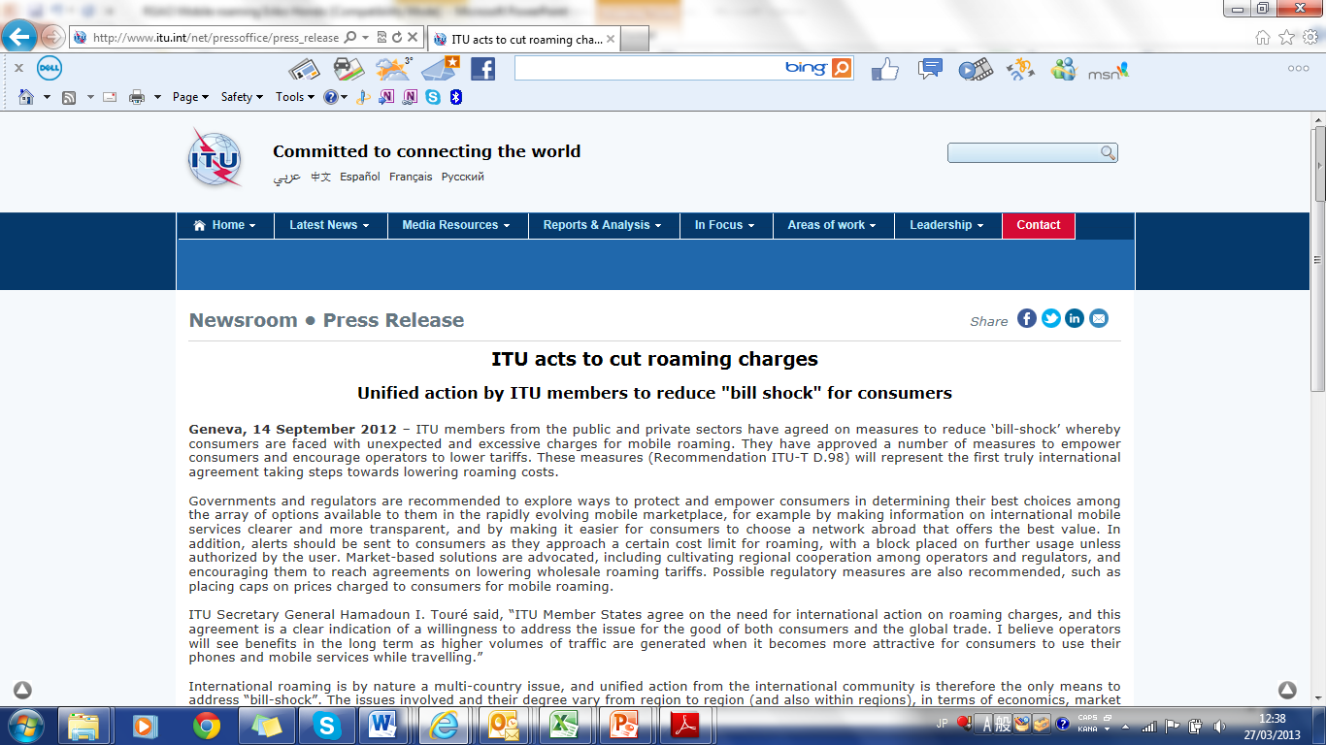
ITU-T Recommendation D.98 ITU Press Release
Source: http://www.itu.int/net/pressoffice/press_releases/2012/57.aspx

Slide 11
After approval of ITU-T D.98, work is ongoing!
The May 2013 SG3 meeting agreed to continue the work of the mobile rapporteur group for the new study period (2013-2016)
Rapporteur: Ms. Eriko Hondo (KDDI, Japan)
Associate Rapporteur: Mr. Shin-won Kang (ETRI, Korea)
Objective: to encourage Member States and Sector Members to provide examples/actual situations of how the principles of Recommendation D98 are used to empower consumer rights, promote market solutions, and consider proportionate regulatory intervention where appropriate

Slide 12
Current ITU-T SG3 Roaming Rapporteur Group: Terms of Reference
Encourage Member States to observe Recommendation ITU-T D.98
Seek feedback from Member States on ITU-T D.98
Collect/Analyze practical cases from Members of examples supporting the principles of Recommendation D.98
Evaluate whether consumer education and protection measures are sufficiently implemented for both voice and data services. Identify the range of effective protection mechanisms.
Determine which existing market solutions are most effective and how these may apply in other markets according to the relevant market environment
Evaluate the various options for regulatory intervention, taking into account context, background and rationale
Identify information to be included in any potential new guidelines to Recommendation ITU-T D.98 from the analysis above

Slide 13
World Conference on International Telecommunications (WCIT-12)
ITU convened the World Conference on International Telecommunications (WCIT) in Dubai, United Arab Emirates, from 3-14 December 2012.
This landmark conference reviewed the International Telecommunication Regulations (ITRs), which serve as the binding global treaty designed to facilitate international interconnection and interoperability of information and communication services, as well as ensuring their efficiency and widespread public usefulness and availability.
The ITRs contains a number of important new provisions on Roaming, specifically in article 4

Slide 14
Results of WCIT related to mobile roaming
Article 4 of the ITRs
International Telecommunication services
4.4 Member States shall foster measures to ensure that authorized operating agencies provide free-of-charge, transparent, up-to-date and accurate information to end users on international telecommunication services, including international roaming prices and the associated relevant conditions, in a timely manner.
4.5 Member States shall foster measures to ensure that telecommunication services in international roaming of satisfactory quality are provided to visiting users.
4.6 Member States should foster cooperation among authorized operating agencies in order to avoid and mitigate inadvertent roaming charges in border zones.
4.7 Member States shall endeavour to promote competition in the provision of international roaming services and are encouraged to develop policies that foster competitive roaming prices for the benefit of end users.

Slide 15
Article 4 of the ITRs in concrete terms
13
More specifically, the new ITR provisions on International Mobile Roaming could help ensure:
transparency of end-user prices
satisfactory quality
greater cooperation and competition to avoid customer “bill shock”
avoid and mitigate inadvertent roaming charges in border zones
free and quick access for roaming users to the local number(s) for emergency services

Slide 16
Related Information and Events
Information on ITU-T Study Group 3 activities and recommendations is available at : www.itu.int/en/ITU-T/studygroups/2013-2016/03/Pages/default.aspx
The next SG3 meeting will be held in Geneva in 26-30 May 2014
SG3 Regional meetings will be held during 2013-2014 in the four regions: Africa (AFR), Arab States (ARB), Asia-Oceania (AO) and Latin American and Caribbean regions (LAC)

