Slide 1
ICT Standardization Framework in Lao
ITU Regional Workshop on Bridging the Standardization Gap
(Yangon, Myanmar, 28-29 November 2013)
Monesili DOUANGMANY,
Engineer, Ministry of Posts and Telecommunications
Email: monesilietl@gmail.com

Slide 2
Contents
Country profile
Current information on service availability
Ministry of Posts and Telecommunications structure.
The ICT Standardization Policy and Framework in Laos.
Demand for developing ICT standardization in Laos
Conclusion

Slide 3
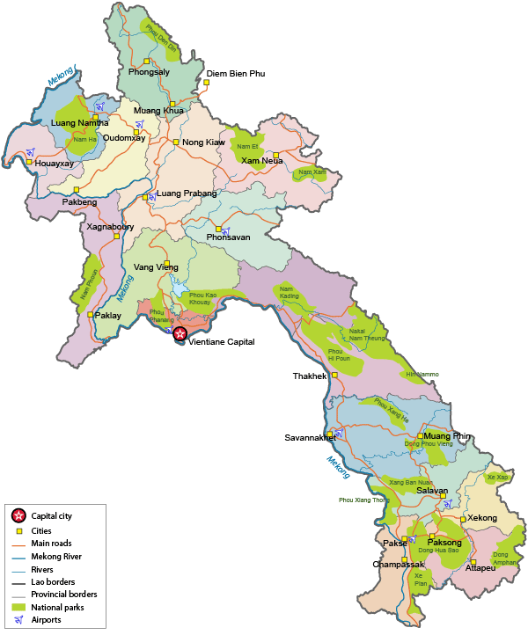
Country Profile
5.6 millions (2005), 80 percent live in rural area
Area 236.800 Km²
Capital city: Vientiane
Province: 17
GDP: USD 800 (2010)
Tele-density: 65 per 100 inhabitant (2010)
Export: Electricity, timber, mining
Economic growth rate: 7.9%
Currency: Lao Kip (LAK)

Slide 4
Current information on service availability
Telecom Operators/ISPs | Technology/Services
Enterprise Telecommunication Lao (ETL) | PSTN (Fixed line), GSM900/1800, GPRS, 3G W-CDMA and ISP Dial up, ADSL, VPN…
Lao Telecommunication Company (LTC) | PSTN (Fixed line), GSM900/1800, GPRS, 3G W-CDMA and ISP Dial up, ADSL, VPN… Testing 4G LTE
Unitel | PSTN (Fixed line), GSM900/1800, GPRS, 3G W-CDMA and ISP Dial up, ADSL, VPN…
Vimpelcom Lao Co. Ltd (Beeline) | GSM900/1800, GPRS, 3G W-CDMA and ISP Testing 4G LTE

Slide 5
MPT Organization Structure
Minister
President of MPT
Deputy President MPT
Deputy President MPT
General Office
(Admins Dept )
Another 3
line-Departments
Department of Telecommunications
(Director General)
PT Department
at Provincial levels
Telecom Division
Regulatory Division
Radio Frequency Management Division
Radio Monitoring Division
Assignment &
Licensing
Regislation
Standardization
Consumer Protection

Slide 6
The ICT Standardization Policy and Framework in Laos
Establishment ICT Standardization Policy and Framework in Laos base on Standardization policy of ASEAN, APT and ITU.
Administration of importation of Telecommunication equipment.
Project of study feasibility to establish Standard Verification and Certification Center.
Cooperation with International organization to develop human resource and technology which be used in standard verification and measurement.
Cooperate with internal institution, collage and University to research on standardization.
Tariff on Radio Frequency charging rate based on Agreement number 848 of June 16, 1995 of Ministry of Communication Transport Post and Construction.

Slide 7
ICT standardization work is being carried out in Laos
Project of study feasibility to establish Standard Verification and Certification Center.
In the beginning we study standardization framework of Vietnam, Thailand and Korea including Policies, Strategies, Organization structure…

Slide 8
Number of licenses of importation telecommunication equipments of 3 Operators in Laos

Slide 9
Demand for developing ICT Standardization in Lao PDR.
Human resource.
Improving technical knowledge.
Fund to establish Standard Verification and Certification Center.
Fund to purchase Standard Verification and measurement equipment.

Slide 10
Conclusion
In Lao PDR, telecommunications equipment have been expanded rapidly followed the increased import without checking or control the quality and confirmation assessment.
The National Strategy focus on development of effective regulations, staff training and international cooperation with neighboring countries and the region.

Slide 11
THANK YOU FOR YOUR KIND ATTENTION

