Slide 1
Peer review in the context of integrated sustainable urban development strategies
Dr Ruslan Rakhmatullin
and Martina Pertoldi
Smart Specialisation Platform
DG JRC, European Commission
Rome, 18 May 2016

Slide 2
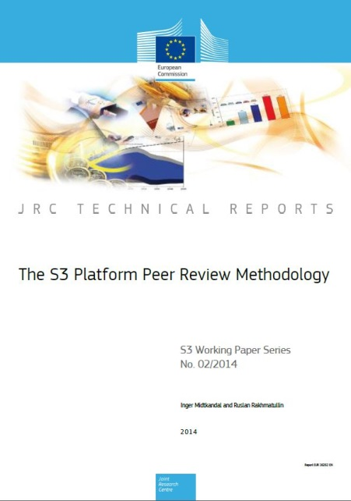
The S3 Peer Review approach to mutual learning applied to Integrated Urban Strategies
From Research & Innovation to Urban Development (From regional level to city level)
This peer review methodology was originally developed by the team at the S3 Platform (Joint Research Centre, European Commission) in the context of regional Research & Innovation Strategies for Smart Specialisation
Developing further an innovative way for the European Commission to engage with cities
proven to be an effective tool in sharing, exchanging and integrating knowledge
Notes:
More than 20 Peer reviews
More than 70 regions/MSs reviewed

Slide 3
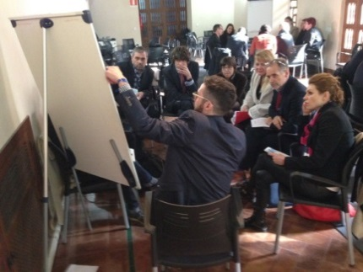
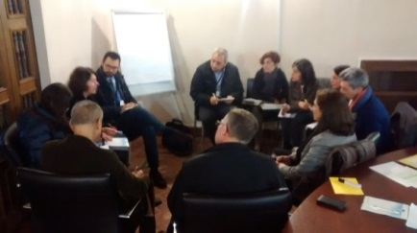
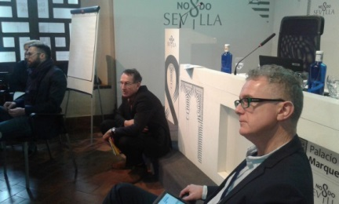
Peer Reviews are about mutual learning
Friendly (yet critical) discussions that allow to:
Learn from each other and together
Integrate knowledge from a variety of sources
as peers, invited experts, EC services
Exchange of roles
Opportunities for networking
Profit from concentration in space and time
'Learn by doing'
Discover good practices and failed policies!
Notes:
Facilitate mutual learning:
Participants switch roles (cities/regions get to be peer reviewed as well as to provide feedback to other cities/regions)
Identify shared objectives – possibilities for collaboration
Improved basis for learning, exploring, development and implementation
Integrating knowledge from a variety of sources: peers, invited experts, European Commission services
Stimulate the emergence of critical friendships:
Learning together and from each other
Overcome challenges together
Build shared cognitive frameworks – common understanding

Slide 4
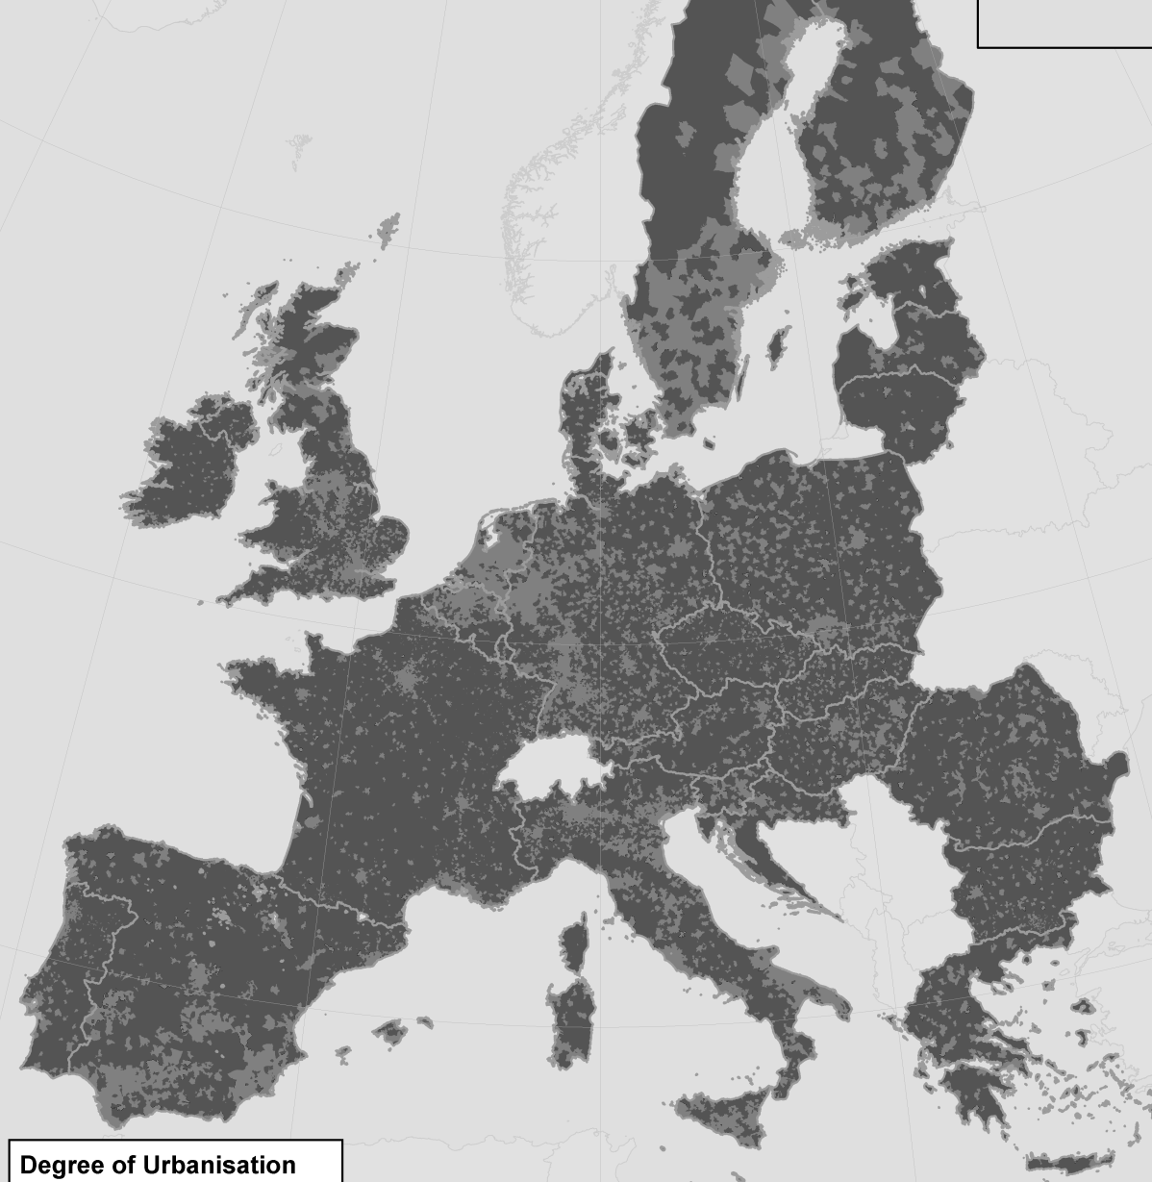
Pilot peer review
Pilot peer review workshop
Organisers: European Commission (DG REGIO and DG JRC) and
the city of Seville
27 cities
from 16 Member States
Seville
Brno
Reggio Emilia
Rotterdam
Alba Iulia
Blagoevgrad
Bristol
Celje
Clermont-Ferrand
Gjión
Maribor
Milano
Narva
Oporto
Peiraiós
Poznan
Rijeka
Roma
Tallinn
Tampere
Terrassa
Udine
Velika Gorica
Venice
Warszawa
Wien
Zagreb
Seville, 28-29 January 2016

Slide 5
Peer-Review Actors
Representatives from the cities under review
Before the workshop: undergo intensive preparatory work.
During the workshop: present for review their strategies.
After the workshop: reflect on their Lessons learned and Next steps.
Critical friends
During the workshop: have the role of a critical friend providing critical (yet friendly) advice and sharing their knowledge and experience. The city being reviewed in one session acts as a critical friend in other sessions.
After the workshop: can provide additional comments.
Invited experts
During the workshop: offer their expert advice and inspire peers.
After the workshop: draft the Feedback report for cities under review.
DG REGIO - UDN team
manages and facilitates the entire peer review process
JRC team
supports the UDN team
in applying the peer review methodology.
EC Team
Notes:
Specific set of actors.
Peers are encouraged to share their own experiences related to each discussed issue and to listen attentively to other participants. This approach allows all participants to understand the peer review process and to create collectively an environment that facilitates mutual learning.

Slide 6
Peer discussions are at the core of peer review
Presentation of the integrated urban strategy from the city
3 questions prepared by the city
3 rounds of discussions in smaller groups
Discussion – Round 1
What is the question behind the question?
Discussion – Round 2
How the underlying issue(s) can be addressed?
Discussion – Round 3
What are the relevant lessons to take home?
Sharing results - Reporting back from groups
Notes:
Presentation: please be short and focus on the main blocks of your presentation
Discussion: build on your own experience and knowledge
Sharing the results – experts as rapporteurs
Remind to say that cities under review will then be asked to structure their Lessons learned and Follow up for the following plenary session

Slide 7
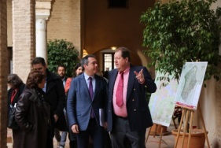
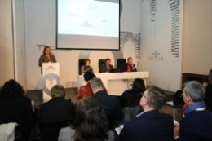
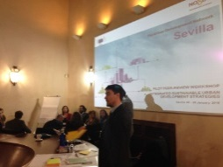
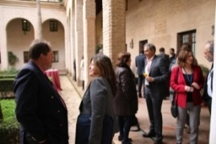
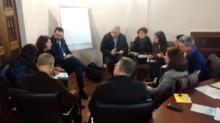
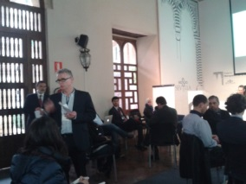
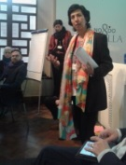
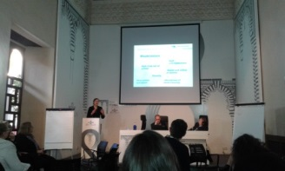
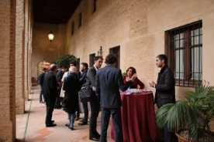
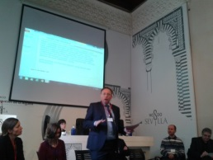
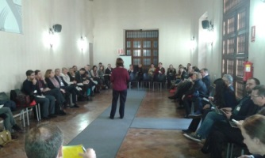
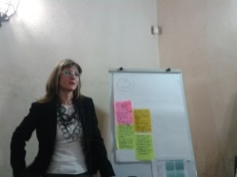
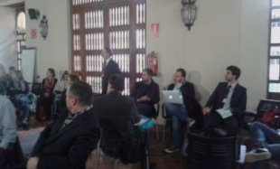
Day 1
'It is very helpful to come with strong examples from other cities'
'It has been really interesting to get confirmation that other cities are facing the same challenges…we got precious hints and practical suggestions and can go back home being sure we are following the right path'
'One of the best discussion on selection criteria since years'
Day 2

Slide 8
Stay in touch
S3 Platform webpage: http://s3platform.jrc.ec.europa.eu
Email: Ruslan.Rakhmatullin@ec.europa.eu

