Slide 1
Towards a 5G Operating Platform: a use case on infrastructure-agnostic orchestration
GRUPPO TELECOM ITALIA
FG IMT-2020 Workshop and Demo Day: Technology Enablers for 5G
Geneva, 7 December 2016
Antonio Manzalini (TIM), Gabriele Castellano and Fulvio Risso (POLITO)

Slide 2
Motivations
Main Drivers of Network Softwarization (…towards 5G) :
pervasive diffusion of ultra-broadband (fixed and mobile);
increase of performance of H/W at lowering costs;
growing availability of Open Source S/W;
availability of “actionable” Big Data;
advances on Artificial Intelligence;
more and more powerful terminals and smart things.
Network Softwarization is paving the way towards X-as-a-Service :
SDN Controllers, Virtual Network Functions (e.g., middle-boxes) up to and end-Users’ applications can all be considered “services”;
This will increase flexibility, programmability but also complexity !

Slide 3
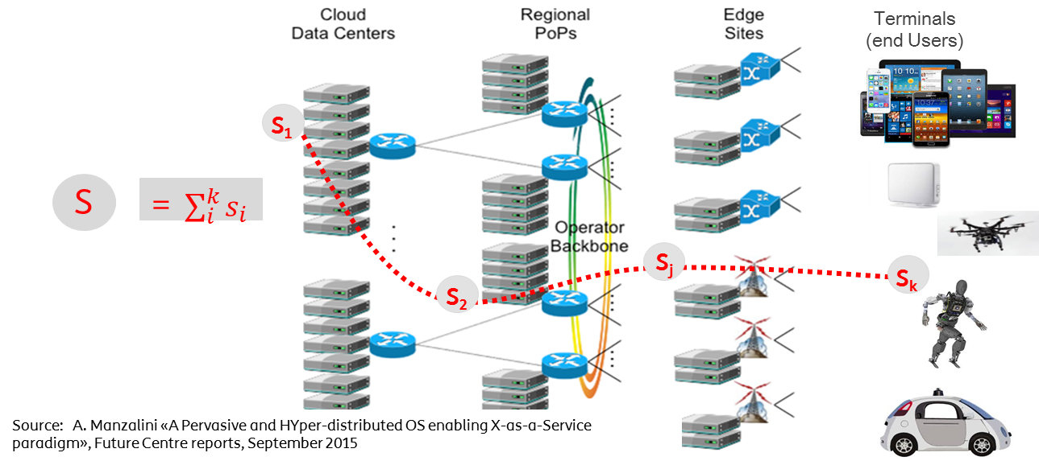
Provisioning “X-as-a-Service” in a Telecom infrastructure
Services can be seen as “chains” of service components (e.g., software tasks) executed/run onto pools of logical resources (e.g., VMs, Containers) interconnected via logical links (e.g., VPN);
concept of “network slice” emerges;
A flexible end-to-end provisioning implies a new complexity: dynamic allocations, move and orchestration of several virtual components.

Slide 4
An Operating Platform as a “generalized orchestration space”
Today there is a high level of fragmentation, in international fora, bodies, projects and initiatives developing systems, platforms for management/control/orchestration for Network Softwarization (even more looking at 5G infrastructures).
Moreover, it is not predictable today which of said platform(s) will be widely accepted and deployed, and how they will evolve.
There a need of an “overarching” Operating Platform as a “generalized orchestration space” decoupling from currently available (and future) control and orchestrations platform (e.g., ONOS, ODL, OpenStack, MANO etc)
… but at the same time “hooking” all of them (for end-to-end services) by using a standard set of abstractions.

Slide 5
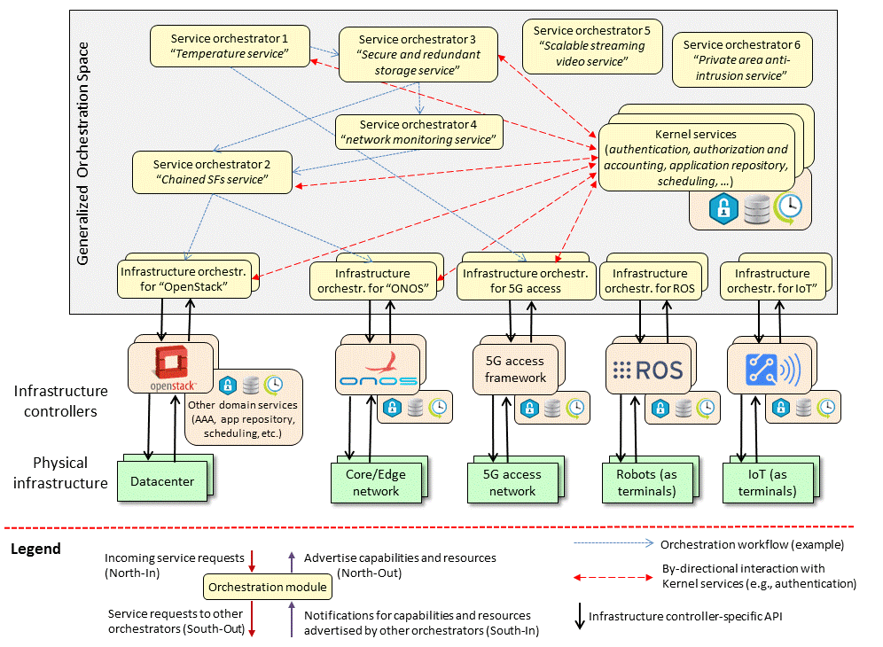
Operating Platform: model and feasibility demonstration

Slide 6
The FROGv4 orchestrator @ Politecnico di Torino
Per-user services with mobility support
NFV configurations orchestrator
NFV orchestrator
Robot orchestrator
IoT orchestrator
Message bus: transports pub/sub information using YANG data models
SDN Domain Orchestrator
OpenStack Domain Orchestrator
Universal Node Domain Orchestrator
Robot Operating System Domain Orchestrator
IoT Domain Orchestrator
Telco SDN network
Telco cloud datacenter
Resource-constrained CPE
IoT domain
Robot
Internet
https://github.com/netgroup-polito/frog4

Slide 7
Everything as a Service, Everything is an Object
Per-user services with mobility support
NFV configurations orchestrator
NFV orchestrator
Infrastructure configurations orchestrator
Personal video surveillance service
Message bus: transports pub/sub information using YANG data models
SDN Domain Orchestrator
OpenStack Domain Orchestrator
Universal Node Domain Orchestrator
Telco SDN network
Telco cloud datacenter
Resource-constrained CPE
SDN Domain Data Model
object sw-bundles {
capability BridgedLAN;
capability TrafficSteering;
capability GenericBundle;
}
object BridgedLAN {
leaf NetworkAddr {type ip4addr; }
leaf DefGwAddr {type ip4addr; }
leaf DHCP {type boolean; }
...
}
Firewall Data Model
list policyEntry {
leaf policy-id { type uint16; }
leaf action {
type enumeration {
enum drop;
enum allow;
}
}
leaf interface {
type leafref {
path "/fw/ifName";
}
}
leaf saddress { type ip4addr; }
leaf daddress { type ip4addr; }
leaf sport { type portnumber; }
leaf dport { type portnumber; }
}
VM Firewall
Webcam Data Model
object webcam {
leaf dpiresolution { type uint16; }
leaf location { type string; }
leaf outdoor { type boolean; }
}
Residential Gateway Data Model
list ethernet {
leaf name { type string; }
leaf address { type ip4addr; }
leaf netmask { type ip4mask; }
}
list wifi {
leaf SSID { type string; }
leaf address { type ip4addr; }
leaf netmask { type ip4mask; }
}

Slide 8
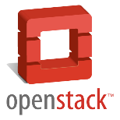
Our demo: Step 1 – Scenario
FROG NFV global orchestrator
Message bus – Pub/sub domain information
Domain Capabilities
Domain
Capabilities
SDN Domain Orchestrator
DC Domain Orchestrator
NAT
VPN
Firewall

Slide 9
Our demo: Step 1 – Deployment
NAT
Global Orchestrator
GRE 0x01
GRE 0x02
GRE 0x01
NAT
GRE 0x02
Domain Orchestrator
Domain Orchestrator
Domain 2:
Telco Cloud
Domain 1:
Telco Network
NAT Graph
NAT

Slide 10
Our demo: Step 2 – Scenario
FROG NFV global orchestrator
Message bus – Pub/sub domain information
Domain Capabilities
Domain
Capabilities
SDN Domain Orchestrator
DC Domain Orchestrator
NAT
NAT
VPN
Firewall

Slide 11
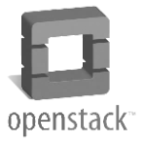
Our demo: Step 2 – Deployment
NAT
Global Orchestrator
NAT
Domain Orchestrator
Domain Orchestrator
Domain 2:
Telco Cloud
NAT
Domain 1:
Telco Network
Domain not
involved in the service

Slide 12
Conclusions
High level of fragmentation, in international fora, bodies, projects and initiatives developing systems, platforms for management/control/orchestration of Network Softwarization.
There the need of an overarching Operating Platform as a “generalized orchestration space” decoupling from currently available (and future) control and orchestrations platform…
… but at the same time “hooking” all of them (for end-to-end services) by using a standard set of abstractions.
Need for flexible and extensible data model and access patterns for generic objects, such as “infrastructure nodes”, “sensors”, “vnf”, and even “services”.
Each object can potentially consume services provided by other objects, while at the same time export services to be used by other objects.
Scalability, security, and accounting will represent major challenges in a fully automated, agile, multi-domain, end-to-end service world.

Slide 13
Questions?

