Slide 1
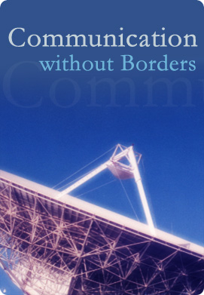
Interference Geolocation Techniques
Introduction and Basic Requirements
  ITU Workshop Limassol, Cyprus
  14-16 April 2014
  G. Baraglia

Slide 2
Presentation Agenda
Detection
Single Satellite Geolocation
Two Satellites Geolocation
Types of Interferences
Basic Requirements
Notes:
Q: What is geolocation?
A: Geolocation is the process of determining the ground position associated with a satellite transmission of interest.
Generally used to mitigate against the effects of accidental interference
Increasingly used to locate hostile attempts to deny the satellite service
Significant uptake from intelligence agencies
Very Long Baseline Interferometry
Developed in the 1960s by astronomers in the US to produce high resolution astronomical images at radio frequencies
Satellite Communications use of Line-of-Site Frequency Bands
In the 1970s/80s UHF (300 MHz) satcom is allocated secondary user to ground based systems
The proliferation of which leads to increased interference of UHF satcoms
A SOLUTION WAS REQUIRED
Illegal transmissions on Commercial Satcom
Captain Midnight – HBO pirate
Jamming of political/religious broadcasts
General Tool for Satellite Communications
Global use of 2 satellite geolocation systems combining the need for interference geolocation and interferometry technology

Slide 3
Radio Space Services Interference Trends
Courtesy: Global VSAT Forum (gvf.org)
Hardware costs
With VSAT terminal costs dropping well below $1000 profit margins are tight.
Interference events
Deployments
Over 100,000 VSATs deployed per year.
Installer fees
Previously an engineer might spend days on site following SSOGs. Now installers are often junior technicians paid less than $50 per VSAT installation.
Satellite sensitivity
Spot beams make satellites more sensitive to uplinks signals. This helps reduce VSAT size and cost, but makes transponders more sensitive to interference.
1990
2010

Slide 4
Types of Interference (1/2)
Cross-Pol Interference – Accidental / very common
Generally caused by: incompatible modulation types transmitted in the opposite polarization field to digital services on the cross-pol; poorly aligned antennas in bursting networks; and/or lack of training/experience of the uplink operators.
Becoming more prevalent as installation margins are squeezed.
Mitigation: monitoring, detection and geolocation tools, carrierID, training.
Adjacent Satellite Interference – Accidental / common
Generally caused by: operator error, or poor inter-system coordination. Transmitting antenna is poorly pointed.
Caused by lack of installation expertise but becoming more prevalent as two degree spacing between satellites in the geostationary arc becomes more common.
Mitigation: monitoring, detection and geolocation tools, carrierID, coordination between satellite operators.
Adjacent Carrier Interference – Accidental / minimum occurrence
Generally caused by: operator error, or equipment failure (unlocked equipment).
Relatively infrequent
Mitigation: monitoring, detection and geolocation tools, carrierID.
!
X
Y
Adjacent satellite
signal
!
!

Slide 5

Types of Interference (2/2)
Unauthorised Access – Accidental & Deliberate
Term given to a signal which is not resident as cross-pol or adjacent satellite or carrier.
Accidental: very common
Generally caused by: equipment failure, human error, improper commissioning, and terrestrial interference.
Interference from proliferation of terrestrial (e.g. microwave) systems.
Mitigation: monitoring, detection and geolocation tools, carrierID, training. Unfortunately terrestrial systems often have priority and so becomes dead capacity.
Deliberate: relatively rare
Generally caused by: unauthorised “borrowing” of bandwidth for test purposes (e.g. at commissioning), piracy, and hostile attempts to deny service.
Becoming more prevalent though geopolitical motivation.
Mitigation: monitoring, detection and geolocation tools. While hostile jamming is generally easy to locate, it is almost impossible to remove without political intervention, which can prove difficult.
!

Slide 6
Ways to Detect Interference
Passive
Wait for end customer complaints or local authority report
Compare spectrum plot of the transponder with the nominal frequency plan
Check for unauthorized carriers, spurious
Active
Continually scan signals and transponders of interest, generate alarms for out-of-tolerance conditions
Analog Spectrum Analyzer
Digital Spectrum Analyzer
Pro-active; problem can be cleared before it is noticed by the customer

Slide 7
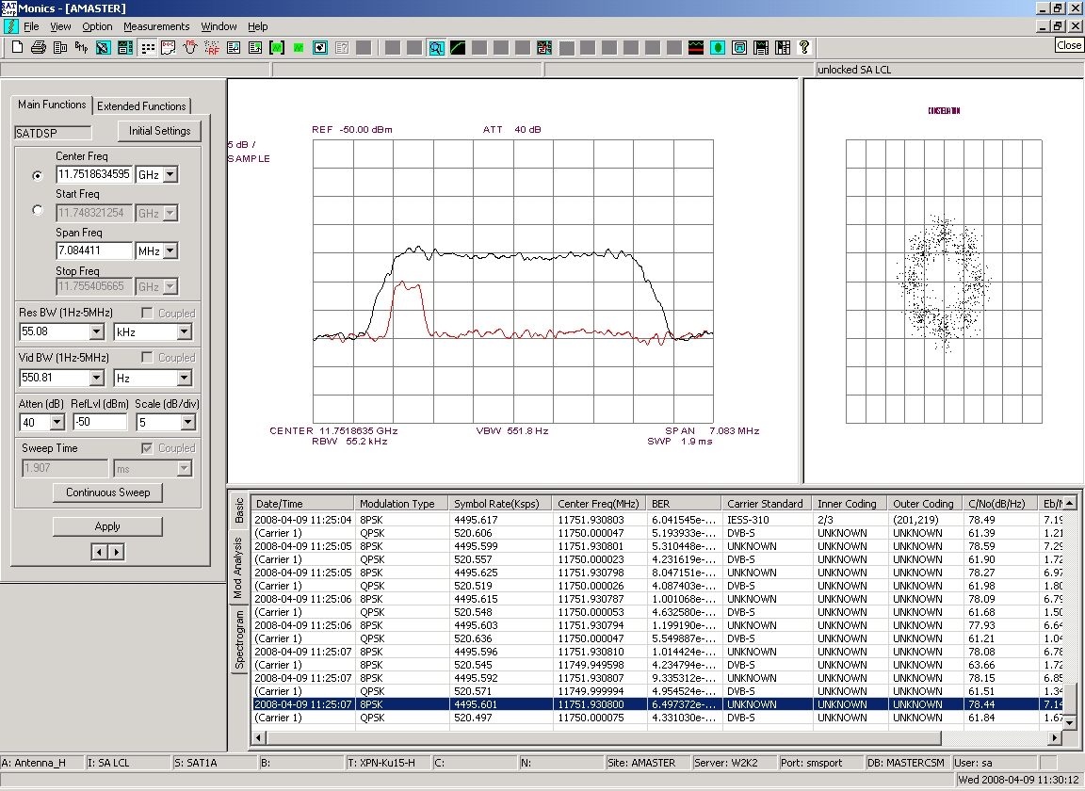
Detection Tools
Analogue
Legacy Spectrum Analyser
Digital
DSP based Spectrum Analyser
A DSP based monitoring system allows for advanced signal analysis and demodulation.
It also allow to perform carrier under carrier investigation.

Slide 8
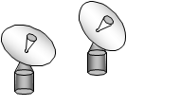
Two Satellites Geolocation (1/9)
A Transmitting Station sends a signal to a satellite.
This signal is received by the Receiving Station.
satID Receiving
Station
Interference
Source

Slide 9
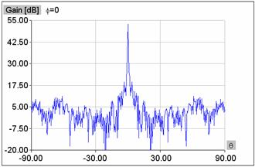
Two Satellites Geolocation (2/9)
Transmitting Station antenna characteristics usually result in a lower power copy of signal being received by a nearby satellite.
Primary
Satellite
Secondary
Satellite
Solid lines: Majority of signal energy
Dashed lines: Some signal energy
satID Receiving
Station
Interference
Source

Slide 10
Two Satellites Geolocation (3/9)
When another antenna is aimed at the nearby Secondary Satellite, this low power copy of the signal can be received.
Primary
Satellite
Secondary
Satellite
satID Receiving
Station
Interference
Source

Slide 11
Two Satellites Geolocation (4/9)
The signal path lengths are different through the two satellites, so the Receiving Station sees different delay on the signals received from each.
Primary
Satellite
Secondary
Satellite
satID Receiving
Station
Interference
Source

Slide 12
Two Satellites Geolocation (5/9)
The resulting Differential Time Offset (DTO) results in partial location information.
Primary
Satellite
Secondary
Satellite
satID Receiving
Station
Interference
Source

Slide 13
Two Satellites Geolocation (6/9)
The two satellites are moving with respect to the ground and each other, so the Receiving Station sees different Doppler shift on the signals received from each.
Primary
Satellite
Secondary
Satellite
satID Receiving
Station
Interference
Source

Slide 14
Two Satellites Geolocation (7/9)
The resulting Differential Frequency Offset (DFO) results in additional location information.
Primary
Satellite
Secondary
Satellite
satID Receiving
Station
Interference
Source

Slide 15
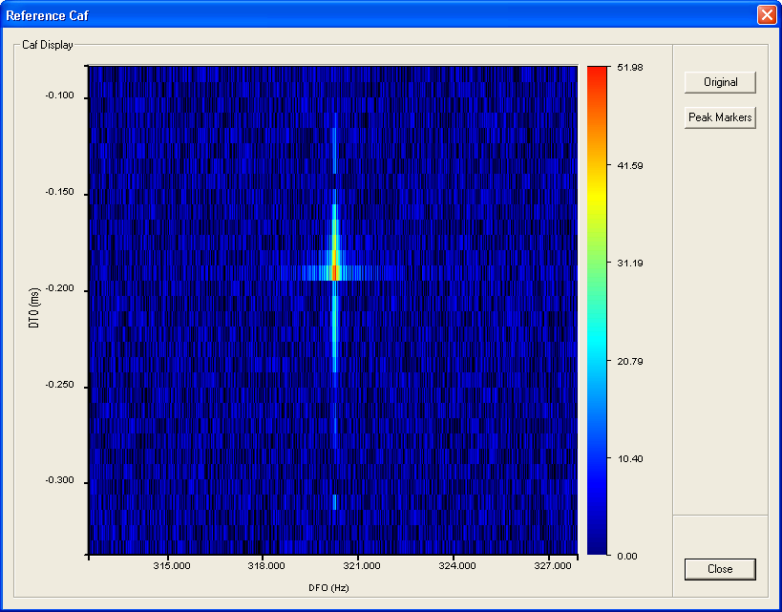
Two Satellites Geolocation (8/9)
Many factors contribute some uncertainty to the results, though patented satID algorithms minimize this uncertainty.
Primary
Satellite
Secondary
Satellite
satID Receiving
Station
Interference
Source

Slide 16
Two Satellites Geolocation (9/9)
A reference signal from a known location improves geolocation certainty by removing common cancellable biases.
Primary
Satellite
Secondary
Satellite
satID Receiving
Station
Interference
Source
Reference signal from satID Transmit Unit, or any other known signal from a known location.

Slide 17
Single Satellite Geolocation (1/2)
  LEO or MEO:
LEOsat
Doppler shift
Time
Intercept site
Target
Shape of curve is position dependant
Notes:
Single Satellite Geolocation Pros…
Not a differential measurement therefore no secondary satellite required
Reduced ground-based infrastructure requirements
Has been exploited by Search and Rescue (SAR) for over 30 years
Only since 1990’s have most distress beacons been transmitting GPS coordinates
Prior to this Doppler Processing was required of signals from Emergency Position-Indicating Radio Beacons (EPIRBs) or Emergency Locator Transmitters (ELTs)
Exploited Low Earth Orbit satellites (LEOs) only.

Slide 18
Single Satellite Geolocation (2/2)
  GSO:
Difficult problem to solve…
  Will never be as accurate as two-satellite correction
… but …
  Has applications where secondary satellites are hard to find (e.g. Ka-band)
  Better than nothing!
  Currently offered as a service
GEOsat
Doppler shift
Time
Intercept site
Target

Slide 19
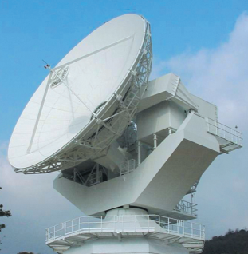
Basic Requirements
Overlaps
Intercept Site
Satellites
Geographical Overlap
Frequency Overlap
Two Antenna per Frequency Band
Geographically Separated
Remotely Controlled
Size Function of Satellites Used
Rain Fade
Frequency Plans
Orbital Ephemeris
Orbital Separation
Ephemeris Error Compensation

Slide 20
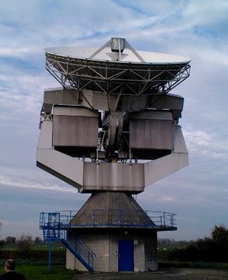
Geolocation Performances
Sensitivity
Accuracy
Speed
Signal (and Sample) bandwidth
System Setup (Antenna Pointing)
New or Existing Scenario
Sampling Bandwidth and Signal Periodicity
Available Processing Gain
Signal Modulation Type
Measurement Frequency Accuracy
Primary and Secondary Satellite relative positions
Satellites relative velocities
Ephemeris Accuracy
Reference signal position and accuracy
De-Correlation Time
Sampling System Performances
System Processing Gain (PG)

Slide 21
Ephemeris Error Compensation (1/2)
“Correct”
DTO
DFO
DTO
DFO
DTO
DFO
DTO
DFO
Calibrators

Slide 22
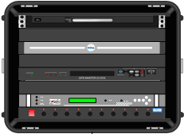
Ephemeris Error Compensation (2/2)
DTO
DFO
DTO
DFO
PN₄
PN₂
PN₁
DTO
DFO
PN₃
DTO
DFO
satID Tx units

Slide 23
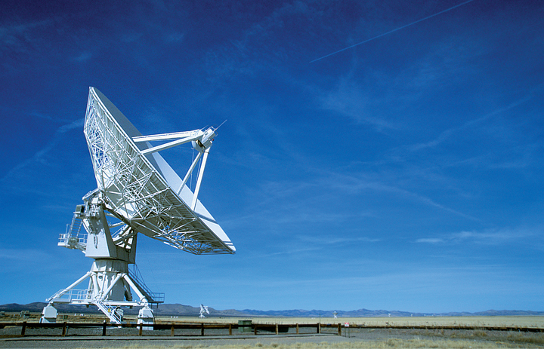

SAT Corporation (SAT) has prepared this document for use by its personnel, licensees, and potential licensees. SAT reserves the right to change any products described in this document as well as information included herein without prior notice.
The information contained herein is presented for educational purposes only and the right to copy and use this document is limited to that necessary to fulfill this function. The recipient agrees that they will not, nor will they cause others to, copy or reproduce this information, either in whole or in part, or manufacture, produce, sell or lease any product copied from or essentially based upon the information contained herein without prior written approval of SAT.
Registered trademarks of SAT Corporation include, but are not limited to, Monics, SAT-DSA, satID and SigMon.
Copyright© 2014 SAT Corporation. All rights reserved.
Contact
Guido Baraglia gbaraglia@sat.com

