Slide 1
BR Workshop on the efficient use of the spectrum/orbit resource
ESOA
Limassol, Cyprus, 14-16 April 2014

Slide 2
Increasing satellite spectrum demand AI 1.6.1 (Imbalance spectrum in Ku band)
Issue
The existing unplanned bands for the FSS in the Ku band range are extensively used for a large variety of satellite applications (e.g. Distribution of TV programs, Direct To Home (DTH), Contribution and Occasional Use, Governmental use)
In addition to the increasing demand for services in Ku band, the geostationary arc over Region 1 is already heavily used by unplanned Ku FSS satellites which will soon create a shortage of Ku band spectrum
This lack of sufficient Ku band spectrum will be a challenge for any entity seeking to launch a new satellite system
Possible solution
WRC-15 will address this issue pursuant to its Agenda Item 1.6.1 : “to consider possible additional primary allocations to the fixed-satellite service (Earth-to-space and space-to-Earth) of 250 MHz in the range between 10 GHz and 17 GHz in Region 1 …”
We encourage countries and companies to participate in this effort by following and contributing to the ITU work

Slide 3
Increasing satellite spectrum demand AI 1.6.2 (Imbalance spectrum in Ku band)
Issue
The existing unplanned bands for the FSS in the Ku band range are extensively used for a large variety of satellite applications (e.g. Distribution of TV programs, Direct To Home (DTH), Contribution and Occasional Use, Governmental use)
There is currently an imbalance in Ku unplanned bands for the FSS in uplink and downlink in Regions 2 & 3
Region 2 uplink has 750 MHz and downlink has 1 GHz → 250 MHz imbalance
Region 3 uplink has 750 MHz and downlink has 1.05 GHz → 300 MHz imbalance
This asymmetric Ku band spectrum allocation leads to an inefficiency use of the spectrum
Possible solution
WRC-15 will address this issue pursuant to its Agenda Item 1.6.2 : “to consider possible additional primary allocations to the fixed-satellite service (Earth-to-space) of 250 MHz in Region 2 and 300 MHz in Region 3 within the range 13-17 GHz …”
We encourage countries and companies to participate in this effort by following and contributing to the ITU work

Slide 4
Increasing satellite spectrum demand AI 1.9.1 (Needs in X band)
Issue
Possible new allocations to the fixed-satellite service in the frequency bands 7 150-7 250 MHz (space-to-Earth) and 8 400-8 500 MHz (Earth-to-space), subject to appropriate sharing conditions
Possible solution
CEPT supports a new primary worldwide FSS allocation of 200 MHz in the above bands under certain conditions
This compromise solution has been agreed and is clearly outlined as the preliminary CEPT position in the draft CEPT Brief
We encourage countries and companies outside Europe to review the agreed CEPT position and participate in the effort of making this allocation happen by contributing to the ITU work

Slide 5
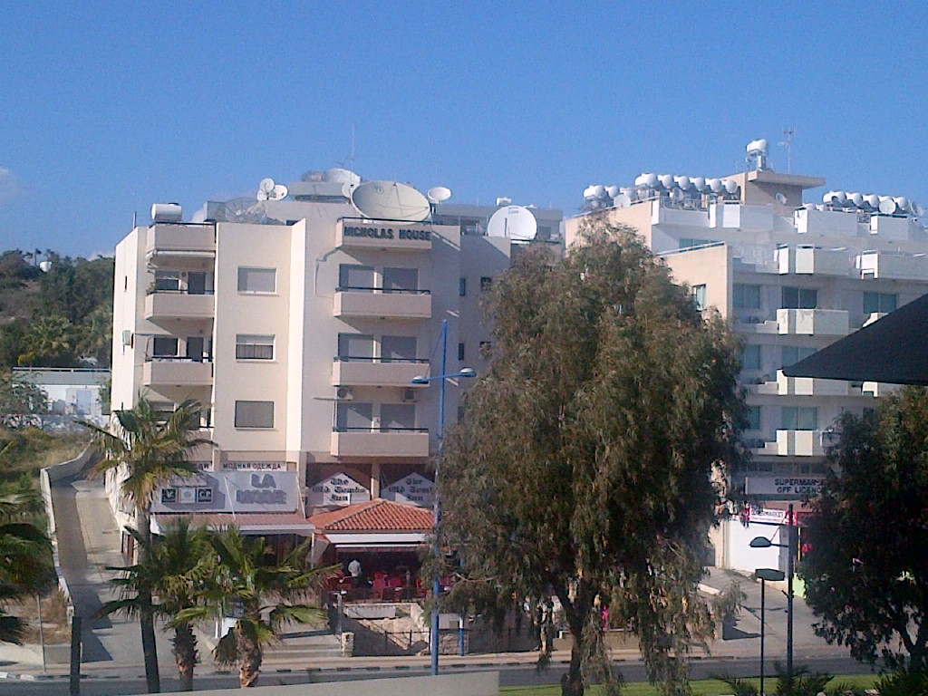

Slide 6
Proposal for Wireless Use of Satellite C Band
3400-3800 MHz – Even if the band might be used for BWA or MFCN in Europe, it is extensively used in other Regions and therefore the European frequency plan should not be exported to the rest of the world. No change to RR required.
3800-4200 MHz – Will need to be maintained for FSS worldwide. High density of Earth stations make sharing impractical. No Change to RR required.
5725-5925 MHz (possible RLAN band) – In the absence of RLAN parameters & deployment scenarios, sharing & compatibility studies still need to be conducted before concluding if a change to the RR is required.
5925-6425 MHz (possible IMT band) – Will need to be maintained for FSS in worldwide. High density of Earth stations and required separation distances around FSS Earth stations make sharing impractical. No Change to RR required.

Slide 7
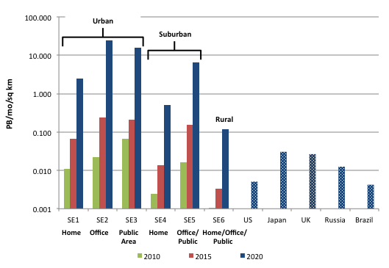
IMT Spectrum Demand: Review of ITU ‘speculator’ model - findings
Monthly data traffic PetaBytes per square km; the figures from the low density settings in the ITU model compared with benchmark values for urban area traffic in five example countries
Image illustrates the traffic that the model shows in each of the service environments, compared to generally accepted forecasts for urban areas in several different countries.
(Note: scale is logarithmic; values from the ITU model are taken from the low demand setting)
Given the unrealistic values the model uses, its outputs cannot be applied to any country

Slide 8
Spectrum Sharing
Examples of FSS sharing
Satellite services have had to share their spectrum with Fixed terrestrial wireless for years.
This used to be the case in C Band in Europe.
This is the case in some parts of Ka Band.
This only works under specific conditions; and such a sharing can constrain high density, ubiquitous deployment of satellite services.
What if Mobile terrestrial wireless deploys e.g. in C Band?
Latest findings: JTG already looked at the possibility of sharing with new LTE systems (incl. when using small cells).
Draft new Report ITU-R [C-BAND DOWNLINK] “Sharing studies between IMT-Advanced systems and geostationary satellite networks in the fixed-satellite service in the 3 400-4 200 MHz and 4 500-4 800 MHz frequency bands in the WRC study cycle leading to WRC-15”
11 different studies, only one summary and one single conclusion:
Deployment of IMT-Advanced would constrain future FSS earth stations from being deployed in the same area in the bands 3 400-4 200 MHz and 4 500-4 800 MHz as shown by the studies.

Slide 9
Spectrum Sharing?
The GSMA issued a report in Feb 2014 indicating that shared spectrum can complement but in no way replaces the need for exclusive-access spectrum in the provision of mobile broadband.
The report, “The Impacts of Licensed Shared Use of Spectrum”, developed by Deloitte, highlights how strict limitations associated with Licensed Shared Access (LSA) spectrum agreements – such as shorter terms, build obligations, lack of certainty and small allocations – can significantly reduce the likelihood of a mobile operator to invest.
This means that the potential economic benefits derived from spectrum sharing are ultimately lower than those achieved through exclusive-access spectrum.
http://www.gsma.com/newsroom/gsma-report-reveals-licensed-spectrum-for-mobile-offers-best-possible-economic-benefit/

Slide 10
Thank you
Cecil Ameil
cecil.ameil@ses.com

