Slide 1

RAG Informal Meeting on ITU-R Strategic and Operational Plans
Geneva, 21 May 2013
DRAFT FOUR-YEAR ROLLING OPERATIONAL PLAN
for the 2014-2017 timeframe
William IJEH
Head, Administration
Radiocommunication Bureau

Slide 2
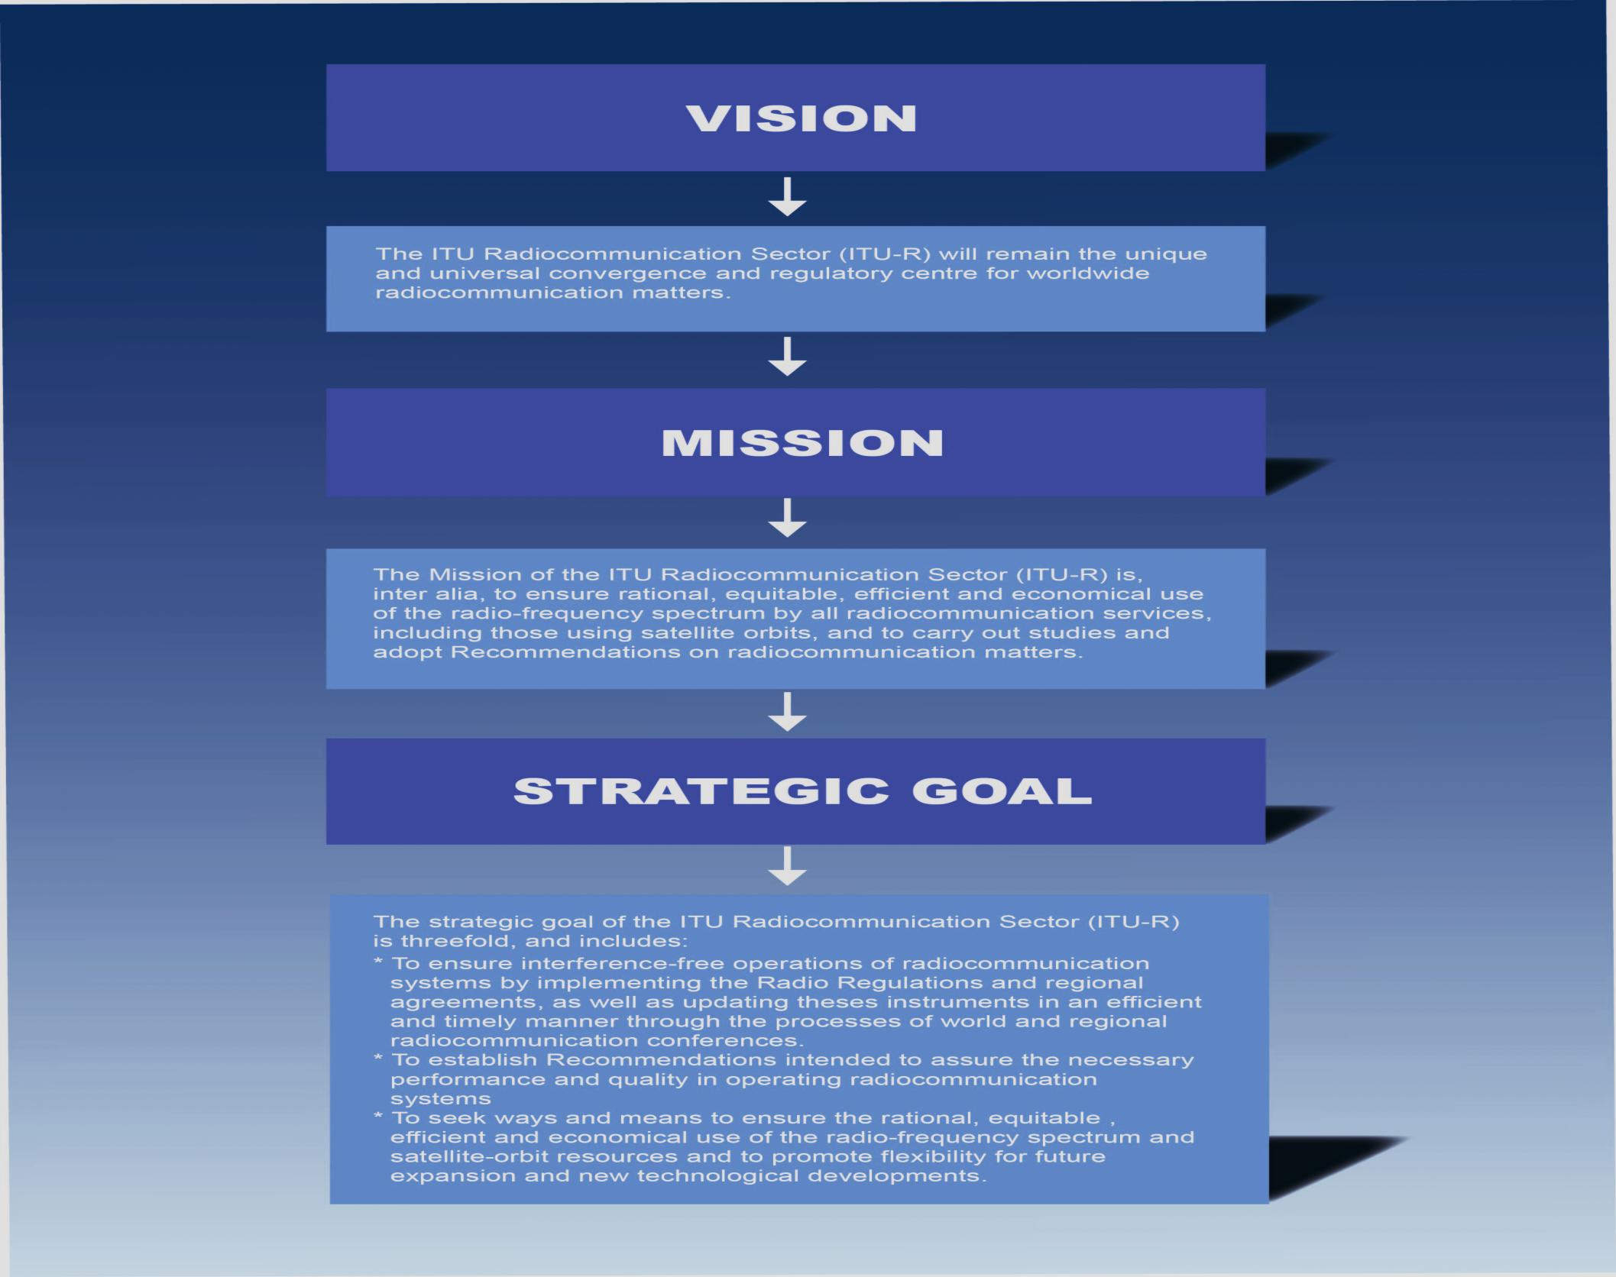

Slide 3
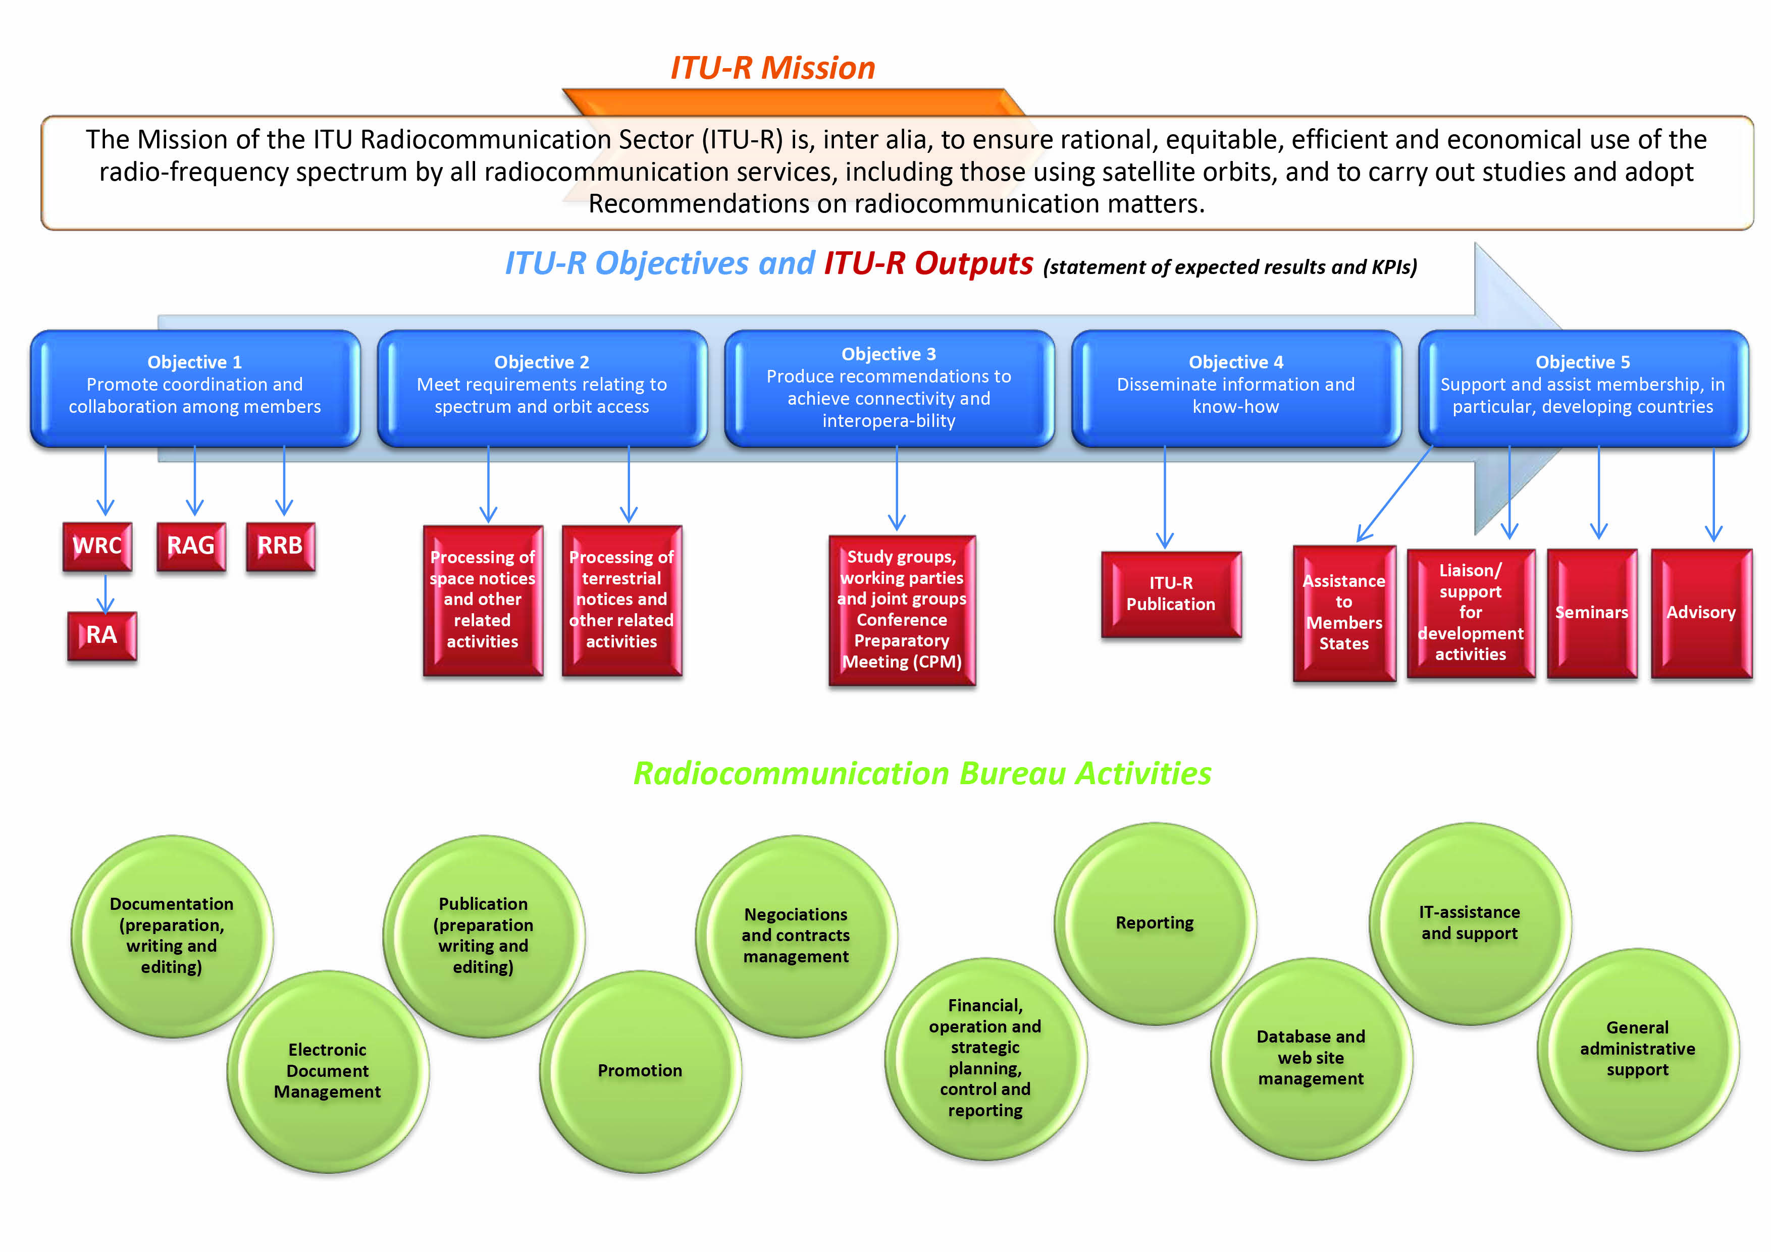
3

Slide 4
ITU-R Objectives
Objective 1: Coordination
Objective 2: Processing
Objective 3: Production
Objective 4: Information
Objective 5: Assistance
4

Slide 5
Objective 1: Coordination
“To promote, foster and ensure cooperation and coordination among all Member States in decision-making on radiocommunication issues, with participation of Sector Members and Associates, as appropriate” Resolution 71 (Rev. Guadalajara, 2010)
World Radiocommunication Conference (WRC)
Radiocommunication Assembly (RA)
Radiocommunication Advisory Group (RAG)
Radio Regulations Board (RRB)
5

Slide 6
Objective 2: Processing
“To meet the requirements of the membership for spectrum, orbit access and operations in application of the Constitution, Convention and Radio Regulations, in the light, inter alia, of the accelerating convergence of radiocommunication services” Resolution 71 (Rev. Guadalajara, 2010)
Processing of space notices and other related activities
Processing of terrestrial notices and other related activities
6

Slide 7
Objective 3: Production
“To produce Recommendations on radiocommunication services in order to achieve connectivity and interoperability in applying modern telecommunications/ICTs, as well as to provide for the most efficient use of spectrum and orbit resources” Resolution 71 (Rev. Guadalajara, 2010)
Study groups and working parties
Conference Preparatory Meeting (CPM)
7

Slide 8
Objective 4: Information
“To respond to the needs of the membership by disseminating information and know-how on radiocommunication issues, by publishing and distributing relevant materials (e.g. service publications, reports and handbooks), in coordination and collaboration, as appropriate, with the other Bureaux and the General Secretariat”. Resolution 71 (Rev. Guadalajara, 2010)
ITU-R Publications
8

Slide 9
Objective 5: Assistance
“To provide support and assistance to the membership, mainly to developing countries, in relation to radiocommunication matters, information and communication network infrastructure and applications, and in particular with respect to a) bridging the digital divide; b) gaining equitable access to the radio-frequency spectrum and to satellite orbits; and c) providing training and producing relevant training materials for capacity building” Resolution 71 (Rev. Guadalajara, 2010)
Assistance to members, in particular developing countries and LDCs
Liaison/support for development activities
Seminars
9

Slide 10
ITU-R Objectives x Outputs
Outputs | Objective 1 | Objective 2 | Objective 3 | Objective 4 | Objective 5
World Radiocommunication Conference | X
Regional radiocommunication conferences | X
Radiocommunication Assembly | X
Radiocommunication Advisory Group | X
Radio Regulations Board | X
Processing of space notices and other related activities |  | X
Processing of terrestrial notices and other related activities |  | X
Improvement (e.g. user-friendly) of Radiocommunication Bureau software |  | X
Study groups and working parties |  |  | X
ITU-R publications |  |  |  | X
Assistance to members, in particular developing countries and LDCs |  |  |  |  | X
Liaison/support for development activities |  |  |  |  | X
Seminars |  |  |  |  | X
10

Slide 11
2014 – 2017 Resources Allocations
11

