Slide 1
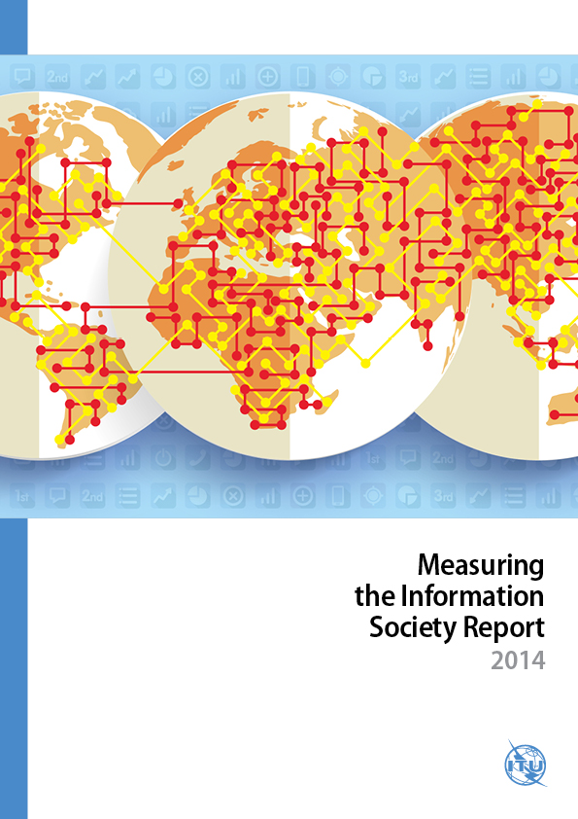
Measuring
the Information
Society Report
24 November 2014

Slide 2
MIS Report 2014 statistical highlights
Mobile broadband is driving ICT growth
Global mobile-broadband penetration increased from 9% to 32% in the last five years
Africa stands out with a mobile-broadband growth rate of over 40% in 2014
3G progressing in developing countries, and mobile-broadband penetration 21%
3G+ techs driving mobile-broadband penetration in developed countries: 84% in 2014
Internet access and use growing steadily
Almost 44 per cent of the world’s households have Internet access at home
Growth driven by developing countries in 2014: 14% as against 4% in developed countries
Internet users doubled in five years to reach 3 billion, 2/3 live in developing countries
Mobile-cellular and fixed-broadband uptake slowing down
Growth in mobile penetration slows to a ten-year low of 2.6%
Mobile markets have reached saturation with almost 7 billion subscriptions
Fixed-broadband growth rates have dropped to 6% in developing countries, despite penetration remaining low (6%) in the developing world
Fixed broadband has reached mature levels in developed countries: 27.5% penetration and continuous low growth (3.4%)

Slide 3
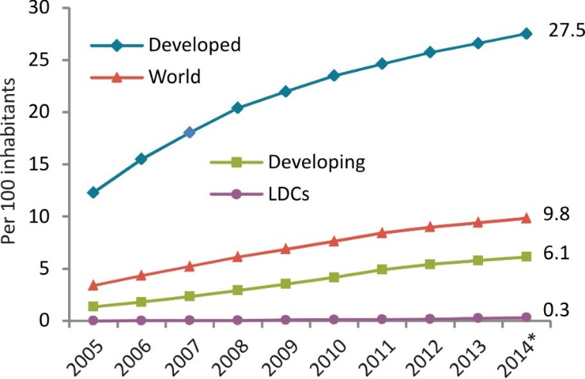
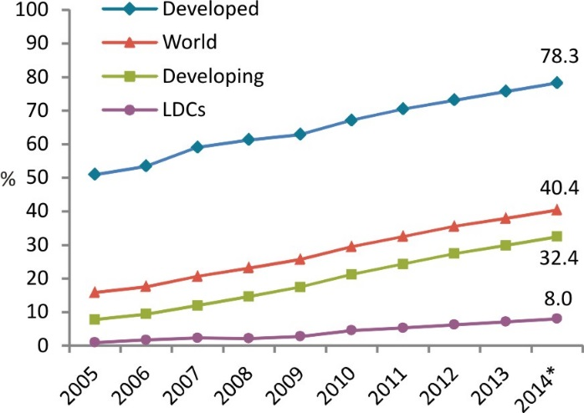
The digital divides
Fixed (wired)-broadband subscriptions, 2005-2014*
450 million people worldwide without access to mobile services
<1% fixed-broadband penetration in least developed countries (LDCs)
Rural-urban divide: lower 3G coverage, smaller proportion of households with Internet access and fewer enterprises and schools connected in rural areas.
4.3 billion people worldwide are not yet using the Internet, 90% live in the developing world
Individuals using the Internet, 2005-2014*
Source: ITU MIS Report 2014, * Estimate

Slide 4
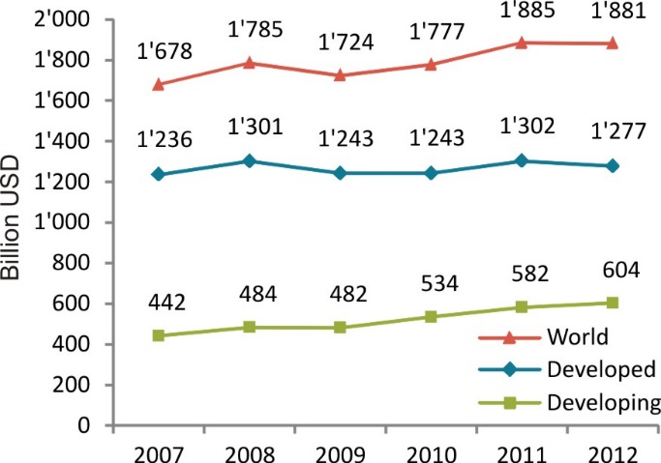
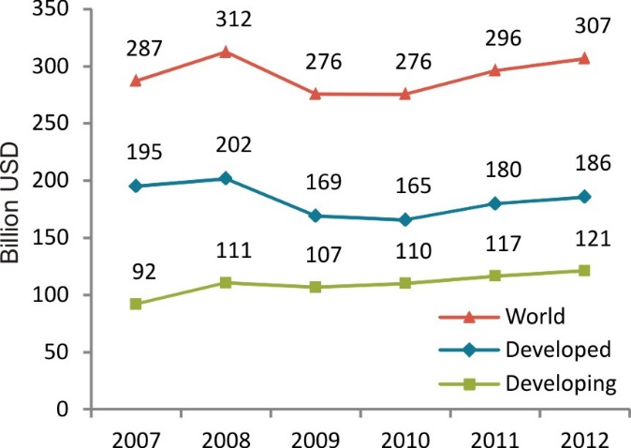
Investment and revenue trends
Total telecommunication revenues have stagnated at USD 1.88 trillion, 2.7% of world GDP
The sector returned to negative growth in developed countries, whereas revenues in developing countries increased by 4% in 2012
Global investment in telecommunications grew by 4% to reach USD 307 billion in 2012
The developing countries’ share in total investment reached almost 40% and an all-time high value of USD 121 billion
Telecommunication revenues, 2007-2012
Investment by telecommunication operators, 2007-2012
Source: ITU MIS Report 2014

Slide 5
The ICT Development Index (IDI)
11 indicators, covering 3 areas:
ICT access, use and skills
166 economies
Comparison of data from 2013 and 2012
Regional analysis
Assessment of the relationship between geography and population and IDI performance
Analysis of the link between IDI and the MDGs

Slide 6
Almost all countries improved in the IDI but Least Connected Countries lag behind
IDI 2013 top ten
Key findings
Denmark
Korea (Rep.)
Sweden
Iceland
United Kingdom
Norway
Netherlands
Finland
Hong Kong, China
Luxembourg
Top IDI performers have high income levels, competitive markets and a skilled population
Effective implementation of policies to achieve ambitious ICT targets help drive national information economies
Some 2.5 billion people living in the world’s least connected countries (LCCs) need targeted policies for improved access to ICTs

Slide 7
Wireless broadband drives IDI progress in dynamic countries, most of which are from the developing world
Most dynamic countries - changes between IDI 2013 and 2012
Note: * In the access sub-index, Mali, Mexico, Nepal, Nigeria, the Russian Federation and Uruguay also went up four places between 2012 and 2013. **In the use sub-index, Belarus and Oman also went up seven places.
Source: ITU MIS Report 2014

Slide 8
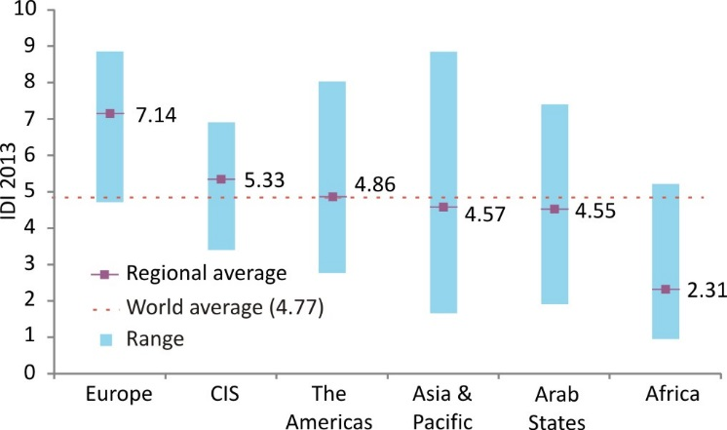
Regional IDI
IDI ranges and averages, by region and compared to world average, 2013
Source: ITU MIS Report 2014

Slide 9
Top five per region
The top five economies in each region and their ranking in the global IDI, 2013
Source: ITU MIS Report 2014

Slide 10
There is a strong relationship between the IDI and many MDG indicators
IDI
Goal 1: Eradicate extreme poverty and hunger
1.1 Proportion of population below $1 (PPP) per day
1.1 Population below national poverty line
1.2 Poverty gap ratio
1.6 Proportion of employed people living below 1$ per day
1.9 Proportion of population below minimum level of dietary energy consumption
Goal 4: Reduce child mortality
4.1 Under-five mortality
rate
4.2 Infant mortality rate
4.3 Proportion of 1 year-old children immunized against measles
Goal 6: Combat HIV/AIDS, malaria and other diseases
6.1 HIV prevalence among population aged 15-49 years old
6.9 Incidence, prevalence and death rates associated with tuberculosis
6.10 Proportion of tuberculosis cases detected and cured under directly observed treatment short course
Goal 7: Ensure environmental sustainability
7.2 CO2 emissions, metric tons of CO2 per capita
7.8 Proportion of population using an improved drinking water source
7.9 Proportion of population using improved sanitation facility
Goal 5: Improve maternal health
5.1 Maternal mortality ratio
5.2 Proportion of births attended by skilled health personnel
5.4 Adolescent birth rate
5.5 Antenatal care coverage (at least one visit and at least four visits)
Significant partial correlations between IDI and MDG indicators

Slide 11
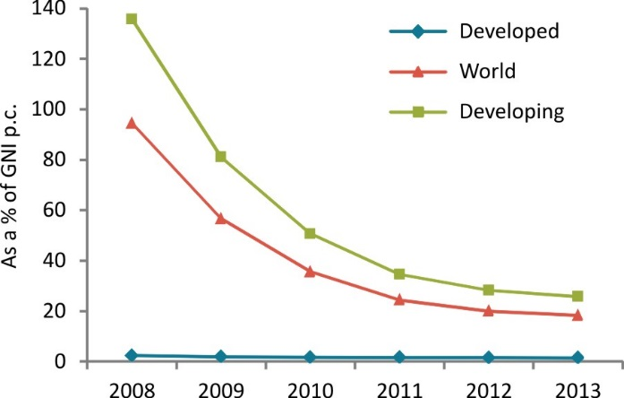
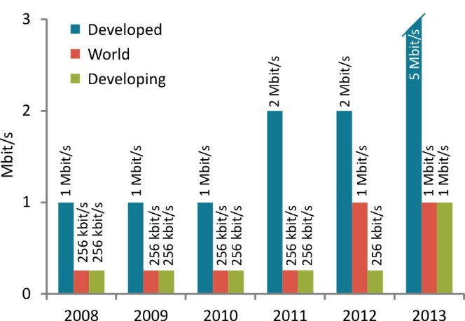
Fixed-broadband prices continue to decrease and entry-level speeds are increasing
From 2008 to 2012, entry-level fixed-broadband prices decreased by 20% per year on average in developing countries
In 2013, there was a slowdown: price in developing countries decreased by only 4%
1 Mbit/s was the most common entry-level speed in 2013, compared with 256 kbit/s in 2008
But:
The price of a basic plan corresponds to >5% GNI p.c. in most developing countries
Fixed-broadband prices as a % of GNI p.c.
Most common entry-level fixed-broadband speed
Source: ITU MIS Report 2014

Slide 12
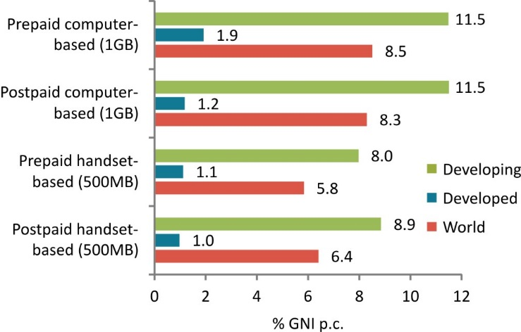
Mobile-broadband prices in developed countries six times more affordable than in developing countries
The number of developing countries offering mobile-broadband plans increased by 20% from 2012 to 2013
The price of mobile-broadband plans corresponds on average to >5% of GNI p.c. in the developing world
But:
In almost half of the African countries, mobile-broadband is more than USD 10 per month cheaper than fixed broadband
Mobile-broadband prices as a % of GNI p.c.
Source: ITU MIS Report 2014

Slide 13
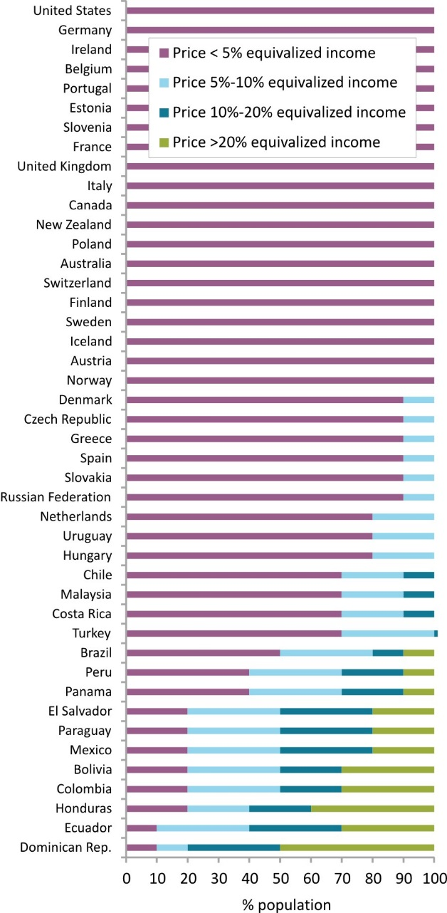
Income inequalities contribute to making broadband unaffordable
Prepaid handset-based mobile-broadband prices as % of equivalized household income
Fixed-broadband is affordable for the 20% households with highest income in most developing countries
but unaffordable for the 20% households with lowest incomes in almost all developing countries
Handset-based mobile-broadband prices are affordable for almost all households in the developed world
but unaffordable for some segments of the population in the developing world
Source: ITU MIS Report 2014

Slide 14
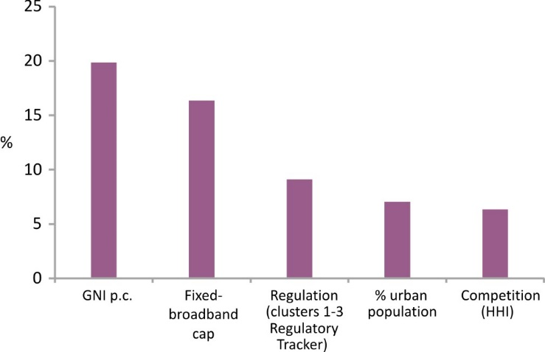
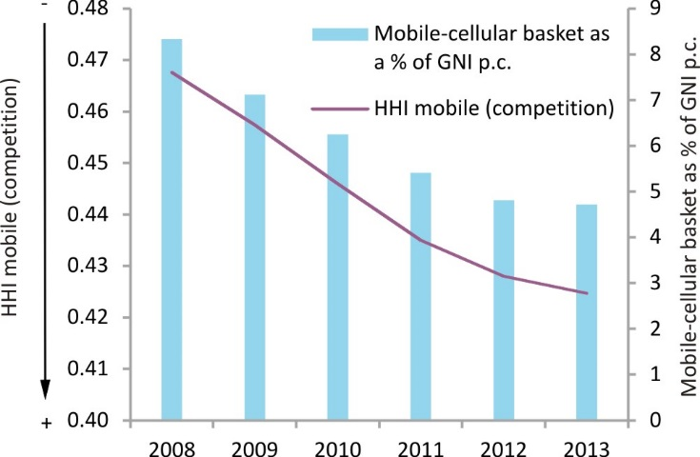
Competition and regulation are key drivers of affordable ICT prices
Variation in fixed-brodband prices explained by each factor
Fixed-broadband prices could be reduced by 10% if competition and the regulatory framework in developing countries improved
An increase in competition in developing countries could lead to a 5% reduction in mobile-cellular prices
International regulatory best practices, such as the ones adopted at the ITU Global Symposium for Regulators, may serve as guidelines for effective regulatory frameworks
Competition and mobile-cellular prices
Source: ITU MIS Report 2014, HHI data sourced from Informa

Slide 15
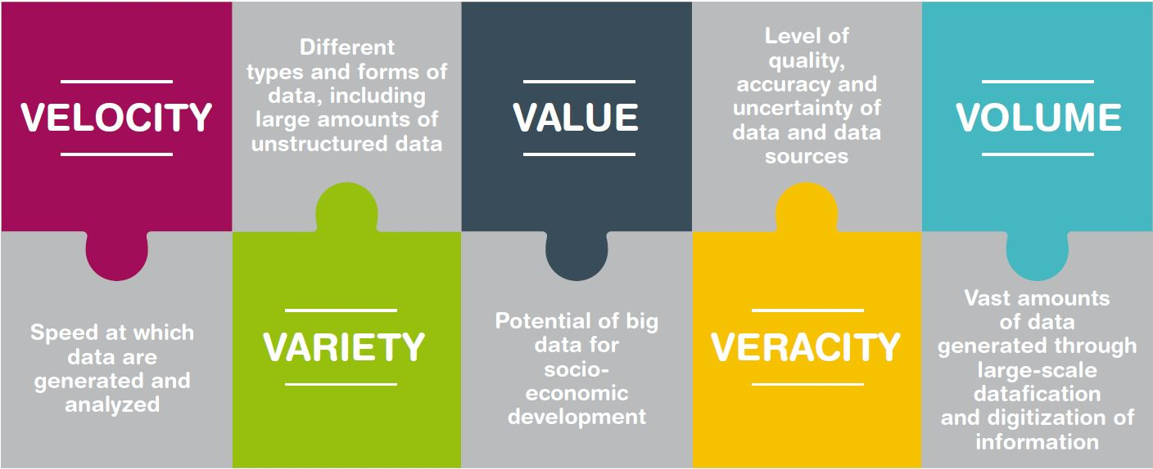
Big data for development
Big data are the result of an increasingly digitized world
Big data hold great promise for improving the timeliness and completeness of official statistics
Big data can be used for formulating social and economic development policy
Source: ITU MIS Report 2014

Slide 16
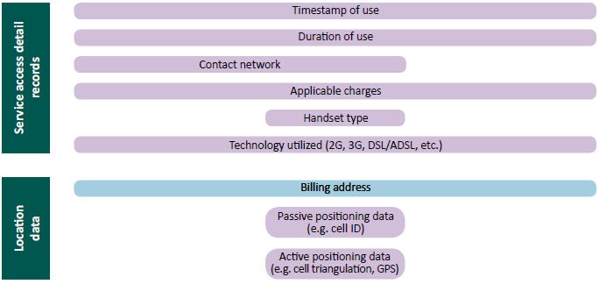
Big data from the ICT sector
The ICT sector is one of the richest sources of big data
Data from mobile operators are real-time and low-cost, and are an area with huge development potential
+
…
Source: ITU, adapted from Naef et al. (2014).

Slide 17
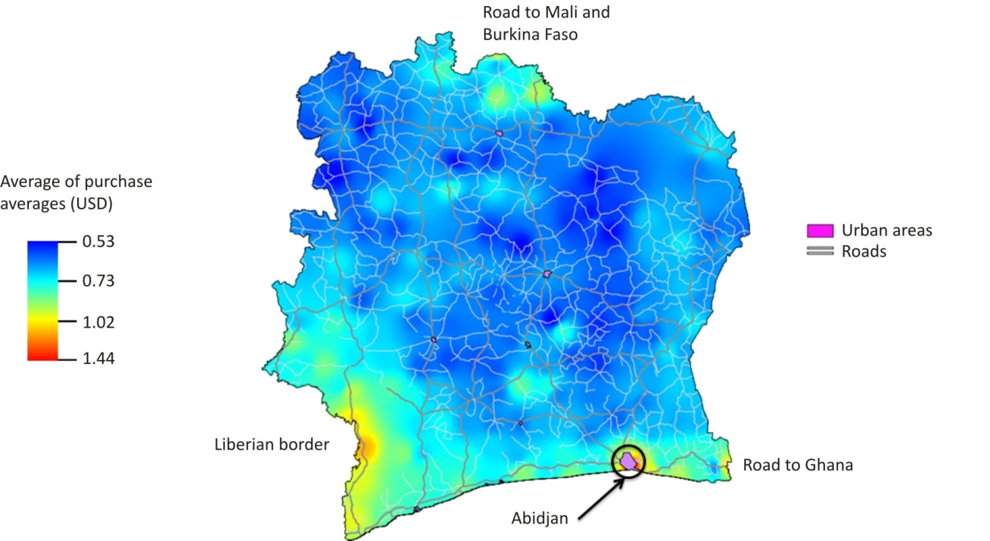
Use of big data from mobile operators
Moibile data can reveal new insights into the digital divide
Mobile data can reveal socio-economic information about mobile users
Example: Poverty mapping in Côte d’Ivoire using mobile-network data
Source: Gutierrez et al. (2013).

Slide 18
Big data from the ICT sector: development potential and challenges
Potential
Telecommunication operators, Internet companies and content providers are a rich source for big data
Data from mobile operators are real-time and low-cost, and are an area with huge development potential
Big data could reveal new insights into the digital divide
Challenges
Privacy issues remain the biggest challenge
Public-private partnerships are required to harness the potential of big data
Cooperation among international stakeholders

Slide 19
For further information:
indicators[at]itu.int
www.itu.int/ict

