Slide 1
Breaking the sound barrier
eAccessibility in Television Broadcasting in Central and Eastern Europe
3-4 December 2013
HRT Academy, Zagreb, Croatia
Tanja Gombar, B.Sc.E.
EBU
Notes:
Dear colleagues,
my name is Tanja Gombar on behalf of HRT. I am a broadcast engineer and I will be giving you a short presentation about what we have done in terms of eAccessibility so far.
The main focus of this presentation are the techniques for helping the hearing impaired. HRT has enabled broadcasting of numerous TV programmes for the hearing imparied, in example everyday news, Sunday Mass and few family programmes. What is important is that all foreign programmes (films, series, etc.) are subtitled, not synchronised. This makes it easier for them.

Slide 2
Breaking the sound barrier
HRT has enabled broadcasting of numerous TV programmes for the hearing imparied
i.e. everyday news, Sunday Mass and several family programmes
all foreign programmes (films, series, etc.) are subtitled, not synchronised
EBU

Slide 3
Techniques – sign language
sign language with the help of a presenter
enabled in some of the news shows, Sunday Mass and some family programmes
EBU
Notes:
HRT uses several techniques. One of them is sign language. This is done in a way that a presenter can be seen parallel on screen during a TV programme.

Slide 4
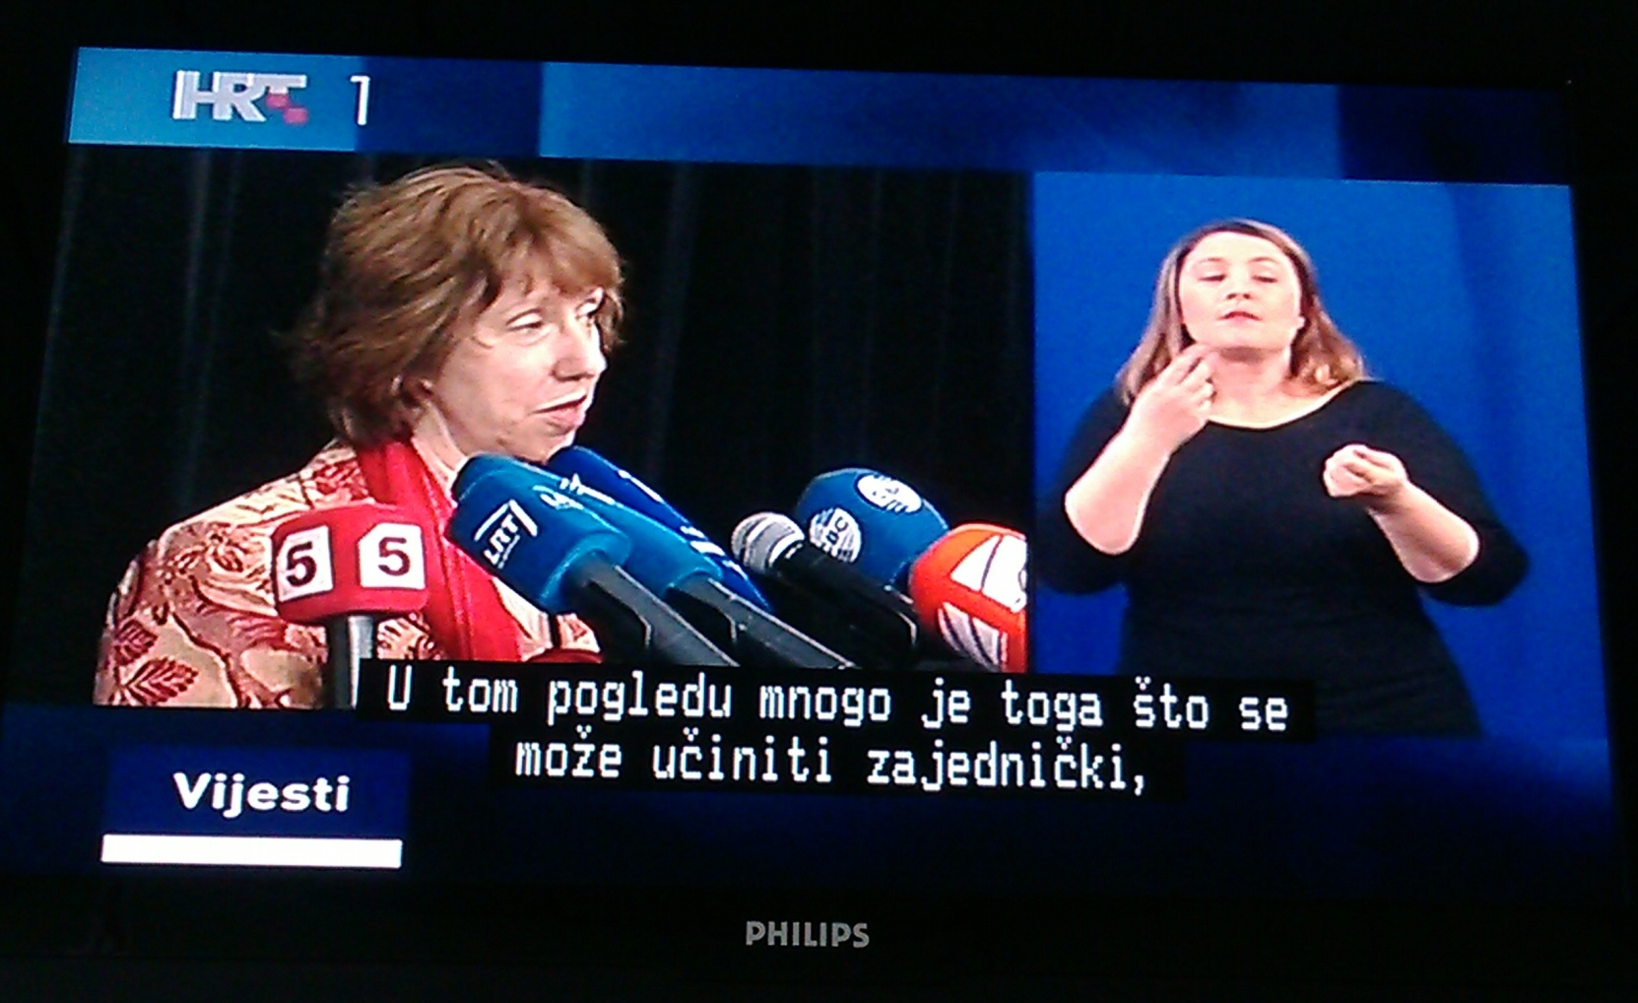
EBU
Notes:
This is an example of daily news where people can choose if they want to turn on the subtitles or turn them off and watch the presenter.

Slide 5
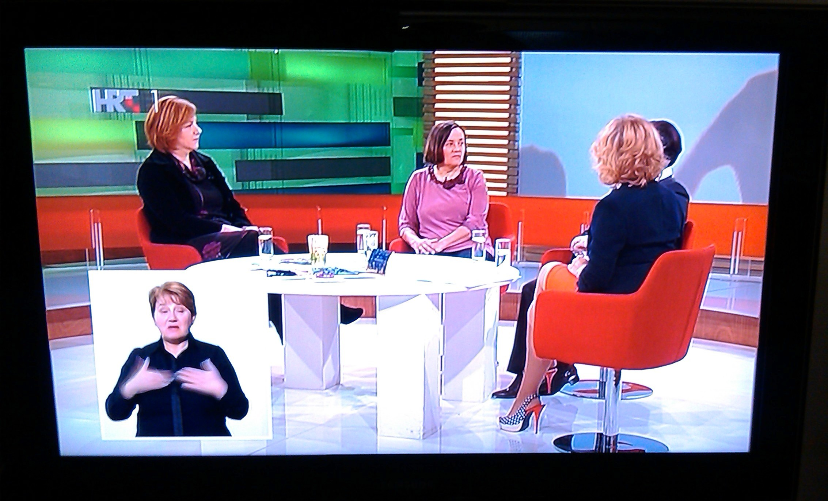
EBU
Notes:
This is an example of a family programme. As you can see, a presenter is seen on a small part of the screen. There isn't an option for TTXT subtitling.

Slide 6
Techniques – TTXT subtitling
teletext subtitling, also known as closed subtitling
this means that viewers can choose whether or not to display the subtitles
this data is added into the VBI area
EBU
Notes:
Nevertheless, TTXT is suitable for news programmes. It is also known as closed subtitling. This means that viewers can choose whether or not to display the subtitles. The subtitles are imported as data into the VBI area of the TV frame.

Slide 7
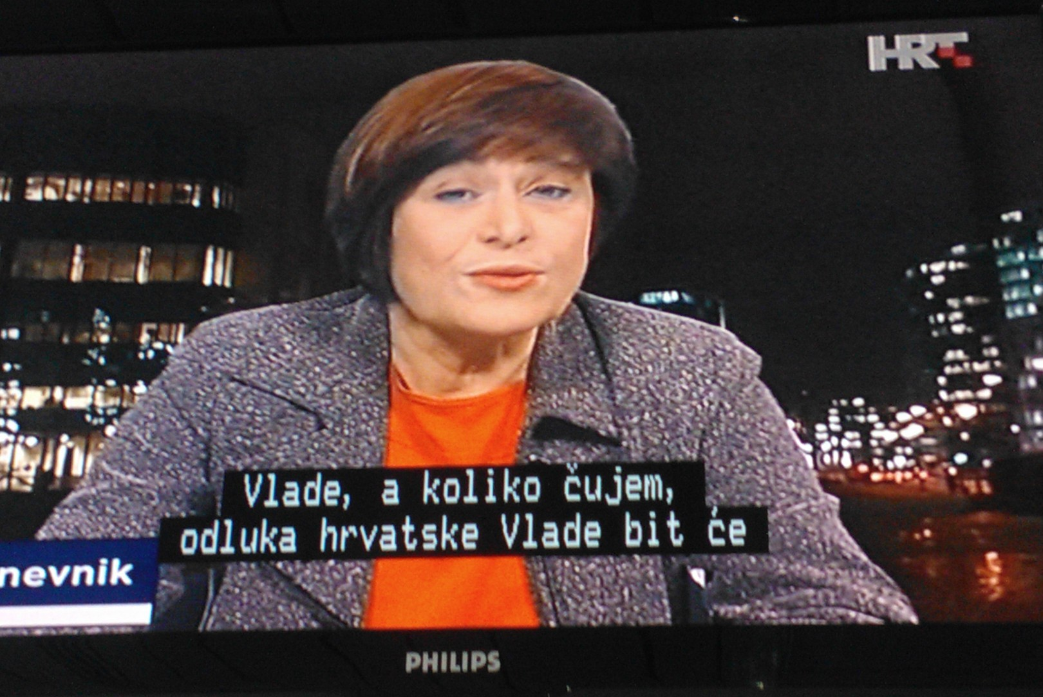
EBU
Notes:
The subtitles can be turned on when the viewer goes to the TTXT page 888.

Slide 8
Techniques – TTXT subtitling
news programme subtitles are prepared in advance and imported from iNews
the subtitles are broadcasted manually, they are not triggered by a time code and are not automated
reporting live is not subtitled
there is a number of programmes which have the potential to be subtitled, but there is a lack of people and workspace
EBU
Notes:
News programme subtitles are prepared in advance and imported from iNews where the reporters have already written the news text.
The subtitles are broadcasted manually, they are not triggered by a time code and are not automated.
Reporting live is not subtitled because the implementation is highly complicated.
There are a number of programmes which have the potential to be subtitled, but there is a lack of people and workspace.
As for the technical realization of all this, there are two subtitling workstations in New Media department.

Slide 9
Techniques – TTXT subtitling
there are two subtitling workstations in New Media department
one of them is used for immediate subtitle editing
the other workstation is on-air and is used to manually broadcast subtitles
EBU

Slide 10
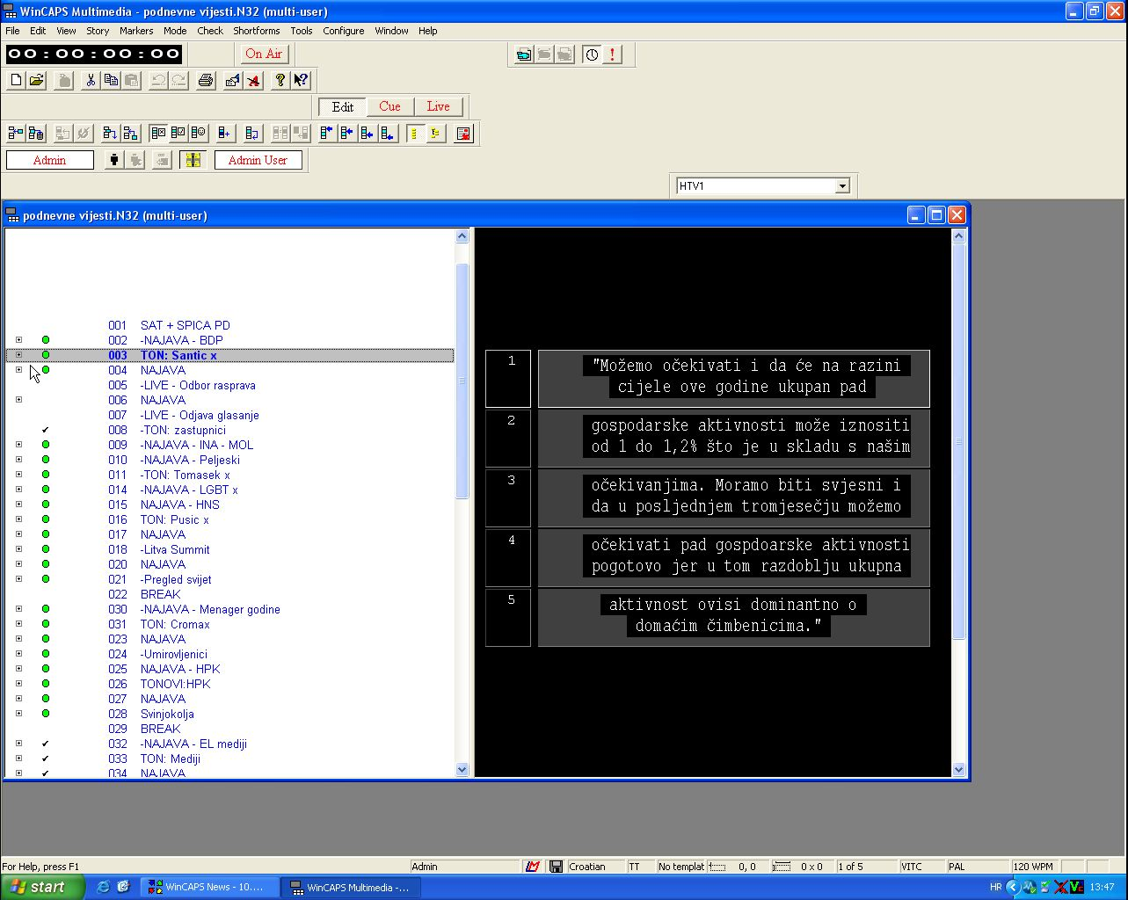
EBU
Notes:
One of them is used for immediate subtitle editing and the other workstation is on-air and is used to manually broadcast subtitles.

Slide 11
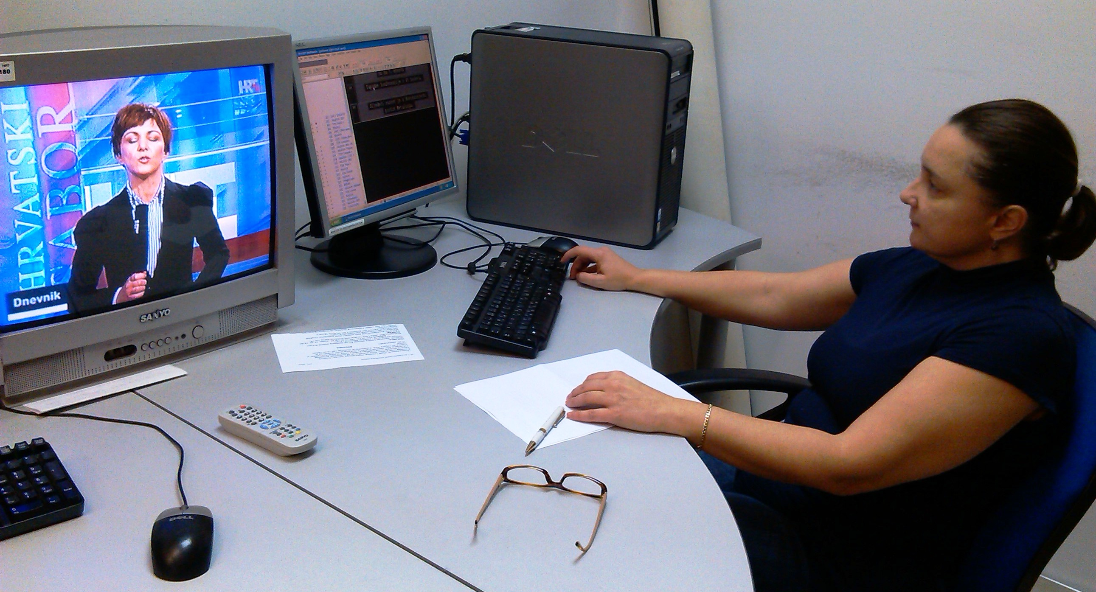
EBU
Notes:
This is all done in WinCAPS aplication, software by Screen.

Slide 12
Techniques – TTXT subtitling
“real-time speech recognition” is a system based on voice recognition
in Croatia it still doesn’t exist
this type of subtitling can be unreliable
EBU
Notes:
Some countries use real-time speech recognition. This is a type of subtitling based on voice recognition. It can sometimes be unreliable.
Currently, on the market there is no voice recognition for Croatian language and this is one of the reasons why we don't have it.

Slide 13
Conclusion
although HRT uses several techniques for the hearing impaired, there is still room for improvement
in the future, we hope to increase the number of TTXT subtitled programmes
EBU
Notes:
Although HRT uses several techniques for the hearing impaired, there is still room for improvement.
In the future, we hope to increase the number of TTXT subtitled programmes.
That is all. Thank for your attention!

Slide 14
Thank you for your attention!
EBU

