Slide 1
SOCIAL MEDIA IN THE PHILIPPINES
Statistics, Uses, and Policies
Maria Leanna A. Beltran-Dorado
Information and Communications Technology Office
Department of Science & Technology
Republic of the Philippines

Slide 2
SOCIAL MEDIA
Statistics

Slide 3
SOCIAL MEDIA STATISTICS
Philippines “The Social Networking Capital of the World”
Total Population (2014 Est.) : 105, 720, 664
49% Urban
51% Rural
36%
35%
Internet Penetration
Social Media Penetration
Source: wearesocial.sg thru http://fleirecastro.com/
http://vulcanpost.com/

Slide 4
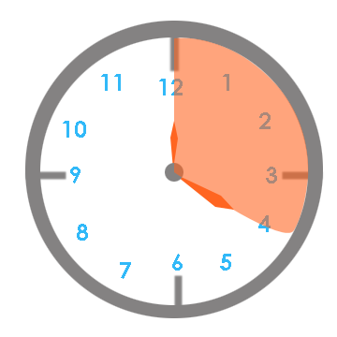
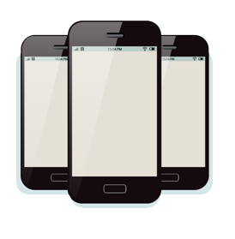
SOCIAL MEDIA STATISTICS
32%
Facebook
Penetration
62%
Mobile users using social media apps
4Hours 1Min
Ave. time social media users spend on social media each day
Source: wearesocial.sg thru http://fleirecastro.com/

Slide 5
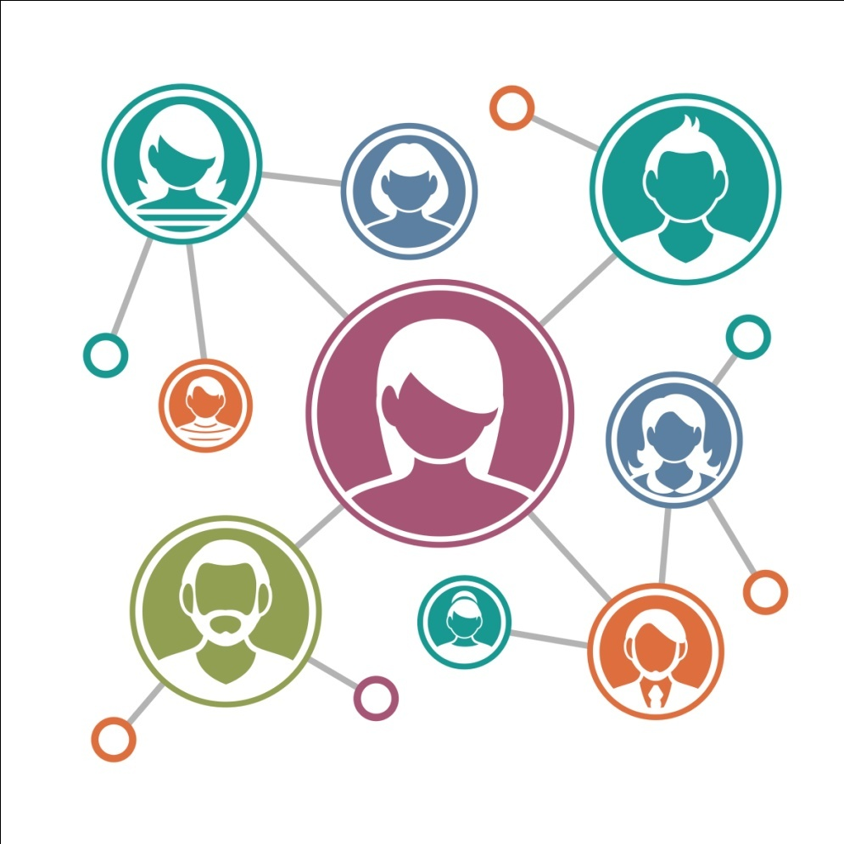
SOCIAL MEDIA
Uses

Slide 6
SOCIAL MEDIA USES
How Filipinos Use Social Media
74%
To stay in touch with friends and family
62%
To keep company
70%
To meet new people
65%
To have fun
63%
To share new experiences
Source: http://vulcanpost.com/12971/research-philippines-social-media/

Slide 7
SOCIAL MEDIA STATISTICS
Social Media as a Tool for Governance
Provides easy publication and information dissemination to the citizens
Allows citizens easy access to government services and government officials
Saves time and money
Opens up new ways of working and collaboration
Can be used as a form of election campaign material
and aid in criminal investigations
Source: http://blogs.worldbank.org/

Slide 8
SOCIAL MEDIA STATISTICS
Negative Uses of Social Media
Cyberbullying
Spread of Unreliable and False Information
Invasion of privacy
Online crimes
Vulnerability to security attacks
Source: http://socialnetworking.procon.org/

Slide 9
POLICIES
Regulations

Slide 10
POLICIES / REGULATIONS
RA 10175 or Cybercrime Prevention Act of 2012
The cybercrime law regulates acts committed online, including
provisions on the prevention of cybersex, online child pornography,
identity theft and spamming. It also covers provisions for online libel
and gives officials powers to search and obtain data from online users accounts.
Injunction
Cyberbullying
Republic Act No. 10627 or the Anti-Bullying Act of 2013
Source: http://www.bakermckenzie.com/
http://www.gov.ph/2013/09/12/republic-act-no-10627/
http://www.bbc.com/news/world-asia-15527446

Slide 11
POLICIES / REGULATIONS
Censorship and Free Speech
Censorship is partly addressed in RA 9775 or the Anti-Child
Pornography Act and the Cybercrime Law. Provisions on the freedom of speech is covered in the Constitution Section 4 stating that:
“No law shall be passed abridging the freedom of speech, of expression, or of the press, or the right of the people peaceably to assemble and petition the govt for redress of grievances.”
Others
Smarter Philippines policy
Magna Carta for Philippine Internet Freedom
Think Before You Click
Source: http://www.bakermckenzie.com/

Slide 12
Thank You!

