Slide 1
PRESENTATION
The CYBER GUARDIAN Product RANGE

Slide 2
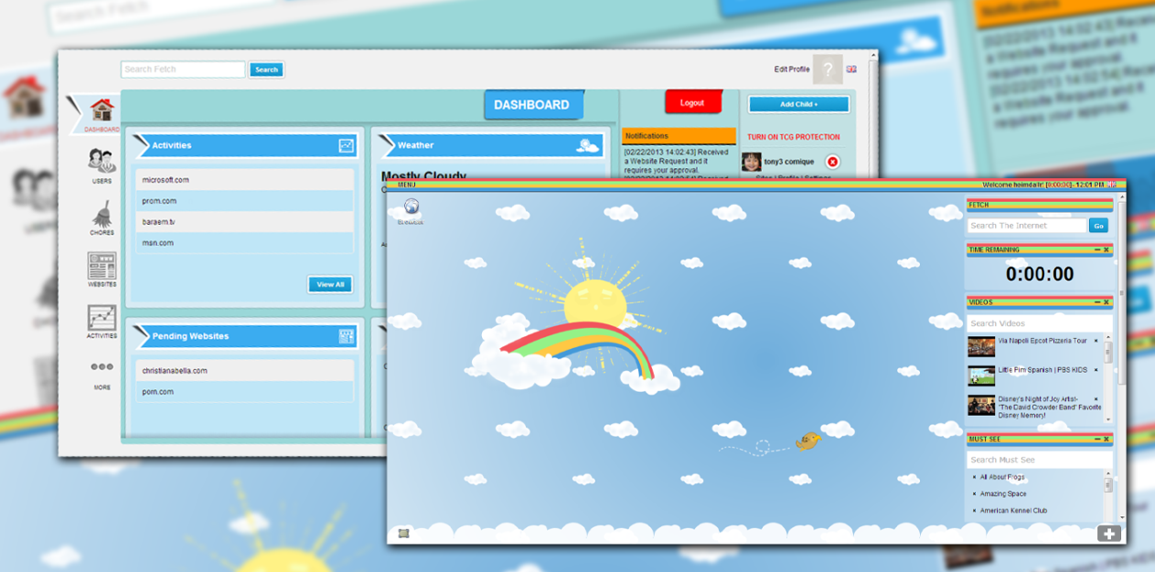
TCG CHILD ONLINE PROTECTION
PARENT AND CHILD

Slide 3
TCG Child Online Protection
Easy to use web based control panel for Parents and Children

Slide 4
TCG Child Online Protection
Parents can create custom Categories, Blacklist and Whitelist for each Child

Slide 5
TCG Child Online Protection
Parents can go anywhere but children are restricted to TCG Whitelist by default

Slide 6
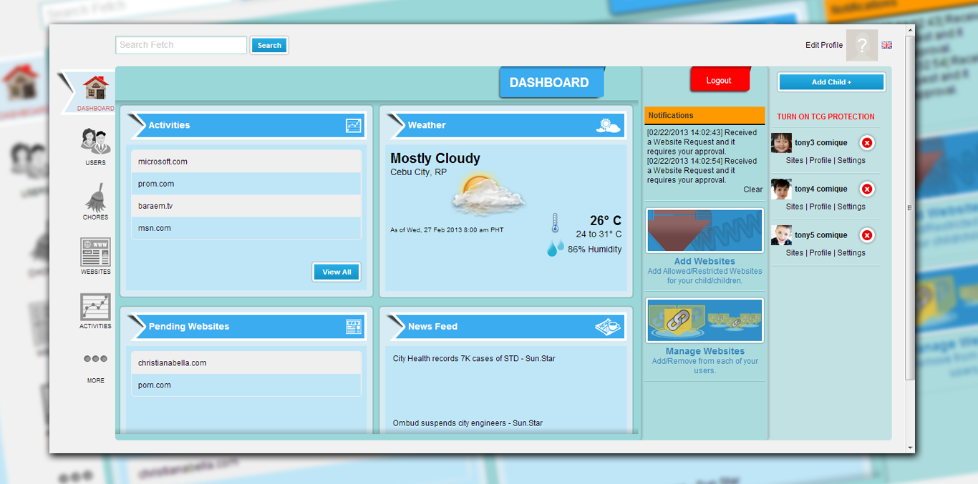
TCG Child Online Protection PARENT
Private Messaging between parents and children
Control allowed/restricted websites for each child
Create chores for children and they get bonus online time
Monitor visited websites and searched keywords
Download reports for visited sites and searches
Control number of hours your child can surf for each day
Control surfing period for any website
FEATURES

Slide 7
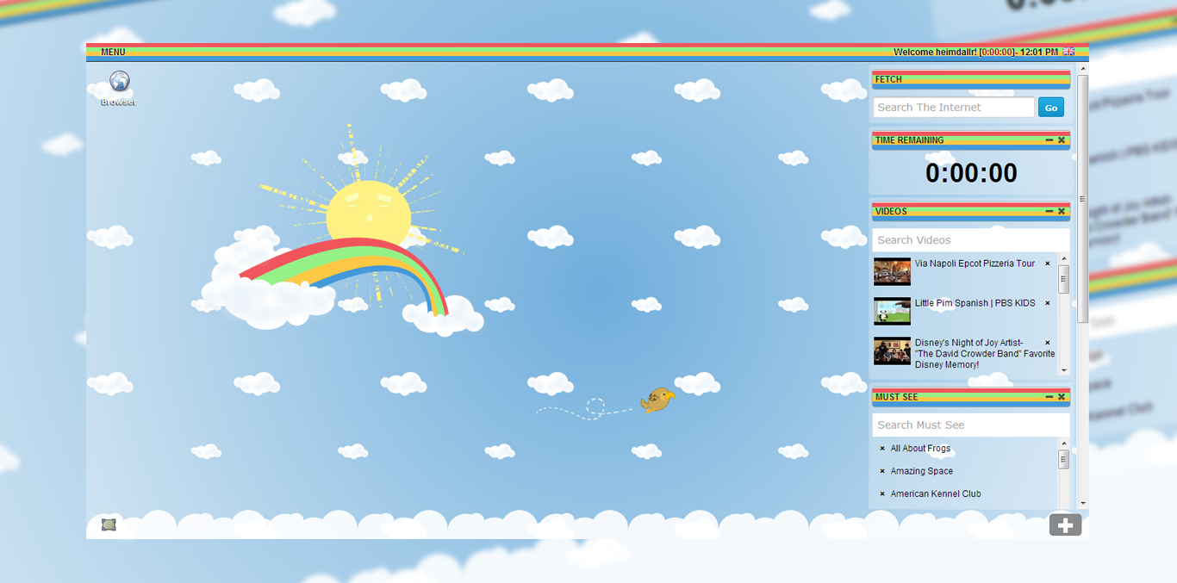
TCG Child Online Protection CHILD
Beautifully designed and customisable childrens landing pages
Tens of thousands cleaned and checked Youtube and Vimeo videos
Must see websites for children of different age brackets
Online Games
TCG Wiki For Schools (Online Encyclopaedia)
FEATURES

Slide 8
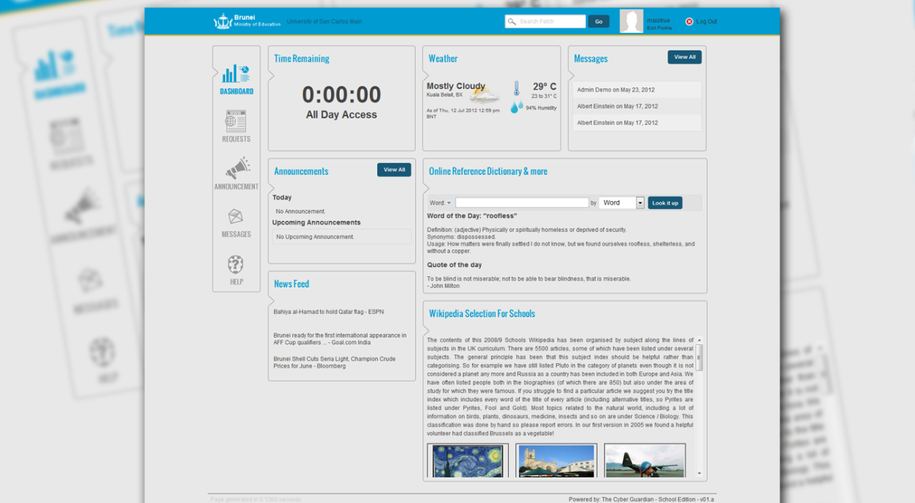
TCG SCHOOL EDITION

Slide 9
TCG SCHOOL Edition
Custom Website Categories, Content Filtering, Whitelist and Blacklist for teachers and students per school

Slide 10
Web Based Control Panel
Create Unlimited Schools
Control allowed/restricted websites for different schools
System-wide Announcements
Events and Calendars
System-wide Messaging
Monitor visited websites and searched keywords
Set time teachers and students can surf the internet
TCG SCHOOL Edition
FEATURES

