Slide 1
Inclusion Finaniera, Banca Movil y Seguridad
“A Global Vision of the Future of Mobile Banking”
‘Real-time Connected with my Bank’
Presented by: Patrick Degreef – Mobile Banking Expert UIT Switzerland
Tegucigalpa – Honduras – August 12 & 13, 2013
Copyright reserved © 2013. Confidential intellectual property of Patrick Degreef

Slide 2
“A Global Vision of the Future of Mobile Banking”
‘Introduction’
Definitions of a Retail Bank
a Computer with a Wall around it
a Financial Service Application on a Smart Phone
Real-time Financial Processing Apps on a Wearable Computer: for example Smart Money Watch/m’iWatch
Inclusion Finaniera, Banca Movil y Seguridad
P2/10
Copyright reserved © 2013. Confidential intellectual property of Patrick Degreef

Slide 3
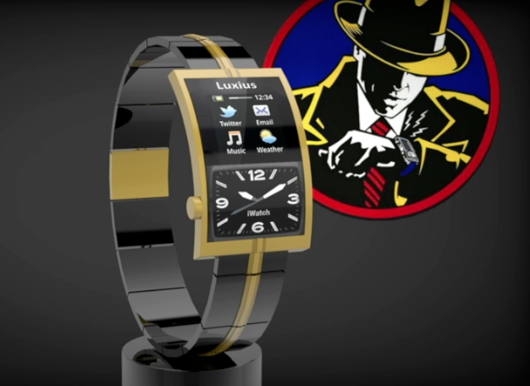
m’íWatch: “The Innovative Mobile Banking Device of the future”
Functional Description:
The m’’iWatch is a truly unique and innovative watch which combines modern technology with traditional watch craftsmanship and provides a secure and practical end-user device to support mobile banking & text and voice telecommunication & multi-media functions.
Technical Characteristics:
Android OS
SIM card based communication
and Multimedia & Bluetooth integrated PCB
3G Internet connection
Lithium Battery
Mini-USB port for charging & headphones
Payment and Mobile Banking Apps
Security software & hardware
Owner Authentication & Theft Protection System
Upgradable, extendable, open SOA-platform
Configurable Integration with standard Mobile Centric Banking Systems
Inclusion Finaniera, Banca Movil y Seguridad
P3/10
Copyright reserved © 2013. Confidential intellectual propertyof Luxius Suisse

Slide 4
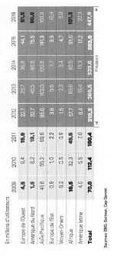
“A Global Vision of the Future of Mobile Banking”
‘Mobile Banking Statistics’
The exponential growth of mobile payments
‘African growth 7x LATEM!’
Inclusion Finaniera, Banca Movil y Seguridad
P4/10
Source: Bilan.ch
Copyright reserved © 2013. Confidential intellectual property of Patrick Degreef

Slide 5
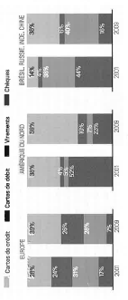
“A Global Vision of the Future of Mobile Banking”
‘Mobile Banking Statistics’
The global evolution of mobile payment methods
‘Limited dematerialisation on the receiving end = Transferts/Virements’
Inclusion Finaniera, Banca Movil y Seguridad
P5/10
Source: Bilan.ch
Copyright reserved © 2013. Confidential intellectual property of Patrick Degreef

Slide 6
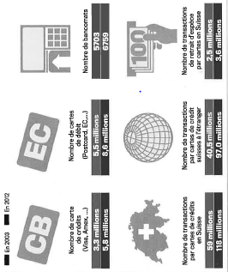
“A Global Vision of the Future of Mobile Banking”
‘Mobile Banking Statistics’
Dematerialisation of payment methods in Switzerland
‘Limited dematerialisation on the receiving end = Cash’
Inclusion Finaniera, Banca Movil y Seguridad
P6/10
Source: Bilan.ch
Copyright reserved © 2013. Confidential intellectual property of Patrick Degreef

Slide 7
“A Global Vision of the Future of Mobile Banking”
‘Convergence Model’
Characteristics
De-Regulation, Re-Regulation, Right-Regulation (EU)
Technology, Functionality, Business Model
Bank vs Telco model: New Structures needed
‘Mobile TelcoBanking’
Inclusion Finaniera, Banca Movil y Seguridad
P7/10
Copyright reserved © 2013. Confidential intellectual property of Patrick Degreef

Slide 8
“A Global Vision of the Future of Mobile Banking”
‘Roadmap to the Future’
How to Create Mobile Banking Services
1) Define mobile banking services & products
2) Create mobile bank organizational & operational structures
3) Implement & configure bank-systems & user devices
‘Adapt & Adopt Proven Solutions with Experts versus Build In-House’
Inclusion Finaniera, Banca Movil y Seguridad
P8/10
Copyright reserved © 2013. Confidential intellectual property of Patrick Degreef

Slide 9
“A Global Vision of the Future of Mobile Banking”
‘Bank Systems & End-User Devices’
Characteristics
Mobile centric banking systems: telecom product added value accounts & real-time mobile enabled
Innovative & Powerful End-User Communication Devices: extendable, independent, real-time functional & technical financial processing platform
Open Service Oriented Architecture: secure, evolutionary & upgradable, flexible integration points
‘Mobile & End-user centric bank systems & communication devices’
Inclusion Finaniera, Banca Movil y Seguridad
P9/10
Copyright reserved © 2013. Confidential intellectual property of Patrick Degreef

Slide 10
“A Global Vision of the Future of Mobile Banking”
‘Conclusion’
What does the Future of Mobile Banking looks like?
Real-time Financial Processing Functions
Convergence between Banks & Telcos
Innovative User-Devices for Wearable Computing: for example Smart Money Watch/ m’iWatch
‘The Future Starts Now!’
Inclusion Finaniera, Banca Movil y Seguridad
P10/10
Copyright reserved © 2013. Confidential intellectual property of Patrick Degreef

Slide 11
“A Global Vision of the Future of Mobile Banking”
‘Questions?’
‘The Future Starts Now!’
Patrick Degreef
Mobile Banking Expert UIT - Switzerland
patrick.degreef@experbank.com
+41-76-4790657
Inclusion Finaniera, Banca Movil y Seguridad
Copyright reserved © 2013. Confidential intellectual property of Patrick Degreef

