Slide 1



ICTs for Employment and Economic Growth
By Osama Rayis (PhD, IEEE senior Member)
rayis@hotmail.com
Regional Development Forum for the Arab States,
Khartoum, Republic of Sudan 29 January,2017

Slide 2
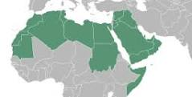
Regional Development Forum for the Arab States,
Khartoum, Republic of Sudan 29 January,2017

Slide 3
Agenda
ICT and Youth in the Arab World
New Economic Growth Model
Education and Training issues
Enabling Factors
Entrepreneurship and Digital SMEs
Incubation in The Arab Region
Finance
Regional Development Forum for the Arab States,
Khartoum, Republic of Sudan 29 January,2017

Slide 4
ICT and Youth in the Arab World
The contemporary Arab world has a combined population of around 422 million people, over half of whom are under 25 years of age (UNESCO)
Adult literacy (ages 15 and older) is 76.9%
Arab Spring (An ICT phenomena)
total Arab world GDP is estimated to be worth at least $2.8 trillion in 2011 (Alarabia)
Regional Development Forum for the Arab States,
Khartoum, Republic of Sudan 29 January,2017

Slide 5
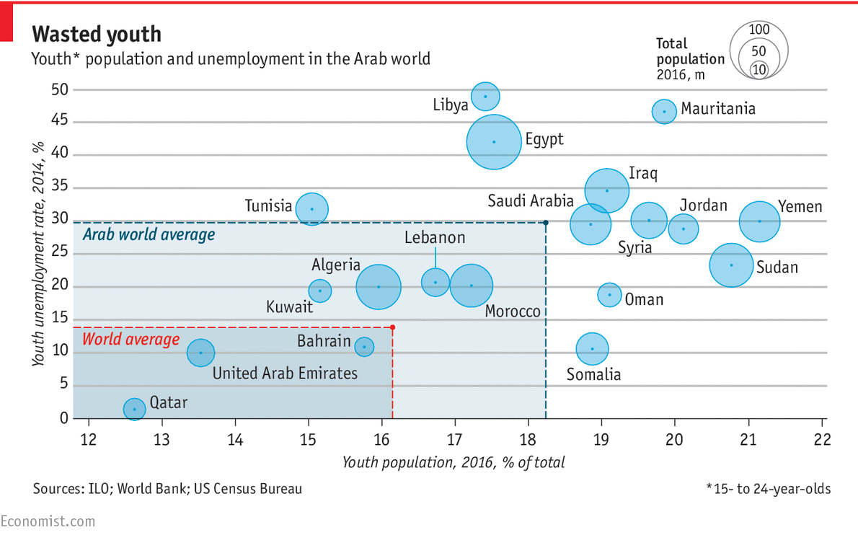
Wasted Youth
Regional Development Forum for the Arab States,
Khartoum, Republic of Sudan 29 January,2017

Slide 6
Education and Training issues
“For the young, jobs are few and far between. In 2010, on the eve of the Arab uprisings, total and youth unemployment rates in the Arab world were already the highest of any region, at 10% and 27% respectively. Since then these figures have risen further, to nearly 12% and 30%. Amazingly, in some Arab countries, the more time you spend in school, the less chance you have of finding a job. In Egypt 34% of university graduates were unemployed in 2014, compared with 2% of those with less than a primary education.” The Economist
Accredited Education
Certified Training
Soft Skills

Slide 7
New Economic Growth Formula
New Economic Growth Model
Why investing in innovation SMEs!
Economic Growth EG is a function of
(Technological Development TD + Savings S * Technology Level TL)
EG = f_{innov} (TD + S*TL)
Innovation index characterizes the function

Slide 8

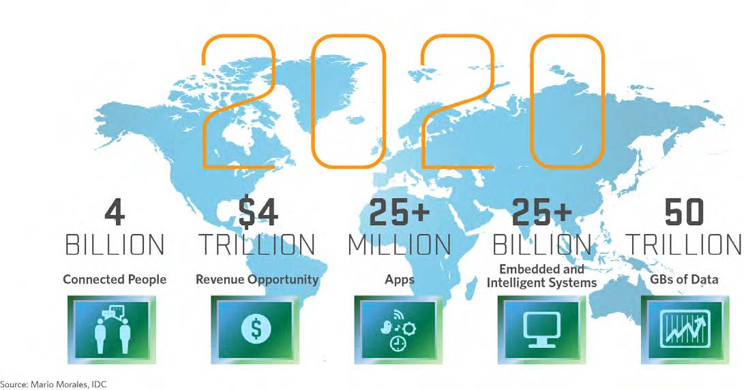
2020
It is estimated that @ 2020:

Slide 9
ICT is no more a luxury, it is no more a necessity, it is part of our existence …
The cyberspace
So let us speak about innovation and development within this augmented reality.
Our world is now having an extra sphere, the cybrosphere like the atmosphere and the stratosphere.
The new Globe

Slide 10


Paradigm Shift
Industrial Society …
Knowledge Society …
Innovation Society …
wired city
Telecity
Teletopia
Ubiquitous city
Cyberville

Slide 11


اInnovation
Training
Venture Capital
Synergy
Incubation
Main Enablers

Slide 12
National Innovation Ecosystem
Is the enabling environment that fosters innovation to solve national problems and accelerate socioeconomic development and growth.
It is the people and set of entities and their relations, policies and acts; Moreover it is the hole culture and structure that sustain an innovative nation.

Slide 13
اInnovation
Entities
Uni, RC, NIC, NTC, ACT ………….
Policies
STI, InfoACT, Inv…
culture
Relations
STI council, Forums, ….
National Innovation Ecosystem

Slide 14



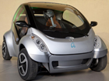

Smart
Cloud
Green
Mobility
All in one
IoT
Smart Home
Innovation
Innovation & ICT are Main Drivers for Development

Slide 15
Digital SMEs
EDU
BPO
DA
SE
Call Center

Slide 16
Innovation-based Economy
Innovation-based economy is already taking place all over the globe. In some place like G7 and BRICS innovation economy is dominating the arena,
in some other economies like Turkey countries are heading towards that.
LCDs and especially in Sub-Sahara are still economies that are struggling the resource-based scenarios.
Innovation with its nature is based on the capacities of individuals and the culture of the society.

Slide 17
Innovation-based Economy …2
Innovation based economies are those who had discovered ways and means of incubating, supporting and harnessing innovation in their ecosystems.
A healthy economy is healthy from its grassroots.
Innovation for inclusive growth is now a major issue in the global forums.
One of the key issues is how to support innovation startups to withstand and grow.
Incubation is the business process of supporting the acceleration of innovation SMEs by providing them with an array of resources and services.
A key service is finance.

Slide 18
Innovation-based Economy
Knowledge & Innovation
Industry
Material Resources
Energy Resources
Turning
ideas to value,
innovation to development.
Turning
Ideas into Seeds
growing Trees harvesting Fruits

Slide 19
الواحة المعرفية K-Zone
Innovative
Social
Enabled
Connected
The innovator

Slide 20


مدينة أفريقيا التكنلوجية
www.act.sd
Africa City Of Technology
Quad Helix Model
Academia-Government- Industry- Finance

Slide 21


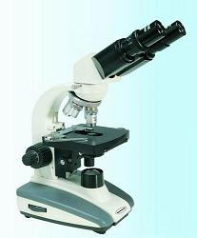
Bzns Sector
University
Government
Innovators
Development of Joint Innovation Ecosystems to give Leverage to a Global Knowledge Triangle

Slide 22
Knowledge Triangle
Academia
Innovators
Government
Innovation Ecosystem
Integrating ICT innovation in national Agenda

Slide 23
Knowledge Triangle
Academia Knowledge & Innovation
Industry Drives & Development
Community Synergy & Benifits
Government Policies & Support

Slide 24
Issues
Trust Gab
Lack of Coordination
Lack of joint Vision

Slide 25
Players Roles and Initiatives
Academicians
Youth
Financial Institutions
Universities
Government
Integrating ICT innovation in national Agenda

Slide 26
Solutions
Entrepreneurial University
Venture Capital, …
Synergy
Inspired,
Free & Autonomous
Solutions for Integrating ICT innovation in national Agenda

Slide 27
Technology Incubators:
Incubation is a business support process that accelerates the successful development of start-up and fledgling companies by providing entrepreneurs with an array of targeted resources and services.
حضانة الأعمال هي عمليات دعم الأعمال التجارية و التي تعجل بعملية التنمية الناجحة للبدء وللشركات الوليده من خلال توفير مجموعة متنوعة من الموارد والخدمات المستهدفة للمبادرين.
حاضنات الأعمال تجلب النمو والثروة والفرص والعمالة والتجدد في الاقتصادات المحلية والإقليمية والوطنية

Slide 28

Vision
Turning
Ideas into Seeds into,
Trees into Fruits .
فكرة بذرة شجرة ثمرة

Slide 29
Goal:
A technology incubator’s main goal is to produce successful technology firms that will leave the program financially viable and freestanding.
الهدف الرئيسي لحاضنة الاعمال التكنولوجية هو انتاج الشركات الناجحة التي ستغادر البرنامج مقتدرة ماليا وقادرة على البقاء بذاتها.
تعمل الحاضنات التكنولوجية علي إستضافة تلاقح التكنولوجيا والإبداع حيث يتم إبتكار المعرفة وتطبيقها العملي على المجتمع.

Slide 30
Technology Incubators:
A graduate of the incubator have the potential to create jobs, revitalize neighborhoods, commercialize new technologies, and strengthen local and national economies.
لدي خريج الحاضنه القدرة على خلق فرص العمل وانعاش المحيط ، وتسويق التكنولوجيات الجديدة ، وتعزيز الاقتصادات المحلية والوطنية.

Slide 31
المنتج
A graduate of the incubator have the potential to create jobs, revitalize neighborhoods, commercialize new technologies, and strengthen local and national economies.
لدي خريج الحاضنه القدرة على خلق فرص العمل وانعاش المحيط ، وتسويق التكنولوجيات الجديدة ، وتعزيز الاقتصادات المحلية والوطنية.

Slide 32
Finance Model
Enterprise
Commercial
Development
Piloting
Venture Capital
Personal
Angel
Idea Level
Social Finance
Angel Finance
Personal Savings

Slide 33
Return on Investment
Enterprise
Good Profits
Normal Risks
Piloting
High Profit
Manageable Risk
Idea Level
High Profit
High Risk

Slide 34
Returns
Intellectual Property
New Value Models
(eg. in WEB no of visitors)
Direct revenues

Slide 35
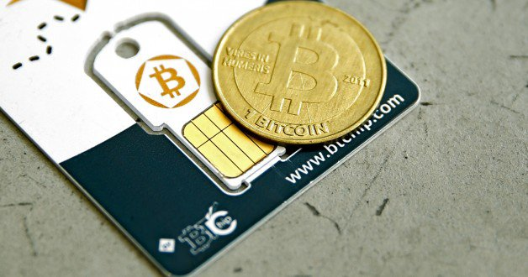
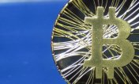
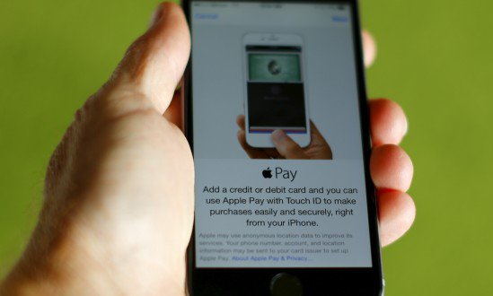
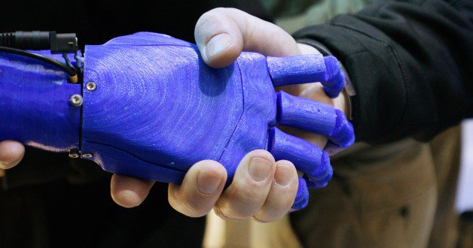
Future Payment Solutions

Slide 36
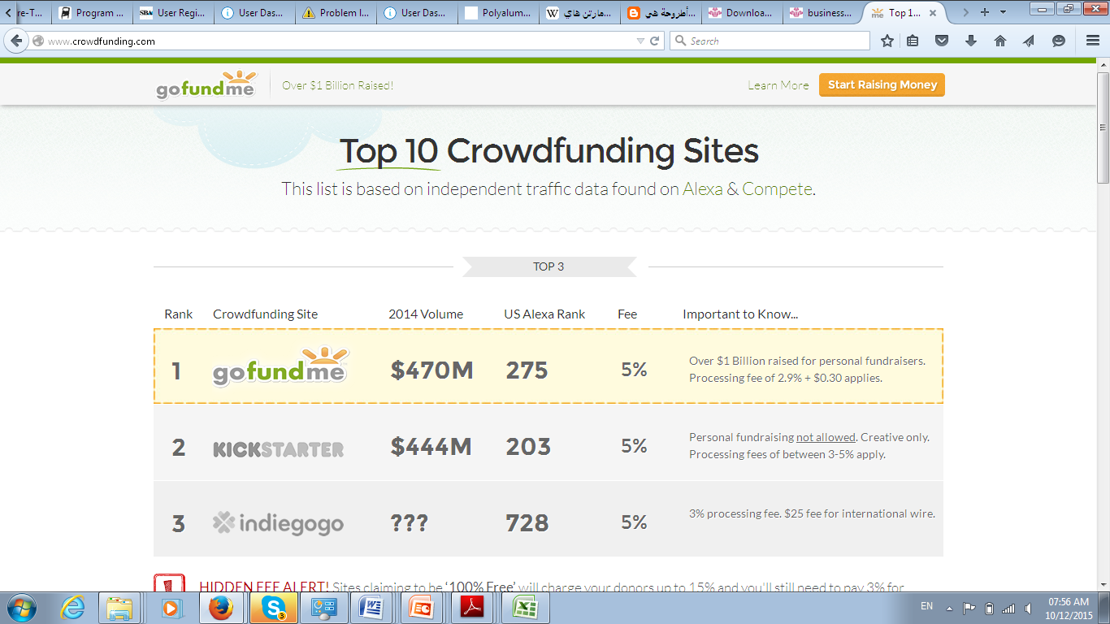
New Finance Systems
Crowd Funding
Crowd funding

Slide 37
Conclusion
National economies are aggregates of grassroots economies
Arab RTegion is characterized by innovative individuals
Lack of Suitable Finance Models is hindering the overall growth of Macro economies
A step into the future needs SME finance to be adequate.
Incubation is a MUST issue

