Slide 1
ICT in Education
ITU Regional Development Forum for the Arab States Khartoum – Sudan, 29 January 2017
Turhan Muluk, Regional Manager & ITU-D Representative

Slide 2
Agenda
Importance of ICT in Education (smart learning)
Intel’s Role for Education
National and Regional Plans
Recommendations

Slide 3

Benefits of Education Transformation
Employment and Economic Development
  Build 21st century workforce
  Reduce unemployment
Competitiveness
  Equip every student for success
  Increase academic rigor
  and achievement
Citizenship and Social Equity
  Unlock student potential
  Prepare students for social leadership
  and citizenship
“
Job losses and earnings losses have been concentrated in low-skilled, low-income households. …Many workers remain trapped
in low-paid, insecure jobs with little social protection…Young people continue to face record unemployment levels.
— OECD
”

Slide 4
WHY INVEST ICT IN EDUCATION
Government are already using billions of US dollars each year for classical education systems. They usually ineffective, inefficient and inconsistent if not updated and improved by technology.
Due to lack of standardization of resources, the classical system cause more differentiations, inequalities in opportunities. Rich always learn more and better than Poor; they receive bigger share from the Pie.
Digital learning can help to close the gap in Digital Divide.
ICT based education system is for the future generations, gives them new skills and intelligent knowledge.
With e-content, they learn as they play and they play as they learn. Whatever learned stays with them since they enjoy the learning process – Good learning experience
Education Transformation is in reality an Education Based ICT Transformation. Students will teach digital skills to their friends – families; whole society benefit, not just students.
Digital Literacy is key to increase the Broadband Penetration, Internet Usage and e-inclusion

Slide 5
Digital Transformation (Digital Economy)
High-speed and high-quality Broadband
Digitization (both government and private sector)
Digital Skills (ICT in Education)

Slide 6
Digital Transformation of Education
Connect all schools, classrooms with broadband.
Provide interactive smart boards at classrooms.
Provide subsidized internet devices for students and teachers.
Educate all teachers and students regarding the use of ICT.
Provide digital content for education
Provide subsidized home broadband connectivity for low income student families.
Provide public internet access at schools (community access centres).

Slide 7
Checklist of Policies to Promote Demand for Broadband
Infrastructure • Connect schools to broadband networks
• Make government an anchor tenant
• Expand access to underserved communities with universal service fund support
• Construct community access centers
Services, applications, content • Undertake government-led demand aggregation
• Provide e-government applications
• Promote creation of digital content
• Implement reasonable intellectual property protections
• Ensure non-discriminatory access sider expanding universal service to include broadband
Users • Provide low-cost user devices in education
• Develop digital literacy programs for citizens
• Address content and security concerns
• Facilitate affordability of broadband devices
• Monitor service quality
• Support secure e-transactions
• Provide training to small and medium enterprises
Source: World Bank, Broadband Strategies Handbook; http://broadbandtoolkit.org/Custom/Core/Documents/Broadband%20Strategies%20Handbook.pdf

Slide 8
5G for Future Education
• 5G will enter the classroom and bring new ways of learning to students and what could
be described as a revolutionary wirelessly connected educational environment.
• Augmented Reality, Virtual Reality and Virtual Presence will mean that students will be
immersed in a more visual and interactive learning experience where students and
teachers may not necessarily be in the same location.
• Teachers and lecturers will be able to gain an instant view on individual student needs
via feedback on student activity and will be better equipped to deal with their needs.
• This will create new demands on educational IT networks where both fixed and wireless
networks in both licensed and unlicensed radio bands will need to be fully integrated –
delivering a totally seamless service to educational organisations and students.
• This future “Smart Classroom” will require 5G and technologies.
(Ref: GSA 5G Verticals Series http://gsacom.com/paper/5g-verticals-education)

Slide 9
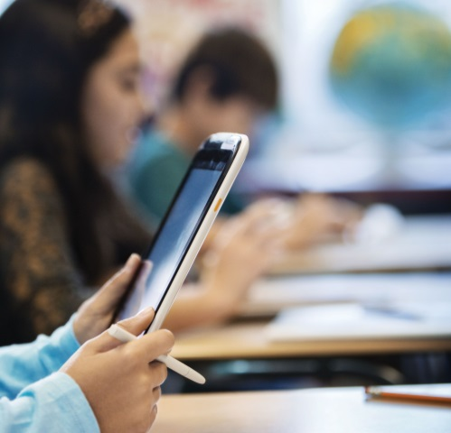



Intel® Education Solutions
User Experience
Hardware
Software & Services
Content Ecosystem
Implementation Support
Flexible, holistic education technology solution
Other names and brands may be claimed as the property of others.

Slide 10
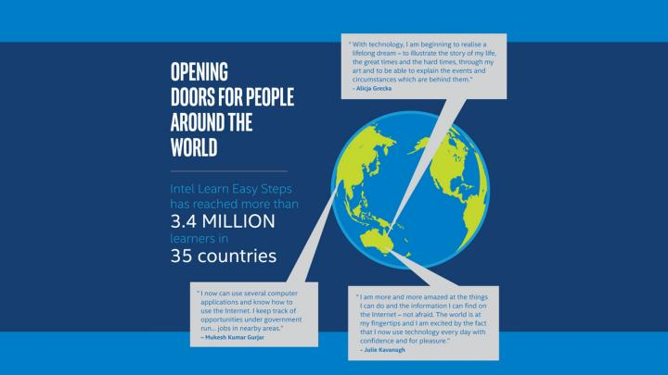
Intel® Learn Easy Steps
Intel’s digital literacy program provides simple, practical, and relevant instruction in basic technology skills that enhance an individual’s opportunities for social engagement and economic self-sufficiency.

Slide 11



Intel Global Girls and Women Initiative
Empower millions of girls and women through education and technology to advance economic opportunity
Education Access
Drive awareness and action to expand education opportunities for girls
STEM & Tech Careers
Inspire more girls and women to become creators of technology
Technology Access
Connect girls and women to new opportunities through technology access, digital literacy and entrepreneurship
Building upon the foundation: Investing in our own talent and supply chain diversity

Slide 12

Inspire Girls and Women to Become Creators of Technology
Examples of Programs and Partnerships:
Girls Who Code
NCWIT AspireIT
Robotics programs
Hermanas: Diseña Tu Futura
Compugirls
TechGYRLS
Intel Computer Clubhouse Network Start Making! program
Intel International Science and Engineering Fair and the Intel Science Talent Search*
EPICS program
Higher Ed Scholarships and fellowships
  Use of hands-on “Maker” and coding activities
  Exposure to peer mentors and role models
  Connecting technology and engineering careers to real world applications and positive social impact
Girls Who Code Video::http://www.youtube.com/watch?v=OVwrO1AxhJo
12
*programs of Society for Science & the Public
12

Slide 13
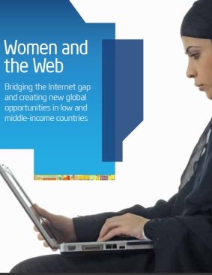
Intel® She Will Connect Program
Goal: Empower millions of girls and women through technology and bridge the Internet gap
Directly responds to findings and call to action in 2013 Intel-supported “Women and the Web” report to empower women in developing countries.
Innovative combination of digital literacy training, online peer networks, and gender-relevant content.
To be piloted in sub-Saharan Africa in 2014 and then scaled to other regions.
Program to be delivered through partnerships with leading local NGOs and other organizations.
Intel® She Will Connect Video: http://www.intel.com/content/www/us/en/technology-in-education/she-will-connect-program-close-gender-gap-video.html
13

Slide 14
Korean Economic Growth
What Made Korea to Get there?

Slide 15
South Korea - Smart Learning

Slide 16
European Union – Digital Agenda
Pillar VI: Enhancing digital literacy, skills and inclusion
Action 68: Member States to mainstream e-Learning in national policies
Member States should mainstream eLearning in national policies for the modernisation of education and training, including curricula, assessment of learning outcomes and the professional development of teachers and trainers.
Action 58: Develop a framework to recognise ICT skills
We need skilled ICT practitioners who can take the economy forward.

Slide 17
ITU WTDC-2014 ARAB STATES REGIONAL INITIATIVE
ARB4: Smart learning
Objective: To bring about a shift from traditional methods of teaching in schools and universities, using books and paper-based sources, to smart learning with the use of tablet computers, the latest software and modern telecommunication/ICT techniques to provide access to a range of academic information, resources and subject matters.
Expected results
Assistance to the countries in the following:
1) Eradication of digital illiteracy in the Arab region
2) Finding smart and low-cost computing devices, either with the support of Arab governments or by concluding agreements with manufacturers to provide such devices
Development of Arab educational e‑content for schools and universities in the Arab region.
How should we plan for the next four years (WTDC-2017) ?

Slide 18
Arab States Statistical Information
(Source ITU, penetration rates)
Fixed Broadband: 4.8 %
Mobile Telephone: 109.9%
Active Mobile Broadband: 47.6%
Households with a computer: 44.6%
Households with internet at home: 45.7%
Individuals using the internet: 41.6%
We also need statistical information for ICT in education?
-What percent of schools/classrooms connected with broadband and data rates?
-What percent of schools are using modern ICT technologies (smart classes, smart boards)?
-What percent of students/teachers are using ICT technologies at school, at home?
-What percent of schools are using digitized textbooks and digital content?

Slide 19
Success Factors for ICT in Education
Political Support
Regional and national plans with time bounded goals.
Coordination between Ministries (especially ICT and Education)
Funding mechanism

Slide 20
Recommendations
Develop National/Regional Digital Transformation Plan (including ICT in Education for Digital Skills) with time bounded goals and an implementation plan.
Prioritize ICT in Education (both in National and Regional plans)
Get political support and provide coordination between relevant Ministries.
Establish national/regional committees for the implementation.
Provide financial source through USF and other sources.

