Slide 1
The role of Universal Service and infrastructure sharing in the development.
By:
Eng. Iman Magzoub
Regional Development Forum for the Arab States,
Khartoum, Republic of Sudan 29 January,2017

Slide 2
Outlines:
Introduction
Universal services definition
Classification Criteria
Current Status
Infrastructure Sharing

Slide 3
Introduction
National Telecommunication corporation (NTC) believes that all citizens have a right to access to telecommunications and information technology without any discrimination on the basis of region and place of residence.
Universal service project is the most effective solution to achieve the NTC aim .

Slide 4
Universal Service
Is defined as the availability of telecommunication services (voice, internet) for all members of society, especially for rural, remote areas which are economically non profitable areas according to feasibility study that based on different criteria.

Slide 5
Classification criteria :
The total population (6000 or less)
Distance from the networks infrastructure
The security situation and accessibility
Public services and utilities (electricity, education, market, police ..... etc).

Slide 6
Funding:
Universal Service Fun provides CAPEX
MNO provides OPEX

Slide 7
Survey:
There is an annual field survey that is done under NTC supervision to collect a real demographic data for non covered areas which help on feasibility classification study and then providing the non-profitable regions by telecom Services.

Slide 8
US Project Status
Phase I:
2G only (voice, internet)
Infrastructure sharing (tower)
31 targeted areas

Slide 9
Cont. Phase I
Zain
In 2015, 16 rural areas are completely covered by telecom Services by Zain network in different states of Sudan

Slide 10
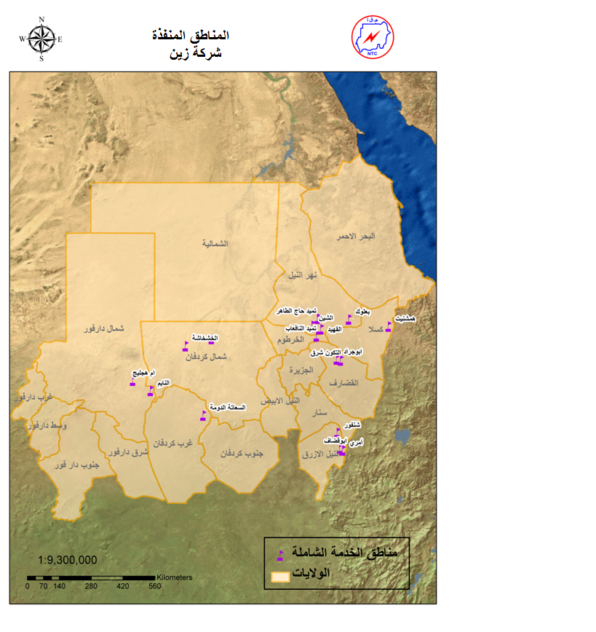
# | State | region
1 | Gadarif | Altkon East
2 | Gadarif | Abo Jarad
3 | Kassala | Hamshteat
4 | North Kordofan | Alkhashkhasha
5 | North Kordofan | Almahbas
6 | West Kordofan | Saata Doma
7 | North Darfour | Alnire
8 | North Darfour | Om Hejelij
9 | River Nile | ALGHEAD
10 | River Nile | ALSHEEN
11 | River Nile | Timead Alnafaab
12 | River Nile | Altmead Haj Altahir
13 | River Nile | Balook
14 | Blue Nile | SHNGOR
15 | Blue Nile | ABOGODAF
16 | Blue Nile | AMRY

Slide 11
Cont. Phase I
Sudatel
recently 11 regions are going to be connected on March by Sudatel network.

Slide 12
# | State | Area | On-Air Date
1 | Central Darfour | Kardal | 31/3/2017
2 | Blue Nile | Menza | 15/3/2017
3 | Blue Nile | Belgwa | 15/2/2017
4 | North Kordofan | Barara | 28/2/2017
5 | South Kordofan | Eltimor | 31/3/2017
6 | South Kordofan | Giraid | 31/3/2017
7 | West Kordofan | ElOdam | 22/2/2017
8 | West Kordofan | Elazza | 31/3/2017
9 | West Kordofan | Abuhmaid | 22/2/2017
10 | North Darfour | Omsidra | 28/2/2017
11 | North Darfour | Hajar Sari | 28/2/2017

Slide 13
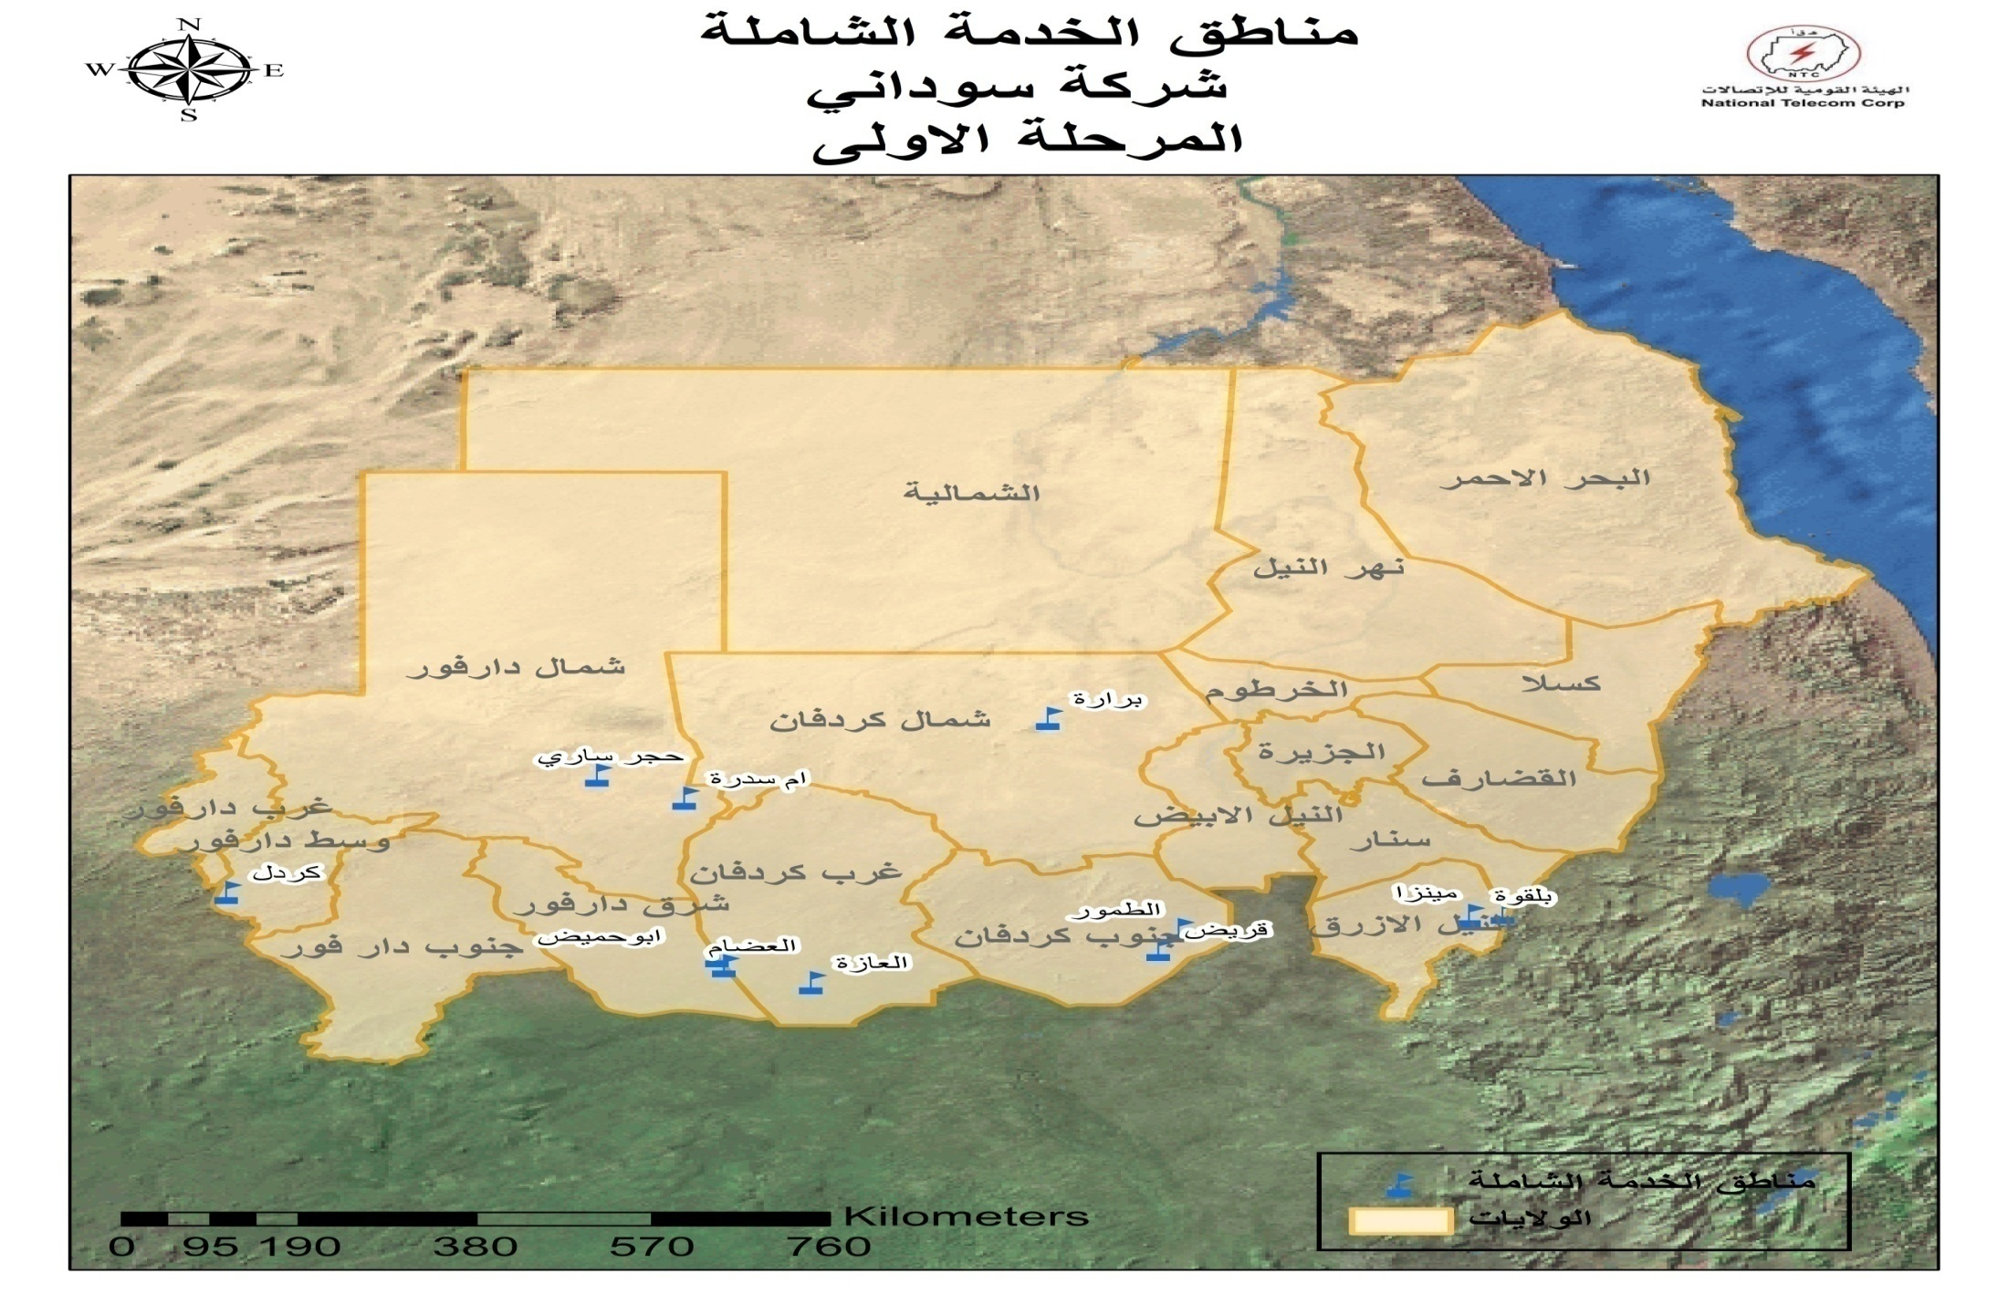
المناطق المستهدفة لمشروع الخدمة الشاملة (شركة سوداتل) : (خريطة )

Slide 14
Phase II
NTC is ready to go on USAF project phase II which started by field survey for 505 area.
168 areas are classified as non-profitable and apportioned to MNO to cover them by telecom services under US project umbrella.

Slide 15
Current Status :
Three operators sign the US Project framework contract to carry out Phase II by providing 3G technology .
Zain to cover 83 areas .
MTN to cover 10 areas
Sudatel to cover 6 areas

Slide 16
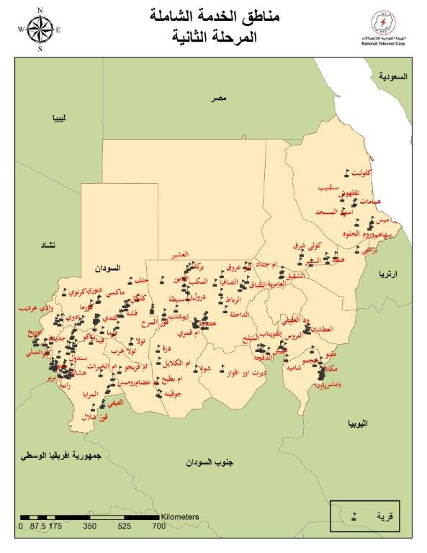

Slide 17
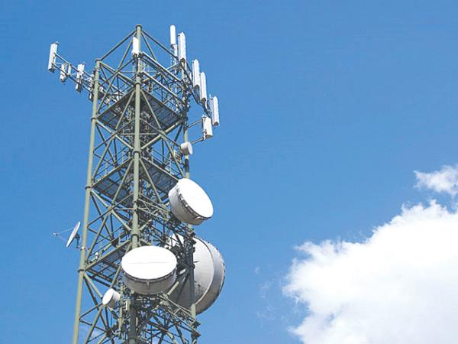
Infrastructure Sharing
NTC has done:
Consultation paper in 2011
Guideline for infrastructure sharing in 2012, include:
Goals of infrastructure Sharing
Types of infrastructure Sharing
General terms and conditions, and
Procedures

Slide 18
Infrastructure Sharing: cont
NTC establish committee in 2015 consisting of (all the relevant part from NTC and MNO), to:
Prepare a roadmap to enable the Infrastructure Sharing
Put method to audit and focus in all cases related to the issue
And study the legal hubs

Slide 19
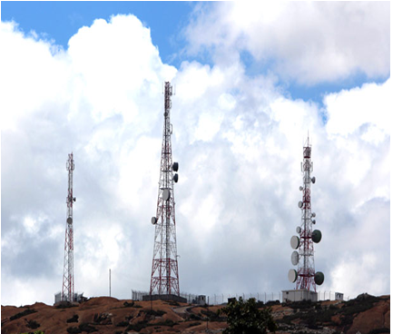
Infrastructure Sharing: cont.
The committee has proposed to encourage and stimulate MNO’s to implement the infrastructure sharing, NTC shall do:
When we find more than three BTS’s in the same area, NTC could replaced by another BTS ready to run all operators.
The cost of transfer this BTS’s will be paid by NTC
Will be use all BTS’s are removed in rural areas (USF Projects).

Slide 20
Any Question
Regional Development Forum for the Arab States,
Khartoum, Republic of Sudan 29 January,2017

