Slide 1

What are some of the ICT Strategic Initiatives that contribute to Sustainable Development?
Saleh Tarradah
Chairman
ICT Committee
Federation of Arab Engineers
ITU Arab Regional Development Forum
“ICT = I C Tomorrow”
28 October 2013, Manama, Bahrain

Slide 2

Content
Sustainable Development Framework
Utilization of Limited Resources
Minimizing Environmental Impact
ICT products and services
Conclusion

Slide 3
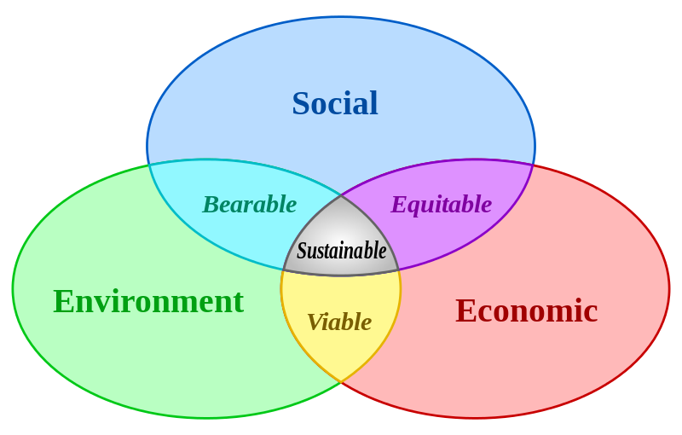
Sustainable Development Framework
‘Information and
communication
technologies (ICTs), while
not an end in themselves,
have a key role as a basis
for economic development,
while also promoting and
enhancing social cohesion,
cultural enrichment and
environmental
conservation’
The Wellington Declaration

Slide 4
Utilization of Limited Resources
Promote the use of shared ICT facilities
Improving energy efficiency of Data Centres and Mobile Base Stations
Enabling reuse of existing ICT systems
Moving towards a common infrastructure underpinned by a set of common standards

Slide 5
Minimizing Environmental Impact
Use renewable energy to power ICT systems
ICT companies to increase the energy efficiency of their real estate.
Promote and support the establishment of e‐waste/green ICT programmes
Use ICT to help other sectors reduce energy consumption and curb carbon emissions, by digitizing processes that are carbon intensive

Slide 6
ICT products and services
Use cloud computing to deliver infrastructure, platform or software as a utility service
Decommission and Switch off surplus ICT that is no longer required
Increase Mobile Working Capability
Establish early warning and disaster management systems

Slide 7
Conclusion
The implementation of these ICT Strategic Initiatives will contribute and facilitate National Sustainable Development .

Slide 8
CONTACT
Mobile
+973 39 60 69 55
eMail : saleh@stconsultants.co

