Slide 1
Easyprep

Slide 2
A virtual education platform which provides structured and well researched educational content to high school students.
Notes:
- Online - needs to be hosted on a server. (live, localhost, intranet)
- Access requires devices with ability to connect to the hosting server
- Structured manner/format - by default, student has access to content he needs

Slide 3
Innovation
Well researched and structured content, in line with official education curriculum(s)
Real final year exams and timed tests with detailed explanations – familarise student with exams
Social and multimedia features e.g. games, study groups, calendar planner
Administrator features for system and content management
Notes:
Well researched - founder is in education & has a wider perspective on how schools & education systems work. Also through partnerships with more schools, content vendors & authors
Structured format e.g. KCSE student accesses KCSE related content by default, unless request is made for others
Social – integrated with educational tools such as scientific symbols so as to encourage students to engage in educational discussions when they chat with friends.
Multimedia - educational games designed with a purpose of challenging students to improve on basic skill such as typing, widening their vocabulary etc

Slide 4
Motivation
Effective tool to prepare students for their final year exams
A tool that allows parents, teachers and students to easily measure progress
A fun and interactive environment for learning i.e. integrated games and social tools

Slide 5
Impact
High quality & standard educational content for all
Needy students able to get sponsors
A tool for homeschooling
Publishing platform for content vendors and authors
Crowdsourcing features allows for best answers to questions
Teamwork in solving problems by use of the social features
Notes:
Remote learning with ease – content delivered with features that filter exactly what student needs at every stage
Improved learning patterns – since students have access to all education levels content at every point in time
Expanded knowledge base for students – since students can access content from other countries

Slide 6
Results
Better performance irrespective of socioeconomic background
Easier learning techniques by use of multimedia e.g. videos and interactive images
Collaborative and not just competitive approach in solving problems
Better interest and passion in education
Notes:
Uniform/standardized content for all students – due to input from various stakeholders i.e. teachers, content vendors & authors

Slide 7
Uniqueness
Supports multiple education systems
Sample questions, timed tests & detailed explanations
Progress tracking features – for easy monitoring
Social and multimedia features – encourages interactivity
No hardware limitations i.e. Online/Offline, USSD & SMS, mobile applications
Content uploaded directly into the platform for better user experience i.e. not just documents
Notes:
Sample quizes, tests & explanations leads to improved understanding by student.

Slide 8
Demo

Slide 9
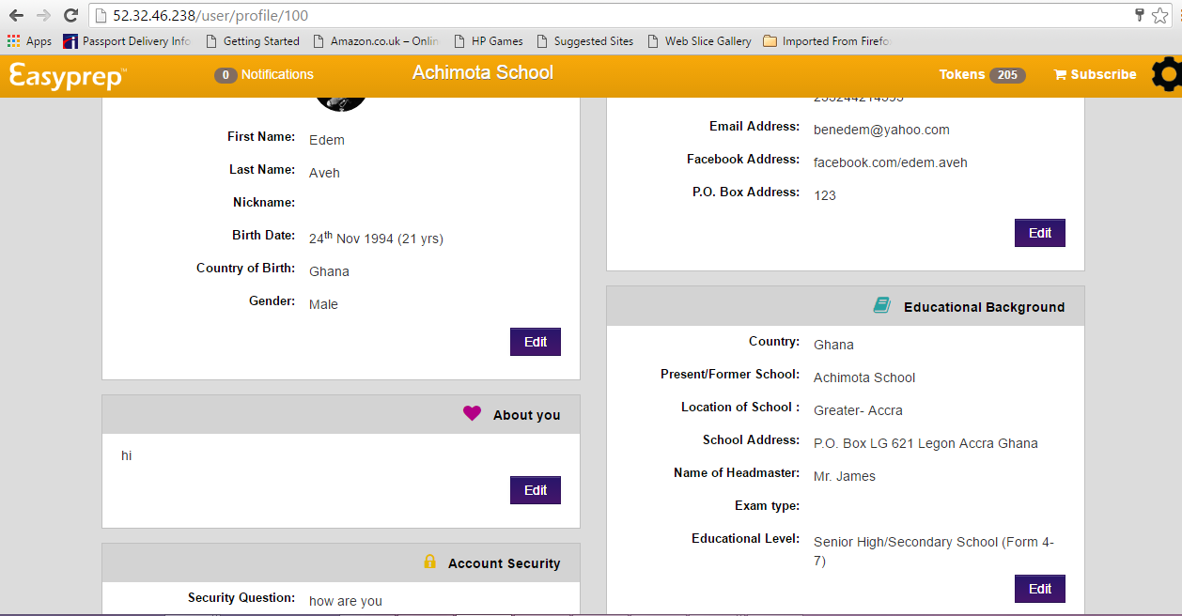

Slide 10
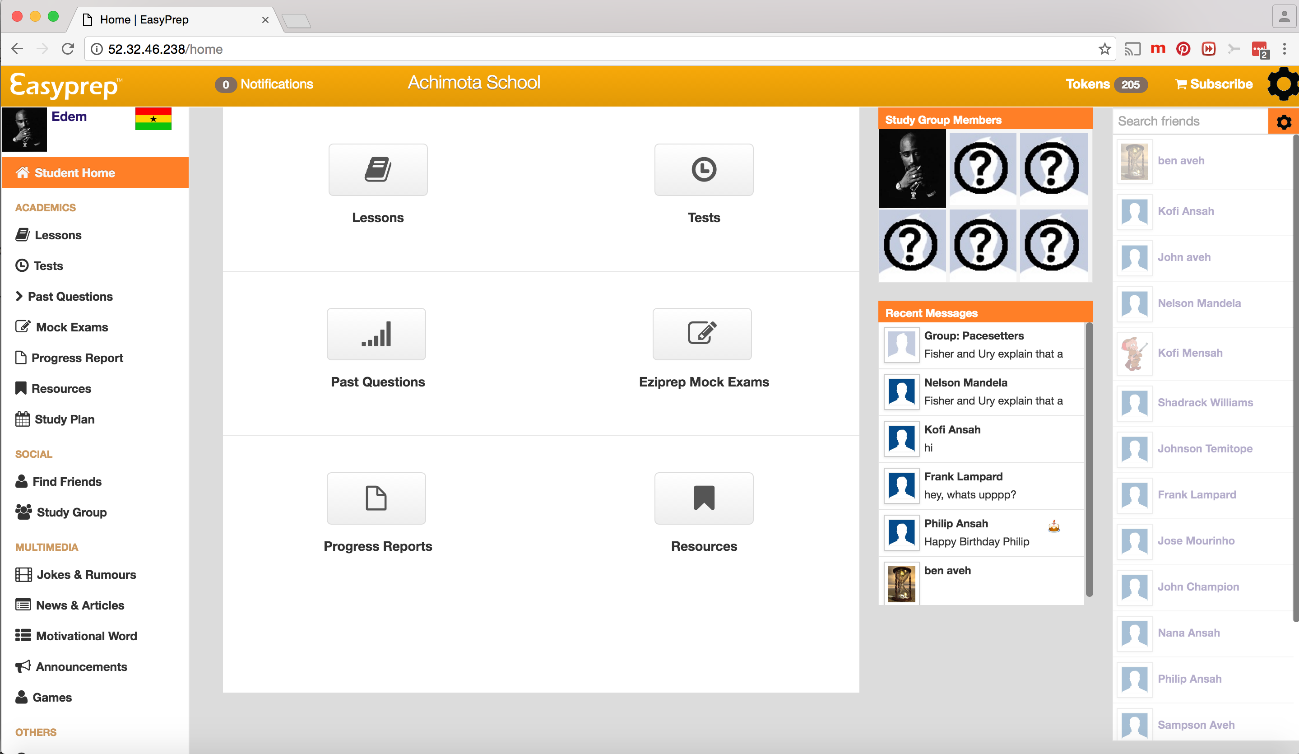

Slide 11
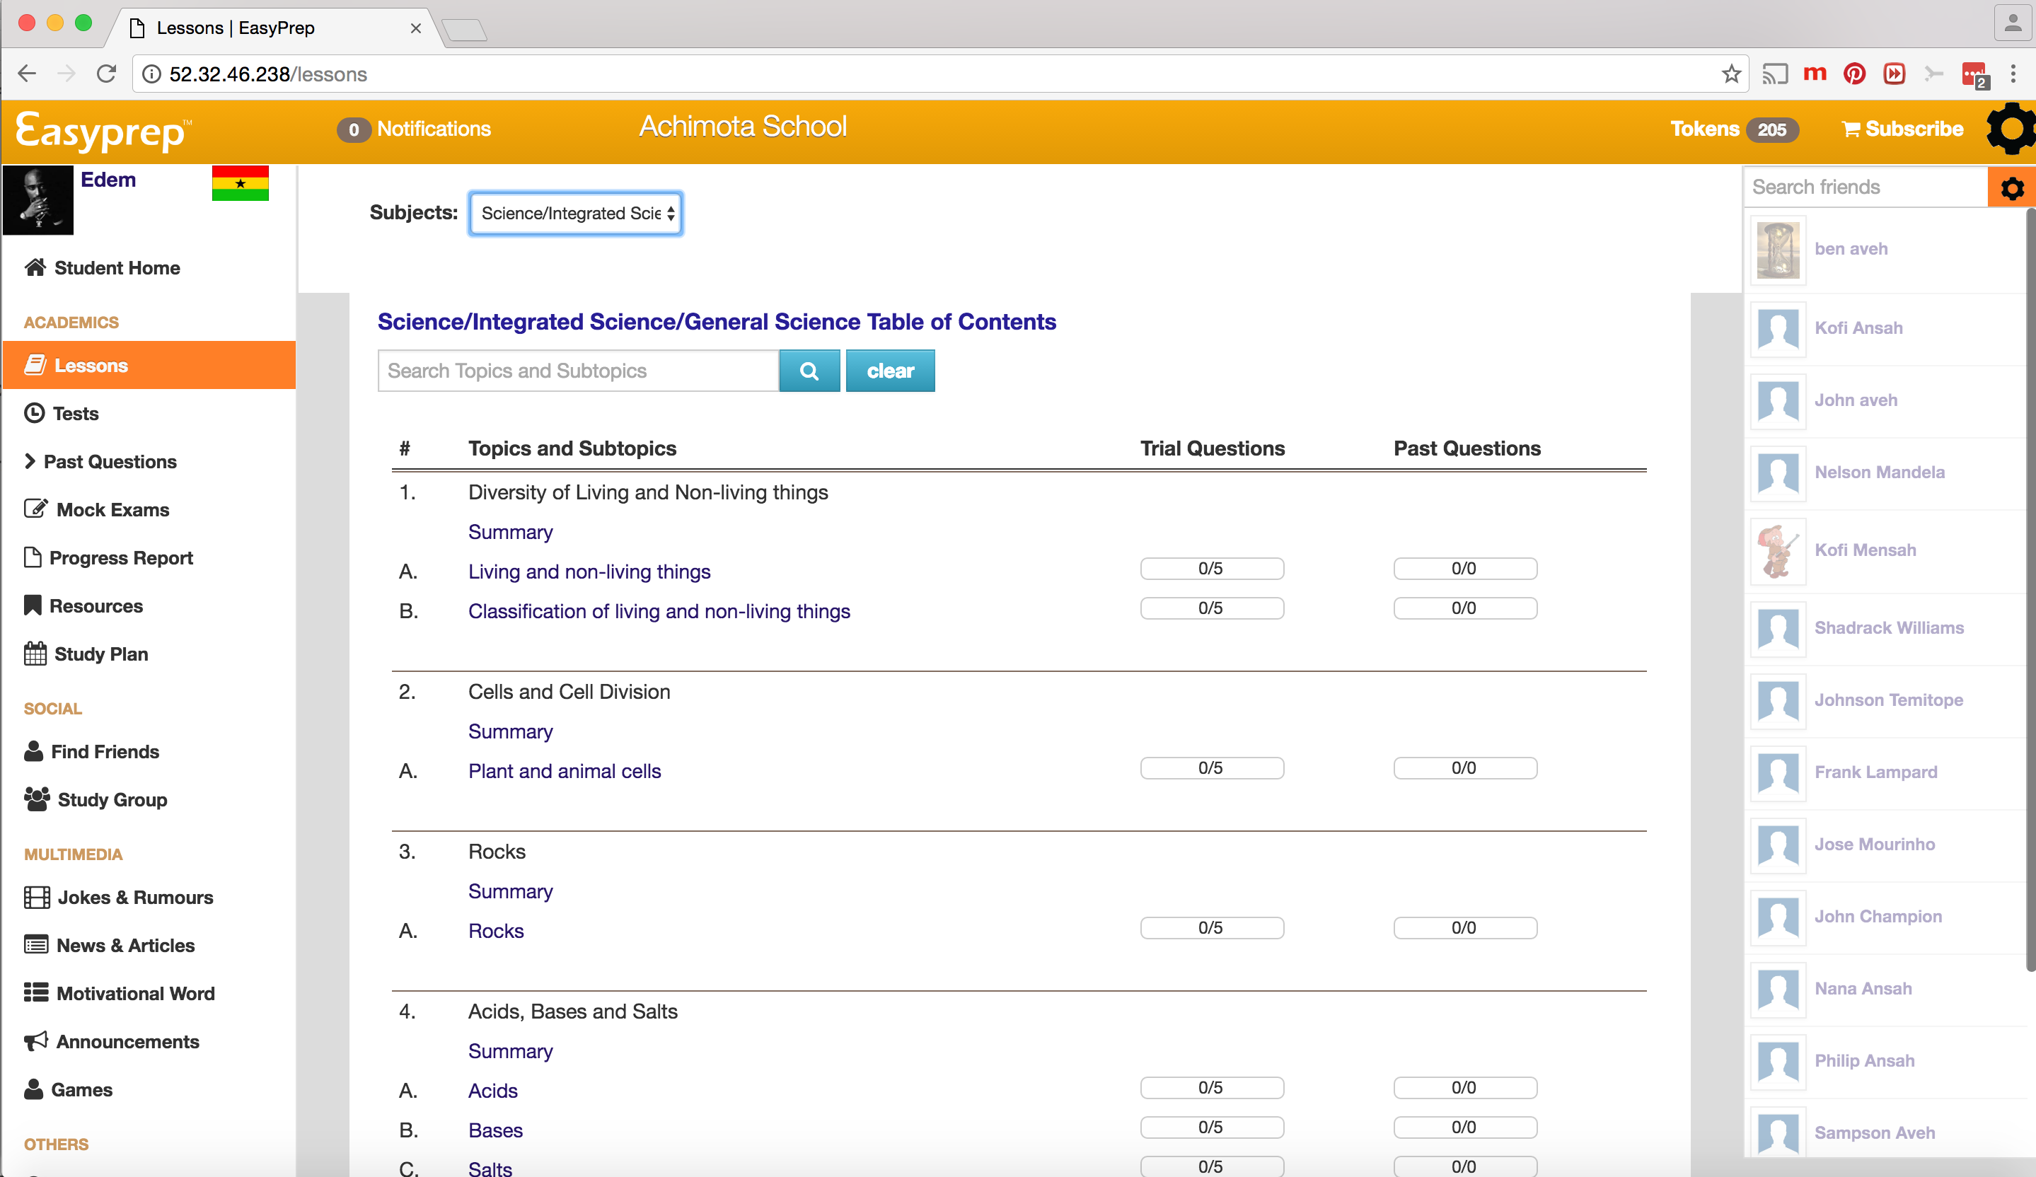

Slide 12
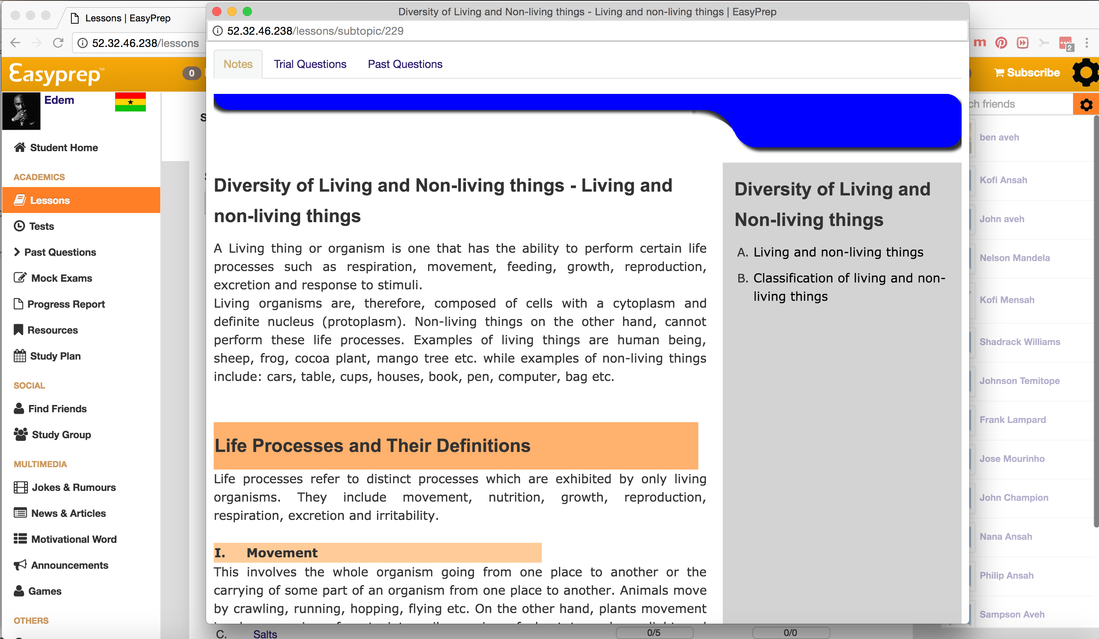

Slide 13
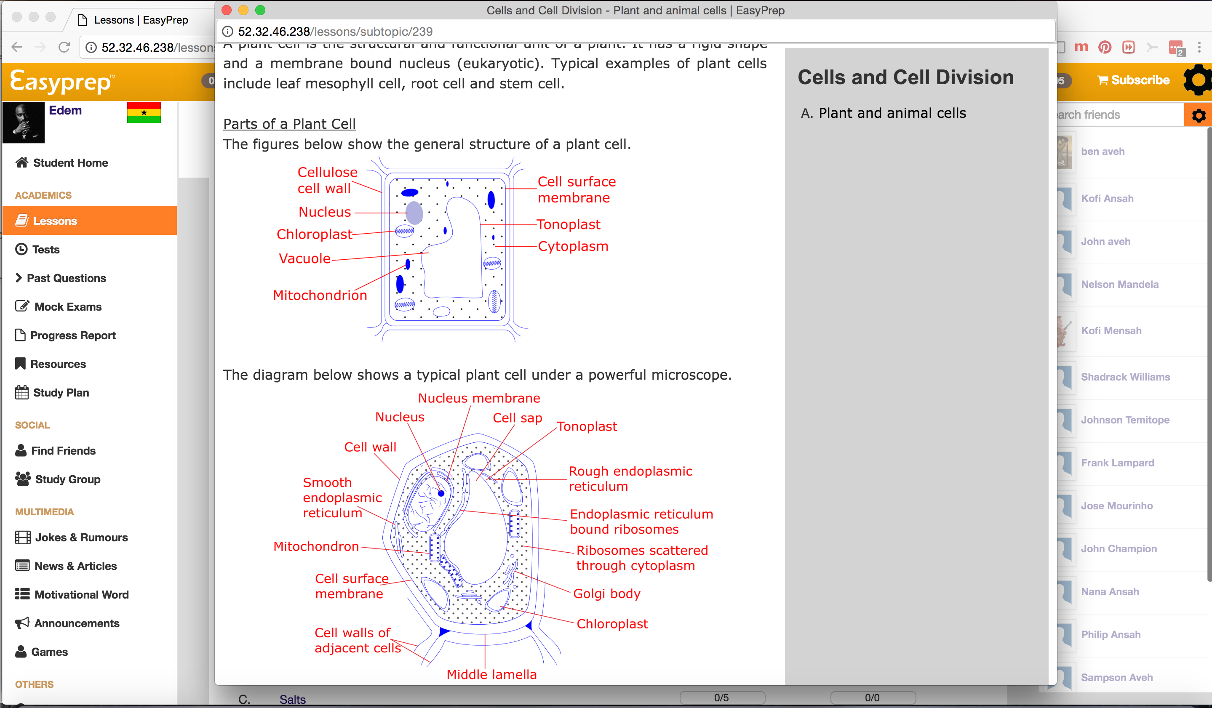

Slide 14
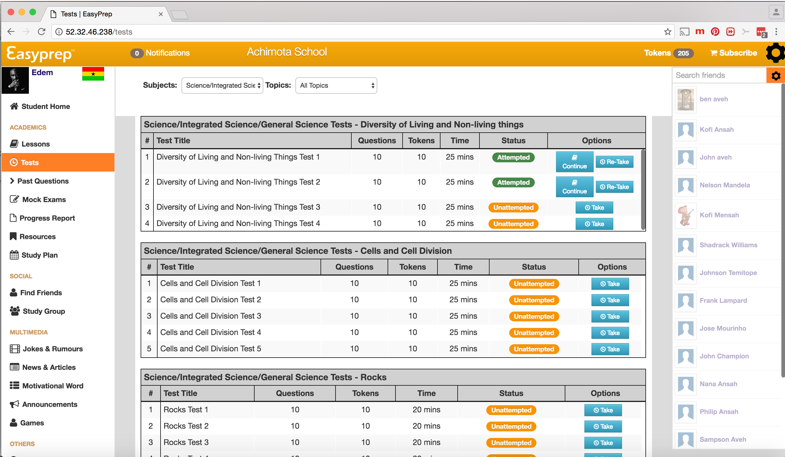

Slide 15
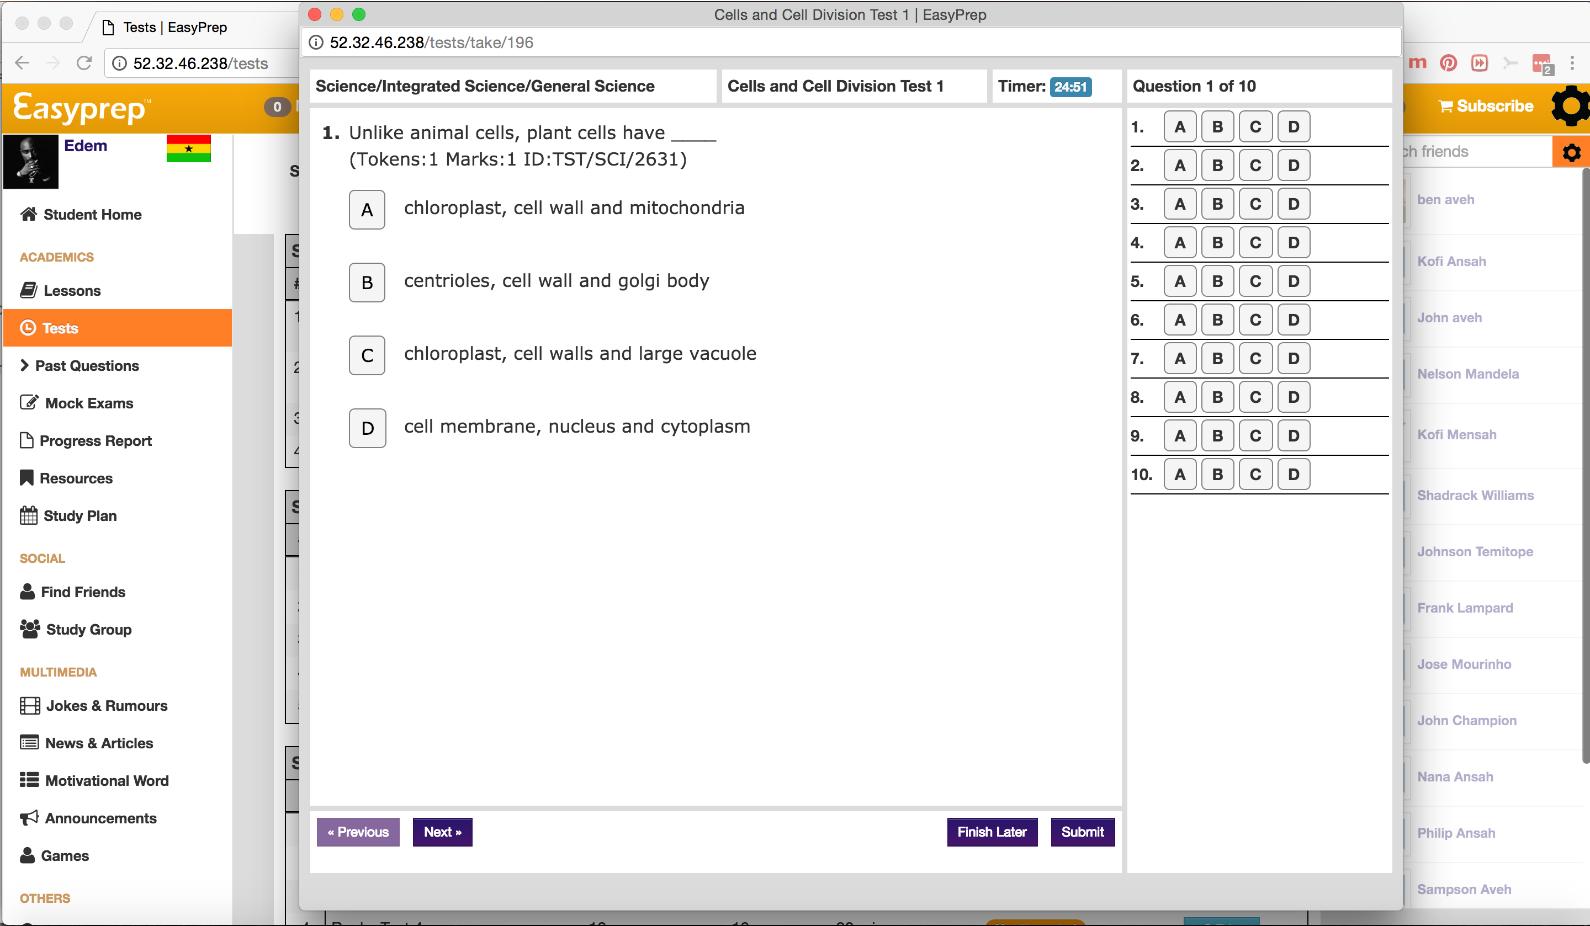

Slide 16
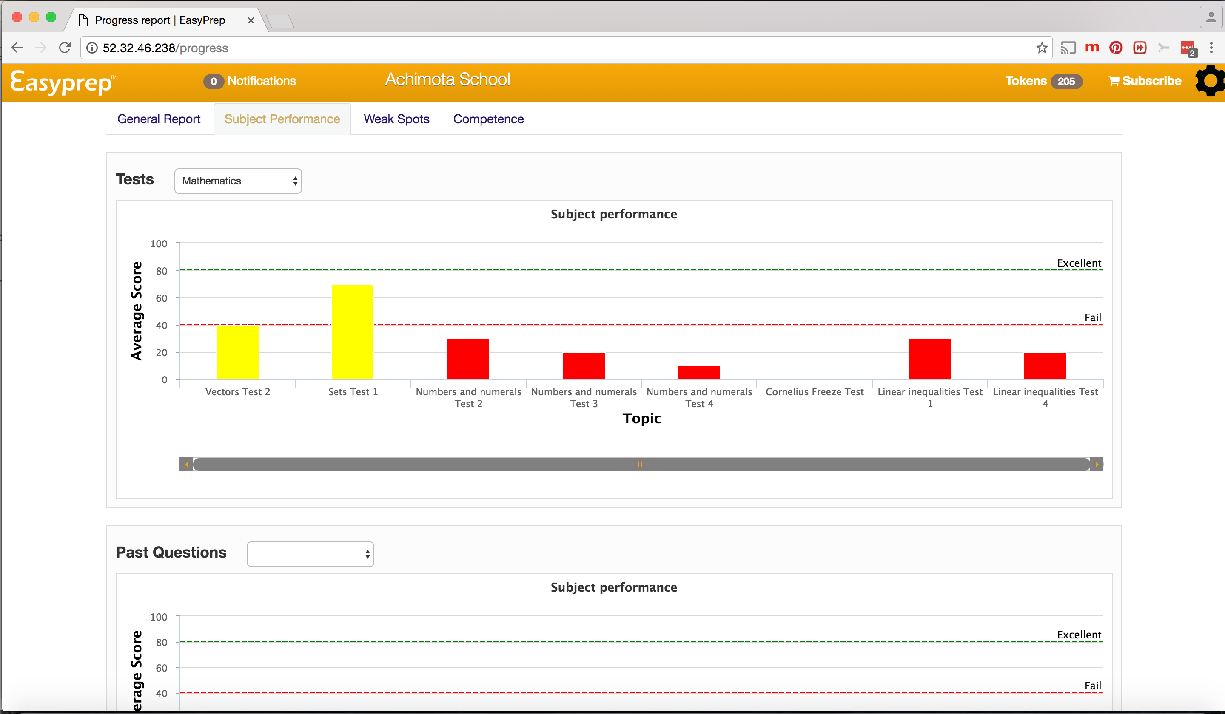

Slide 17
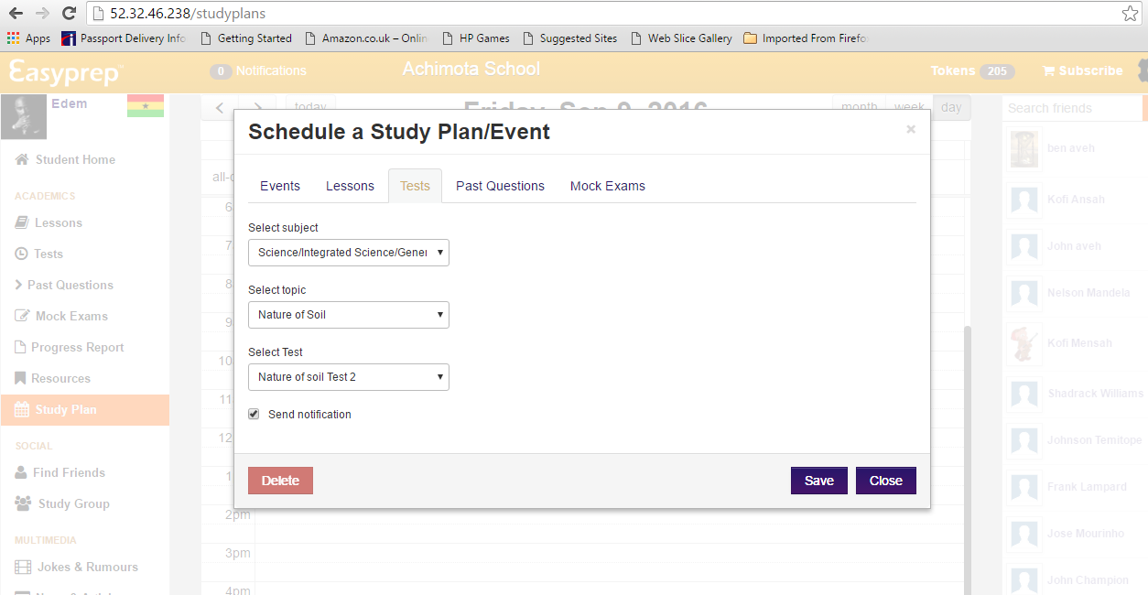

Slide 18
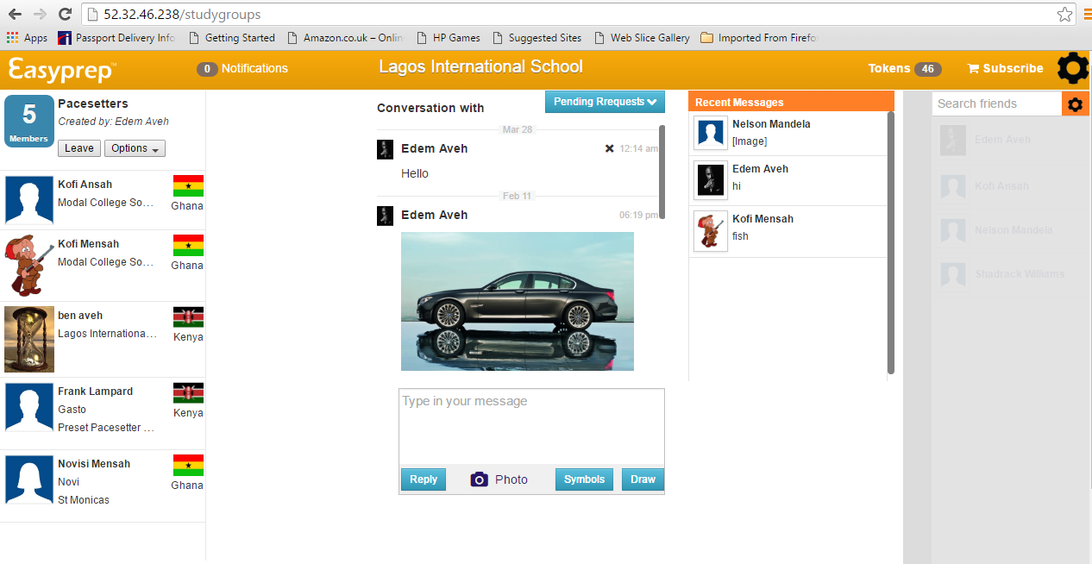

Slide 19
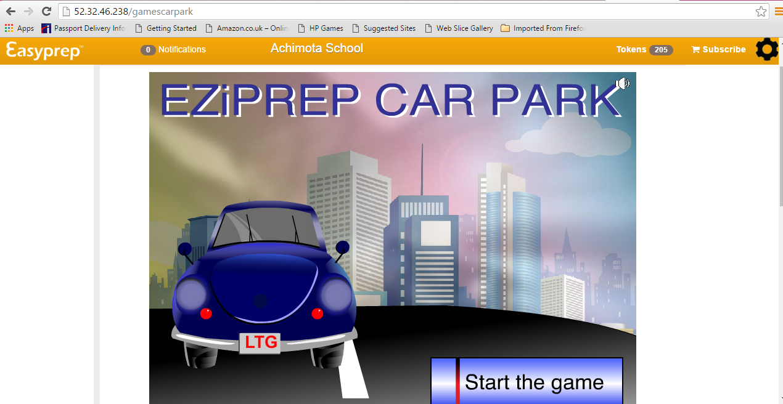

Slide 20
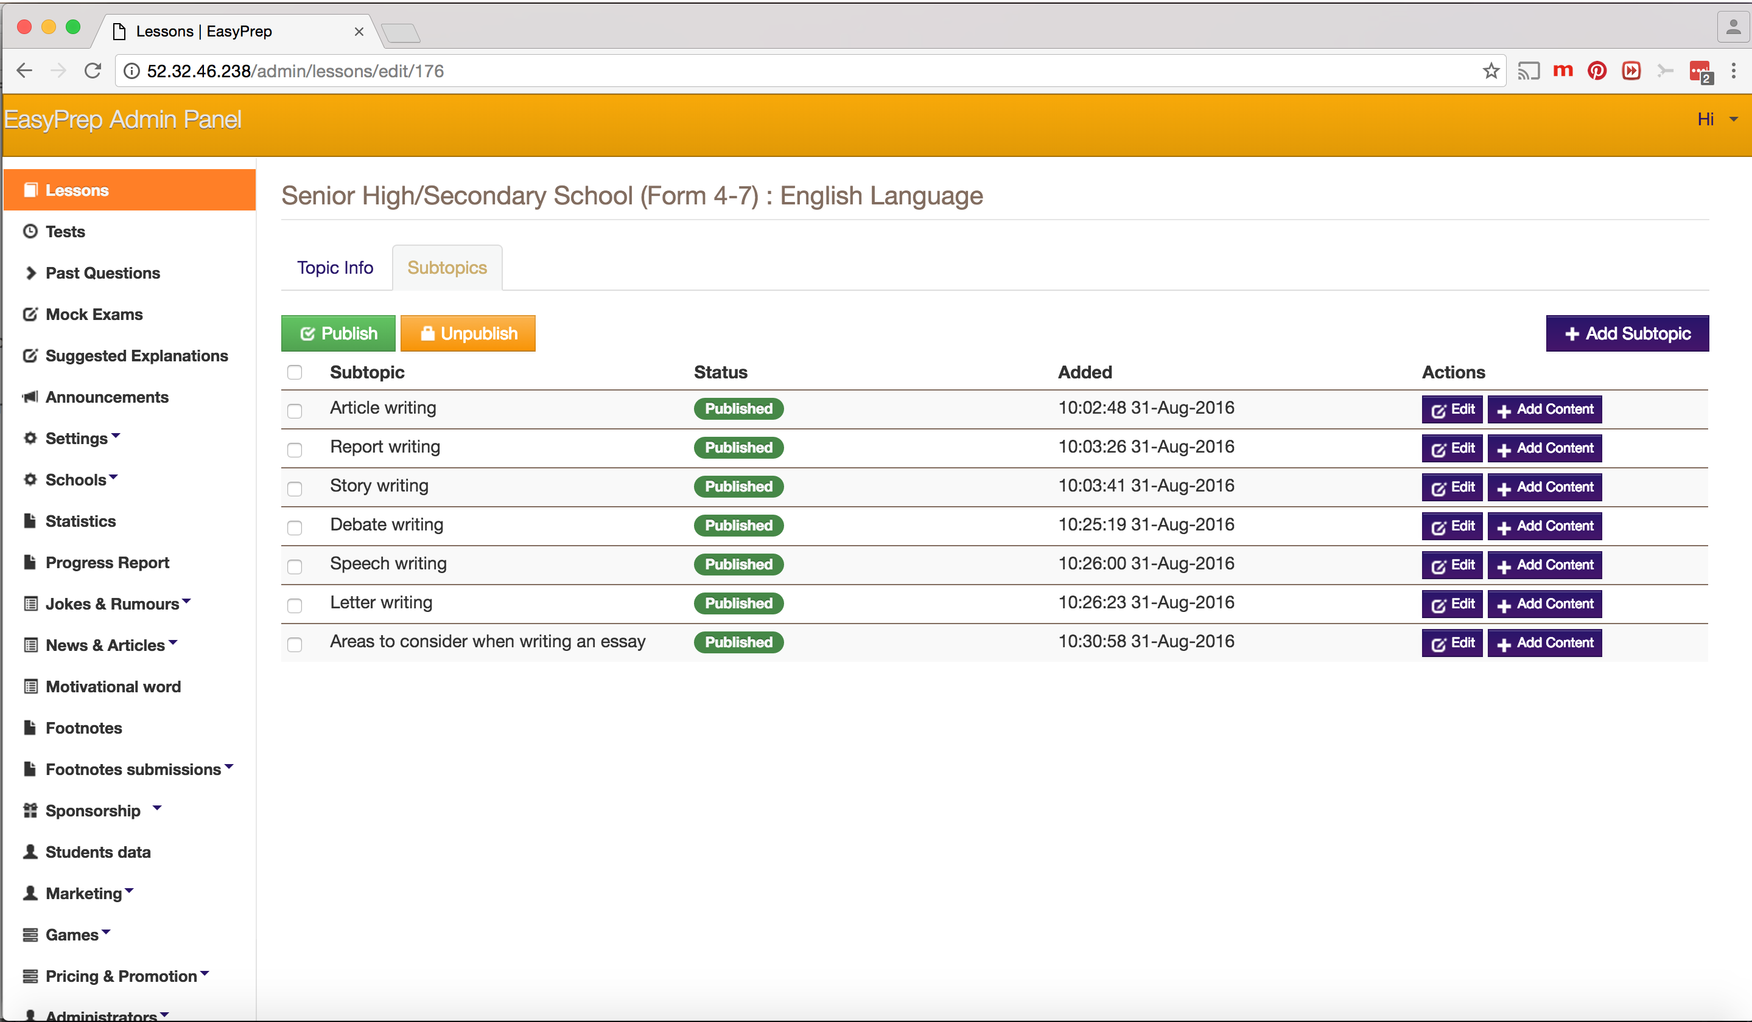

Slide 21
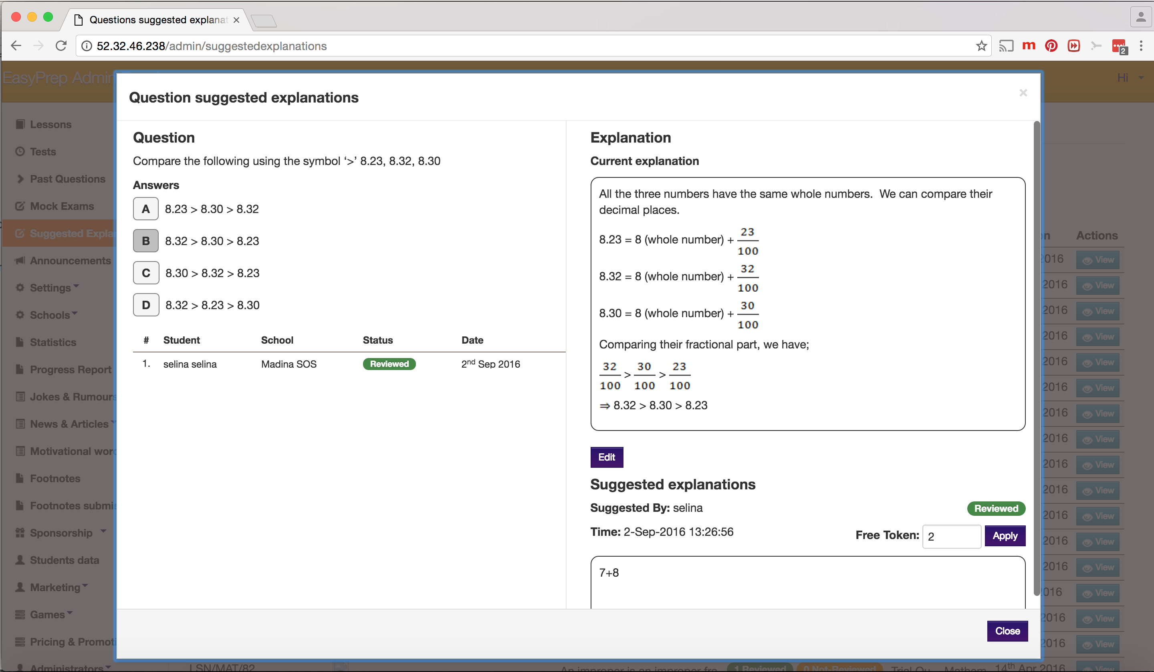

Slide 22
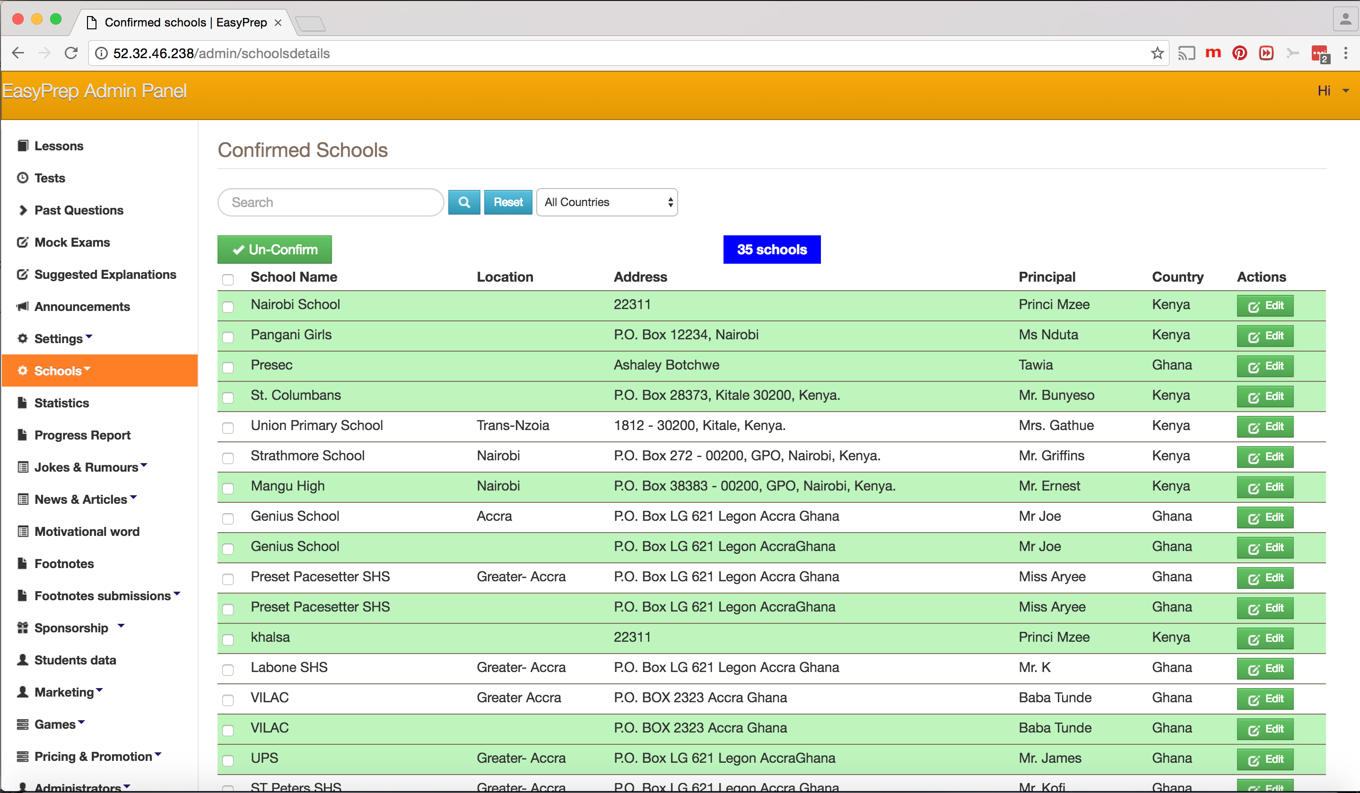

Slide 23
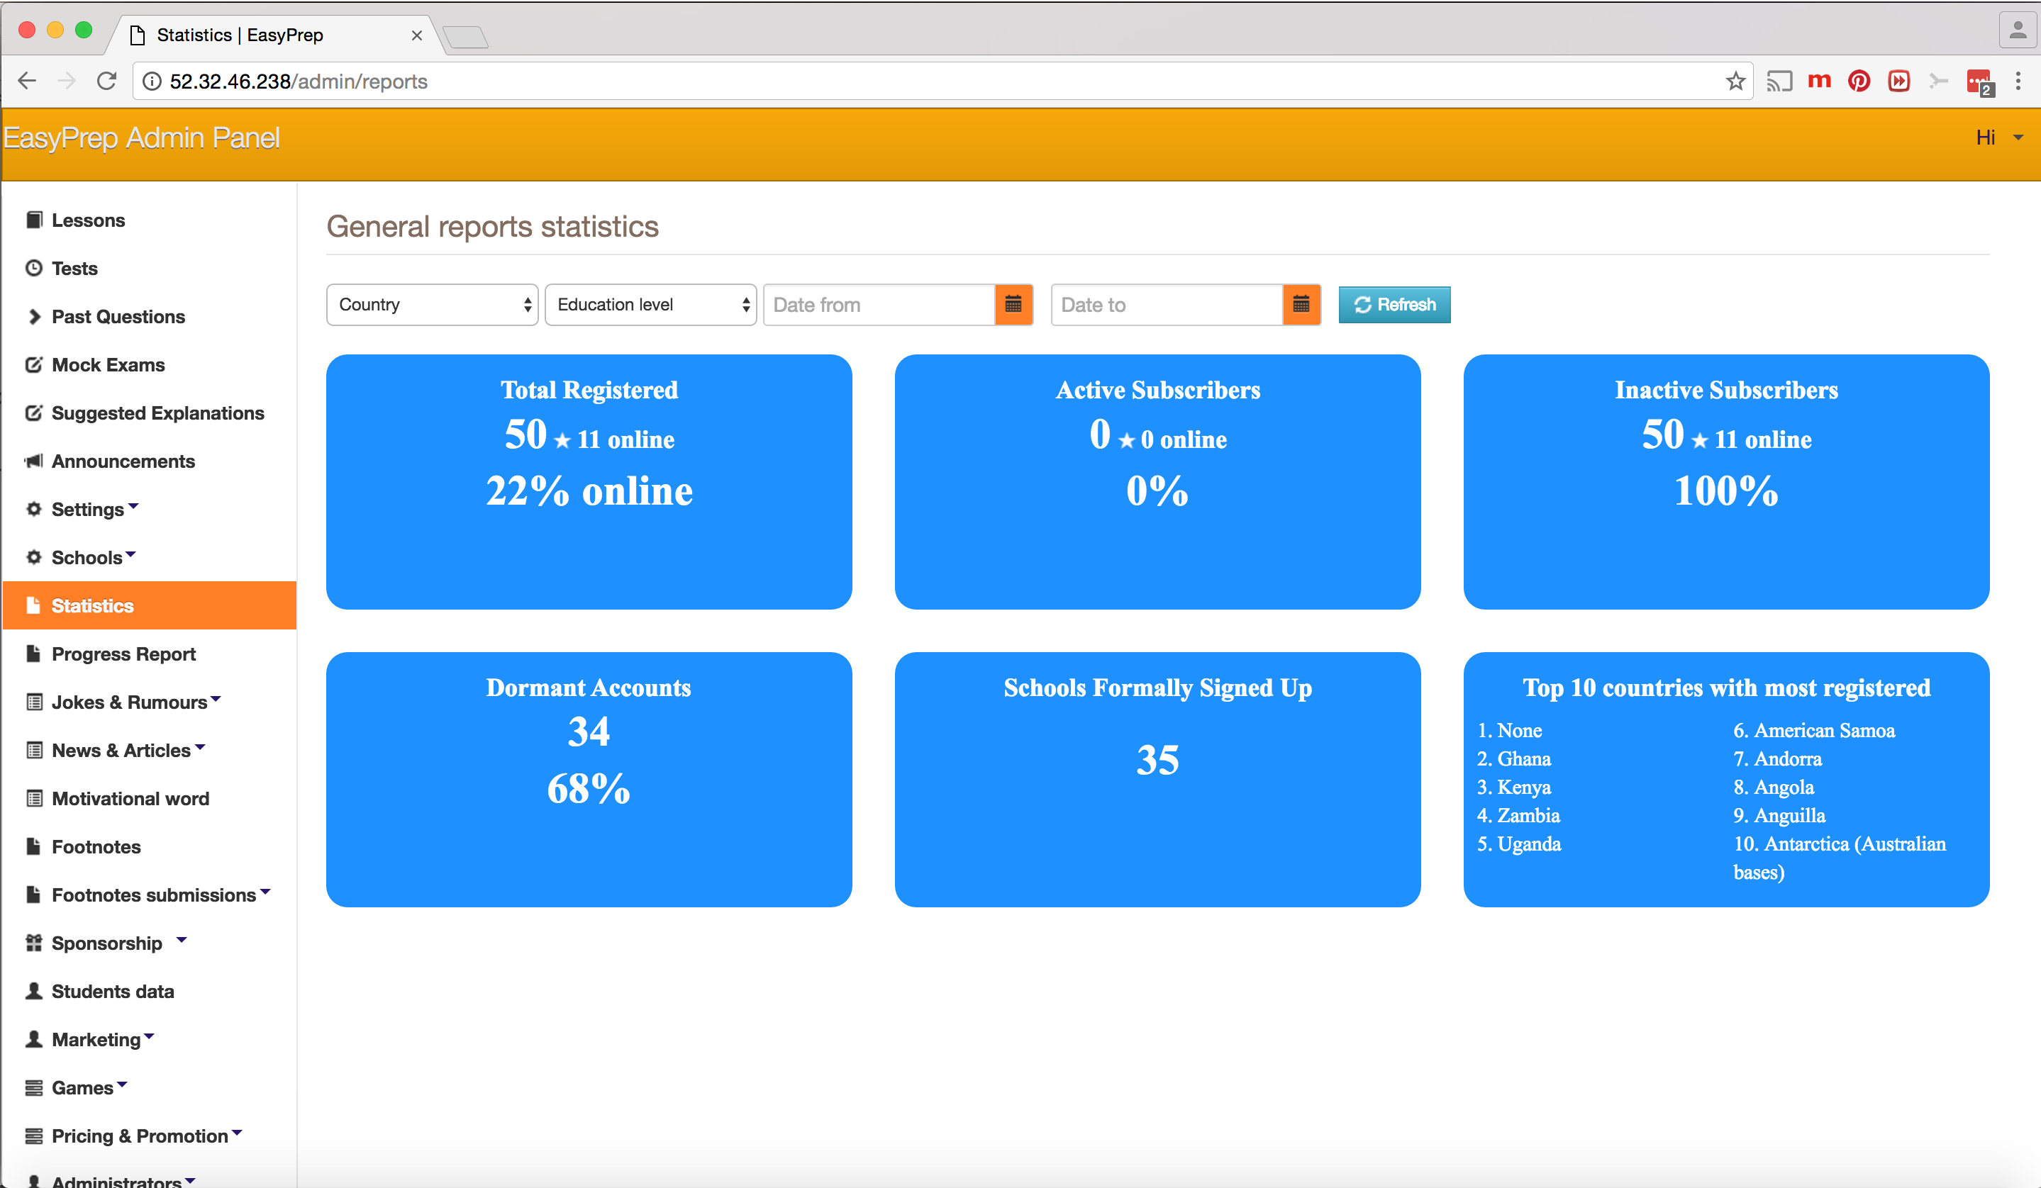

Slide 24
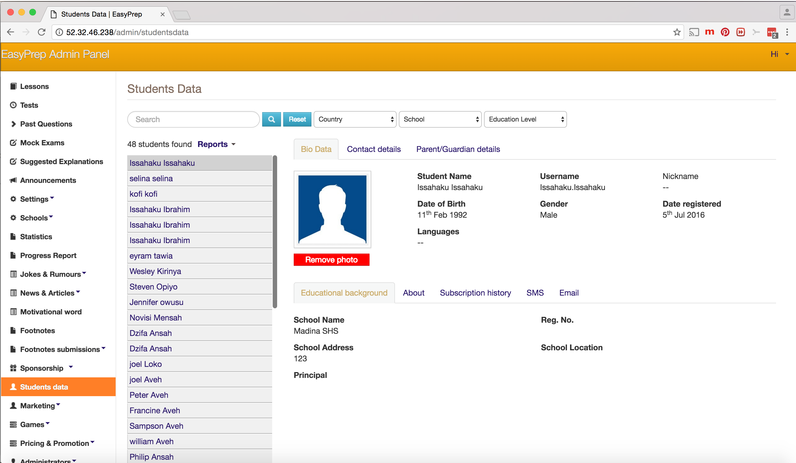

Slide 25
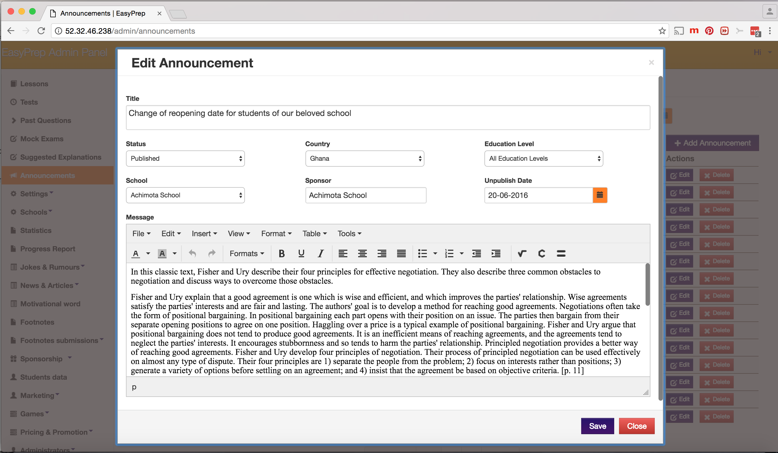

Slide 26
Thank you
(+233) 244 214 593
(+254) 726 734 650
benedem@yahoo.com
cornelius.wafula@gmail.com

