Slide 1
Toolkit on End-of-Life Management of ICT Equipment
Tatiana Terekhova
UNEP/Secretariat of the Basel Convention

Slide 2
Contributors & Collaborators
Laura Reyes (DATEC – BELMONT)
Tatiana Terekhova (UNEP/Secretariat of the Basel Convention)
Shannon West (Verizon)
Federico Magalini (UNU)
Cristina Bueti (ITU)
THANKS:
Elisabeth Dechenaux, Didier Marquet, and Ahmed Zeddam (France Telecom/Orange)
Gilbert Buty and Thomas Okrasinsiki (Alcatel Lucent)
THANKS:
Microsoft
Verizon

Slide 3
Purpose:
Aims to give directions on how to find an environmentally sustainable solution for EOL equipment by providing a checklist that allows full monitoring of the decisions made in relation to ICT EOL
To present different initiatives for ICT equipment’s End of Life management solutions.
Identify social, economic and environmental aspects related to End of Life management of ICT equipment.
Illustrate how the end-of-life management and its environmental aspect can be integrated into the design process as part of the life-cycle approach within the framework which is developed by the ITU-T Study Group 5 (SG5).

Slide 4
The Document:
End of Life Management
General Material Recovery and Recycling Facility Guidelines
Clean Supply Chain and Conflict Minerals
Socio – Economic Issues
Offsetting Opportunities and Mitigation
Case Studies
Check list
Conclusions - Suggestions

Slide 5
End of Life Management:
Definition of End-of-Life for ICT Equipment: Advises on the need to conduct functionality tests.
Definition of Environmentally Sound Management of E-Waste
General description of the end-of-life management chain for ICT equipment
Transboundary Movements of Hazardous Wastes and Other Wastes
End-of-Life Management: Stages and Waste Hierarchy
E-WASTE: “Any device that for functional reasons is dependent on electric currents or electro-magnetic fields in order to work properly. It becomes e-waste when the holder discards, intends or requires to discard”

Slide 6
General Material Recovery and Recycling Facility Guidelines:
Environmental Management System, Licences & Permits
Monitoring and Record Keeping
Emergency Planning
Occupational Health and Safety: Best Practices to Ensure Workers’ Safety
Personal Protective Equipment
Employee Training
Financial Guarantees

Slide 7
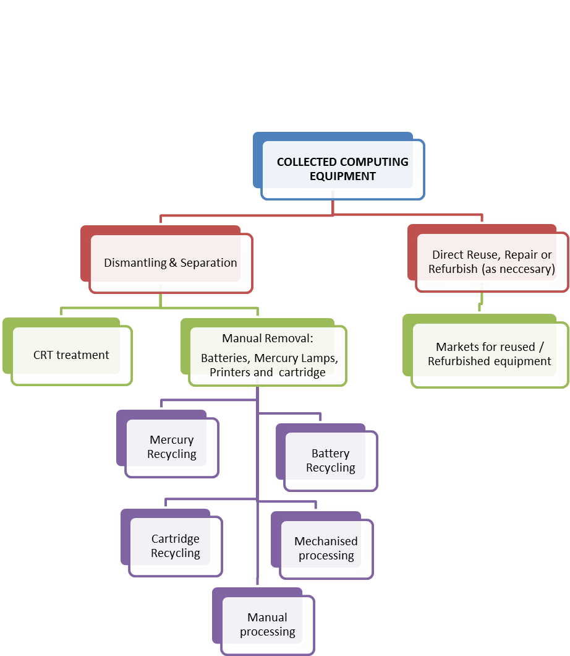
Example of End of Life Management processing for Computing Equipment.

Slide 8
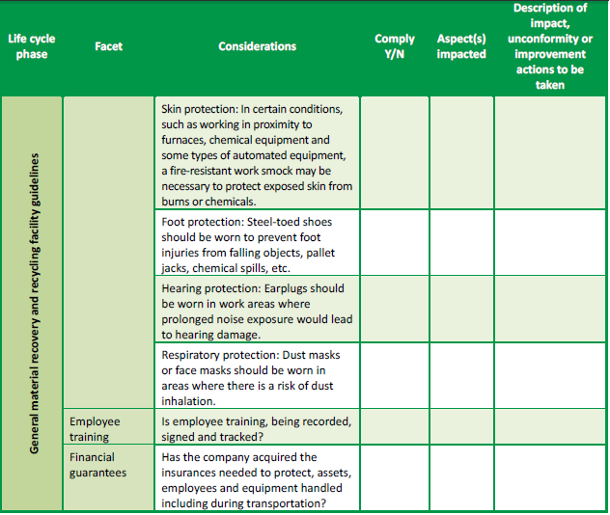
Checklist example :

Slide 9
Clean Supply Chain and Conflict Minerals:
Closing the loop on e-waste by introducing or reinserting precious and rare metals recovered or recycled from the unwanted ICT equipment to the supply chain represents an opportunity for manufacturers to:
Ensure a clean supply chain
Reduce the demand on limited natural resources, which is auditable, measurable and tractable;
Reduce production costs of brand new product
Influence customer’s purchasing power by offering a product that is verifiable conflict-free.

Slide 10
Clean Supply Chain and Conflict Minerals:
Manufacturers can support recyclers ‘ efforts to recover material by:
Designing products that through their different life -cycle stages reduce environmental impact and waste generation. (See Sustainable Products - Designing for End-of-Life Treatment)
Designing, producing, labelling and commercialising equipment that have has a reasonable extensive life and can easily be repaired or dismantled for reuse or its value recovered without influencing economic growth.
Recycling rare metals in ICT equipment - ITU-T L.1100
Detailing the procedures to be employed when recycling these metals.
The Recommendation outlines key considerations in all phases of the recycling process, and provides guidelines as to how organizations may fairly and transparently report on rare metal recycling.

Slide 11
Socio – Economical Issues:
Developing countries main challenges in relation to e-waste:
Imported non- functional / non - repairable equipment as second-hand with very short life spam, as well as domestically generation is rising.
Positive and Negatives effects depending on whether the EOL management of ICT equipment is managed responsibly or not.
Efforts need to focus on:
Stopping unlawful competition of traders who calling themselves “recyclers” offering large economic benefits but no guarantees for the EOL management
Development and adoption of policies, legislation and standards to support sustainable jobs creation and use of technology for environmentally sound management of EOL ICT equipment.
The importance to regulated refurbishing and reuse practices in developing countries to support the protection of global community and limit the operations of unlawful players on the market
Ghana Case Study.

Slide 12
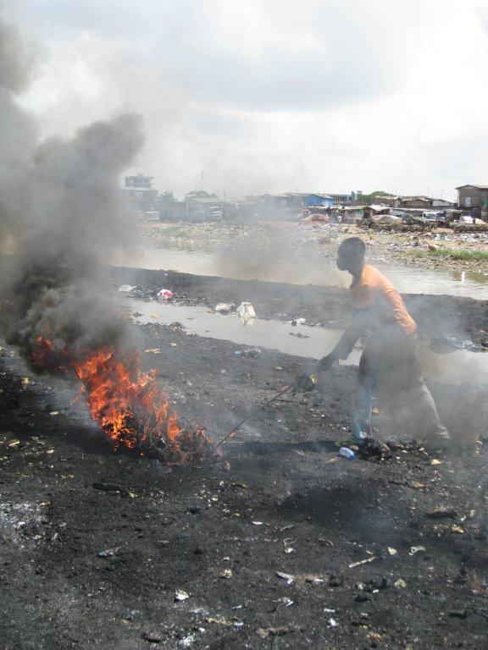
Offsetting Opportunities and Mitigation:
Corporate Social Responsibility
CO2 Management:
Allowing the e-waste recycling industry to actively participate in the to carbon markets.
Enabling project-based offsets for different stakeholders
Enabling project-based offsets for different stakeholders for setting up a take back scheme in a country without legislative obligations.

Slide 13
Conclusions - Suggestions
ICT product design issues:
Clean supply chain: reduction of the demand on limited natural resources; products with reasonable extensive life.
Technical guidance applicable to refurbishment and repair facilities as well as marketing of used ICT equipment:
To include processing and management of equipment and components destined for reuse; record keeping and performance measurement (partly covered here), etc.
Environmental, socio-economic aspects:
Guide the industry in how to help governments and communities to end bad EOL practices , taking into account the micro-economics.

Slide 14
Suggestions to ITU-T Study Group 5:
4. Principles for donors of ICT equipment
Ensure that products are functional and that appropriate products are provided; availability of technical support in the country of destination; ensure full transparency, contract and notification and consent prior to delivery; etc.
5. Development of national ICT policies where necessary.
Ensure that the life-cycle approach is used for developing national ICT policies. E.g. inter alia, green design, collection, recycling, disposal should be considered in the policy.
6. Map Guidance document on ICT applicable standards and legislation
Develop a map or guidance document that helps the user to make an independent but informed decision over which standard to use according to the needs and objectives of the stakeholder on its specific role within the recycling chain.

Slide 15
Suggestions to ITU-T Study Group 5:
7. Development of a Global CO² - equivalent market.
To directly control and incentivise reduction on pollution emissions
8. Recovery of Rare metals and Green Supply Chain
Actively includes and facilitates access to the Recycling and Precious Metals industry in the discussions of possible developments that aim to return such a metals to the industry.

Slide 16
More information
Contact:
Cristina Bueti (greenstandard@itu.int)
Laura Reyes (lreyes@datectech.co.uk)

