Slide 1
Innovation for Sustainability:
Smart + Connected Communities
Nicola Villa
Global Director, Urban Innovation
Cisco

Slide 2
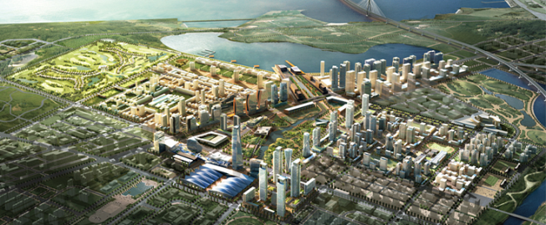
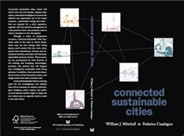
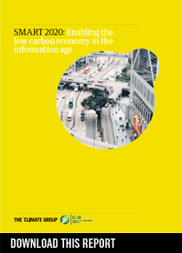
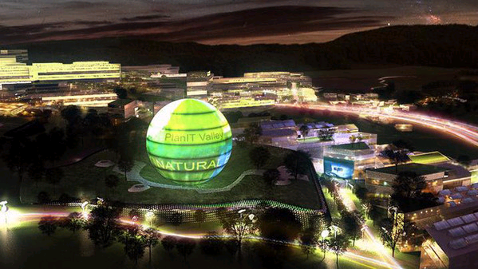
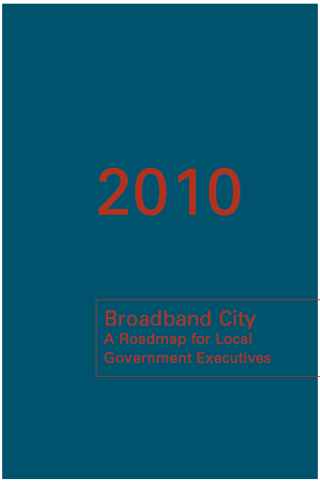
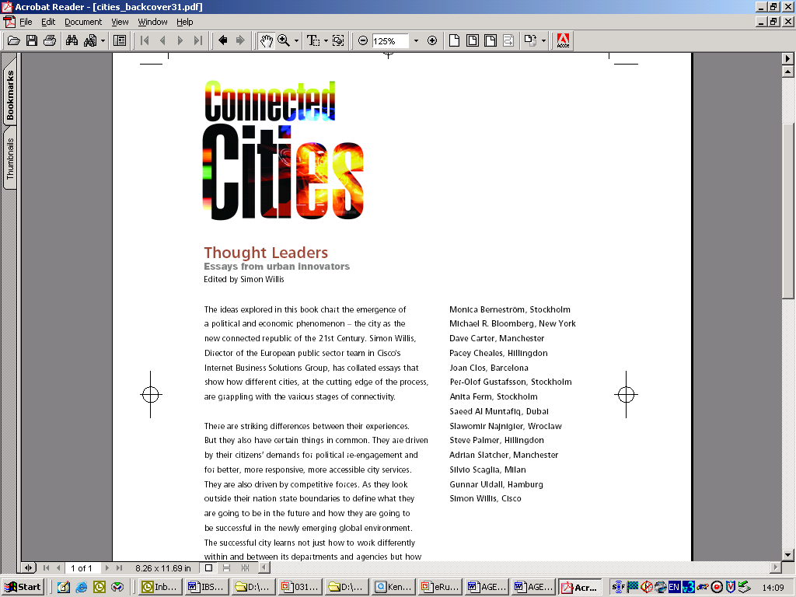
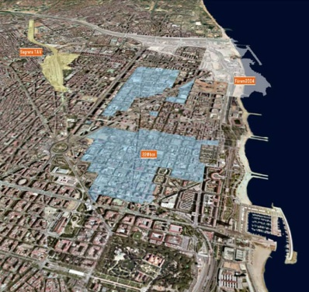
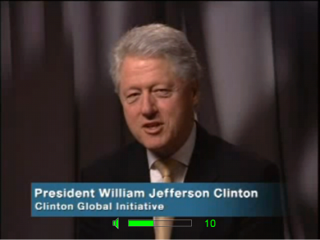
Cisco, Sustainability and the City…
2009-2011
2005-2008
1998-2004
Public Sector Vertical
Connected Urban Development
Smart + Connected Communities
Connected Real Estate BU
EcoBoard
Globalization Center
Smart Grid BU

Slide 3
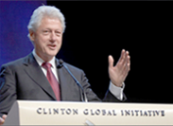
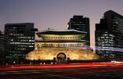

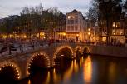

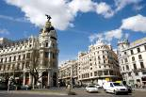

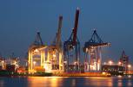


Connected Urban Development (CUD)
CO2 emissions reduction enabled by Broadband and Information & Communication Technology
2006
Three founding cities:
Seoul
San Francisco
Amsterdam
In 2008, four new cities joined in Europe. More cities joined between 2008 and 2010
Lisbon
Madrid
Birmingham
Hamburg
www.connectedurbandevelopment.org
Notes:
Connected Urban Development
In 2006, Cisco initiated a collaborative program with the Clinton Foundation, committed to the Clinton Global Initiative, in conjunction with three founding cities; San Francisco, Amsterdam and Seoul. In 2008, four European cities joined CUD: Birmingham, Hamburg, Lisbon and Madrid.
The primary objective of this program is to reduce CO2 emission through the smart application of technology.

Slide 4
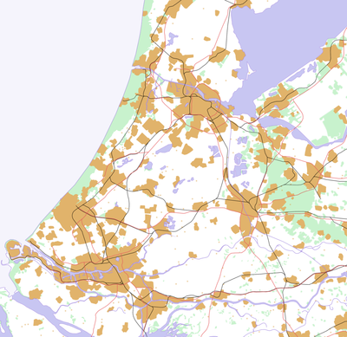









Triple Bottom Line: Smart Work Centers
Amsterdam
Almere
The Hague
Rotterdam

Slide 5
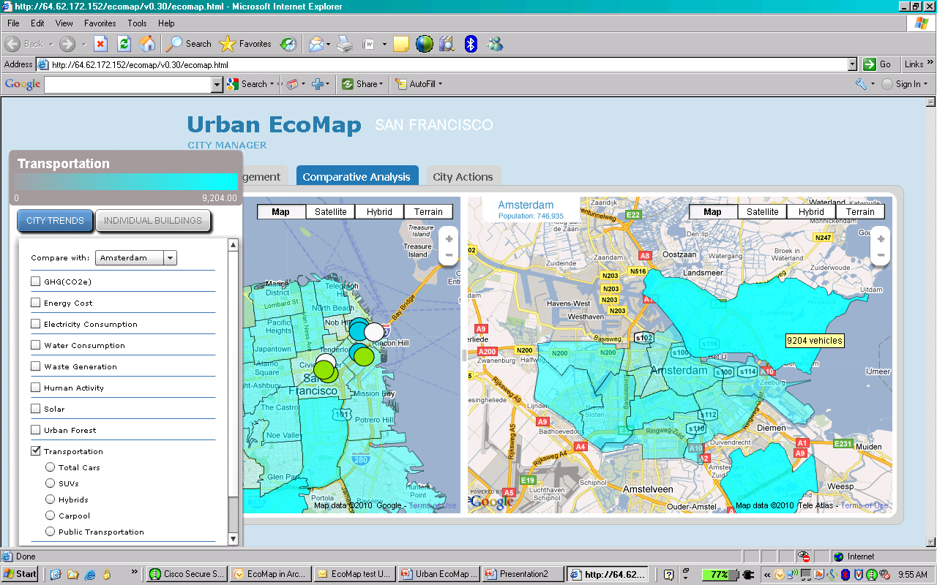
Cloud in Action: Urban EcoMap

Slide 6
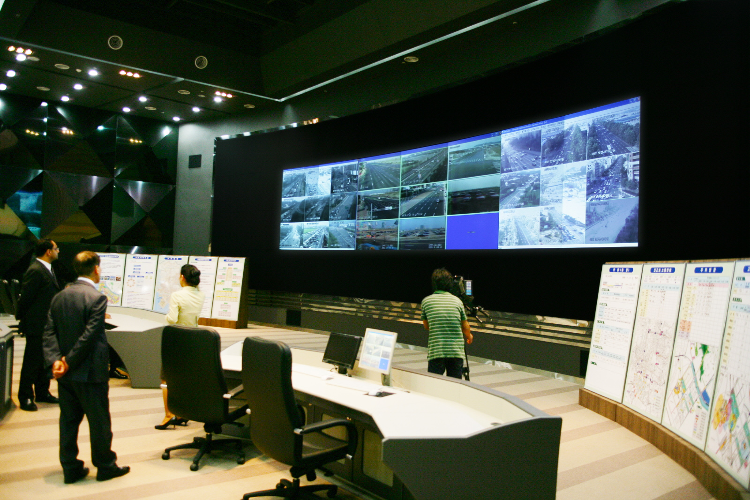





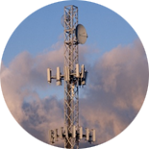


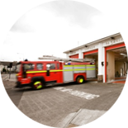



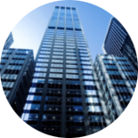
A Service Delivery Platform
Notes:
Government visionaries and their private sector community partners can take a sustainable management approach to help ensure thriving communities. "Community+Exchange" is a back office operations center, "behind the scenes approach" that streamlines planning and management operations at the community level. By providing the network as a highly secure and resilient service delivery platform, you can share information and collaborate across a community's ecosystem of government agencies and private sector partners to facilitate utilities planning, transportation systems enhancements, and health and government social services needs.

Slide 7

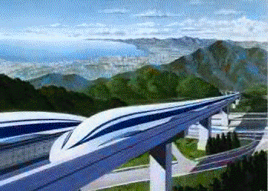
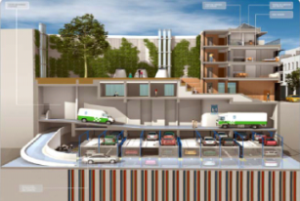
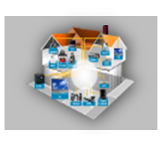
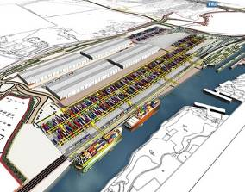
Busan: Green u-City
Living Lab and Open Data
Smart Community
Smart Green
Urban Mobility
Smart Energy
Smart Safety
& Security
Smart Green
Logistics
Smart work
Mobile
application center
Video
contact center
Smart learning
Smart healthcare
Busan PTA
Smart travel stations
Smart parking
Mobile augmented reality tour
Busan eco-pass
Green urban services center
Smart energy management center
Smart buildings
Eco-mileage
(eco-card)
Integrated safety and security with CCTV
build-to-lease IOC
Emergency response and disaster prevention
Real-time logistics infrastructure
Green logistics operation system
Green u-logistics information
utility service
Green U-City Services Cloud Infrastructure
Applications
Busan Mobile Application Center
Integrated Operation Center (IOC)
Public Data

Slide 8



















From Incubation to Market Development
Proof Points
New Development
Revitalization & Growth
Amsterdam: Smart Working Centres
South Korea:
Songdo
Toronto
Seoul: Personal Travel Assistant
China: Chengdu
San Francisco
San Francisco: Urban EcoMap; Connected Bus
India: Lavasa
Barcelona
Case Studies
Portugal: PlanIT
Valley
Colorado: Connected Communities Initiative
Kuwait:
Al Hamra Tower
Qatar:
Gate Building
Russia: Skolkovo
Holyoke
NYC:
Yankee Stadium
China: Chongqing
India: UST Global
campus, Kerala
China: Chengdu
Cisco on Cisco
Busan

Slide 9
What does it take ?
From Corporate Social Responsibility to new Market Adjacency
Triple Bottom Line: Environmental, Social and Economic impact
Public Private Partnerships... with People !

