Slide 1


HIPSSA Project
Support for Harmonization of the ICT Policies
in Sub-Sahara Africa,
Workshop on the SADC Harmonized Legal Framework for Cyber Security Gaborone Botswana 27th February-3rd March 2012
PRESENTATION ON REGIONAL ASSESSMENT OF DATA PROTECTION LAW AND POLICY IN SADC
Pria Chetty,
Regional Legal Expert on Data Protection,
Associate Director, Technology Legal Advisory, PwC Southern Africa
Notes:
.

Slide 2
Summary of the Content
Objectives of the Regional Assessment
Methodology Followed
Key Frames of Inquiry
Comparative Analysis of National Policy and Legislation on
Data Protection in SADC Member States (15 Countries)
Summary of Findings
Statement of Best Practices

Slide 3
Objectives of Regional Assessment
Analysis of the key issues and common principles reflected in ICT regulatory and legislative frameworks relating to data protection in the SADC Member States
Review of laws to identify relevant trends and key issues on data protection regulation
Conduct Comparative Analysis to facilitate harmonisation of policies and laws
Document Best Practice findings that may be used for the development of a Model Law for the SADC Region

Slide 4
Regional Assessment Methodology
Review
Questionnaires to Member States
Desktop Research
Comparative Analysis
Review of National Legislation
Comparison of common and differentiated approaches
Statement of Best Practice
Analysis of compatibility with global standards
Distinguish the best practices

Slide 5
Frames of Inquiry
International and regional frameworks establish the primary themes, intent and functional requirements for data protection regulation.
Within SADC Member States, inquire:
Designated national data protection legislation
Prevalence of regulation that has a bearing on the right to privacy and protection of personal information in the SADC Member States.

Slide 6
Frames of Inquiry
Definitions of personal information and sensitive information,
Principles of data protection
Nature and functions of the Data Protection Regulator Regulation of Transborder flows of personal information
Nature of the Constitutional right to privacy
Privacy in Consumer Protection
Privacy in Electronic Communications
Rights of Access To Information versus the right to privacy

Slide 7
Comparative Analysis/ Data Protection Law and Policy
None of the Member States have a dedicated Data Protection Policy
Namibia, Lesotho, Swaziland, Botswana have ICT Policies that reference the importance of/ need for data protection regulation
Mauritius, Angola and Zimbabwe have enacted data protection laws
South Africa has a data protection law pending enactment

Slide 8
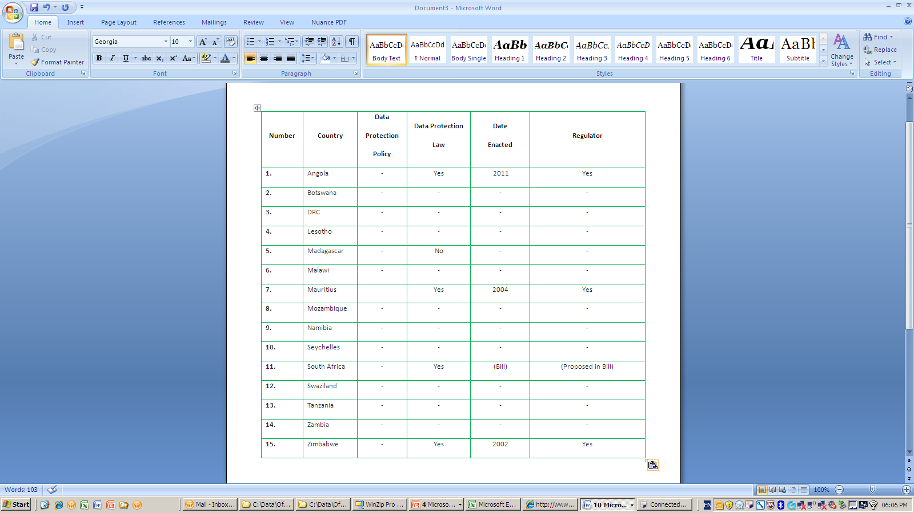

Slide 9
Comparative Analysis/ Right to Privacy
All countries have a constitutional right to privacy
Certain countries including Malawi, Namibia, Tanzania and Zambia
recognise the privacy of communications
Limited data protection
May be the basis for future data protection regulation

Slide 10
Comparative Analysis/Data Protection in Electronic Communications
Certain countries (e.g. South Africa, Zambia) have data protection principles in electronic commerce regulation:
Voluntary subscription
Data protection in relation to personal information in electronic communications and transactions.

Slide 11
Comparative Analysis/Access to Information Rights
Majority of countries have a constitutional right of access to information
Countries (e.g. Lesotho, Malawi, Zambia. Mozambique, South Africa and Zimbabwe) have enacted access to information law
Restrictions on access to information due to privacy
Shared (Information) Regulator

Slide 12
Comparative Analysis/Interception of Communications
Countries provisioned for privacy in communications by restricting interception and monitoring of communications and disclosure of communication records
Countries include Botswana, Zambia, Namibia

Slide 13
Comparative Analysis/ Consumer Protection and Privacy
Prohibitions on “spamming” or unsolicited commercial communications in electronic commerce legislation and/or consumer protection legislation
Consumers have rights over contact information

Slide 14
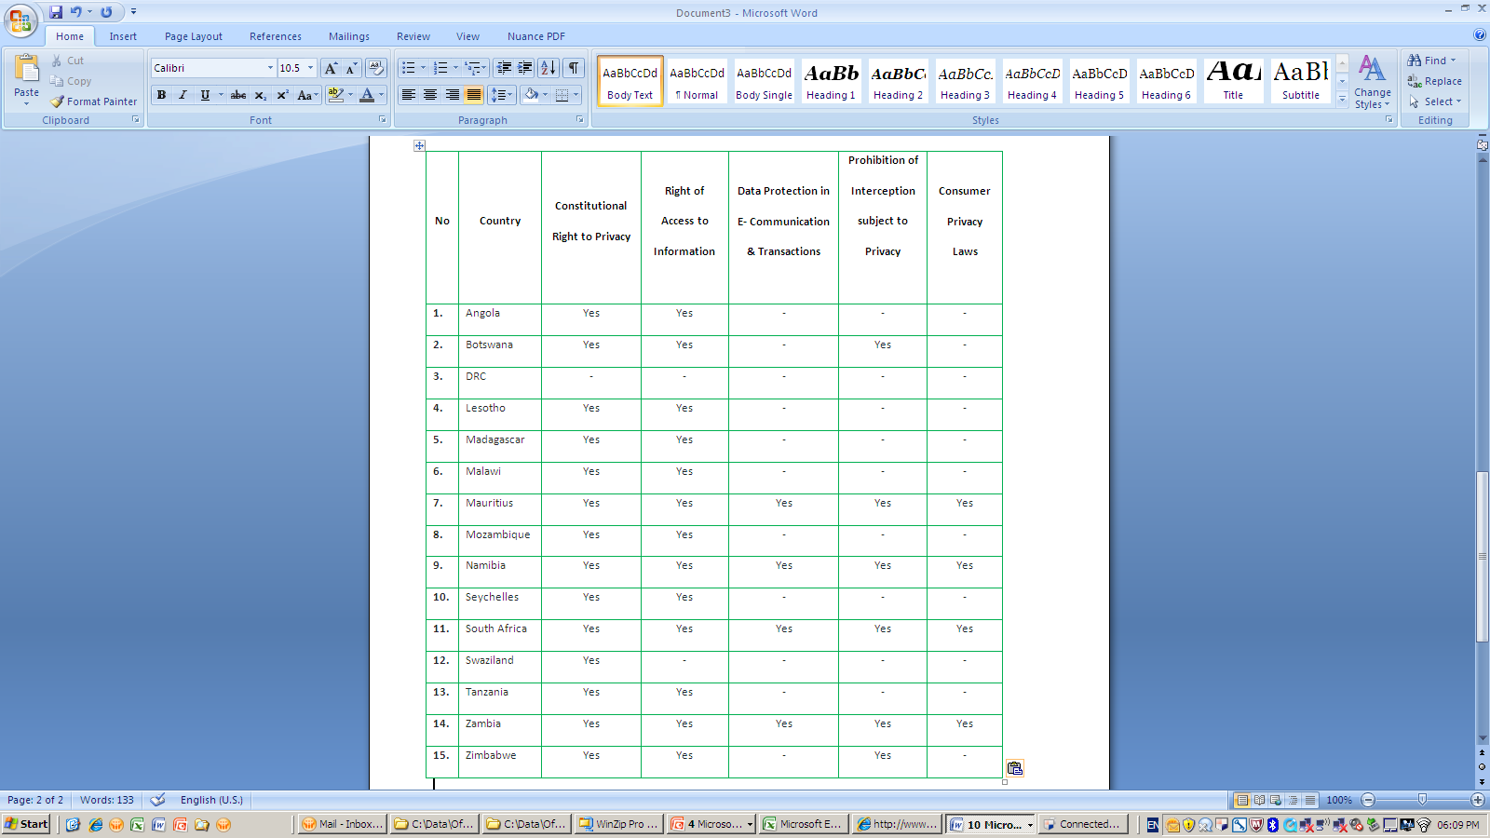

Slide 15
Best Practices
Angola, Botswana, Mauritius, South Africa and Zimbabwe reveal an awareness of need for data protection regulation
Mauritius and Angola have comprehensive data protection regulation in force compatible with international frameworks
Mauritius regulation of data protection is mature with active Data Protection Regulator

Slide 16
Best Practices/ Mauritius
Definitions (including definition of consent)
Data Protection Principles aligned with international standards
Data Protection Regulator functions and powers defined
Consideration of conflict with other laws e.g. criminal law
Order of Precedence of data protection legislation and industry specific legislation
Addresses direct marketing

Slide 17
Best Practices/ South Africa
Distinction between personal and sensitive information
Conditions for Transborder flow of information
Detailed enforcement provisions
Pro-active powers of the Regulator

Slide 18
Conclusion
Divide between the levels implementation of ICT Policies in SADC Member States
Harmonisation of data protection includes harmonisation of laws having a bearing on data protection and privacy “data protection legal universe”
Challenges of skills and expertise must be addressed

Slide 19
Thank You
Questions?
Pria Chetty
PwC Associate Director
Office: 011 797 5141 | Mobile: 083 384 4543
Email: pria.chetty@za.pwc.com
PricewaterhouseCoopers
2 Eglin Road, Sunninghill, Johannesburg
http://www.pwc.com/za

