Slide 1
Digital Health for Rural Communities: a Spectrum of Challenges
ITU, Geneva, 17 September 2010
Peter Drury PhD.,
Director, Health and Development
Internet Business Solutions Group
Emerging Markets
Cisco Systems
pdrury@cisco.com

Slide 2
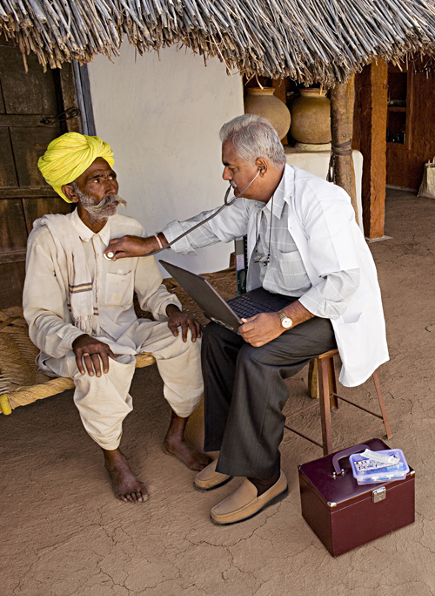
Healthcare: a Spectrum of Opportunities for Transformation
  Improve health outcomes
  Provide better access to care for all patients by offering healthcare without boundaries
  Create more efficient clinical workflow and process
  Provide better point-of-care information in hospitals, clinics, and remote sites
  Develop preventative care solutions to manage infectious and chronic disease
  Offer better access to healthcare content for Continuing Medical Education
Notes:
New technology is crucial to the successful delivery of modern healthcare services. Information and communications technology, or ICT, has proven to be a massive influence on growth, efficiency and innovation worldwide. ICT integration, in which once-disparate areas of infrastructure are unified and consolidated, is especially important.
It is common for healthcare to be viewed as an expensive function, scattered inefficiently across different, discrete areas – general practice surgeries, local clinics, specialist consultancies and other points of delivery. And since today's advanced hospital networks typically run more than 300 applications, it can be costly to share data between healthcare professionals across a fragmented ICT infrastructure.
The promise of healthcare integration concentrates the minds of governments, prompting them to focus on healthcare as a worthwhile and wide-ranging social and economic benefit. It is Cisco’s goal to make it easy and practical for healthcare professionals in emerging markets to share vital medical, clinical and patient information, in turn fostering a culture that perpetuates the idea of an integrated service, with the patient at its heart.

Slide 3
Managing Health Systems: a Spectrum of issues
Spatial organisation
Income: Affordability
Solutions
Outcomes

Slide 4


Slide 5


Slide 6
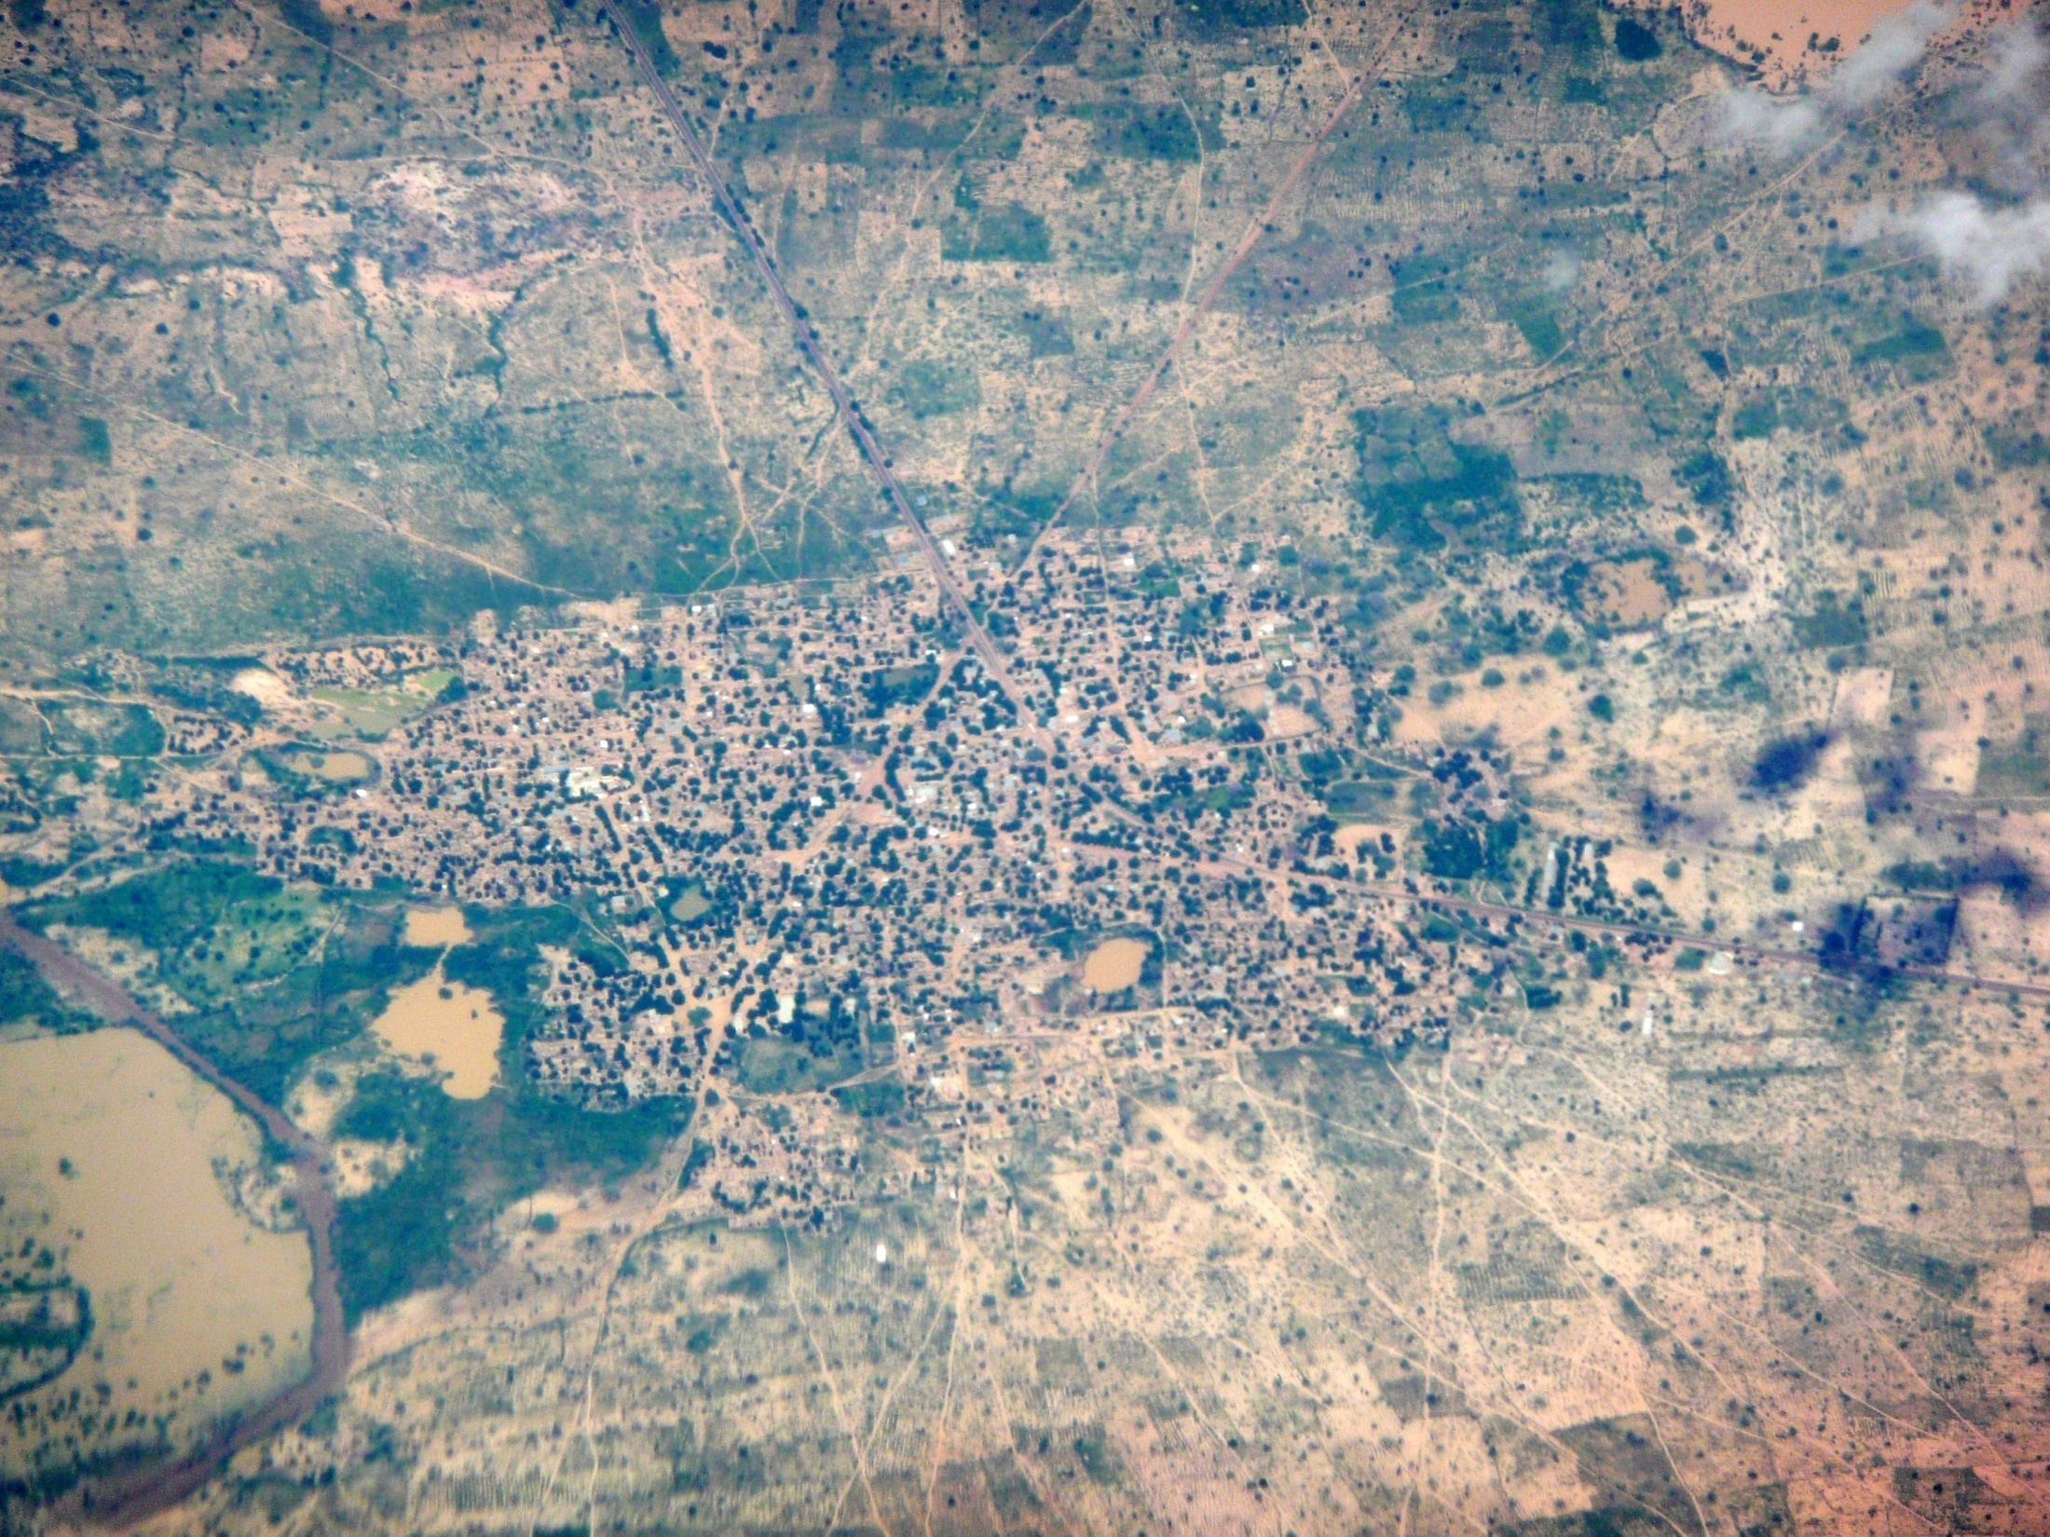

Slide 7
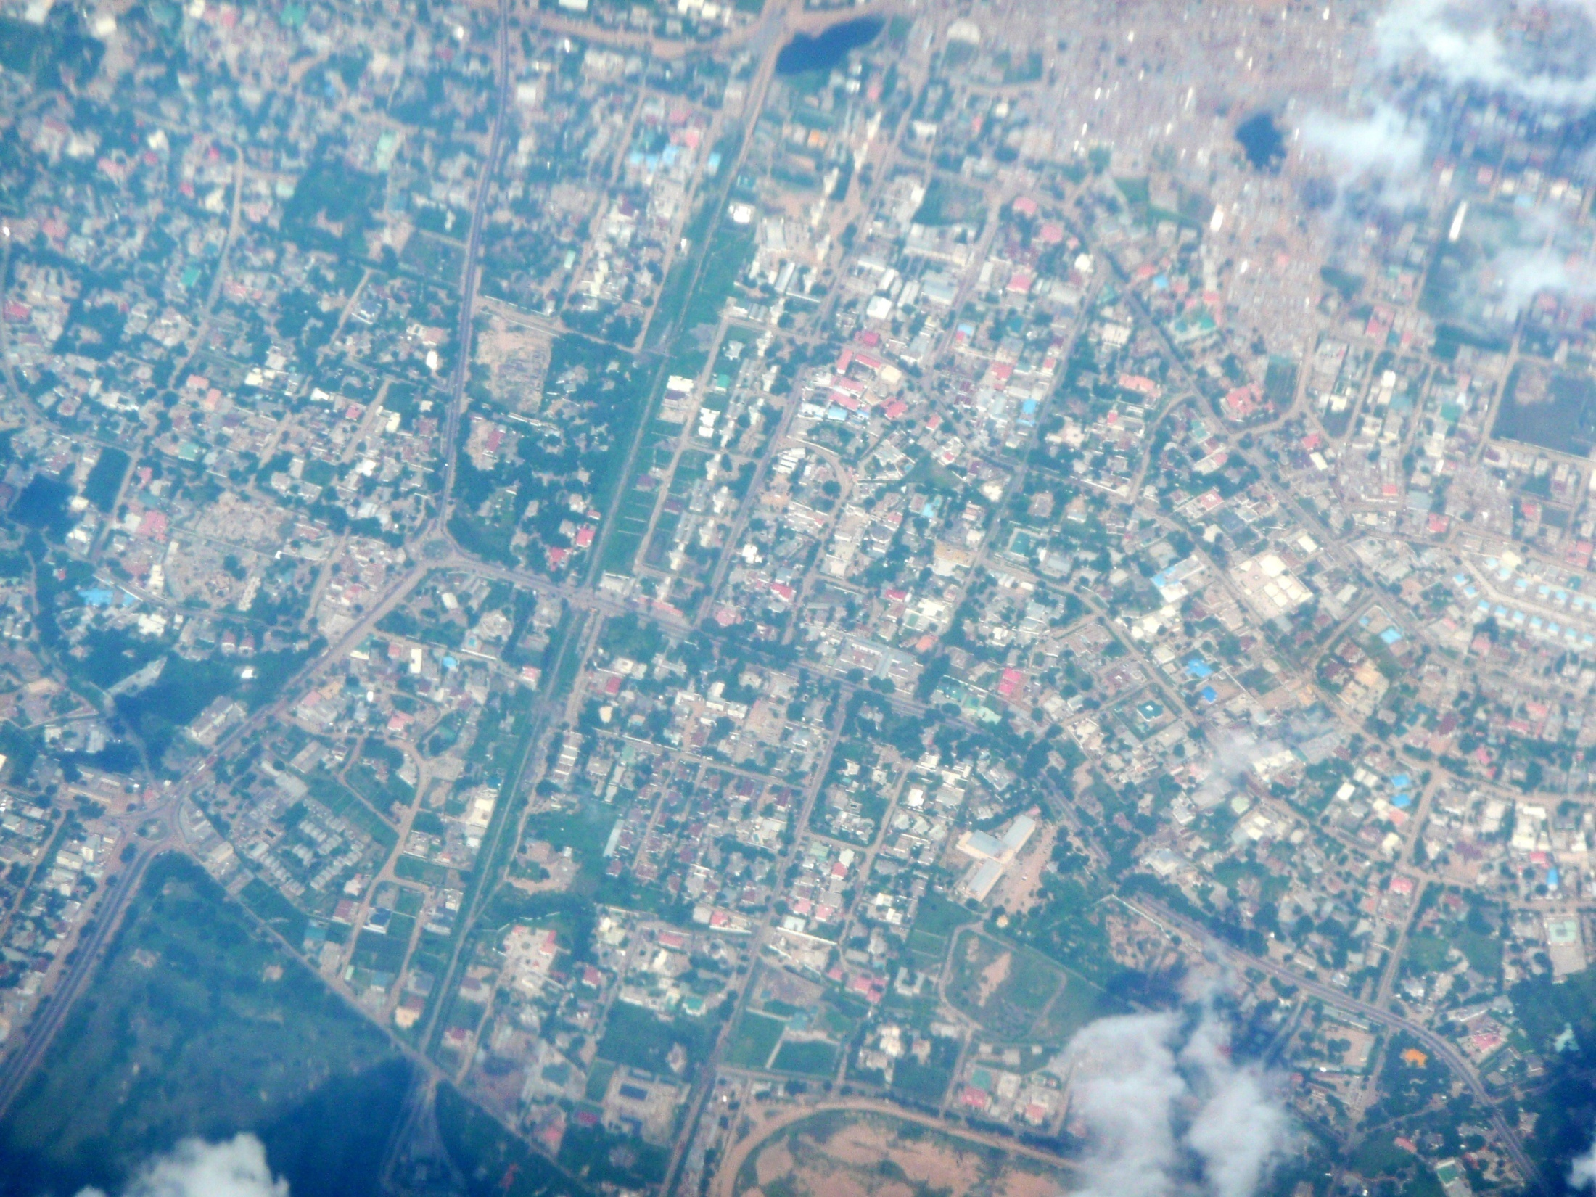

Slide 8
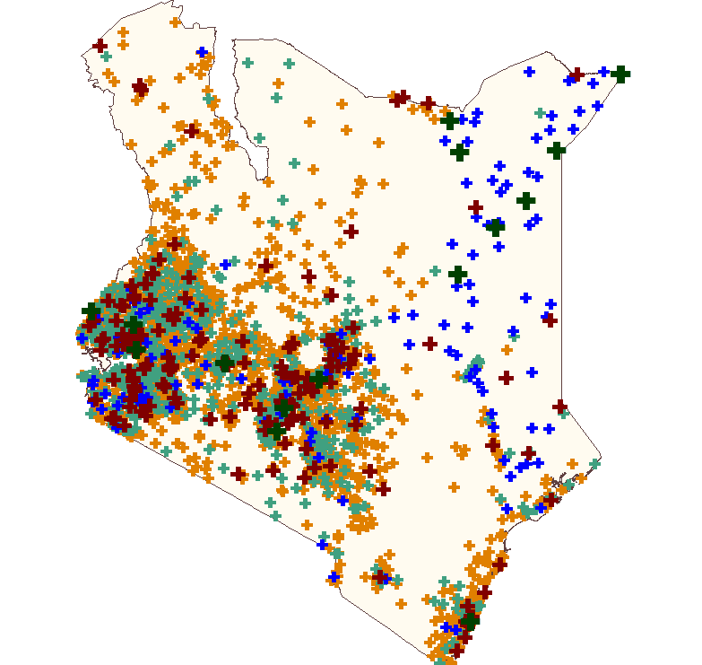
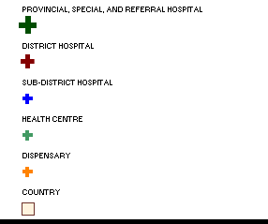
Health Facilities in Kenya

Slide 9
Spectrum of Income
Gross National Income of Countries
World distribution of High, Middle, Low Income
70000
GNI per capita (USD PPP)
60000
Area of bars represent country GNI
50000
United States
40000
30000
20000
Russian Federation
Mexico
Brazil
10000
China
India
Kenya
0
0
1000
2000
3000
4000
5000
6000
7000
Population (m)
Source: World Bank 2008

Slide 10
lncome Distribution within Brazil
HIGH 53M
MIDDLE 128M
LOW 11M
Source: World Bank 2008 WDR Table 2.7

Slide 11
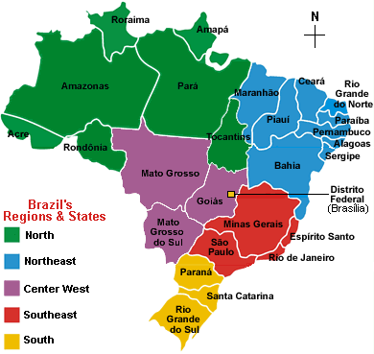
State | Population (2005) | GDP per capita PPP (US$) (2007)
Acre | 656,043 | 8,789
Alagoas | 3,015,912 | 5,858
Amapa | 594,587 | 10,254
Amazonas | 3,232,330 | 13,043
Bahia | 13,815,334 | 7,787
Ceara | 8,097,276 | 6,149
Distrito Federal | 2,333,108 | 40,696
Espírito Santo | 3,408,365 | 18,003
goias | 5,619,917 | 11,548
Maranhao | 6,103,327 | 5,165
Mato Grosso | 2,803,274 | 14,954
Mato Grosso do Sul | 2,264,468 | 12,411
Minas Gerais | 19,237,450 | 12,519
Para | 6,970,586 | 7,007
Paraiba | 3,595,886 | 6,097
Parana | 10,261,856 | 15,711
Pernambuco | 8,413,593 | 7,337
Piaui | 3,006,885 | 4,662
Rio de Janeiro | 15,383,407 | 19,245
Rio Grande do Norte | 3,003,087 | 7,607
Rio Grande do Sul | 10,845,087 | 16,689
Rondonia | 1,534,594 | 10,320
Roraima | 391,317 | 10,534
Santa Catarina | 5,866,568 | 17,834
Sao Paulo | 40,442,795 | 22,667
Sergipe | 1,967,761 | 8,712
Tocantins | 1,305,728 | 8,921
Notes:
map: http://www.brazil-help.com/mapa_do_brasil.gif

Slide 12
lncome Distribution within Kenya
MIDDLE 23M
LOW 16M
Source: World Bank 2008 WDR Table 2.7

Slide 13
Healthcare Messaging
Spectrum of Solutions: Connected Health Framework
Hospital Drivers:
Reduce Costs. Improve Productivity. Deliver Better Care.
Patient
Drivers:
Patient Safety • Quality of Care • Patient Satisfaction • Cost Effectiveness • Staff Satisfaction • Regulatory Compliance
Portfolios:
Connected Imaging Solutions
Solutions that optimize imaging workflow and image access.
Care-at-a-Distance Solutions
Solutions that support clinical care unbounded by distance, physical location or setting.
Clinical Workflow Solutions
Solutions that streamline workflows and improve communication among clinicians.
Healthcare Technology Foundations
Comprehensive healthcare IT infrastructure solutions that enable security, reliability, and regulatory compliance.
Smart Healthcare Facility Solutions
Services that enable hospitals to reduce capital and operating expenses of their facilities.
Solutions:
Collaboration and Reporting
Medical Data Exchange
Image Architecture
Collaboration and Reporting
Tele Presence for Healthcare
WebEx for Healthcare
Health Presence
Mobile Collaboration
Nurse Connect
Context-Aware Healthcare
Collaboration and Reporting
Medical Data Exchange
Digital Media System for Healthcare
WebEx for Healthcare
Security and Compliance
- Biomed Network Access Control
Secure Wireless
Data Center for Healthcare
Digital Media System for Healthcare
Connected Real Estate for Healthcare
InfrastructureFramework
Medical-Grade Network
Framework to meet healthcare’s unique needs for interoperability, security, availability, productivity, and flexibility.

Slide 14
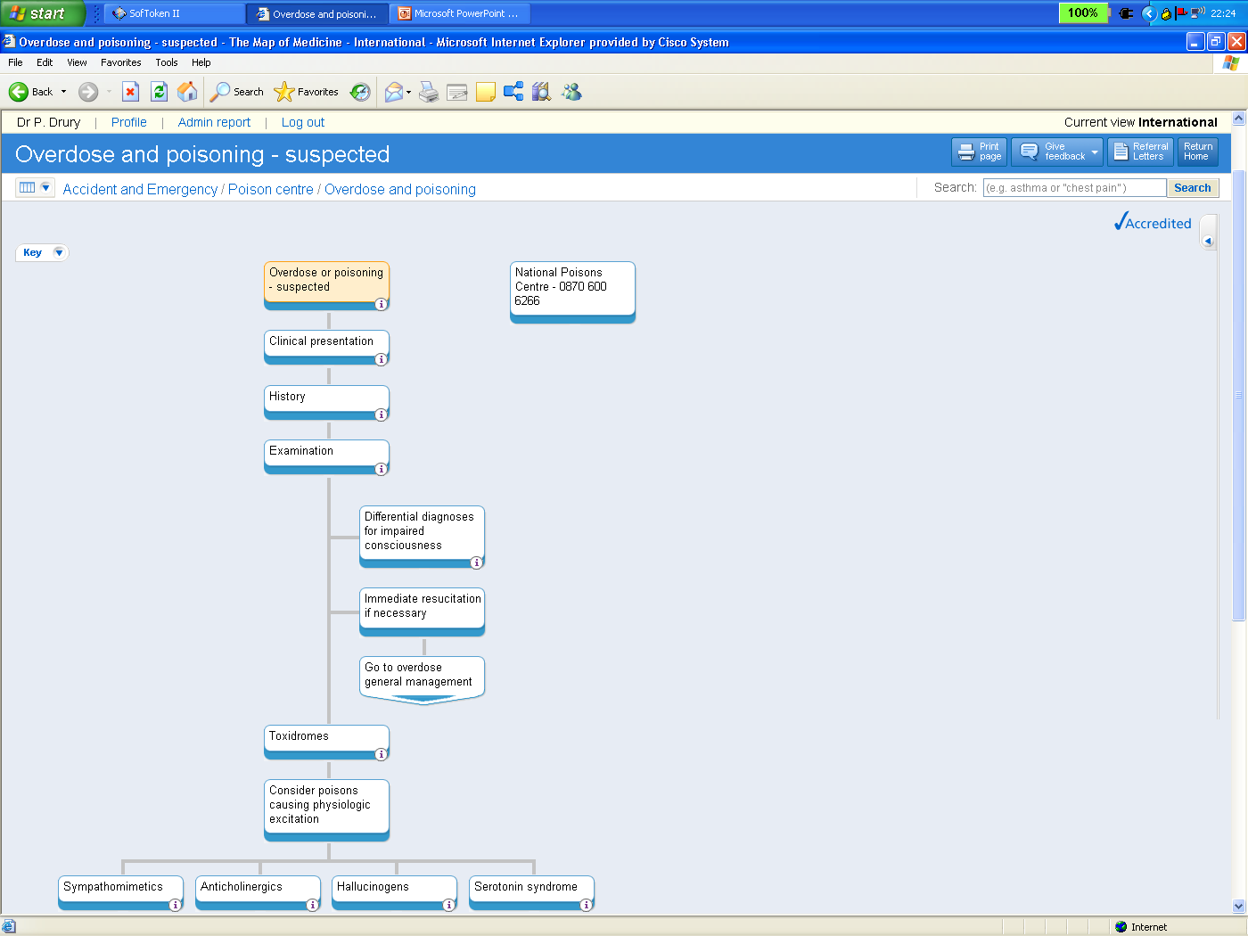
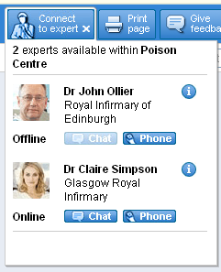
Connected Health Workers
CASE STUDY
Within health organizations:
  Continuing education
  and training
  Integrated care pathways
  Clinical knowledge support
  Clinical records
  Management information
  and activity reporting
Between organizations
  Telehealth
  Tele-education
  Interpreter services
  Expert networks
Map of Medicine, developed by the UK NHS,
Source: Cisco IBSG, 2008
Notes:
Within and among organizations, health workers need continuing education and training to keep skills and knowledge up to date.
The range of online material now available is vast and growing, and can provide great value when digital images or video clips of procedures are used as part of the package.
An integrated care pathway (ICP) is a multidisciplinary outline of anticipated care—with specific conditions or symptoms—that moves progressively through a clinical experience to positive outcomes.
Clinical freedom still is exercised, but ICPs help reduce unnecessary variations in patient care and outcomes. ICPs can be used to incorporate local and national guidelines into everyday practice, manage clinical risk, and meet the requirements of clinical governance.
Providing health workers with knowledge to support decision making can be done offline (on paper, or for review after the event) or at the point of care.
When clinical records are available, particularly if they are electronic patient records, then more patient-specific data is available and better decisions are made.
Information management and activity reporting is of better quality (complete, accurate, timely) if it is derived as a by-product of information collected for operational purposes.
Among organizations, specific health systems can be strengthened when telehealth services provide expert advice to health workers and patients without requiring travel. Tele-education services can improve the continuing professional development of health workers and enable a shared understanding of when and where patients are to be referred.
When communication with other healthcare systems is available, then national and international expert advice and guidance on a 24 x 7 basis is possible. For example, when patients need an interpreter, a call is placed via the Medical-Grade Network and routed to an appropriate interpreter based on language and healthcare skills.
When this is coupled with a knowledge support system, such as the Map of Medicine, then the Cisco IP Communicator can provide an “Expert Network” function that has the potential to link clinicians across organizational and professional boundaries, ensuring the right skills are available for a given patient at the right time.
The Map of Medicine, developed for the NHS, combines best-practice patient journeys, clinical evidence, and public and private health knowledge.

Slide 15
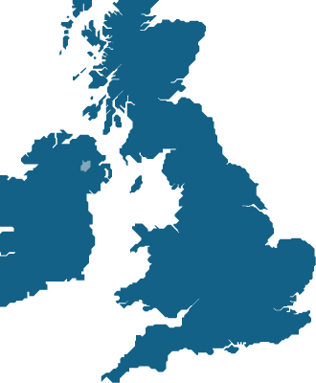
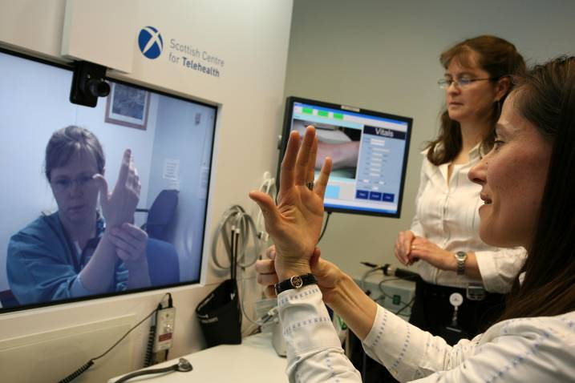
NHS & The Scottish Centre for Telehealth
Innovative Patient Care Delivery
Cisco HealthPresence Pilot
“Cisco HealthPresence is an asset to improve the quality of telephone advice and triage. Being able to visualize and have physiological parameters on a patient will improve patient care. It also enables us to offer convenience for patients and service delivery efficiency for our doctors.“
Dr. Karyn Webster and
Dr. Fiona Mair,
Royal Aberdeen Infirmary,
Scotland
Improved patient care
Reduced cost of delivery
Patient satisfaction
Benefits
Improved access to clinicians
Richer diagnostic capability
Result
Source: Cisco IBSG, 2008

Slide 16
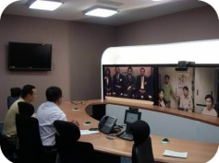
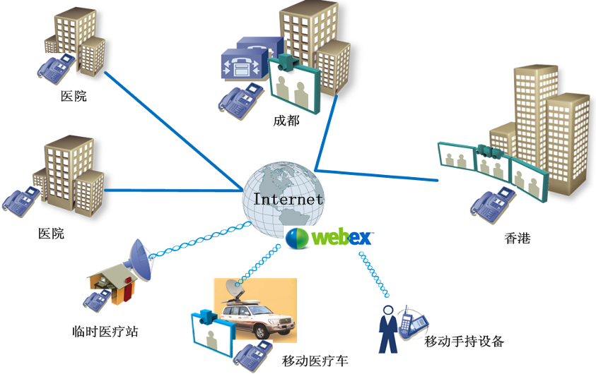

HK-Sichuan Rehabilitation Centre: Traumatology
HK-SC HealthPresence Centre – Opened April 2009
Psychological Counselling Centre
Chengdu
People’s Hospital
Huaxi Hospital
Chengdu
Prince of Wales Hospital Hong Kong
Temp Clinic
Mobile hand-held device
Mobile Clinic

Slide 17
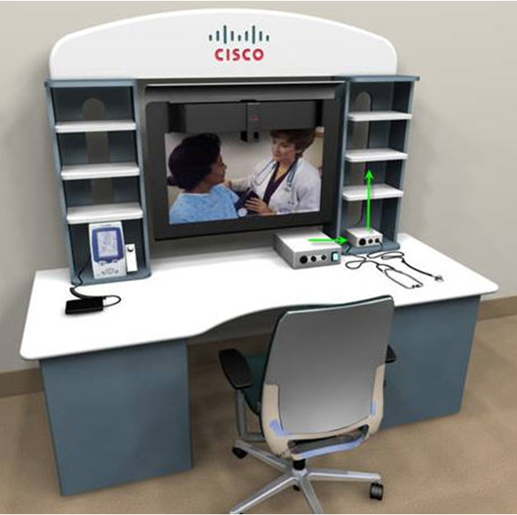
Cisco HealthPresence Extended Reach
Desktop based Telemedicine Solution
Flexibility for the doctor and patient to provide and receive consultation from any location
Cisco Unified Communication based High quality audio-video collaboration in real time
Information on availability of specialists, their status, and preferred mode of communication
Easy to establish contact with any available specialist – needs just one click
Biomedical device interfacing
Ability to capture, store, and retrieve all patient details including demographic details, patient history, allergies, clinical findings, vitals, and medications
Reporting functionality
Ability to function effectively on bandwidth as low as 512 kbps

Slide 18



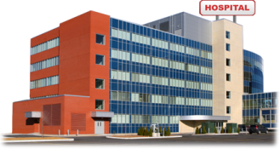
TSC and TCC Consultation Workflow: ISDN / Broadband
Guwahati
Port Blair
Burdwan
Apollo Hospital - Chennai
Network
Internet/ VPN Router
Siliguri
Application Server
EMR
Telemedicine DB server
CUCM cluster
Durgapur
CUP cluster
Archive
Servers
TSC : Telemedicine Specialist Center
TCC : Telemedicine Consultation Center
Apollo DataCenter
Communication modalities

Slide 19
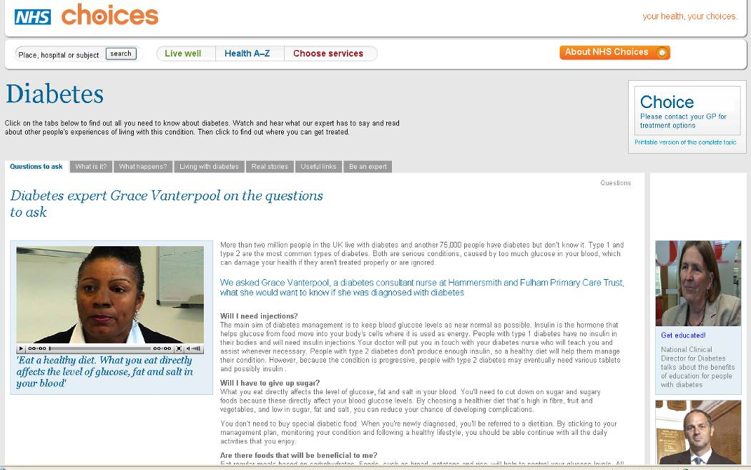
Connected Citizens
CASE STUDY
Health information
  Posters, pamphlets, books
  Radio programs, TV
  Call centers
  Videos, CDs, DVDs
  Websites
Self-support tools
  Health risk assessments
  Health diaries / records
Home monitoring
  Diabetes management
  Fetal monitoring
  SMS reminders
Peer support
  Health blogs
Patient clinician linkage
Online, NHS Choices provides text, audio, video, and other resources to help citizens make informed choices
Source: Cisco IBSG, 2008
Notes:
There is a growing spectrum of media for providing health information to citizens.
The earliest, simplest, and cheapest have been posters—usually concerning a public health issue; these can be supplemented by pamphlets and books.
The next technology media is radio, which often is the most effective means of providing rapid dissemination of knowledge in developing countries. Next comes television programming.
The availability of (mobile) phones makes it possible to provide health data and advice via call centers.
The ability to use videos, CDs, and DVDs marks the progression to the availability of computers and, when connected to the Internet, provides many Websites with critical health information.
Providing self-support tools that enable informed lifestyle choices to be made and monitored help engage citizens with responsibility for maintaining good health.
Technologies that support home care and monitoring (e.g., for diabetes or to provide fetal monitoring) are becoming affordable. But perhaps the simplest form is the reminder (sent via SMS message) to a patient to ensure he or she has followed a procedure (e.g., taken medication).
The importance of peer support by phone has long been recognized, but new Web 2.0 technologies are enabling communities to assemble. Blogs allow easy sharing of experiences and ideas regarding specific health issues.
An increasing number of clinicians now are using ICT to extend the range of media with which to maintain contact with patients. This may be via a community blog or an e-mail to specific patients.
The NHS Choices Website “has been developed to help you make choices about your health, from lifestyle decisions about things like smoking, drinking, and exercise, through to the practical aspects of finding and using NHS services when you need them.”
This site provides disease-specific information, healthy living advice, health monitoring tools, the ability to compare hospitals, and a view into the Map of Medicine to see what the doctor sees.

Slide 20
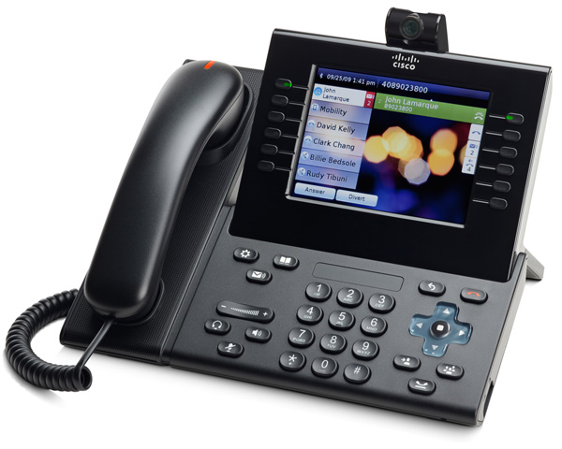
CarePhone
Pre-configured call lists, can display currently available care/service providers on soft
Audio and Visual Alarm
Fixed camera, can be remotely activated
Large screen, can easily change display
Voice connectivity can be remotely activated
ALERT
USB port for data feeds
Key pad could be configured for accessibility
Conversation can transfer to TV

Slide 21
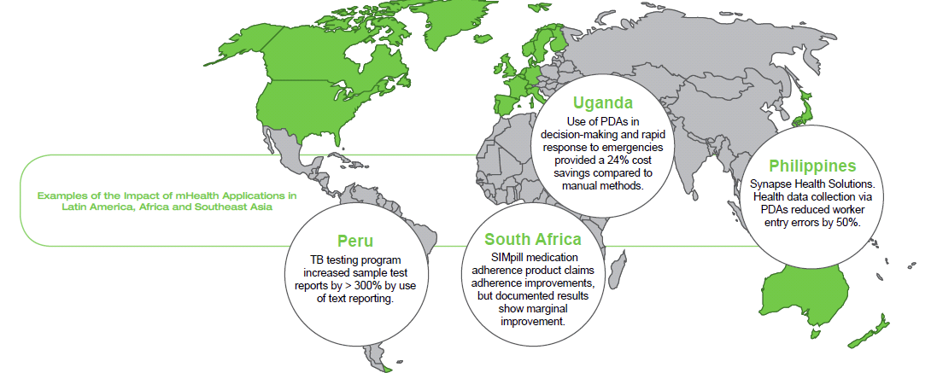
Mobile phones
Source: mHealth Alliance: mHealth for Development. 2010

Slide 22
Connected (Health) Communities
Connected Citizens
Connected Clinicians
Health & Wellness Programs: Fitness, Nutrition,
Smoking Cessation
PCs, Telepresence Tools Provide Resources for Telehealth Services
Business Owners | Vocational Trainers | Health Workers | Citizens and Employees | Bank Staff | Teachers
Community Portal
Market Status and Prices | Knowledge and Skill Content | Health Advice and Disease Prevention | Personal Property and Census Records | Commercial Content and Services | Learning Support
News Feeds and Industry Community | Content Management Systems | Healthcare Knowledge Stores | E-government Systems | Enterprise Systems | Education Systems
Communication and Collaboration Tool
Intelligent Network
Map of Medicine,
NHS Choices
Health Education
in Schools
Health Infrastructure Contributes to Community's Social and Economic Development
WebEx Platform, Integrated Call Center
Source: Cisco IBSG, 2008
Notes:
In developing the Connected Community model, Cisco is developing ways in which an intelligent broadband IP network, with appropriate communication and collaboration tools, can be used to support a range of services.
These may include access to call centers for healthcare (but they also can be used for providing advice to others, such as farmers in the Cisco / BT Lifelines project in India).
The Connected Health model brings together the many stakeholders involved in delivering services across health systems, such as clinicians, patients, families, managers, pharmacists, and more.
From the point of view of citizens, health is just one of many services they need. While some may have connectivity from home, for others, particularly in middle- and low-income households, this may not be affordable, and a community-based approach to the delivery of infrastructure may be required.
Highlighted in the model above are the health components—using localized versions of international or national knowledge stores, such as the Map of Medicine or NHS Choices, which support the provision of health advice and disease prevention.
These services may be accessed via a community portal, or perhaps via a community center, where there may be PCs or even advanced telepresence services that can be used to provide telehealth advice.
The model also suggests that the health system is strengthened when there is health education in schools, which may well use online resources.
If the health infrastructure can contribute to the social and economic development of a community, then it will be playing a part in reducing poverty and, thereby, improving health.

