Slide 1
Development of the IP-based Infrastructure & Services Ecosystem (1/2) : Needs for Indicators and benchmarking
Regional Workshop
on
ICT Indicators: from Policy & Strategy to Impact and Vice versa
Sharm ElSheik, Egypt, 8-9 June 2012
Dr. Ahmed ElHefnawy
Senior Advisor for Arab States - ITU

Slide 2
WHY IP-Based Infrastructure & Services?
Most of the Investments will be directed in the next 10 years to IP-Based Infrastructure & Services.
The Digital Divide is largest in this.
Special stress to Broadband; the current decade is the Broadband Decade compares to the last one was Mobile Decade.
Different Scope & Measures for meaningful Analysis & Planning.
Different Business Models.

Slide 3
WHY Do We MEASURE?
Plan (Integrated)
Looks Good (Political)
Attract Investment (Economic)
Imitate Others (Social)

Slide 4
MEASURE Scheme
Ranking (Ignore Socio-economic Factors or gets very complicated)
Maturity (Complex)
Hypo-Normal-Hyper, (Simple & Needed for Balanced Development)

Slide 5
Are Critical Measurements Available?
Yes, there are many measurements available, but not integrated and sometimes inconsistent.
A Conceptual Model is Needed.

Slide 6
What We NEED to Measure?
Items which make the total ICT system, normalized by External Forces
(like economy, market size, etc,…)

Slide 7
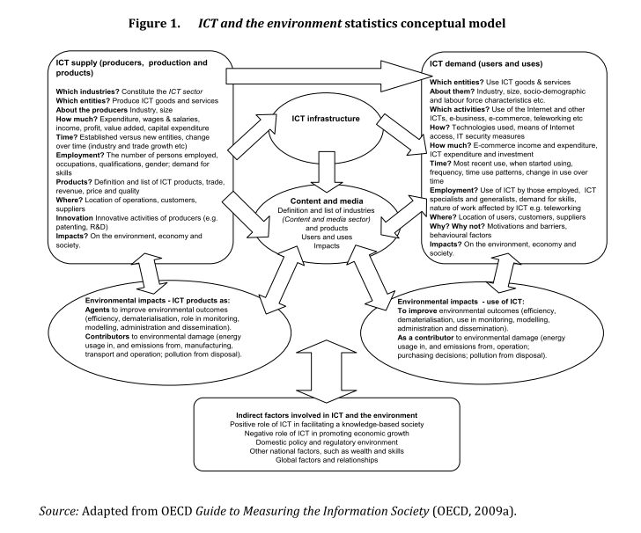
Supply
Demand
Infrastructure
Content & Media
Environmental Impacts
Indirect Factors, Policy & Regulation, etc.

Slide 8
Registration of Subjects
Traditionally, you have a phone number, then phone and mobile numbers, then came the Internet and users start to interact and get recognized by one or more of the following:
Web Site,
Email,
Blog,
Facebook / LinkedIn / Google Plus / My Space
Twitter
YouTube
Flickr, Instagram,
BBM/ What is up /…
Skype / Viber / …
PayPal,
Open ID,
IP (static, dynamic, )

Slide 9
Results of the Survey on ICT Indicators
Deliverable 2 of Project : Selection of an appropriate set of indicators and a roadmap for potential development of ICT statistics based on international and national experience.
17 countries responded.
For development of new/revision of indicators; 70% related to Broadband; 58% for Digital Content; 52% for Cybersecurity.
For participating in the portal; 88 % wants to participate.

Slide 10
Proposed Ecosystem Conceptual Model (1/2)
Devices
(HW & SW Suppliers)
Content
(Users/
Producers)
Register Sites
Receive
Transmit
Connect
Users
Connectivity
(ISPs, Cables, IXPs,
Spectrum, Exchanges
Sub.
Sites
(Registrars)
Users/ Producers
Hosts
Data Centers
(Hosting)
Producers

Slide 11
Proposed Ecosystem Conceptual Model (2/2)
Economy
ICT
Operational System
Policy & Regulation
Geography
Human Resources

Slide 12
Sources for Main Parameters
IP per Country:
http://www.whois.sc/internet-statistics/country-ip-counts/ ,
Akamai: http://www.akamai.com/stateoftheinternet/
Connectivity:
Akamai: http://www.akamai.com/stateoftheinternet/
Netindex.com: http://netindex.com/upload/allcountries/, http://netindex.com/download/allcountries/
Domains :
http://www.webhosting.info/domains/country_stats/
IXPs:
https://prefix.pch.net/applications/ixpdir/index.php?sort=country&order=asc
https://prefix.pch.net/applications/ixpdir/summary/growth
Root Servers:
https://prefix.pch.net/applications/ixpdir/summary/root-servers/
http://root-servers.org/
Registrars:
GTLD: http://www.webhosting.info/registrars/
Registries:
GTLD: http://www.webhosting.info/registries/country_stats
Traffic/Services (not at level of Arab Countries):
http://www.cisco.com/en/US/solutions/ns341/ns525/ns537/ns705/ns1186/vnisa_graphing_tool.html
http://www.cisco.com/web/solutions/sp/vni/vni_mobile_forecast_highlights/index.html

Slide 13
Benchmarking Arab Region
The Arab region which has 5.13% of world population, 3.8% of world GDP, 4.53% of world literates, 9.63% of world land, 4.22% of world Internet Users , 5.8% of world mobile subscribers, 2.99% of world fixed lines, 0.88 % of world IP addresses, 0.2% of world hosts, 0.16% of world domains, and 0.0036% of world IXP Traffic from 0.34% of world IXP participants .
5.13

Slide 14
The Resulting Performance
The effect of the divide in the region compared to the global. The amount of data transmitted per capita is about 1 GB/Month compared to a global average of 14.5 GB/Month with an average speed of 1.1 Mbps compared to global average speed of 10.44 Mbps , and the price of delivery per 1 Mbps/Month is 1000% for ADSL and 2215% for Leased lines compared to OECD.
High Cost Low Usage
5.13

Slide 15
Experiences Needed for Indicators & Planning
Telecom
IT
Media
Statistics
Economics
Human Resources
Strategic Planning
……Multi-Experiences
To work effectively with
Politicians, Operators, Infrastructure Providers, ISPs, etc….

Slide 16
Main Components of ICT Infrastructure
International Links
Internet Exchange Points
Data Centers
Backbone
IP Exchanges
Backhaul
Last Mile
Balanced Investment is needed in this infrastructure in addition to Policies for regulation to ensure socioeconomic development.

Slide 17
Main Components of ICT Services
Digital Content
Marketing
Support Facilities (Payment, Search Engines, Directories, ..)
Policies are needed to direct/attract Needed Balanced Investment to ensure socioeconomic development.

Slide 18
Changing ICT Industry
Item | Old | New
Main Communication Component | Voice | Data
Main Revenue Stream | International Calls | Subscription; Transactions; Advertising;
Main Links between Operators | Transit | Peering
Infrastructure Investment | Backbone | Backhaul
New Facilities | N/A | Internet Exchange Points; Data Centers; Fiber optic Cables;
Main Elements of Traffic | Local Voice Calls | Video; TV streaming; User Generated Content
Main ICT Companies | Telecom Operators | Apple, Google,
Ownership | Government | Private

Slide 19
Vision (Proposed)
By Year 2015,
XX % of People & Entities (subjects) will spend an Average of XX USD/year
to exchange XX GB/year/subject in a secure and reliable manner
in XX % of time & locations…

Slide 20
Investment & Revenue
How much of the Revenue directed to Investment ?
Where is it generated at National/ Regional / International? ; How it is to be distributed from Content, Service and Infrastructure Providers?
Revenue
Investment

Slide 21
شكرا
لحسن إستماعكم

Slide 22
ahmed.elhefawy@itu.int

Slide 23
Q & A

