Slide 1
Spectrum Management System for Developing countries SMS4DC
ITU Regional Workshop on Efficiency of the Frequency use in Arab Region
Amman-Jordan, 5-7Dec2011
E.Yasir Mohammed Bashar --National Telecommunication Corporation NTC- Sudan

Slide 2
Telecommunication in Sudan
The regulatory body of Sudan is National Telecommunication Corporation.
5 operators:2 fixed service, 3 mobile service and 2 ISPs.
Sudan population is 33 million, number of mobile subscribers is 22 million, number of fixed service subscribers is 440 thousand.
Fiber length is more than 22,000KMs.
Sudan share its borders with eight countries, in some borders there are highly populated areas.

Slide 3
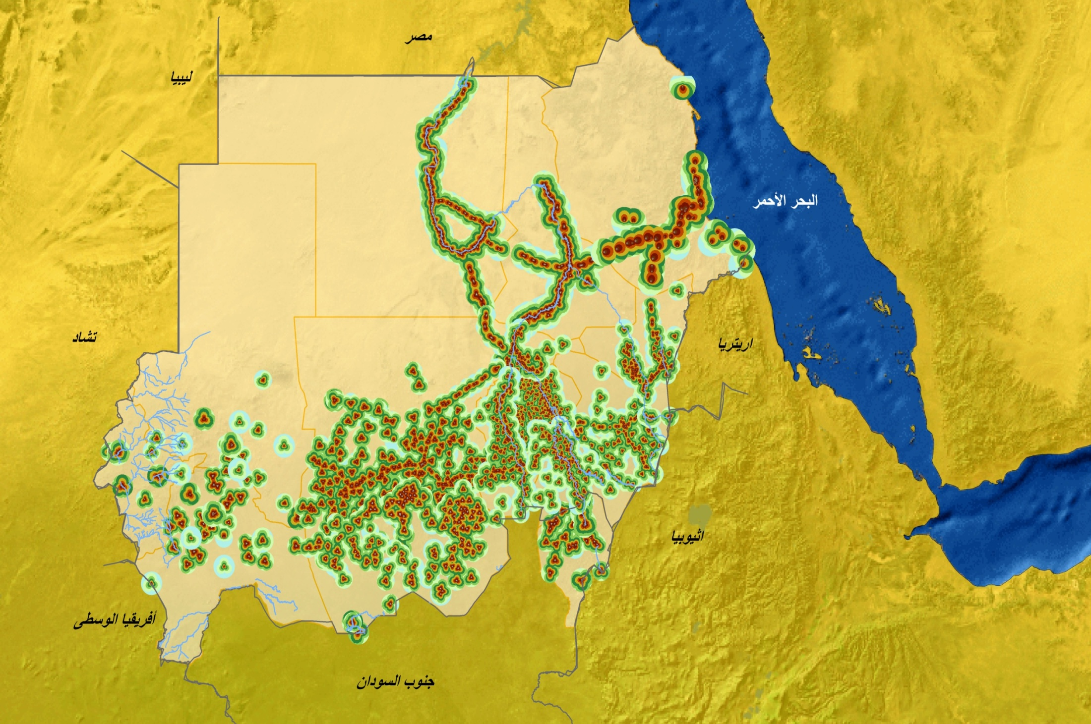
Mobile networks coverage map

Slide 4
Why need for efficient use of frequency spectrum
The radio frequency spectrum, is a limited and valuable resource, is used for all forms of wireless communication.
The growth in telecommunications services and radio technologies have led to an ever increasing demand for the use of spectrum among competing business, public sector and other users.
Electronic facilities enable efficient use of frequency spectrum, and mitigation of interference.

Slide 5
Spectrum Management System for Developing Countries-SMS4DC
SMS4DC is software designed by ITU based on ITU recommendations , and it is mainly designed to help Regulators, and is consist of both administrative and technical tools.
SMS4DC covers terrestrial fixed, mobile, sound and television broadcasting services in the bands above 30 MHz, including GE-06 as well as satellite Earth stations in space service.

Slide 6
Main features of SMS4DC
frequency arrangement, assignment.
Interference calculation
Managing the database
Propagation models based on ITU-R recommendations
Generation of electronic notice forms
Regional agreements with technical calculations
Frequency planning capabilities
Interfacing BR-IFIC and SRS databases
Coordination contour calculation around Earth stations
Coverage area, field strength, field strength contour, Microwave link calculations, Microwave link availability, network coverage and best server calculation
GUI and DEM.

Slide 7
Sudan case
The Spectrum Management department uses some electronic facilities to assist in performing functions of Spectrum Management.
Examples of these programs are: SMS4DC, Geographical information system GIS, and Cellular expert software, and ITU softwares, and some local designed software.
Sudan Owned SMS4DC software since 2007 starting with the first version, and then version two and now is applying for version 3.
SMS4DC software is used to perform some technical and administrative tasks in Spectrum Management department(National Telecommunication Corporation), as well as resolving interference problems.

Slide 8
Examples of tasks :
Frequency arrangement, assignment, licensing, coordination data, import data from BRIFIC & SRS
Perform electronic notices.
Technical analysis like Coverage, field strength, field strength contour, Microwave link calculations, interfere calculations.
Replanning of digital broadcasting bands.
Replanning of Fm broadcasting band.

Slide 9
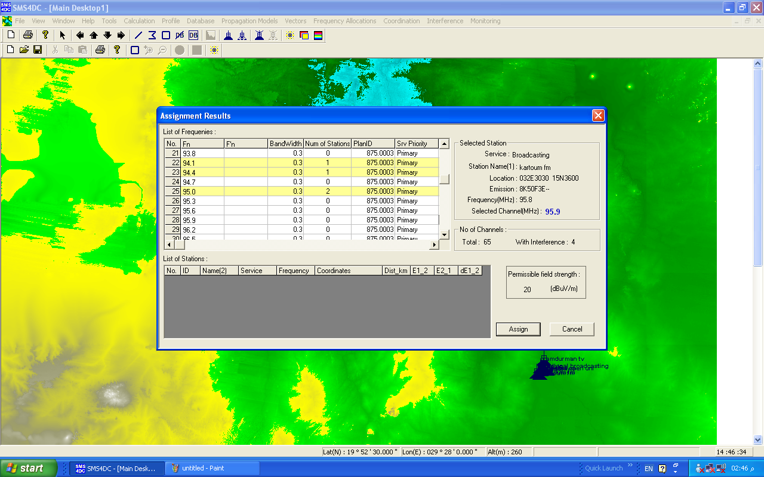
Frequency assignment

Slide 10
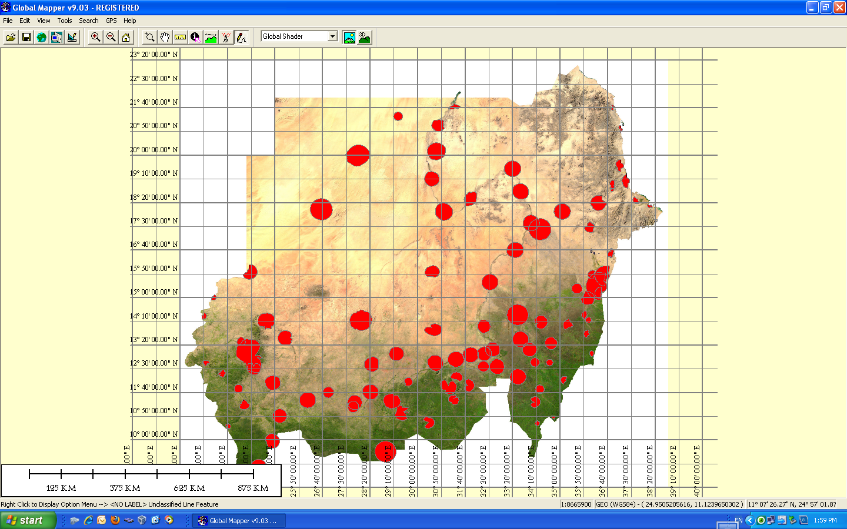
DVB-T plan

Slide 11
Advice for SMS4DC
SMS4DC is above 30GHz
No possibility of Batch processing
Difficulty to add high resolution maps.
Complicated not user friendly
Waiting for Arabised version.

Slide 12
Thank you
E.Yasir Mohammed Bashar NTC-Sudan Yasir_192@ntc.gov.sd

